Slide 1

Minimum steps to reach target by a Knight and the Probability of Knight to remain in the chessboard using Dynamic programming
Maddala H S M Krishna Karthik
AM.EN.U4AIE20046

Slide 2
outline
Introduction
Problem
Solution (PART-I)
Solution (PART-II)
Sample input and output
Pictorial Representation
Inference
References

Slide 3
Introduction
Dynamic programming is a technique for solving a complex problem by first breaking into a collection of simpler subproblems, solving each subproblem just once, and then storing their solutions to avoid repetitive computations.
It uses the fact that the optimal solution to the overall problem depends upon the optimal solution to its individual subproblems.
In this way, the efficiency of the CPU can be enhanced.
Dynamic algorithms use memoization to remember the output of already solved sub-problems.
It is mainly an optimization over plain recursion.
This simple optimization reduces time complexities from exponential to polynomial.

Slide 4
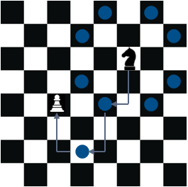
Problem
Given a square chessboard of n x n size, the position of knight (kx, ky) and position of a target (tx, ty).
The task is to find out the minimum steps a knight will take to reach the target position.
And also to calculate the probability that the knight remains in the chessboard after taking minimum steps, with the condition that it can’t enter the board again once it leaves it.
The problem can be solved using dynamic programming.
In a chessboard the knight has eight possible moves.
Each time the knight is to move, it chooses one of eight possible moves uniformly at random and moves there.
Each move is two cells in a cardinal direction and then one cell in an orthogonal direction(forming the shape of L).

Slide 5
Solution (PART-I)
There are three cases to be considered for finding the minimum steps taken by a knight to reach the target position.
Case-1: If the position of the knight and the target cell are along different rows and columns. (kx!=tx and ky!=ty)
Case-2: If the position of the knight and the target cell are along same rows or columns. (kx==tx or ky==ty)
Case-3: If either the knight or the target is at the corner and [abs(kx-tx), abs(ky-ty)]=[1,1], then the minimum steps to reach the target will be 4.
Firstly, Add all the base cases which satisfies case-3.
Then, initialize a dp array to store the sub paths and add all the base cases as shown below.
dp[1][0]=dp[0][1]=3 , dp[1][1]=dp[2][0]=dp[0][2]=2 , dp[2][1]=dp[1][2]=1

Slide 6
Cont.
If the target is reached by the knight then return 0.
If the cell is revisited then return the stored value in the dp array.
Else, select the coordinates which satisfy case-1 and case- 2.
Store 1 plus a minimum of paths obtained by two coordinates in the dp array and recur till the target is not reached.
Here, exchanging the coordinates x with y of both knight and target will result in same answer. So, update the dp array accordingly.
Finally, return dp[abs(kx-tx)][abs(ky-ty)] as the minimum steps a knight will take to reach the target position.

Slide 7
SOLUTION (PART-II)
Top-down variant of dynamic programming is used for calculating the probability of the knight remains in the chessboard after taking minimum steps. This approach uses memorization.
Initially, create a dp dictionary to store all probabilities.
If the knight is not on the board then return 0.
If number of steps is 0 then return 1.0.
If the cell is revisited with same steps then return the stored value in the dp dictionary.
Recursively calculate the probabilities of the knight that will remain on board after making random moves steps-1 number of times. And store the probabilities in dp dictionary. Finally, return the on board probability of the knight.
P(Knight on board after s steps) = ΣP(Knight on board after s-1 steps)*1/8.

Slide 8
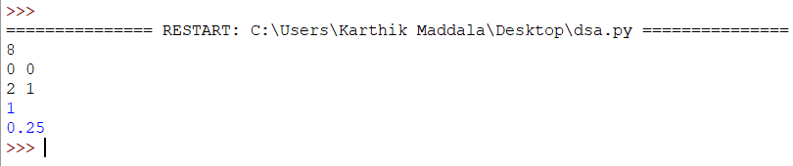
Sample input and output
Input:
8
0 0
2 1
Here,
8 implies dimension of the chessboard (8x8).
0 0 implies position of the knight in the chessboard (0,0).
2 1 implies position of the target in the chessboard (2,1).
Output:
1
0.25
Here,
1 implies the minimum steps required for a knight to reach the target in the chessboard.
0.25 implies probability of knight remains in the chessboard after minimum steps.

Slide 9
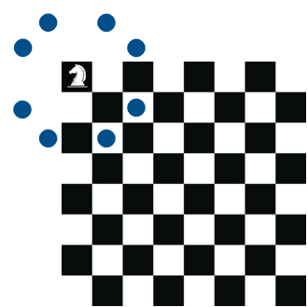
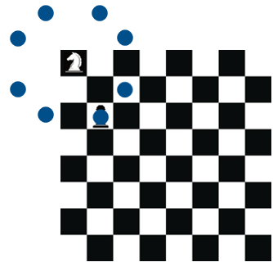

PICTORIAL REPRESENTATION
Fig-I Fig-II Fig-III
8x8 Chessboard Knights position-(0,0) Target position-(2,1)
Knight starts from position (0,0) then it takes one step to reach the target position (2,1).
Knight starts from position (0,0), after taking one step it will lie inside the board only at 2 out of 8 positions, and will lie outside at other positions. So, the probability of knight on the board is 2/8=0.25.

Slide 10
INFERENCE
The problem is solved with optimization using dynamic programming.
Minimum steps a knight take to reach the target position is calculated.
Its time and space complexity is O(abs(kx-tx)*abs(ky-ty)).
Where, (kx, ky) implies position coordinates of knight and (tx, ty) implies position coordinates of target.
And also, Probability of the knight remains in the chessboard after taking minimum steps is calculated.
Its time and space complexity is O(NxNxK).
Where, N implies dimension of the chess board and K implies number of steps.

Slide 11
References
Reference-1
Reference-2
Reference-3
Reference-4
Reference-5
Reference-6

Slide 12

Thank you

