Slide 1
Travelling Salesman Problem
using Genetic Algorithm
Group - 12
Group Members :
Kadiyala Monish Mithra - AM.EN.U4AIE20038
Kumpatla Mahit Venkat Gautam - AM.EN.U4AIE20043
Maddala H S M Krishna Karthik - AM.EN.U4AIE20046
Paladugula Pruthvi - AM.EN.U4AIE20054

Slide 2
Project Summary
Objectives :
The Travelling Salesman Problem (TSP) is a classic combinatorial optimization problem, which is simple to state but very difficult t o solve.
This problem is known to be NP-hard, and cannot be solved exactly in polynomial time.
The problem is to find the shortest possible tour through a set of n vertices so that each vertex is visited exactly once.
This Project offers a solution which includes a genetic algorithm implementation in order to give a maximal approximation of the problem with the reduction of cost.
Scope:
Different hybrid selection, crossover, and mutation operators can be added to the research.

Slide 3
Literature Review
The Traveling Salesman Problem (TSP) is one of the most researched combinatorial optimization problems, according to Aybars Uur's work throughout the “Genetic algorithm based solution for tsp on a sphere”.
Crossover and mutation are biologically inspired themes that are used in his research.
The major goal of FOZIA HANIF KHAN's work throughout “Solving tsp problem by using genetic algorithm” is to offer a new chromosomal representation approach based on binary matrices and new fittest criteria to be utilized as a strategy for finding the best TSP solution.
He proposed method concept is based on a genetic algorithm with artificial inelegance, which has been employed as a search algorithm to locate near optimal solutions and he adds more improvements by supplying an algorithm for both symmetric and asymmetric TSP.

Slide 4

Background Study
Travelling Salesman Problem (TSP):
The traveling salesman problem consists of a salesman and a set of cities.
The salesman has to visit each one of the cities starting from a certain one (e.g. the hometown) and returning to the same city.
The challenge of the problem is that the traveling salesman wants to minimize the total length of the trip.
The problem generates a sequence of n cities (c1, c2...cn) and permutations (p1..., pn), the goal is to find pi such that the total among all Distance measure between every vertex and its successor is as small as possible.
The first city in the combination is the parent of the final node. As demonstrated below, the Euclidean distance d between these two cities with coordinates (x1, y1) and (x2, y2)

Slide 5
Cont…
Genetic Algorithm(GA) :
A genetic algorithm is a search heuristic that is inspired by Charles Darwin’s theory of natural evolution.
A computational intelligence technique known as a genetic algorithm (GA) is a search strategy being used in computer science to discover approximate answers for optimization problems.
This algorithm reflects the process of natural selection where the fittest individuals are selected for reproduction in order to produce offspring of the next generation.
Several variations to the original GA have been developed using different representation schemes, selection and reproduction operators.

Slide 6
Cont…
The process of natural selection starts with the selection of fittest individuals from a population.
They produce offspring which inherit the characteristics of the parents and will be added to the next generation.
If parents have better fitness, their offspring will be better than parents and have a better chance at surviving.
This process keeps on iterating and at the end, a generation with the fittest individuals will be found.
This notion can be applied for a search problem. We consider a set of solutions for a problem and select the set of best ones out of them.
Five phases are considered in a genetic algorithm.
1)Initial population
2)Fitness function
3)Selection
4)Crossover
5)Mutation

Slide 7
Research Design : Methods and Algorithm
Algorithm :
1) Create a population at random.
2) Determine the chromosome’s fitness.
3) Repeat until all of the steps have been completed:
Choose your parents.
Crossover and mutation should be done.
Determine the new population’s fitness.
Add that to the gene pool as an addition.

Slide 8
Research Design : Methods and Algorithm(Cont…)
Population
Methods :
1) Population
This Method is used to Create the initial Population.
2) Fitness
This Method is used to to rank each individual in the population.
3) Selection
This Method is used to return a list of Route ID’s.
4) Breed
This Method is used to fill out the rest of Next Generation.
Fitness
Selection
Breed

Slide 9
Research Design : Methods and Algorithm(Cont…)
Mutate
Methods :
5) Mutate
This Method helps us to avoid local convergence by introducing Novel
Routes.
6) Repeat
Now we just Let’s pull these pieces together to create a function that produces
a new generation.
7) Genetic Algorithm
This Method uses all the Parameters and Returns the best Route.
8) Plot
This Method is used to Plot the Best Possible Path.
Repeat
GA
Plot

Slide 10
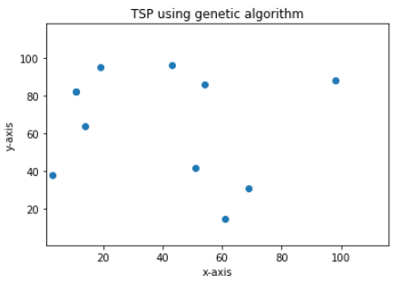
Data
Input data to our program is a set of cities (points) in 2d plane which are generated randomly using the Random Function.
Here, randomly x & y coordinates for each city are generated and append them to a city list.
Sample data for a problem of 10 cities is shown below.

Slide 11
Results & Analysis
The optimum route will be achieved and the procedure will be ended once a variety of processors, such as selection, crossover, and mutation, have been applied to the problem.
In order to get the optimal route, we should make the best assumptions.
We employed 100 children in each generation, maintained 20 elite persons, used a 1% mutation rate for each trait, then repeated many times through 500 generations in this work.

Slide 12
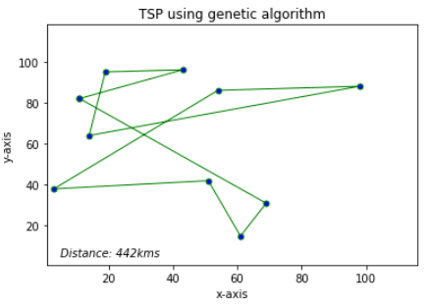
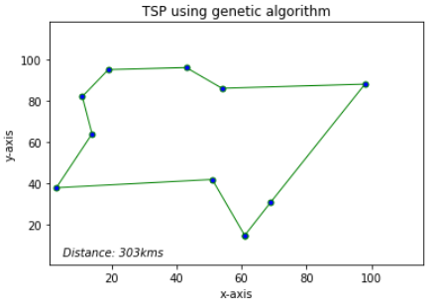
Cont...
Sample output for a tour between 10 cities is shown below.

Slide 13
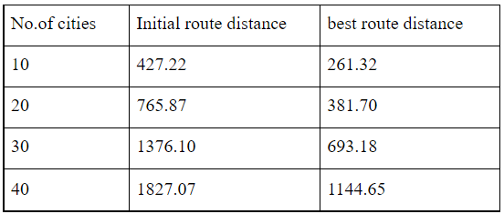
Cont...
The performance of the proposed genetic algorithm for a variety of cities are calculated.
The best and worst results obtained are shown below.
The table shows that using a genetic algorithm is a speedy way to get the best possible route for TSP.

Slide 14
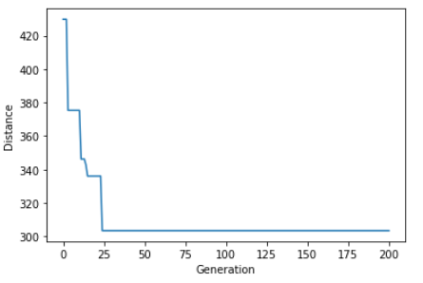
Cont...
An improvement graph is drawn to show how the distance has improved over time for each generation.
The graph shows that using a genetic algorithm is a speedy way to get the best possible route for TSP.

Slide 15
Conclusion
Genetic algorithm appear to find effective results for traveling salesman problem.
It depends very much on the way the problem is encoded and which crossover and mutation methods are used.
Different hybrid selection, crossover, and mutation operators can be added to the research.
Genetic algorithms do not scale well with complexity. That is, where the number of elements which are exposed to mutation is large there is often an exponential increase in search space size.
Therefore, the user should specify the program which operator and numerical ranges to search under before running the GA to search for a problem.
The suggested method can be used to solve a variety of network models, such as task scheduling models, vehicle navigation routing models and the same method can be used to assign frequencies to cells in a cellular network.

Slide 16
References
Varshika Dwivedi, Taruna Chauhan, Sanu Saxena and Princie Agrawal. Article: Travelling Salesman Problem using Genetic Algorithm. IJCA Proceedings on Development of Reliable Information Systems, Techniques and Related Issues (DRISTI 2012) DRISTI(1):25 - 30, April 2012.
Gupta, Saloni & Panwar, Poonam. (2013). Solving Travelling Salesman Problem Using Genetic Algorithm. International Journal of Advanced Research in Computer Science and Software Engineering. 3. 376-380.
S. S. Juneja, P. Saraswat, K. Singh, J. Sharma, R. Majumdar and S. Chowdhary, "Travelling Salesman Problem Optimization Using Genetic Algorithm," 2019 Amity International Conference on Artificial Intelligence (AICAI), 2019, pp. 264-268, doi: 10.1109/AICAI.2019.8701246.
D. Chen, "Solving a new type of TSP using genetic algorithm," IECON 2017 - 43rd Annual Conference of the IEEE Industrial Electronics Society, 2017, pp. 3333-3339, doi: 10.1109/IECON.2017.8216564.

Slide 17
Thank you

