Slide 1
SILVERSQAUD’S SEARCH ENGINE
TEAM MEAMBERS:
S20160010003 – DHARANI DEVI AKURATHI
S20160010045 – SAHITHI KRISHNA KOTTE
S20160010052 – SUBASH KARTHIK
S20160020142 – N.V.VAISHNAVI

Slide 2
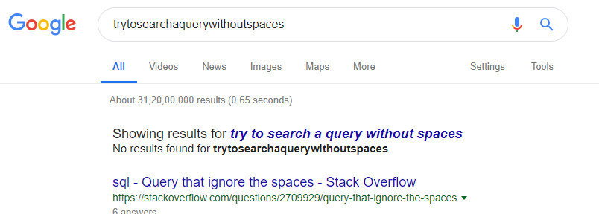
PROJECT AIM

Slide 3
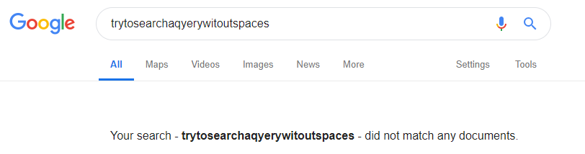

PROJECT AIM
The aim of the project is to come up with a search system which is capable of handling misspelled queries or keywords , sentences with improper spacing as well a s a combination of both kinds of errors.

Slide 4

dataset
The dataset considered is a collection of documents containing information about musical instruments.
It is an unstructured set of files having only text data without any structuring elements like fields and zones( ie title, author, body etc)

Slide 5
Steps and functionalities
Collect data
Tokenize
Stopword removal
Stemming
Indexing
Pre-process the query
Retrieve the documents

Slide 6

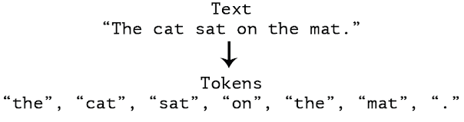
Tokenize
X
Tokenizing removes spaces and punctuation marks from the sentence and results in words which are called TOKENS.

Slide 7
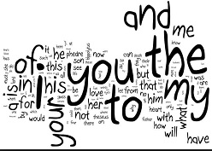
Stopwords
X
Words like a, an, the, in, and, but, of etc do not contribute towards the retrieval of the relevant documents for a query. So, they have to be removed.

Slide 8

Stemming
A word and its stem probably have same meaning. So, stemming helps to reduce the vocabulary size by removing the repetitive instances of a word in different forms.

Slide 9
Edit distance
3 operations
Replace : Cost =1 Ex: word1 -> Cat word2-> Can We replace ‘n’ in word2 to get word1
Delete : Cost =1 Ex: word1 -> Cat word2-> Cats We delete ‘s’ in word2 to get word1
Insert : Cost =1 Ex: word1 -> Cats word2-> Cat We insert ‘s’ in word2 to get word1
We add up all the costs of the operations required to convert string1 to string2 .

Slide 10
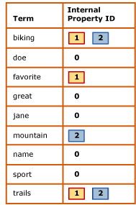
Indexing
Instead of searching directly from the documents, lucene creates an index and uses this index for searching
This dictionary has key value pairs where the keys are the terms and the document ID’s in the form of a linked list in the values – POSTINGS LIST

Slide 11
Let us see how we used above functionalities to process given unnatural queries and retrieve the documents.

Slide 12
Methodology
The query is given to the search engine
The substrings of this query are taken and the edit distance are found with every word present in the vector of vectors starting with first letter of these substrings.
These edit distances are stored in a vector.
The least edit distances are then considered and these ratio is taken for the edit distances to the length of the word matched. And the least ratio is taken and this word is added to the new string.
Hence, by doing this we obtain the first match and then the pointer is shifted to position of the length of the word matched.
Again the whole procedure is again done for the rest of the string.
Now, we have obtained new query which is stemmed and searched in the index for document retrieval

Slide 13
Methodology - example
Lets consider the following table as inverted index
Tokens | Documents
Drums | [2] -> [3]
Gazab | [1]->[4]
Guitar | [1] -> [3]->[5]
Tabla | [2]
Veena | [1]-> [3]
Violin | [2] -> [4]
Query : GuitaVena

Slide 14
Methodology - example
Guitavena
Vector (v)
[5, drums]
[6, gazab, guitar]
[5,tabla]
[6,veena,violin]
Str = g
Max_len = 6 (The maximum length of the word starting with letter )
We calculate edit for g with gazab and guitar and least edit distance and str are stored another vector
Guitavena
Str = gu
Max_len = 6 (The maximum length of the word starting with letter )
We calculate edit for g with gazab and guitar and least edit distance and str are stored another vector
Similarly we go till Max_len and calculate edit distances and store

Slide 15
Methodology - example
Guitavena
Guitavena
Vector (v)
[5, drums]
[6, gazab, guitar]
[5,tabla]
[6,veena,violin]
Guitavena
Guitavena
Final vectors
Prefixes till Max_len : [‘g’ , ‘gu’ , ’gui’, ‘guit’, ‘guita’ , ‘guitav’]
Matched words with least edit distance : [‘gazab’, ‘ gazab’, ‘guitar’, ‘guitar’, ‘guitar’, ‘guitar’,]
Edit distances : [4, 4, 3, 2, 1, 1]

Slide 16
Methodology - example
Final vectors
Prefixes till Max_len : [‘g’ , ‘gu’ , ’gui’, ‘guit’, ‘guita’ , ‘guitav’]
Matched words with least edit distance : [‘gazab’, ‘ gazab’, ‘guitar’, ‘guitar’, ‘guitar’, ‘guitar’,]
Edit distances : [4, 4, 3, 2, 1, 1]
Guitavena
Minimum of edit distance = 1
Corresponding prefix = ‘guita’ which is of length 5 and matching with string ‘guitar’
So, now we move our pointer to the 5th position(i.e 0+5)
Similarly we apply the same method for the rest of the query.

Slide 17
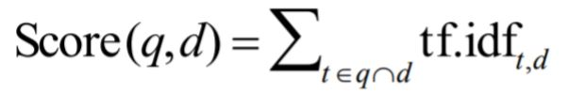
Scoring documents
This formula is used to calculate the score of retrieved documents.
The documents are displayed in the descending order of their scores.
t-term
q-query
d-document
tf- term frequency
Idf- invert document frequency

Slide 18


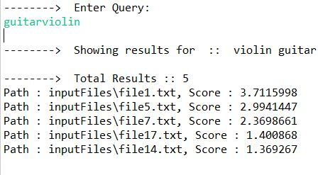

Results – Query without spaces
Regular system
Our system

Slide 19

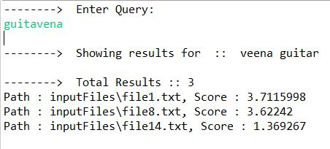
Results - Query without spaces and misspelled words
Regular system
Our system

Slide 20
Further Improvements
We can extend our system built to unknown terms in the query
There can be further improvements in the algorithm in order to achieve less computation time and better refined query.

Slide 21
Thank You

