Slide 1

Gokaraju Rangaraju Institute of Engineering and Technology (Autonomous) Department of Data Science Mini Project Work (CSE(DS))
Review 0 & 1: Title & Abstract Presentation
Batch No - B3
Presented by:
1. B. Karthikeya (22241A6771)
2. B. Abhilash Reddy (22241A6775)
3. B. Sushanth (22241A6776)
Under the Guidance of:
Dr. R.P. Ram Kumar
Professor
CSE(DS) Department

Slide 2
Predictive Analysis of Global Energy Consumption Trends using Time Series and Fine Tuned LLM Models
2

Slide 3
Abstract
This project focuses on a Comprehensive analysis of Global Energy Trends and their consumption every year using “Time series analysis and fine-tuned LLM models” along with data analysis. This project incorporates enhanced prediction and analysis of “Global Energy” Consumption from Natural Resources like Coal, Oil, Natural Gas, Hydroelectricity and more. This project leverages Time Series Analysis (ARIMA, SARIMA) and Fine-Tuned Large Language Models (LLMs) to analyze and predict global energy consumption trends with high accuracy. Using historical energy data from sources like the IEA, World Bank, and BP Statistical Review, the project identifies key consumption patterns across coal, oil, natural gas, and renewables to support informed decision-making.
3

Slide 4
Motivation
As global energy demand rises, it is necessary to analyze consumption trends to manage resources sustainably.
Natural resource depletion and environmental damage necessitate prudent and efficient energy use.
Advanced approaches such as Time Series Analysis and Fine-Tuned LLMs improve energy trend predictions to aid decision-making.
Accurate information help policymakers optimize energy use and promote renewable alternatives for a sustainable future.

Slide 5
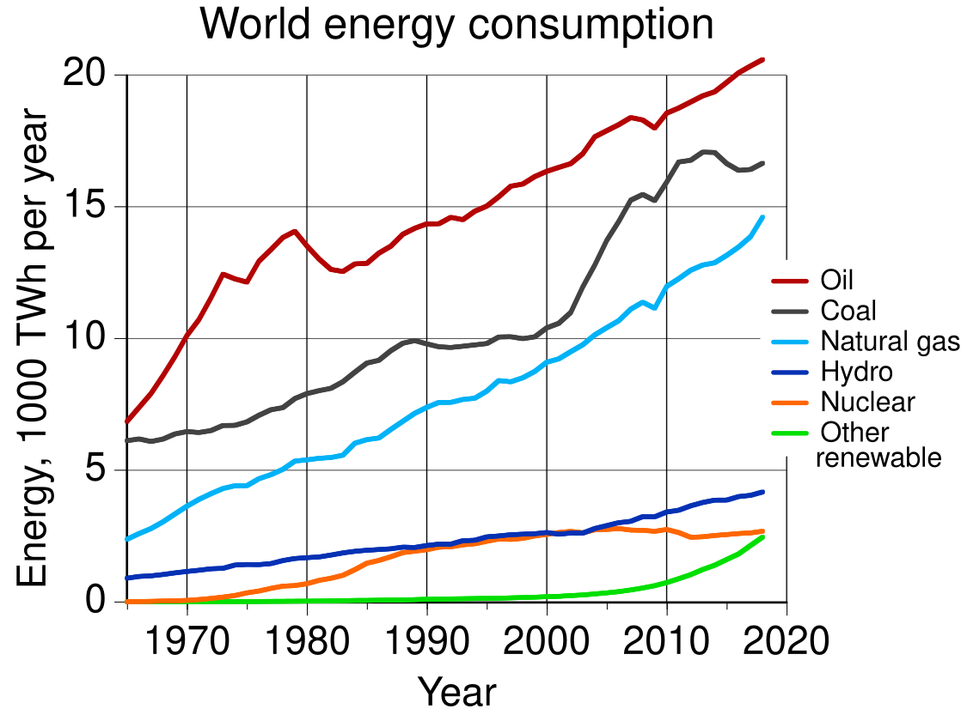
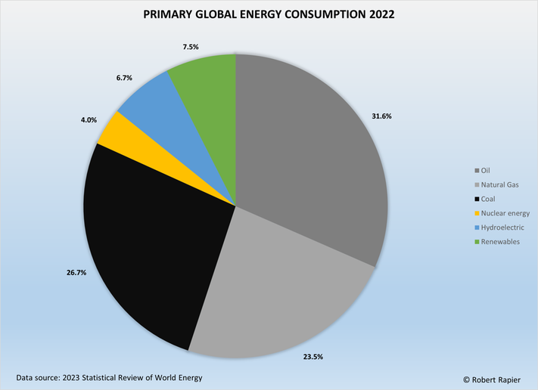
Novelty / Importance
According to recent surveys IEA (International Energy Agency) & Energy Institute, "Over 80% of Global Energy Production relies on Non-Renewable Energy Sources"

Slide 6
Novelty / Importance
Our project enhances traditional energy forecasting by integrating deep learning with time series analysis, enabling real-time adaptability. By fine-tuning LLMs, we incorporate textual data alongside numerical time series data, improving prediction accuracy. This approach not only enhances decision-making but also emphasizes the importance of reducing non-renewable energy consumption, promoting sustainable energy transitions.
Why LLM’s: LLMs can capture complex patterns, trends, and dependencies in time-series data, improving accuracy in long-term energy consumption forecasting.
Fine Tuning: LLM fine-tuning is the process of adapting a pre-trained large language model to a specific task or dataset by further training it on domain-specific data.

Slide 7
Data Sources
Data Source | Description
BP Statistical Review of World Energy | A comprehensive dataset containing global energy consumption statistics, including non-renewable and renewable energy trends over decades. (Past 10 years Data)
IEA World Energy Balances | Provides detailed energy production, consumption, and trade data across various countries, categorized by energy source.
Irenastat Dataset by IRENA (International Renewable Energy Agency) | Offers extensive energy data, including fossil fuel reserves, consumption patterns, and price trends worldwide.

Slide 8
Methodology
LLM Models by Hugging Face & PyTorch
GPT – 2 (OpenAI)
Llama 3.1 (Meta)
BERT (Google)
Time Series Models by Hugging Face & TensorFlow
ARIMA Autoregressive Integrated Moving Average
Seasonal ARIMA
Fine Tuning Techniques
Lora - Low Rank Adaptation
QLora - Quantized Lora
Prompt Tuning

Slide 9
Base Paper 1
Nayeem Hasan, Ismum Ul Hossain, "Forecasting and predictive analysis of source-wise power generation along with economic aspects for developed countries", Science Direct, 2024.
Doi: https://doi.org/10.1016/j.ecmx.2024.100558
Drawbacks:
Global Coverage – The base paper focuses only on developed countries, while our project analyzes global energy trends.
Comprehensive Energy Analysis – Unlike the base paper’s focus on power generation, our project examines overall energy consumption across multiple sources.
Advanced AI Integration – Our project leverages Fine-Tuned LLMs for more accurate predictions, whereas the base paper relies on traditional methods.
Diverse Data Sources – We incorporate historical data from multiple global organizations, ensuring a more comprehensive analysis than the base paper.

Slide 10
Base Paper 2
Ayush Thakur, K.A. Shukla, Jonathan Atrey, "Predictive Analysis of Energy Consumption and Electricity Demand Using Machine Learning Techniques",
IEEE, 2023.
Doi: 10.1109/ICSSES58299.2023.10200636
Drawbacks:
Focus on Demand Forecasting – The base paper emphasizes electricity demand prediction, while our project provides a broader analysis of global energy consumption trends.
Limited Energy Sources – It focuses mainly on electricity consumption, whereas our project covers multiple natural energy sources like coal, oil, and natural gas.
Traditional ML Models – The base paper uses gradient boosting algorithms, while our project enhances accuracy with Fine-Tuned LLMs and advanced time series models.
Narrow Temporal Scope – The dataset primarily includes hourly consumption, whereas our project analyzes long-term annual trends for better global insights.

Slide 11
REFERENCES
Yong Chen, Hongpeng Chen , Songzhi Su, "Fine-Tuning Large Language Models in Education" Institute of Electrical and Electronics Engineers, 2023. https://ieeexplore.ieee.org/document/10505547
Fusheng Wei, Robert Keeling, Nathaniel Huber-Fliflet, Jianping Zhang, Adam Dabrowski, Jingchao Yang, Qiang Mao, Han Qin, "Empirical Study of LLM Fine-Tuning for Text Classification in Legal Document Review", Institute of Electrical and Electronics Engineers, 2023. https://ieeexplore.ieee.org/document/10386911
Mel Keytingan M. Shapi, Nor Azuana Ramli , Lilik J. Awalin ,"Energy consumption prediction by using machine learning for smart building", ScienceDirect, 2020. https://www.sciencedirect.com/science/article/pii/S266616592030034X
11

Slide 12
Thank you
12

