Slide 2
REACT JS

Slide 3
Development Environment Set-Up for React
First install node js and npm
I recommend using React with Babel to let you use ES6 and JSX in your JavaScript code.
ES6 is a set of modern JavaScript features that make development easier, and JSX is an extension to the JavaScript language that works nicely with React.

Slide 4

Step-1 Now, open npm package manager console and fire following command
http://babeljs.io/
Babel is a compiler which lets you write modern JavaScript code that still works in old browser.
Babel has support for latest version of JavaScript through syntax transformers. These plugin allows you to use new syntax without waiting for browser support.

Slide 5
Step-2 Create Root folder
We will create a root folder named reactApp and place it on the desktop.
Once the folder is created then open it and create empty package.json file inside by running npm init --yes from the command prompt .
We create a directory called reactApp on the Desktop and using npm init --yes add an empty package.json file.
npm init allows you to create package.json file intereactively. npm init –yes will install packge.json with default scripts
You can see default package.json file.

Slide 6
STEP 3
Add Dependencies and plugins-webpack,react,babel
Here we will use Webpack bundler wchich allows us to write modular code and bundle it together into small packages to optimize load time. Other bundlers are system.js , Browserify.
npm install webpack --save
You can see webpack version 1.13.3 is installed to the reactApp directory
npm install webpack-dev-server –save
you can see after this command webpack-dev-server@1.16.2 is installed

Slide 7

STEP 3
Since , we want to use React , we need to install it first.
The - - save command will add these packages to package.json file
Again , I am inside reactApp directory and going to add react to package.json npm install react –save
npm install react-dom --save

Slide 8
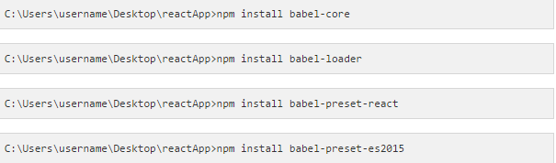
STEP 3
we need babel so now we are going to add babel-references to our package.json

Slide 9
Step-4
Create the below files
index.html ,
app.jsx,
main.js,
webpack.config.js here , we are already having package.json file

Slide 10
Step-4
Open webpack.config.js and add below mentioned code there. We are setting webpack entry point to be main.js.
Output path is the place where bundled app will be served. We are also setting development server to 8080 port. You can choose any port you want.
And lastly, we are setting babel loaders to search for js files and use es2015 and react presets that we installed before

Slide 11
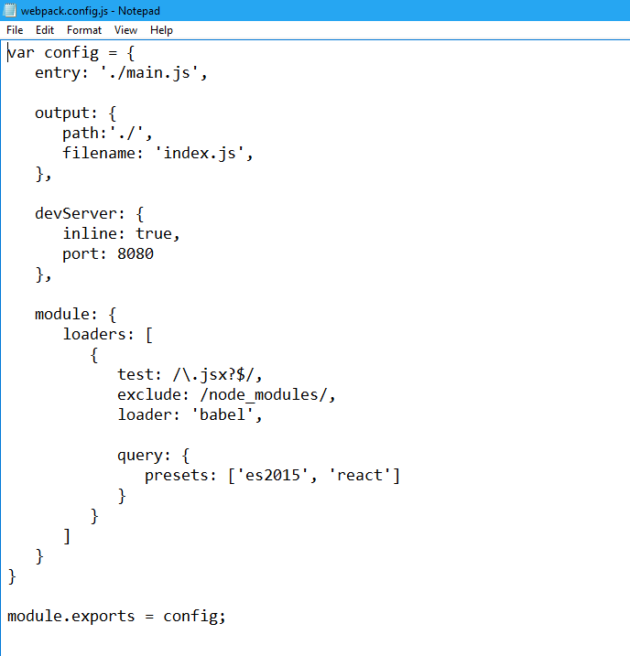
Step-4

Slide 12
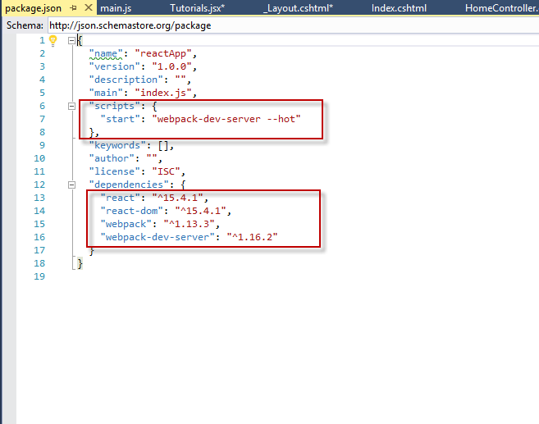
Step-4
Open the package.json and delete "test" "echo \"Error: no test specified\" && exit 1" inside "scripts" object. We are deleting this line since we will not do any testing.

Slide 13
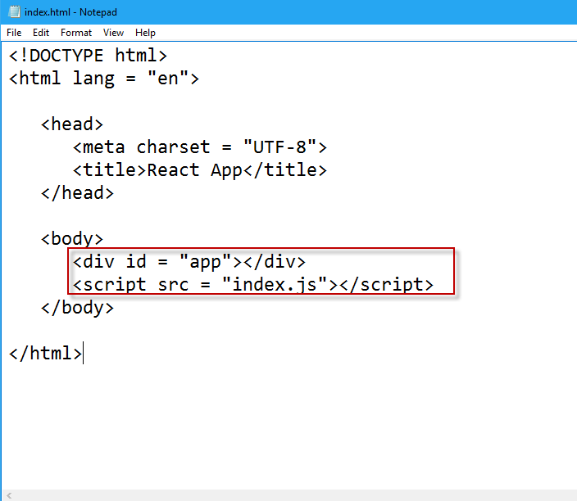
Step-5
Now we can use npm start command to start the server.
--hot command will add live reload after something is changed inside our files so we don't need to refresh the browser every time we change our code.
index.html
This is just regular HTML. We are setting div id = "app" as a root element for our app and adding index.js script which is our bundled app file.

Slide 14
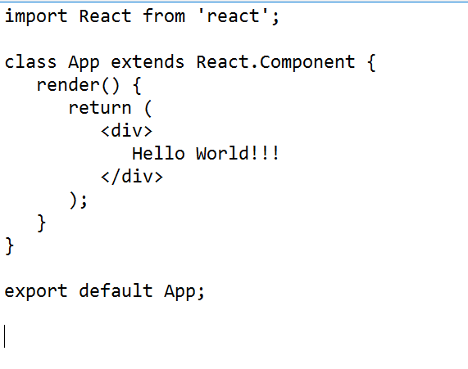
Step-6
App.jsx and main.js This is the first react component. This component will render Hello World!!!.

Slide 15
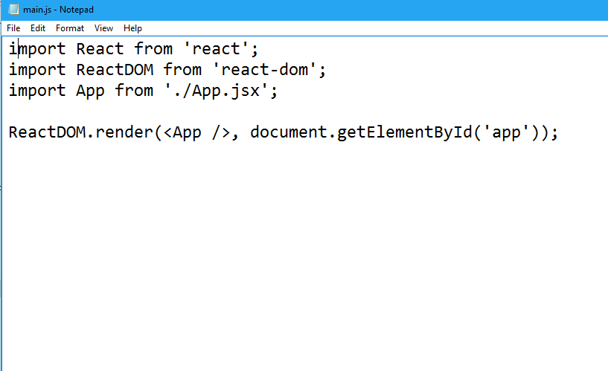
Step-7
We need to import this component and render it to our root App element so we can see it in browser.
Whenever you want to use something, you need to import it first.
If you want to make component usable in other parts of the app, you need to export it after creation and import it in the file where you want to use it.

Slide 16
Step-8
Running the server npm start
It will show you the port we need to open in browser.
In my case it is http://localhost:8080

