Slide 1
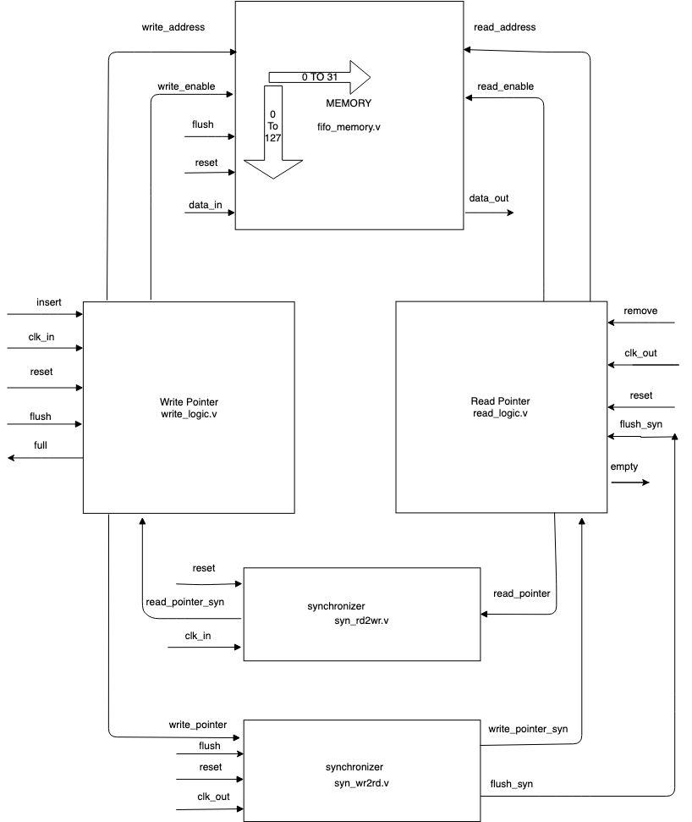
BLOCK DIAGRAM OF DUT
Presented By -TEAM10

Slide 2
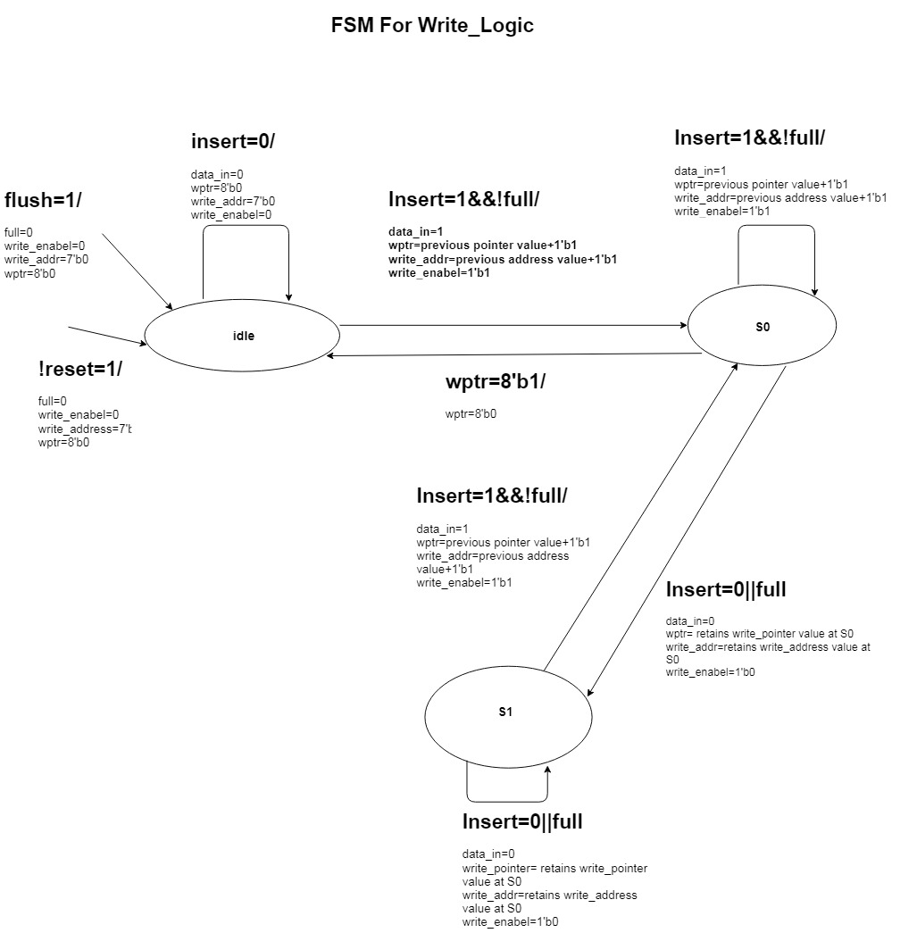
Presented By -TEAM10

Slide 3
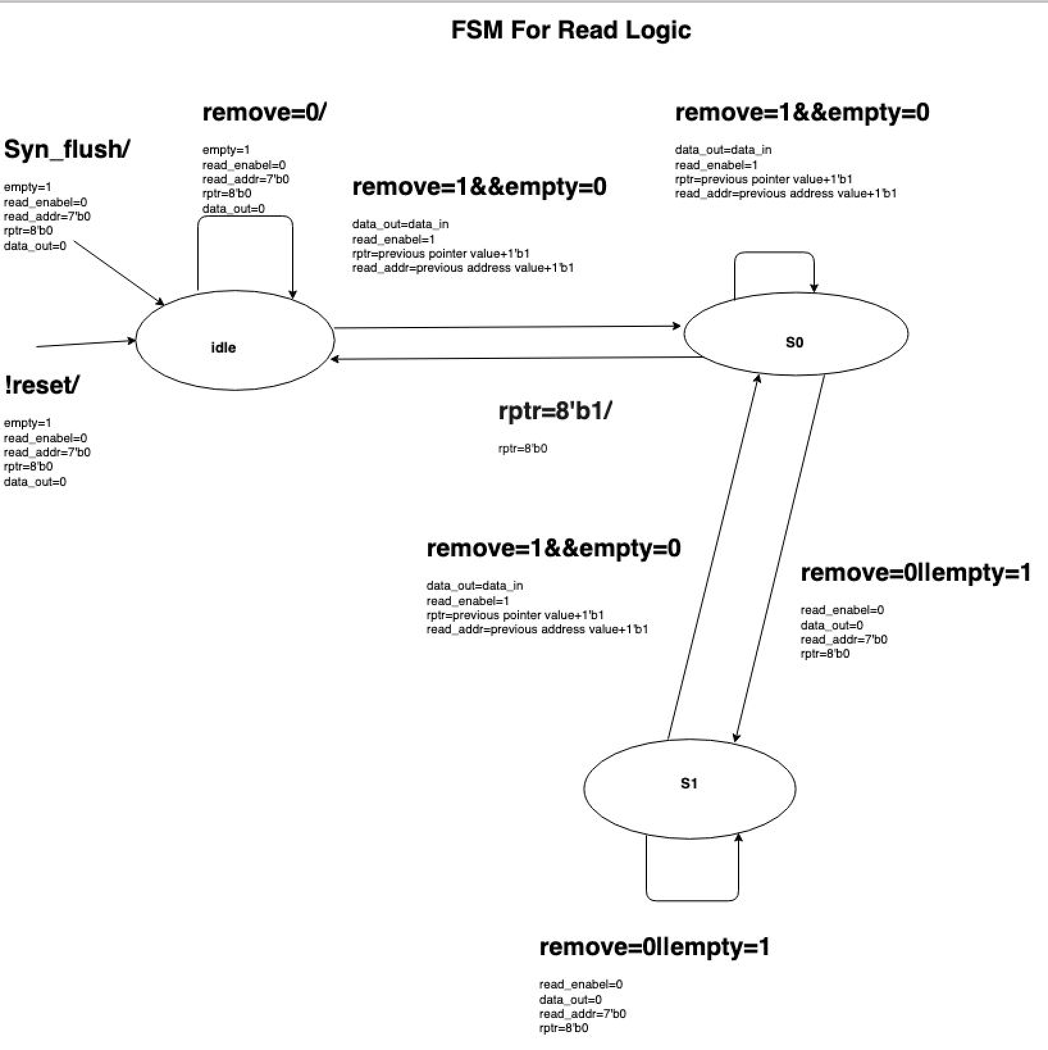
DUT BLOCK DIAGRAM
Presented By -TEAM10

Slide 4
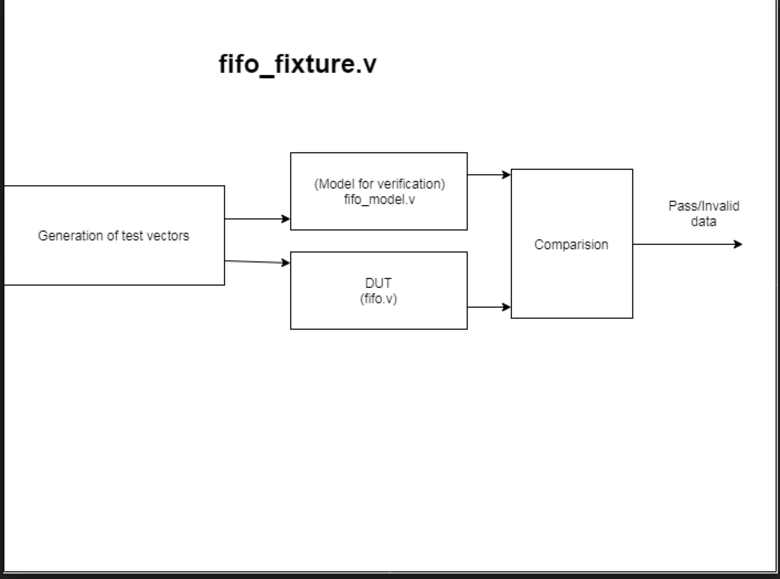
BLOCK DIAGRAM OF FIXTURE
Presented By -TEAM10

Slide 5
1) Reset 2) Flush 3) Consecutive Insert 4) Insert after Full 5) Flush after flush
6) Remove after Insert
SUMMARY OF TEST CASES COVERED
7) empty
8) syn_flush 9) Remove after Empty
10) Consecutive Remove 11) Remove after Flush
12) Consecutive read after write
Uniqueness:-
Optimized DUT FSM states from binary to onehot coding .
Tried to achieve maximum frequency of Clk_in =625 MHz and Clk_out=312.5MHz
Achieved above 96% code coverage for Scope, Line, Toggle, Condition and FSM.
Presented By -TEAM10

Slide 6
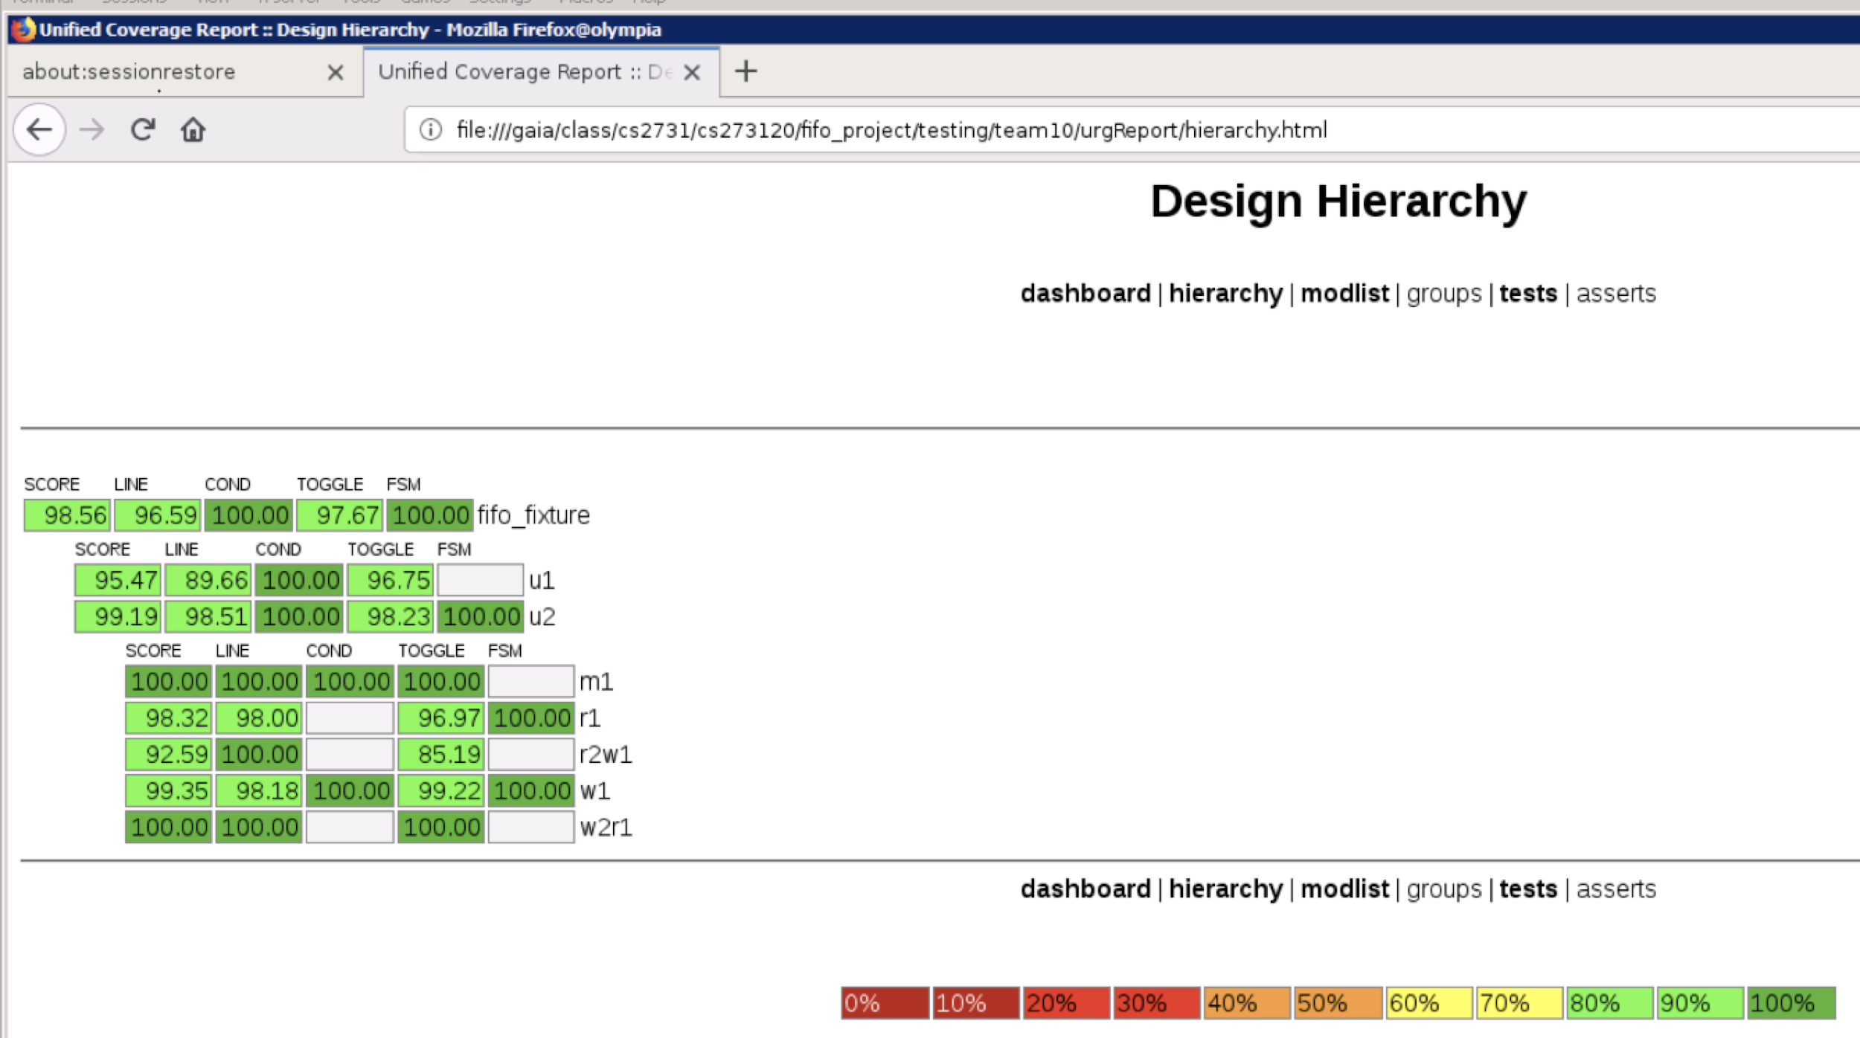
CODE COVERAGE
Presented By -TEAM10

Slide 7
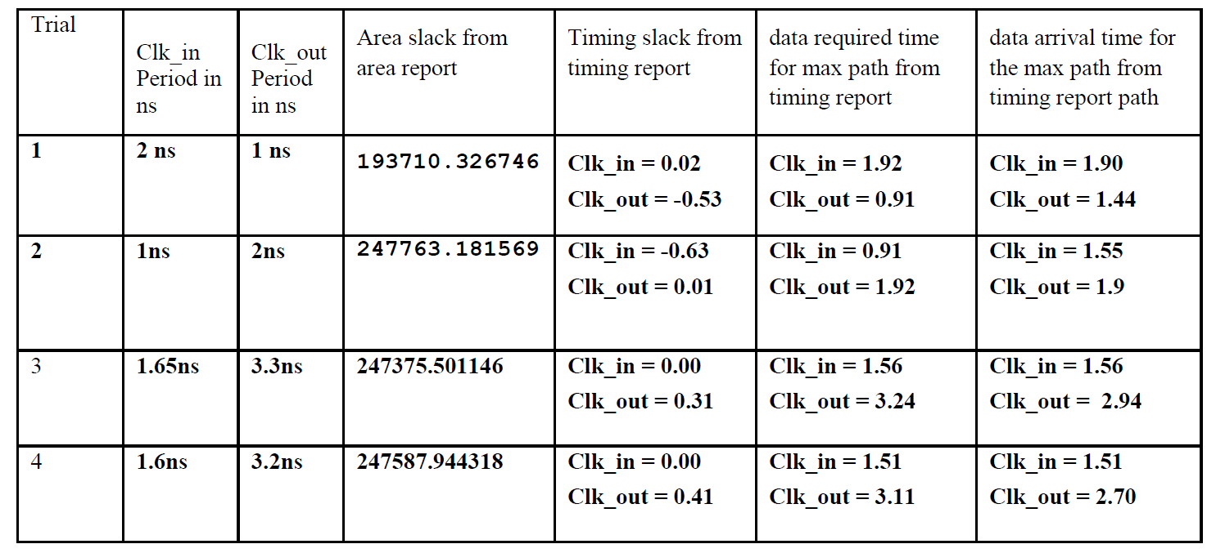
Using Binary : The maximum frequency fifo design can run at Clk_in = 605 MHz and Clk_out = 302.5MHz
SYNTHESIS RESULTS
IMPROVISED DUT: Changed Write and Read Logics to ONE-HOT from Binary
Using ONE-HOT: The maximum frequency fifo design can run at Clk_in = 625 MHz and Clk_out = 312.5MHz
Presented By -TEAM10

Slide 8
CONCLUSION
Concept of Clock Domain Crossing (CDC) using double synchronizers was utilized in our project.
We used the result of Code Coverage to improve our verification to achieve better condition and code coverage.
We also used randomness to exercise our DUT which improved our overall code coverage.
We verified our our DUT results with validated outputs using a model design.
We also used One hot for state transition to improvise timing.

