Slide 1

FINAL-YEAR PROJECT PRESENTATION
Design an OpenVINO-Powered Smart Agriculture Solution for Crop Disease Detection Using Edge Cameras and Evaluate Field Deployment Feasibility
Student: K Karthik | Roll number: 12308818
Department: [Department name]
Institution: Lovely Professional University
Faculty guide: Dr. Diwakar | Academic year: [Academic year]
Late Blight 99%
Notes:
Introduce yourself and the project title. Say: this project builds and evaluates a lightweight tomato leaf disease classifier, converts it to OpenVINO for efficient CPU inference, wraps it in a Streamlit app, and assesses how feasible deployment on edge cameras would be. Make clear from the start that this is a working software prototype evaluated on PlantVillage images, not a field-deployed system.

Slide 2




Introduction
Why it matters
Manual inspection
Blights reduce tomato yield; early recognition lowers loss and treatment cost.
Slow, subjective and hard to scale across large fields.
Computer vision
Why the edge
CNN classifiers can recognise leaf symptoms from a photograph in milliseconds.
Local inference reduces dependence on cloud connectivity and cuts latency.
Notes:
Explain why crop disease detection matters: diseases such as early and late blight reduce tomato yield, and the earlier a grower sees symptoms the cheaper the response. Manual inspection is slow, subjective and hard to scale across large fields. Computer vision lets a model classify a leaf photograph in milliseconds. Edge computing means running that model close to the camera so predictions do not depend on a constant internet connection, which is often unreliable in farms. Say: this project explores exactly that idea on a laptop-based prototype.

Slide 3
Problem Statement and Motivation
The system should
IMPLEMENTED
Identify tomato leaf conditions automatically (Healthy, Early Blight, Late Blight)
Run inference locally, without the cloud for every prediction
Reduce inference latency
Support future integration with edge cameras
Software prototype on a laptop
PyTorch to OpenVINO, CPU inference
Streamlit app, image upload
NOT YET DONE
Real edge camera integration
Testing on an edge device
Field-image validation
Notes:
The problem: a system is needed that identifies tomato leaf conditions automatically, runs locally, has low latency, and can later be connected to edge cameras. Be explicit about the right-hand side: what exists today is a software prototype tested on stored images on a laptop CPU. Physical camera integration, field images and edge hardware testing are future work. This honest split is a strength in a viva.

Slide 4
Project Objectives
1
Prepare and organise a tomato leaf dataset
5
Compare CPU inference performance
2
Train a lightweight image classification model
6
Build an interactive Streamlit application
3
Convert the trained model to OpenVINO IR
7
Discuss field deployment feasibility and limitations
4
Evaluate the PyTorch and OpenVINO models
Notes:
Walk through the seven objectives in order; they mirror the project workflow from data to discussion of deployment. Each one has a corresponding result later in the presentation: dataset (slide 6), training (7 and 8), conversion (10), evaluation (9 and 11), benchmark (12), Streamlit (13), feasibility and limits (15 and 16).

Slide 5
System Architecture
Inference path (implemented)
Tomato leaf image
Image preprocessing
MobileNetV3-Small model
OpenVINO inference
Class prediction
Confidence scores
Streamlit interface
▶
▶
▶
▶
▶
▶
Training and deployment path (implemented)
PROPOSED FUTURE DEPLOYMENT
Training dataset
PyTorch model training
Trained model
OpenVINO conversion
CPU inference
Edge camera + edge hardware
▶
▶
▶
▶
Implemented (solid)
Proposed, not implemented (dashed)
Training used the NVIDIA GPU; all reported inference benchmarks ran on the laptop CPU.
Notes:
Top row: the inference path implemented in the prototype. A leaf image is preprocessed (RGB, 224 by 224, normalisation), classified by MobileNetV3-Small running as an OpenVINO model, and the class prediction with confidence scores is shown in Streamlit. Bottom row: the training and deployment path. The model is trained in PyTorch on the dataset, saved, converted to OpenVINO IR, and executed on the CPU. The bottom-right dashed boxes mark what is proposed for future edge-camera deployment and is not implemented.

Slide 6

Dataset Preparation
Split | Healthy | Early Blight | Late Blight | Total
Training | 1,265 | 800 | 1,527 | 3,592
Testing | 326 | 200 | 382 | 908
Total | 1,591 | 1,000 | 1,909 | 4,500
PLACEHOLDER
Insert sample PlantVillage images
(Healthy, Early Blight, Late Blight)
Report Figure 4 was not supplied
Source: PlantVillage, filtered to 3 tomato classes
Validation: 15% held out from training images
Preprocessing: RGB, 224 × 224, ImageNet normalisation
PLACEHOLDER
Insert dataset-preparation terminal output
(not present in the report)
PlantVillage images are controlled-environment images; they do not by themselves establish real-world field performance.
Notes:
The dataset is PlantVillage, filtered to three tomato classes: Early Blight, Healthy and Late Blight, giving 4,500 images with roughly an 80/20 train/test split in every class. A 15 percent validation split was taken from the training images by the training script. The classes are moderately imbalanced, which is why precision, recall and F1 are reported and not accuracy alone. Important caveat: PlantVillage images are taken under controlled conditions, typically a single leaf on a uniform background, so high accuracy here does not prove field performance. The report also notes near-duplicate leaves in both train and test sets were not ruled out. The sample images and the dataset-preparation terminal screenshot were placeholders in the report; insert them before presenting.

Slide 7
Model Selection and Training
Model
Weights
Input size
MobileNetV3-Small
Pretrained (transfer learning)
224 × 224 pixels
Batch size
Epochs
Training device
32
5
NVIDIA GeForce RTX 3050 Laptop GPU
Training pipeline
Load and preprocess images
Fine-tune pretrained network
Validate each epoch
Keep best validation checkpoint
Evaluate on 908 test images
▶
▶
▶
▶
Notes:
MobileNetV3-Small is a lightweight convolutional neural network designed for mobile and edge devices, with few parameters and low compute, which suits a project aimed at edge deployment. Transfer learning means starting from weights pretrained on ImageNet and fine-tuning for three classes, which needs less data and training time. Images are resized to 224 by 224, batch size is 32, training ran for five epochs on an NVIDIA GeForce RTX 3050 Laptop GPU. Each epoch the model is trained on the training portion and measured on the 15 percent validation split; the best validation checkpoint is kept. Optimiser, learning rate and augmentation were not recorded in the report, so do not claim specific values.

Slide 8
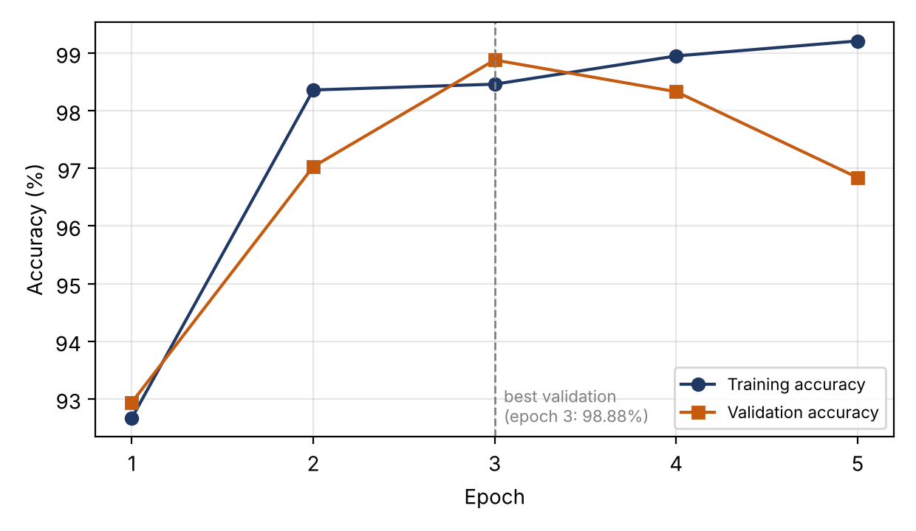
Training Results
Epoch | Training accuracy | Validation accuracy
1 | 92.67% | 92.94%
2 | 98.36% | 97.03%
3 | 98.46% | 98.88%
4 | 98.95% | 98.33%
5 | 99.21% | 96.84%
Best validation accuracy
98.88% at Epoch 3
Training and validation accuracy per epoch (from the report)
Validation accuracy fell to 96.84% by epoch 5 while training accuracy kept rising, so the Epoch 3 weights were kept.
Notes:
These are the recorded per-epoch values. Training accuracy rises steadily to 99.21 percent, but validation accuracy peaks at epoch 3 with 98.88 percent and falls to 96.84 percent by epoch 5, while validation loss rises after epoch 3. This suggests the model began to fit the training data too closely, so the epoch 3 checkpoint is the best validation model. The plot is taken from the report. The training terminal screenshot was not included as an image in the report; insert it if you have it.

Slide 9
PyTorch Test Evaluation
98.68%
98.55%
98.65%
98.60%
Test accuracy (908 images)
Macro precision
Macro recall
Macro F1 (weighted F1: 98.68%)
Class | Precision | Recall | F1-score | Support
Early Blight | 97.52% | 98.50% | 98.01% | 200
Healthy | 99.69% | 98.77% | 99.23% | 326
Late Blight | 98.43% | 98.69% | 98.56% | 382
Macro average | 98.55% | 98.65% | 98.60% | 908
PLACEHOLDER
Insert PyTorch confusion matrix
(results/confusion_matrix.png)
Cell values were not supplied in the report
False negatives (diseased plant called Healthy) and confusion between the two blights have different costs, so per-class results matter.
Notes:
This is the final evaluation of the PyTorch model on the 908 independent test images: 98.68 percent accuracy, macro precision 98.55, macro recall 98.65, macro F1 98.60 and weighted F1 98.68 percent. That corresponds to about 896 correct predictions and 12 errors (derived from the percentages). Precision is the share of predicted positives that are correct; recall is the share of true cases that were found; F1 combines them. Accuracy alone can hide which class is confused, which is why the table is per class. The report did not supply the PyTorch confusion matrix cells, so a placeholder is shown; insert results/confusion_matrix.png.

Slide 10
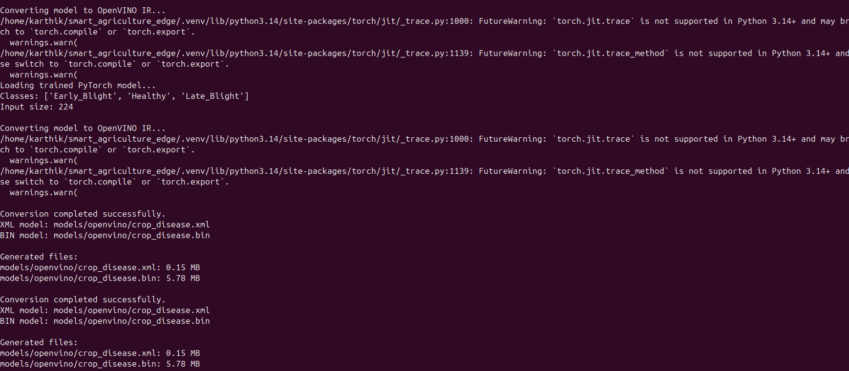
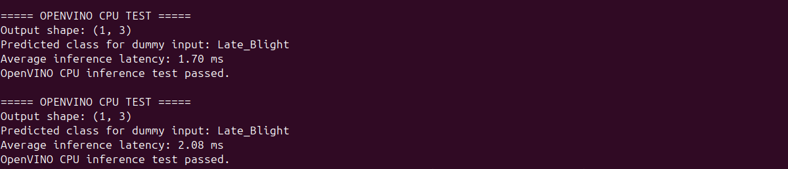
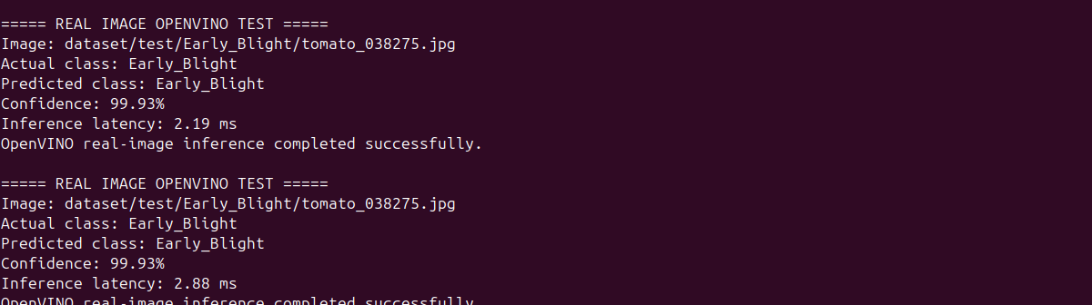
OpenVINO Model Conversion
Why OpenVINO
Optimised, efficient inference runtime for Intel CPUs and other devices; a natural fit for edge-style deployment.
XML
Model structure
≈ 0.15 MB
BIN
Model weights
≈ 5.78 MB
Conversion terminal output (from the report)
A torch.jit.trace warning for Python 3.14+ appeared; conversion still completed successfully.
OpenVINO functional test (dummy input)
Real-image prediction: Early Blight
Notes:
OpenVINO is Intel's toolkit for optimising and running neural-network inference efficiently, especially on CPUs. The trained PyTorch model was converted to OpenVINO Intermediate Representation, or IR, which is a pair of files: the XML describes the network structure and the BIN stores the weights. The recorded sizes are about 0.15 MB for the XML and 5.78 MB for the BIN. During conversion a warning about torch.jit.trace under Python 3.14 appeared, but conversion completed successfully. The small screenshots below show the OpenVINO functional test with a dummy input, so its predicted class is not meaningful, and a real-image prediction of Early Blight.

Slide 11
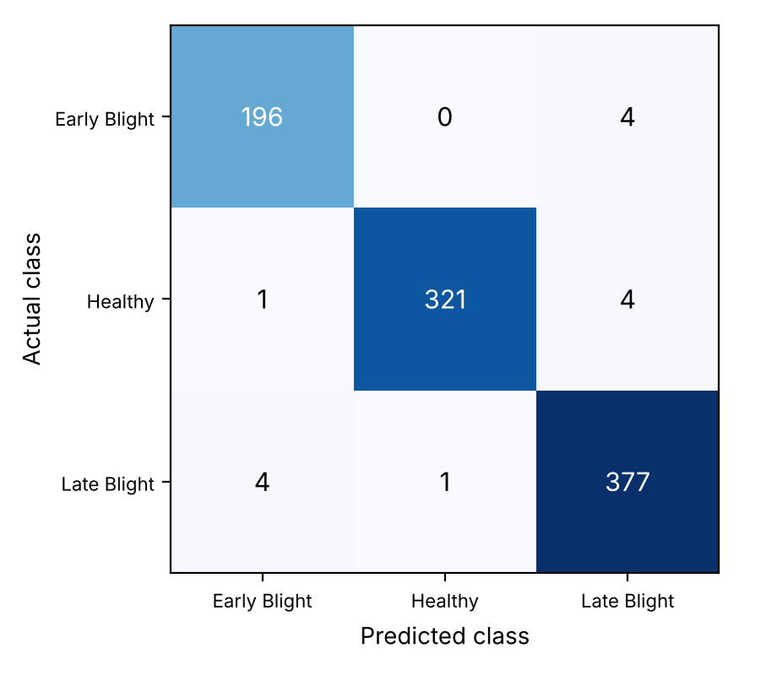
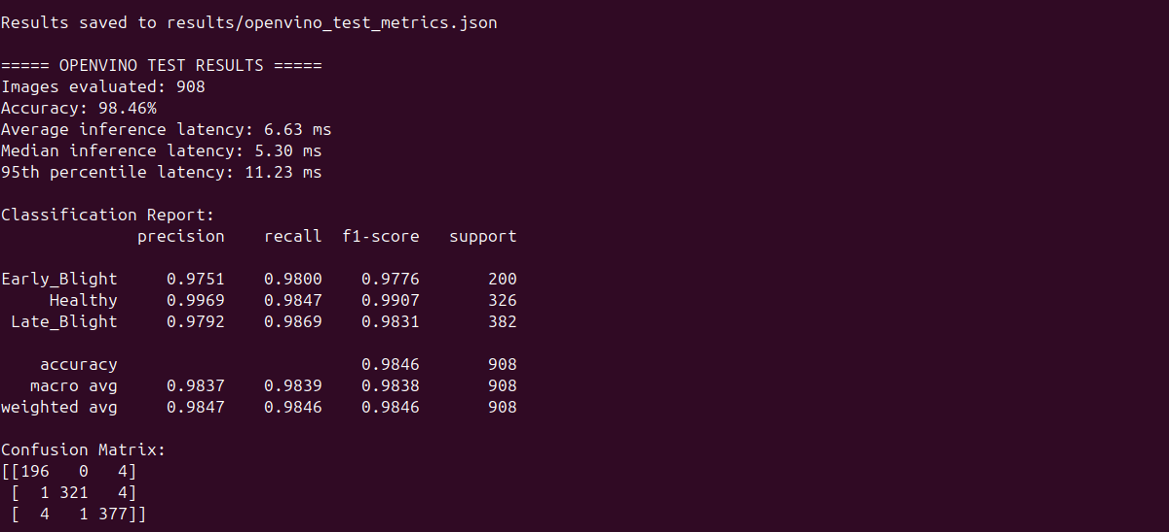
OpenVINO Evaluation Results
98.46%
6.63 ms
5.30 ms
11.23 ms
Accuracy (908 images)
Average latency
Median latency
95th percentile
Class | Precision | Recall | F1-score
Early Blight | 97.51% | 98.00% | 97.76%
Healthy | 99.69% | 98.47% | 99.07%
Late Blight | 97.92% | 98.69% | 98.31%
OpenVINO confusion matrix (908 test images)
PyTorch: 98.68% (896 correct)
OpenVINO: 98.46% (894 correct)
Difference: 2 images
OpenVINO evaluation terminal output (report)
Notes:
This is the full 908-image test-set evaluation of the converted OpenVINO model: 98.46 percent accuracy, average latency 6.63 ms, median 5.30 ms and 95th-percentile 11.23 ms. The OpenVINO accuracy is 0.22 percentage points below the PyTorch model, which equals two images; one fewer Early Blight and one fewer Healthy image were correct. The report states the cause was not established; possible contributors are numerical differences between runtimes, preprocessing differences between the evaluation scripts, or the conversion. Keep this 908-image latency separate from the 102-image benchmark on the next slide.

Slide 12
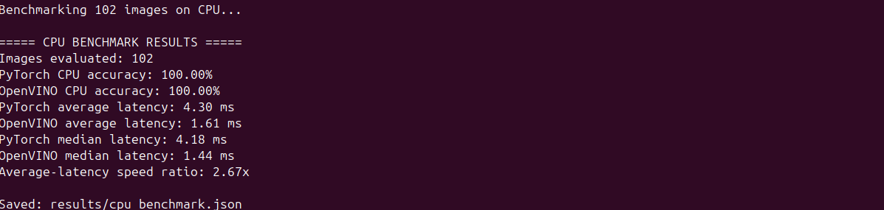
CPU Benchmark: PyTorch vs OpenVINO
Metric | PyTorch CPU | OpenVINO CPU
Images evaluated | 102 | 102
Accuracy (subset) | 100.00% | 100.00%
Average latency | 4.30 ms | 1.61 ms
Median latency | 4.18 ms | 1.44 ms
2.67×
OpenVINO measured average-latency speed ratio in this benchmark
CPU benchmark terminal output (from the report)
102 selected test images, not the full 908-image set
Accuracy is not combined with the full test-set result
Speedup is specific to this laptop and procedure
Notes:
This is a separate CPU-to-CPU benchmark on 102 selected test images. PyTorch averaged 4.30 ms per image and OpenVINO 1.61 ms, so the average-latency speed ratio is 4.30 divided by 1.61, about 2.67 times, a latency reduction of roughly 62.6 percent. Medians were 4.18 and 1.44 ms. Both reached 100 percent on this small subset, which should not be combined with the 98.46 percent full test-set result. This ratio was measured on this laptop under this procedure; do not claim the same speedup on every device. Latency depends on processor, threads, power mode and background load.

Slide 13
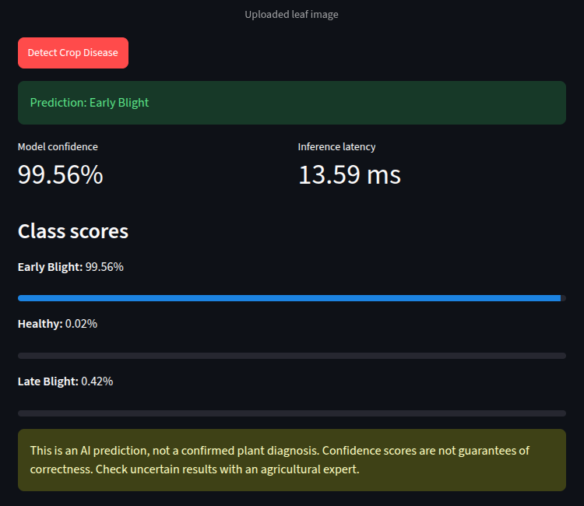
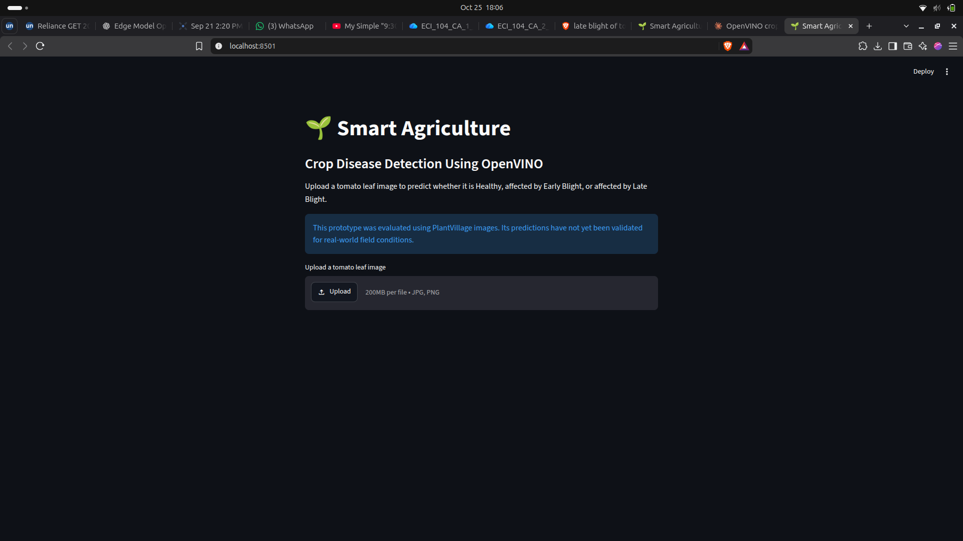
Streamlit Web Application
Upload a tomato leaf image
Click “Detect Crop Disease”
View predicted class
View class confidence scores
View displayed inference latency
Caution: AI prediction, not a confirmed plant diagnosis
Application home screen
The 13.59 ms is the latency shown for this single app run. It is not the same measurement as the 1.61 ms average from the separate 102-image CPU benchmark.
Recorded example
Prediction: Early Blight
Confidence: 99.56%
Displayed latency: 13.59 ms
Result screen: Early Blight
Notes:
Streamlit is a Python framework for building web interfaces. The application runs locally at localhost:8501, lets a user upload a leaf image in JPG, JPEG or PNG, click Detect Crop Disease, and then shows the predicted class, the model confidence, the displayed inference latency and all class scores, plus a warning that the output is an AI prediction and not a confirmed diagnosis. The recorded example is Early Blight with 99.56 percent confidence and a displayed latency of 13.59 ms. That 13.59 ms comes from one application run and must not be compared with the 1.61 ms benchmark average, which was a separate measurement procedure. Late Blight showed 100.00 percent, which is a rounded value, not certainty.

Slide 14
Software and Hardware Environment
Component | Used in this project
Operating system | Ubuntu Linux
Language | Python 3.14 (virtual environment)
Frameworks | PyTorch 2.14.1 and torchvision 0.29.1
Model | MobileNetV3-Small (pretrained)
Inference runtime | OpenVINO 2026.4.1 (CPU)
Web interface | Streamlit 1.66.1
Dataset | PlantVillage (tomato subset)
Training hardware | NVIDIA GeForce RTX 3050 Laptop GPU
Benchmark hardware | Laptop CPU (CPU-to-CPU comparison)
DEVELOPMENT ENVIRONMENT
Dell G15 laptop, Ubuntu. GPU for training; CPU for the recorded OpenVINO benchmark. Exact CPU and RAM were not recorded.
PROPOSED EDGE HARDWARE
Not tested. No ESP32, Raspberry Pi or agricultural camera testing was performed in this work.
Notes:
This slide lists what was actually used. Development and training happened on a Dell G15 laptop running Ubuntu with an NVIDIA GeForce RTX 3050 Laptop GPU used for training only. Inference benchmarks ran on the laptop CPU. The tools are PyTorch, torchvision, MobileNetV3-Small, OpenVINO, Streamlit and the PlantVillage dataset. The exact CPU model, RAM and Ubuntu release were not recorded, so latencies are specific to this laptop. The model was not tested on an ESP32, Raspberry Pi or any real agricultural camera; say this clearly if asked.

Slide 15


Edge Deployment Feasibility
PROPOSED FUTURE DEPLOYMENT: NOT IMPLEMENTED
Edge camera
Image capture
Local preprocessing
OpenVINO inference on edge hardware
Disease classification
Local display or optional dashboard
▶
▶
▶
▶
▶
Benefits
Constraints
Field conditions
Less reliance on continuous cloud connectivity; low-latency local results.
Power and memory limits on edge devices; hardware compatibility needs device-specific benchmarking.
Camera placement, lighting, image quality and weather will all affect results.
Notes:
This is a proposed future architecture, not a completed implementation. An edge camera captures an image, local preprocessing resizes and normalises it, an OpenVINO model runs on compatible edge hardware, the classification is shown on a local display or optionally sent to a dashboard. Benefits: reduced dependence on continuous cloud connectivity and lower latency. Challenges: power and memory limits, camera placement, lighting, image quality, weather, and hardware compatibility. Because latency depends on the device, any edge hardware needs its own benchmark before conclusions are drawn.

Slide 16
Limitations and Challenges
PlantVillage images do not fully represent field conditions
CPU benchmark covered 102 selected test images
Real-world accuracy has not yet been established
Power consumption and long-duration field performance were not measured
Only three tomato classes are supported
OpenVINO conversion showed Python 3.14 warnings (conversion still completed)
Confidence scores are not guarantees of correctness
Not field-validated; further testing is required before any production use.
Notes:
Present these openly; they show scientific honesty. PlantVillage images are controlled, so real-world field accuracy has not been established. Only three tomato classes are supported. A confidence score is not a guarantee of correctness. The CPU benchmark used 102 selected images. Power consumption and long-duration field performance were not measured. The OpenVINO conversion showed a Python 3.14 torch.jit.trace warning, although conversion completed successfully. The model should not be described as production-ready or field-validated.

Slide 17
Conclusion and Future Work
Achievements
Future work
Trained a MobileNetV3-Small tomato leaf classifier
PyTorch test accuracy: 98.68%
Converted the model to OpenVINO IR
OpenVINO test accuracy: 98.46%
2.67× average-latency ratio (102-image CPU benchmark)
Implemented an interactive Streamlit interface
Test on real field images
Collect images in varied light and environments
Evaluate on a physical edge device
Measure power consumption and memory usage
Expand supported crop diseases
Add confidence thresholds and human expert review
Test integration with a real edge camera
Notes:
Summarise the achievements: a MobileNetV3-Small tomato classifier with 98.68 percent PyTorch test accuracy, an OpenVINO model with 98.46 percent, a 2.67 times average-latency ratio in the 102-image CPU benchmark, and an interactive Streamlit interface. Future work is what makes this deployable: real field images in varied conditions, a physical edge device, power and memory measurements, more crops and diseases, confidence thresholds with human expert review, and a real edge-camera test.

Slide 18
References
[3] Hughes and Salathé, “An open access repository of images on plant health…,” arXiv:1511.08060, 2015.
[4] Mohanty, Hughes, Salathé, “Using deep learning for image-based plant disease detection,” Front. Plant Sci., vol. 7, 2016.
[9] Howard et al., “Searching for MobileNetV3,” ICCV, 2019, pp. 1314–1324.
[10] Pan and Yang, “A survey on transfer learning,” IEEE TKDE, vol. 22, no. 10, 2010.
[13] Paszke et al., “PyTorch,” NeurIPS 32, 2019, pp. 8024–8035.
[18] geraldmc/plantvillage-full, Hugging Face dataset, v0.1.0. [Verify availability, licence, revision]
[12] OpenVINO Documentation, Intel: docs.openvino.ai [insert access date]
[16] Streamlit Documentation: docs.streamlit.io [insert access date]
[15] torchvision MobileNet V3 documentation [insert access date]
[5] Barbedo, Comput. Electron. Agric., vol. 153, 2018. [Verify volume, pages, DOI]
Reference numbers follow the project report. Items marked in brackets must be verified before submission.
Thank You: Questions and Discussion
Notes:
References are taken from the project report. Items marked verify must be checked before submission, including access dates for web documentation. Close by thanking the panel and inviting questions.

