Slide 1

WEB DEVELOPMENT
Guide
Dr. K. Giri Babu
Professor and Dean of Academics
Dept. of ECE, VVIT
Presented By
Karthik suryadevara,
18BQ1A0467,
Dept. of ECE, VVIT

Slide 2
What is Web
The World Wide Web (WWW), commonly known as the Web, is the world's dominant software platform.
It is an information space where documents and other web resources can be accessed through the internet using a browser.
Web resources may be any type of downloadable media. Web pages are documents interconnected by links formatted in Hyper Text Markup Language (HTML). The HTML syntax displays embedded links, which permits users to navigate to other web resources
In addition to text, web pages may contain references to images, video, audio, and software components, which are either displayed or internally executed in the user's web browser to render pages or streams of multimedia content.

Slide 3

Uses Of Web
Online booking and Orders (redbus, amazon.. Etc)
Online Payments (sbionline, paytm.. Etc)
Education (Udemy, Youtube.. Etc)
Research (google, yahoo.. Etc)
Electronic Mail (gmail, Hotmail.. Etc)
Entertainment (Netflix, Hotstar.. Etc)
Social Networking (facebook, twitter.. Etc)
Downloading Files (mp3, video ..Etc)

Slide 4
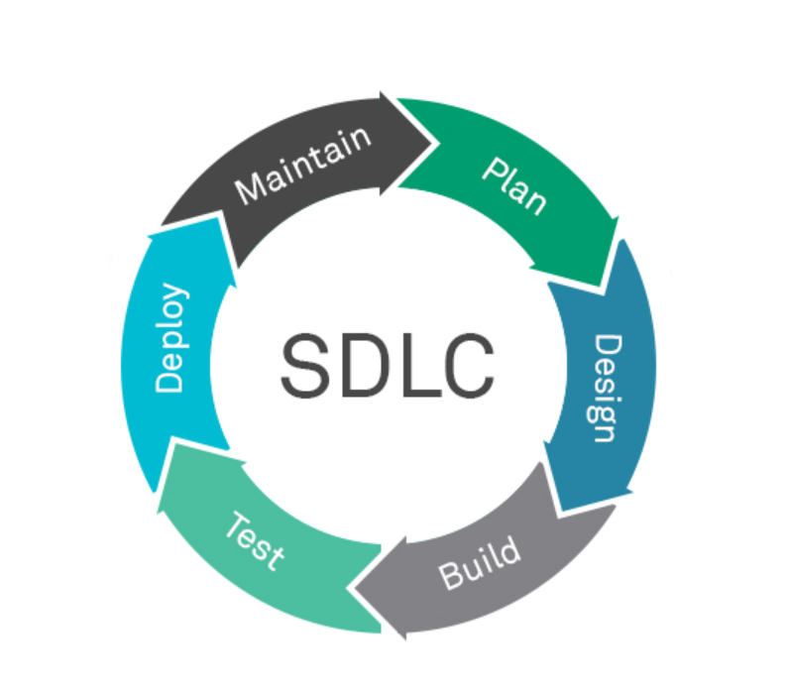
How to Build a Website/Webapp
Steps Involved (Software development lifecycle)
Plan
Design
Develop
Test
Deploy
Maintain

Slide 5


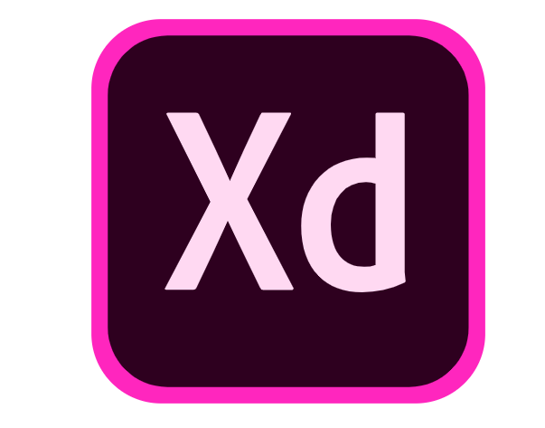


Popular Tools Used for Design
Figma
Adobe Xd
Canva
InVision
Axure RP

Slide 6
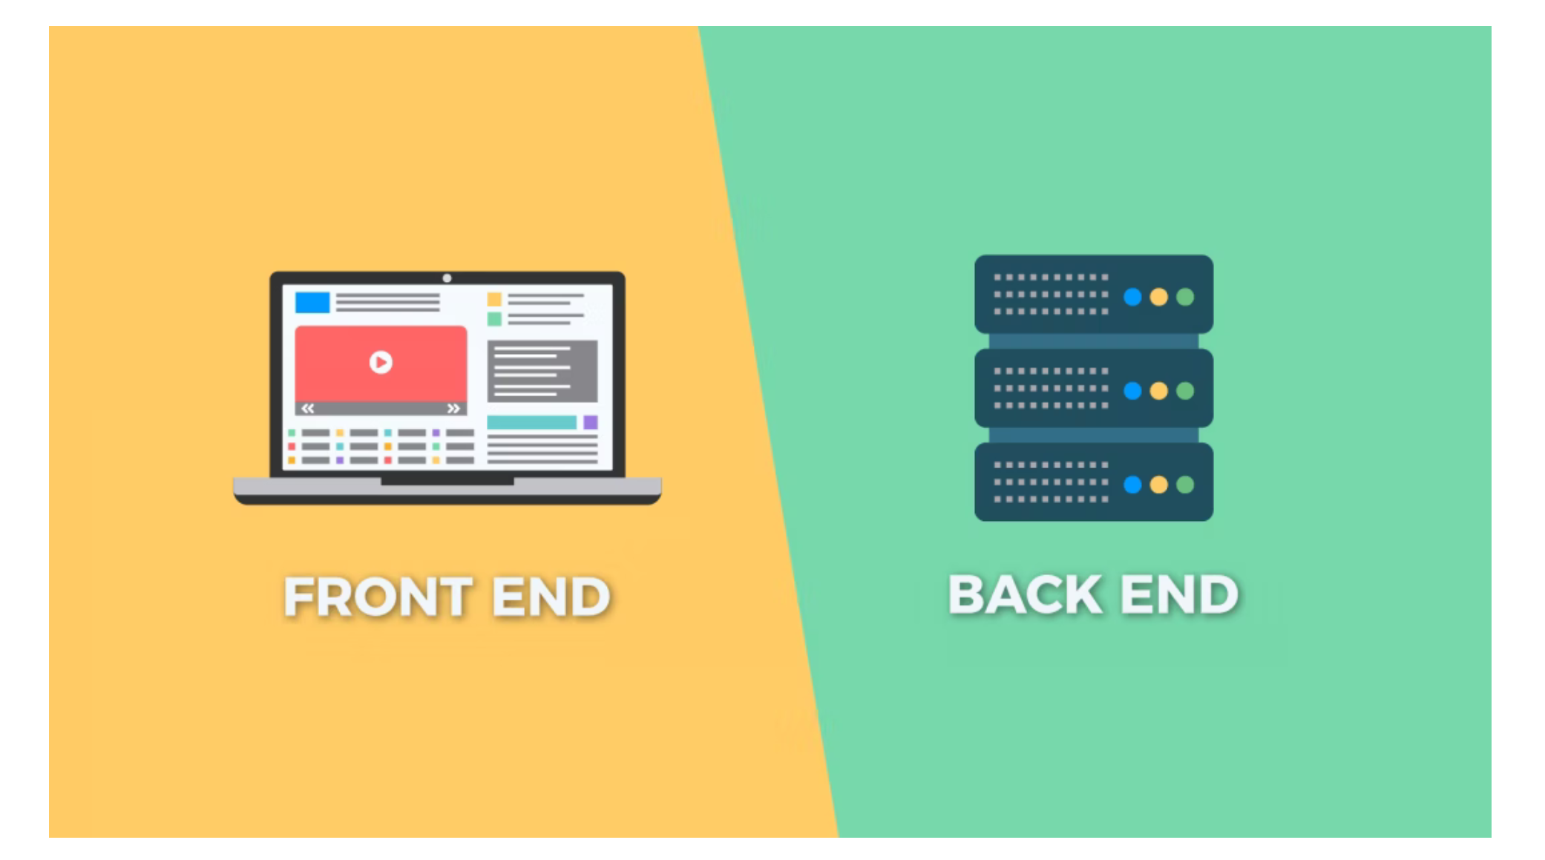
Build Phase

Slide 7
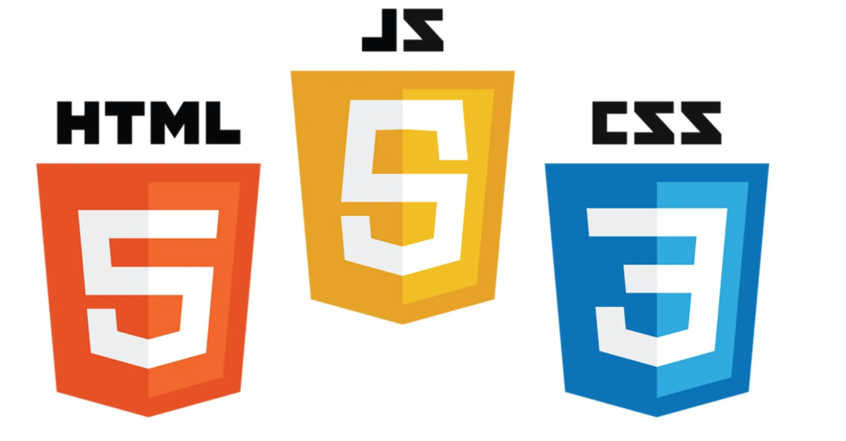
Front End
Front-end web development is the development of the graphical user interface of a website, through the use of HTML, CSS, and JavaScript, so that users can view and interact with that website.
HyperText Markup Language (HTML) is the backbone of any website development process, without which a web page does not exist. Hypertext means that text has links, termed hyperlinks, embedded in it.
Cascading Style Sheets (CSS) controls the presentation aspect of the site and allows your site to have its own unique look
JavaScript is an event-based imperative programming language (as opposed to HTML's declarative language model) that is used to transform a static HTML page into a dynamic interface.

Slide 8




Libraries/Frameworks in Front End

Slide 9
How these Libraries/Frameworks make Front End Development Easier
The web app is divided into reusable and data configurable COMPONENTS
Boost in Perfomance
State Management is easier
Testing is fairly simpler
Third party plugins and support
Mobile App like feel
Cost and Time Effective

Slide 10
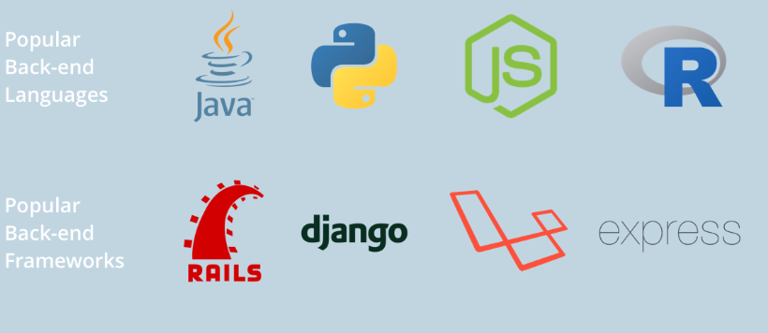
Backend Languages and Frameworks

Slide 11
Databases
A database is an organized collection of structured information, or data, typically stored electronically in a computer system
A database management system (DBMS) is the software that interacts with end users, applications, and the database itself to capture and analyze the data.
There are two types of Databases they are Relational Databases and Non Relational Databases
Relational databases are based on the relational model, an intuitive, straightforward way of representing data in tables
Non-relational databases are different from traditional relational databases in that they store their data in a non-tabular form. Instead, non-relational databases might be based on data structures like documents.

Slide 12
Importance Of Testing
The testing is important since it discovers defects/bugs before the delivery to the client, which guarantees the quality of the software.
It makes the software more reliable and easy to use.
Thoroughly tested software ensures reliable and high-performance software operation.

Slide 13
Steps Involved In Deployment
Purchasing a domain
Choosing a server service provider to host according to the needs
Choosing a server service provider to host the database

Slide 14
Thank you

