Slide 1
19AIE 214 – Big Data Analytics END SEM PROJECT PRESENTATION Classification of malicious URL
By Team 17
BL.EN.U4AIE20006 ------ B Srivathsan
BL.EN.U4AIE20058 ------ Samirit Saha
BL.EN.U4AIE20025 ------ Kanisettypalli Karthik
Presented to Mr S. Saravanan sir

Slide 2
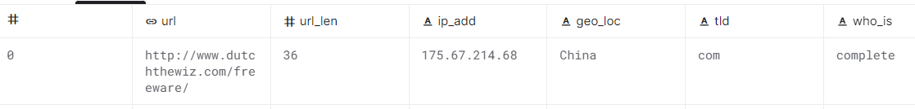
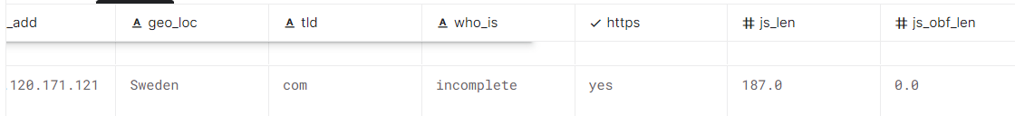
Dataset Description
We obtained the dataset which was used for malicious website classification using lexical tokens content tokens of the given dataset.
URL gives the url domain of the website.
TLD gives the domain name such as .org .com etc.
Who is tells us whether the domain information Is complete or anonymous
Javascipt length and javascript obf length display the code length .
Content is the actual content of the website body to be displayed.
Label is the classification label to be used.

Slide 3
Problem Statement
In our project, a malicious website being malicious or not is assessed based on its ‘attributes and behavior.
The technology of Bigdata is also implemented for the improving the model’s capability to detect malicious URL based on its’ behavior and attributes.
Therefore, the prediction model consists of a set of features and behaviors for the URL that are new, a algorithm that implements machine learning, as well as technology that operates on bigdata.
We use features such as url JavaScript content obfuscated JavaScript code and converting them to one feature to classify it.
Py spark will be used for this project.

Slide 4
System Workflow
We begin by loading the 5.1 Gb dataset into systems spark bin folder .
The cluster configured by the ip address of master is started as slave and master based on the system to enable scheduling and processing of data across the cluster.
We run the pyspark shell and import the feature extraction and machine learning algorithms.
First step is to load the csv file into a data frame in csv format and check the schema.
We then perform typecasting on integer values mapped as string in csv back to integer to be used in vector assembler.
We clean the data by removing rows with null values and removing label which might have been altered by mistake of delimiters due to content being a large string.

Slide 5
System Workflow
We remove the extra features from the obtained dataset to only have original features a feature vector of all features combined and the labels.
We then split the train and test data as 70 30 percent .
We input the labels and training features into the NaiveBayes and LinearSVC and use classification evaluators and give input as predicted and actual labels to predict accuracy f1 score etc.
We write the output from classifier into a folder on the bin folder of spark.

Slide 6
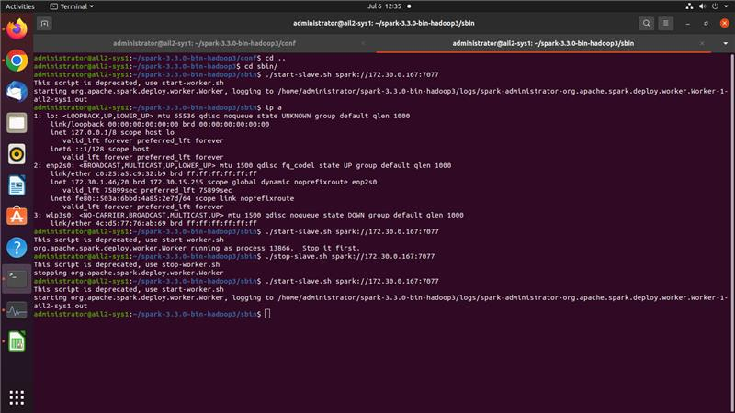
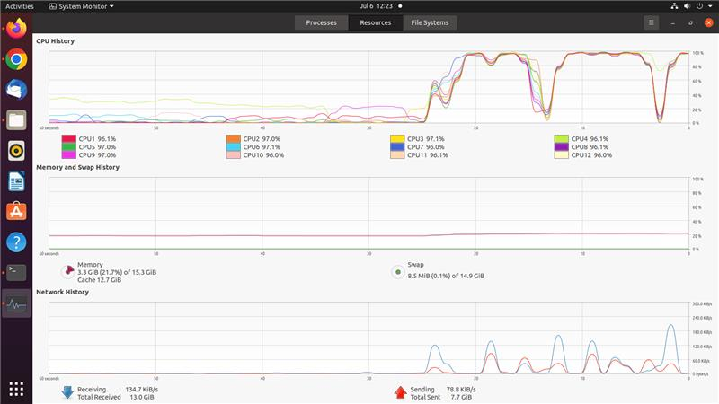
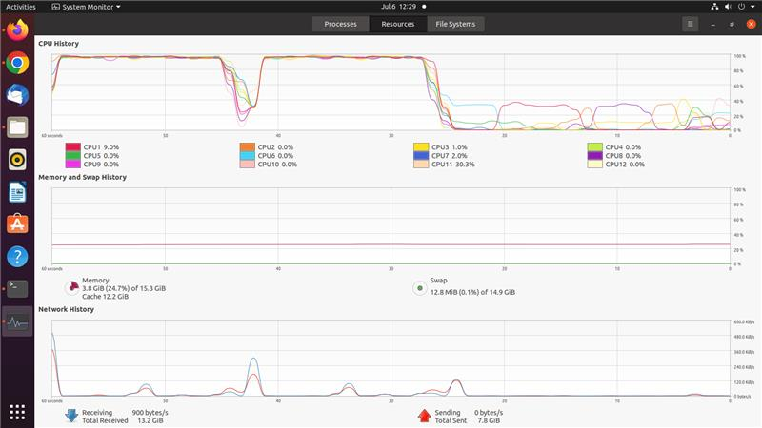
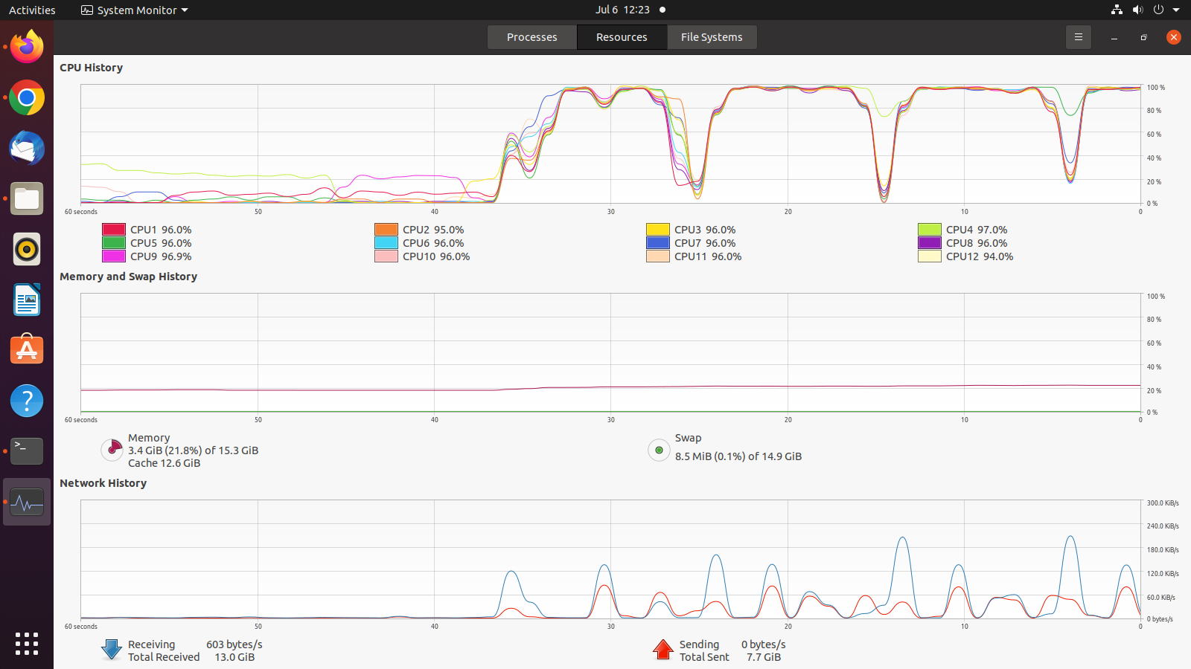
Execution

Slide 7
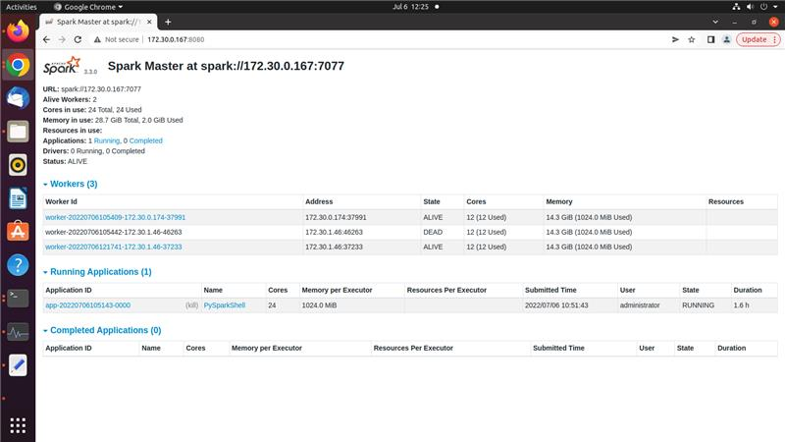
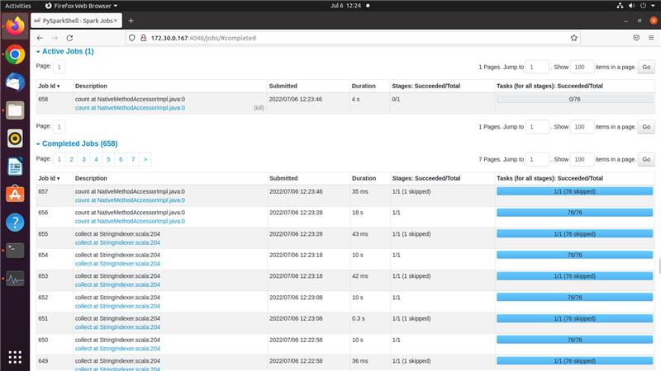
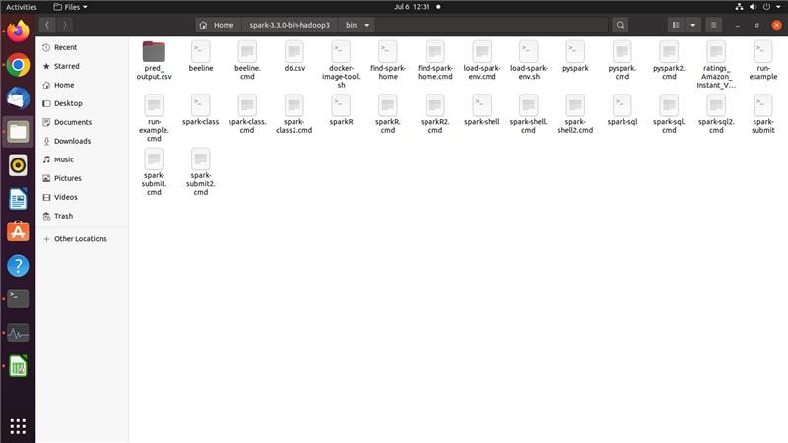
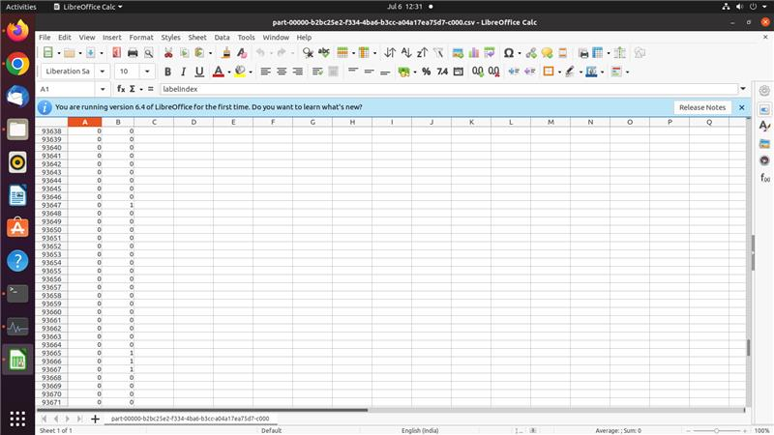
EXECUTION

Slide 8
Individual Contribution
Samirit Saha (BL.EN.U4AIE20058) :-Clustering and Implementation of Naïve Bayes for classification.
Kanisettypalli Karthik (BL.EN.U4AIE20025) :- Clustering and Implementation of LinearSVC for classification.
B Srivathsan (BL.EN.U4AIE20006) :- Pre-processing and Feature Extraction of the CSV database.

Slide 9
References:
[1] Do Xuan, Cho, Hoa Dinh Nguyen, and Victor Nikolaevich Tisenko. "Malicious URL detection based on machine learning." International Journal of Advanced Computer Science and Applications 11.1 (2020).
[2] Vemuri, Pujitha. "Detecting malicious shortened URLs using machine learning." (2018).
[3] Cui, Baojiang, et al. "Malicious URL detection with feature extraction based on machine learning." International Journal of High Performance Computing and Networking 12.2 (2018): 166-178.
[4] Patgiri, Ripon, et al. "Empirical study on malicious URL detection using machine learning." International Conference on Distributed Computing and Internet Technology. Springer, Cham, 2019.
[5] Joshi, Apoorva, et al. "Using lexical features for malicious URL detection--a machine learning approach." arXiv preprint arXiv:1910.06277 (2019).

