Slide 1

Identification of hostile genes in COVID variants
19BIO211--Intelligence of Biological Systems
TEAM 17
B SRIVATHSAN (BL.EN.U4AIE20006)
SAMIRIT SAHA (BL.EN.U4AIE20058)
KANISETTYPALLI KARTHIK (BL.EN.U4AIE20025)
Course Instructor:
Dr. Amrita Thakur
Dr. Nidhin Prabhakar T V

Slide 2
ABSTRACT
Following the transmission of the coronavirus on an epidemic level to various regions of the globe, owing to the process of random evolution, the original genome sequence of this virus has undergone quite a lot of mutations to give rise to different variants, that have altered several prominent features of this virus, such as its’ infectivity, or the symptoms which are caused by the variants that arise from the original strain.
Despite the randomness of the nature of mutation, owing to the biological process of trascription and translation which occur in the conversion of DNA to RNA and then to proteins, one can find certain noticeable patterns in mutations that might occur in the sequence while it is going through these processes.
In this paper, we shall explore a few ways in which those regions in the genome and the subsequent proteins that are synthesized by them, wherein the chance of mutation is great.
To perform this task, we make use of ORF detection to identify regions of the COVID-19 virus’ genome sequence wherein lethal mutations may have occurred, giving rise to the proteins that may have improved the lethal properties of the coronavirus, such as the symptoms it creates or its’ infectivity rate.
This will also enable us to find the possible locations of the spike protein component of the COVID-19 virus, which is responsible for the effective infectivity of the COVID-19 virus.

Slide 3
INTRODUCTION
In terms of its’ genetic nature, the COVID-19 virus contains a gene sequence which is made up of 4 principal nucleotides, which are: Adenosine (A), Thiamine (T), Guanine (G), Cytosine (C).
The idea on which this paper is based is to run gene sequencing algorithms and subsequently protein sequencing algorithms upon the sequence of nucleotides in the coronavirus to easily sort out those sections of the COVID-19 genome which are shown to have a greater number of similarities with the other sections of the COVID gene sequence, as well as with other variants of the COVID-19 virus that have appeared in the world in recent times.
A similar strategy can also be implemented for the proteins synthesized by this virus, following which Once this is done, mutation can be detected in these specific sections once we detect the nucleotides which have undergone changes in the target genome. The task of detecting mutations can be improved with the introduction of detecting open reading frames (ORFs).

Slide 4
THEORY AND CONCEPT
A Brief Introduction to SARS COV-2
To have a better understanding of how mutation takes place within a coronavirus, first we should have a look at the structure of SARS COV-2, which causes COVID-19 in humans. Studies have shown that SARS COV-2 is an RNA virus. Research has shown that the SARS COV-2 virus has a great affinity for attaching onto the ACE2 receptors which exist on the outer surface of human cells.
When it comes to the structure of the COVID-19 virus, we see that the SARS COV-2 virus is made up of a couple of structural proteins which are named as follows: the Spike protein, the Nucleocapsid protein, the Membrane protein, and the Envelope protein.
Understanding this structure of the virus is especially important when it comes to further understanding how mutation takes place. Understanding the structure of the virus further goes on in helping us understand which protein of the virus our vaccine should target for it to have maximum efficiency.
Surface location of the S glycoprotein renders it a direct target for host immune responses, making it the main target of neutralizing antibodies. In the light of its crucial roles in viral infection and adaptive immunity, the S protein is the focus of most vaccine strategies as well as therapeutic interventions.

Slide 5
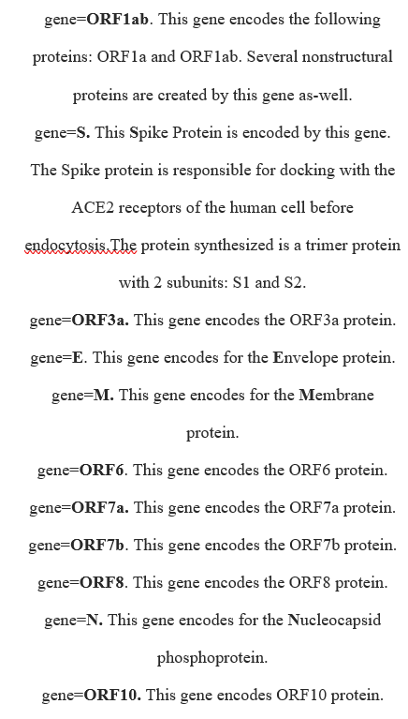
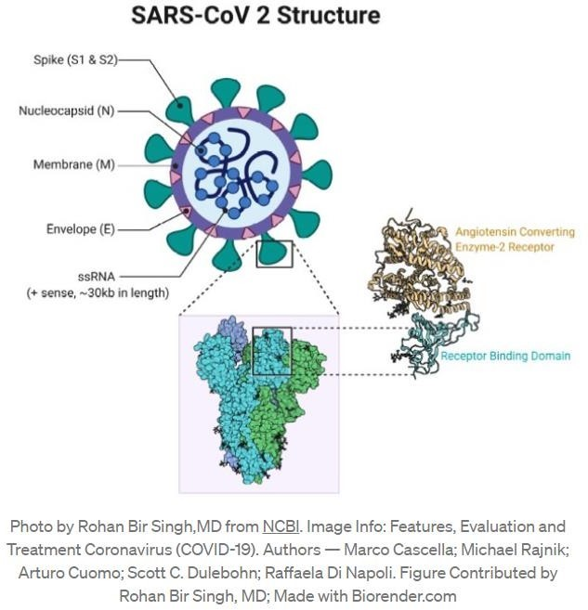

Slide 6
THEORY AND CONCEPT (CONTD.)
B. Open Reading Frame
The open reading frame (ORF in short) is that region of the sequence of nucleotides which stretches from the start codon (which is the first three nucleotides of a nucleotide sequence from where the process of translation, or conversion of a DNA to protein starts, the nucleotide sequence for a start codon is usually ATG) to the stop codon (the region where the process of translation stops).
One usually searches for the open reading frame of an organism’s gene sequence to find and pinpoint the location a particular gene in that organism.
Usually, it is seen that the open reading frame of a DNA will start with the codon “ATG”, though this may not always be the case, and will end with any of the three codons with the following sequences: TAA, TGA or TAG, which are accordingly referred to as ‘stop codons. Depending on the starting point, there are six possible ways of translating a sequence of nucleotides into its’ respective amino acid sequence according to the genetic code.

Slide 7
THEORY AND CONCEPT (CONTD.)
The six ways are as follows: three on forward strand and three on complementary strand.
However, it must be noted that the start and ending of the ORF are cannot be equated to the ends of the messenger RNA (mRNA).
On the other hand, they are contained within the mRNA itself. In case of a gene, ORFs are present, as mentioned earlier, between the start and stop codons. ORFs are found when traversing through the regions of a DNA in search of a specific gene.
The ORFs are identified differently based on the variations of the start code sequence that can take place in an organism’s genetic code due to mutation. A typical ORF finder will, based on the fact mentioned above, make use of algorithms which are based on existing genetic codes (including the altered ones) and all possible reading frames.

Slide 8
THEORY AND CONCEPT (CONTD.)
It has been found that the existence of an ORF is a good indicator of the location of a gene in the surrounding sequence around the desired gene.
In this situation, the open reading frame constitutes a part of a longer sequence that is translated by the ribosomes, if it is long, which is noticed more in the case of prokaryotes (organisms without a well-defined nucleus), and in the, the ORF be present in sporadic gaps called introns. However, shorter ORFs can also be present outside the funcctional genes. However these ORFs will be much shorter and will terminate faster.
After the sequencing of a gene, it is important to the correct ORF is determined so that the desired gene wherein mutation is believed to be taking place is located. The open reading frame is usually considered as the longest sequence without a gap or a stop codon.
This scenario is noticed in eukaryotic messenger RNA which tends to have only one ORF. A problematic situation arises in the case of eukaryotic pre-mRNA wherein large parts of DNA are not properly translated. When the objective is to find ORFs for eukaryotic mRNA it is necessary to have a look at the spliced or split RNA first.

Slide 9
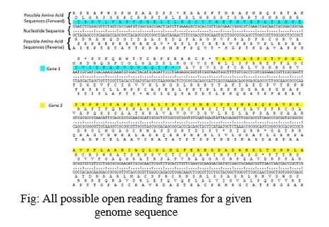
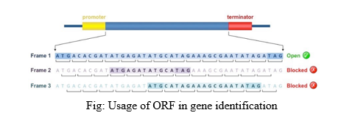

Slide 10
Type of Mutations
There are many types of mutations due to many reasons. Mutations can be harmful, have a mild effect or not affect anything.
The mutations we will be discussing are Point mutations which are caused by small shift of nucleotides.
They can give rise to 4 kinds of mutations.
1.Silent Mutations which are caused by substituting nucleotides in genome base which do not cause any affect or change in amino acid sequence as it forms a codon mapping to the same peptide.
2.Missense Mutations where a single amino acid is altered in sequence changing the function of a protein by a small margin but significant enough to be considered a variant.
3.Nonsense mutations are caused when insertion or inversion of a nucleotide causes a premature stop codon and shortening the Orf of the sequence and when in relation to structural proteins such as S protein in covid may affect their structural integrity. 4. Frame Shift mutations which is a significant mutation which causes a chain reaction in the reading frame due to a single codon change and changes many codons on the genome

Slide 11
Methodolgy
1.Gathering of genomic sequence of COVID-19 and its’ variants in notepad files which we have taken is for original covid and its variants in separate files.
2.Implementation of algorithm to identify the ORIF region and within the same sequence.
3.. Alignment of the genomes using global alignment to account for gaps and mismatches due to Frame Shift mutations using Needleman-Wunsch algorithm.
4.Transcription and Translation of DNA to obtain the protein sequence with multiple ORFs without filtering.
5.ORF's stored in array by identifying the start and stop codons by filtering the codons length. And comparission of ORF of genomes to identify the mutations.

Slide 12
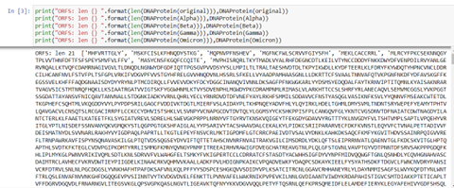
Results
ORF's of protein sequences of all variants

Slide 13

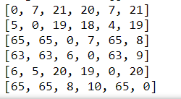
Table Which shows the No: of mutations between variants
Fig(i)
Fig(ii)
Fig(I)-->TABLE WHICH SHOWS THE NO: OF MUTATIONS BETWEEN VARIANTS
Fig(ii)-->point mutaions

Slide 14
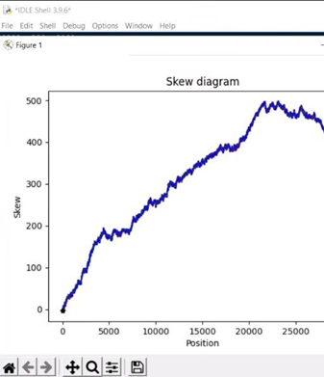
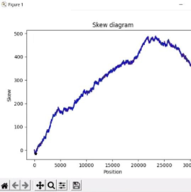
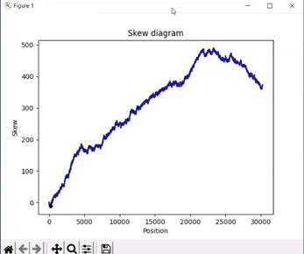
skew diagram of the origin of replication for the gene sequence
Fig(iii)
Fig(iv)
Fig(v)
Fig(iii)--> the skew diagram of the origin of replication for the gene sequence for the Original variant
FIG(Iv)-->THE SKEW DIAGRAM OF THE ORIGIN OF REPLICATION FOR THE GENE SEQUENCE FOR THE Alpha VARIANT
FIG(v)-->THE SKEW DIAGRAM OF THE ORIGIN OF REPLICATION FOR THE GENE SEQUENCE FOR THE Beta VARIANT

Slide 15
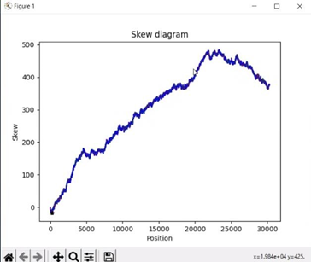
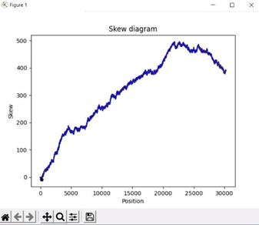
skew diagram of the origin of replication for the gene sequence
Fig(vi)
Fig(vii)
Fig(viii)
Fig(vi)--> the skew diagram of the origin of replication for the gene sequence for the GAMA variant
FIG(vii)-->THE SKEW DIAGRAM OF THE ORIGIN OF REPLICATION FOR THE GENE SEQUENCE FOR THE Delta VARIANT
FIG(viii)-->THE SKEW DIAGRAM OF THE ORIGIN OF REPLICATION FOR THE GENE SEQUENCE FOR THE Omicron VARIANT

Slide 16
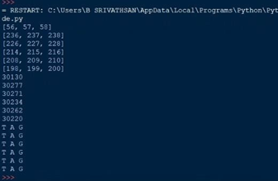
Point of origin and other key features for the original COVID-19 virus and its’ variants

Slide 17
OBSERVATIONS
The Origin of Replication of the aligned sequences begin around the position of 210th nucleotide and are signified by a stop codon.
The GC Skew of all the sequences are of a similar amount despite the mutations and thus the hydrogen bonding structural integrity of the variants seem to have no significant effect.
The Biggest gene sequence of ORF1ab has undergone point mutations between the variant groups of Original,Alpha,Delta while maintaining most other genomes to be the same.
The gene of ORF1a, like ORF1ab has undergone point mutations between the variants of beta gamma and delta.
Both the ORF1ab and ORF1a perform synthesis and functions of nonstructural proteins in the region of suppressing host immunity and response to growth.
Comparing the protein sequences, the mutations occur between Valine and Isoleucine which plays a part in immunity and strength of the host and thus a change in the peptide causes a difference response.
This mutation is due to Isoleucine and Valine being an important part of immune response and by adapting to it the virus tries to fool the immune system.

Slide 18
CONCLUSION:
We have compared 5 Covid Genome variants by transcription and translating the given DNA sequence and identified ORF’s.
We identified 5 genomes responsible for the hostility of the virus in their mutated form among different variants.
The Original, Alpha and Delta variants of the virus have undergone nonsense and missense mutations in their ORF1ab and ORF7 for suppression of host immunity by synthesis of nonstructural protein among themselves. Whereas they have undergone frame shift mutations with Beta Gamma Omicron and caused a lot of mutations in NS-p1 which is a protein derivative of ORF1ab and ORF1a which performs their functions.
The other orfs such as ORF3a have influenced the life cycle incubation period and replication factor of the virus. We also compared the GC skew as they signify the oric and structural integrity of the virus due to the high no of hydrogen bonds shared between them and noticed that the oric starts from the same place and the structural integrity of these strains are similar.
We have arrived at the conclusion that the hostile mutations in the virus are of the ORF ORF1ab ORF3a ORF7 whereas the other mutations involve the envelope E protein and N protein which are studied for suppressing the virus by weakening its spike protein effect.

Slide 19
REFERENCES
^{[1]} Altman, Eleonora, et al. "Effect of the HP0159 ORF mutation on the lipopolysaccharide structure and colonizing ability of Helicobacter pylori." FEMS Immunology & Medical Microbiology 53.2 (2008): 204-213.
[2] Delbue, Serena, et al. "Isolation of SARS-CoV-2 strains carrying a nucleotide mutation, leading to a stop codon in the ORF 6 protein." Emerging microbes & infections 10.1 (2021): 252-255.
[3] Fan Wu, Su Zhao, Bin Yu, Yan-Mei Chen, Wen Wang, Zhi-Gang Song, Yi Hu, Zhao-Wu Tao, Jun-Hua Tian, Yuan-Yuan Pei, Ming-Li Yuan, Yu-Ling Zhang, Fa-Hui Dai, Yi Liu, Qi-Min Wang, Jiao-Jiao Zheng, Lin Xu, Edward C Holmes, Yong-Zhen Zhang. A new coronavirus associated with human respiratory disease in China, Nature 2020 Mar;579(7798):265-269. doi: 10.1038/s41586-020-2008- Epub 2020 Feb 3.
[4] Marta Giovanetti , Francesca Benedetti , Giovanni Campisi , Alessandra Ciccozzi , Silvia Fabris , Giancarlo Ceccarelli , Vittoradolfo Tambone , Arnaldo Caruso , Silvia Angeletti , Davide Zella , Massimo Ciccozzi . Evolution patterns of SARS-CoV-2:

Slide 20
Thank you !

