Slide 1


Income Tax Management System
19CSE202
DATABASE MANAGEMENT SYSTEM
Team 6
B Srivathsan – BL.EN.U4AIE20006
K Karthik – BL.EN.U4AIE20025
Nipun B Nair – BL.EN.U4AIE20044

Slide 2
Abstract
The aim of our project is to maintain income tax information of registered clients such as Salary, TDS, Exemptions availed and keep track of yearly paid and pending tax. On request of user using a webpage developed in python we will return an Income tax returns form to track the paid and pending and pay the pending amount if any. Python will be used for frontend and Oracle DBMS will be used to implement backend which will be accessed by the front end.

Slide 3
Software & Hardware Requirement
Hardware:
1.AMD Opteron, Intel Pentium® at 500 MHz or faster, or Intel EM64T
Minimum 500 MB free disk space for installation, 10 GB recommended
2.Minimum 1 GB physical memory, 4 GB recommended
Software:
1. Java
2.Oracle RDBMS

Slide 4
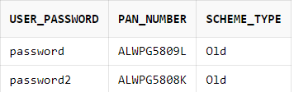
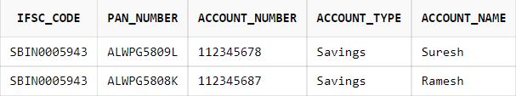
Data Base Table Creation

Slide 5

Data Base Table Creation

Slide 6
Data Base Table Creation

Slide 7
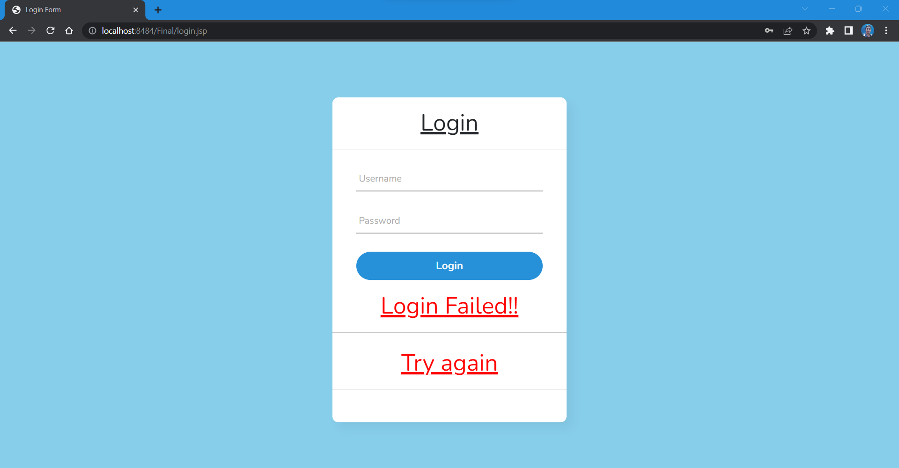
Front End Design

Slide 8
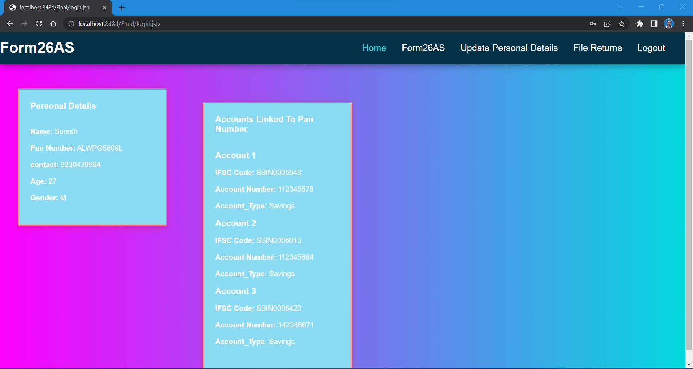
Front End Design

Slide 9
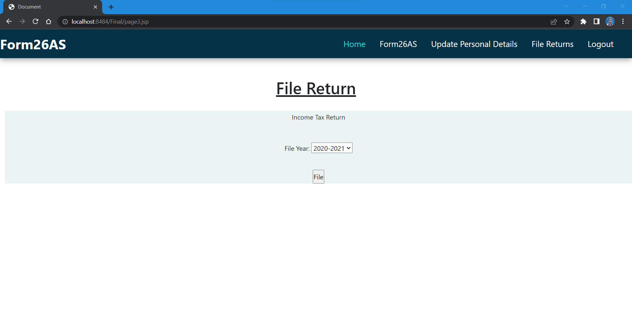
Front End Design

Slide 10
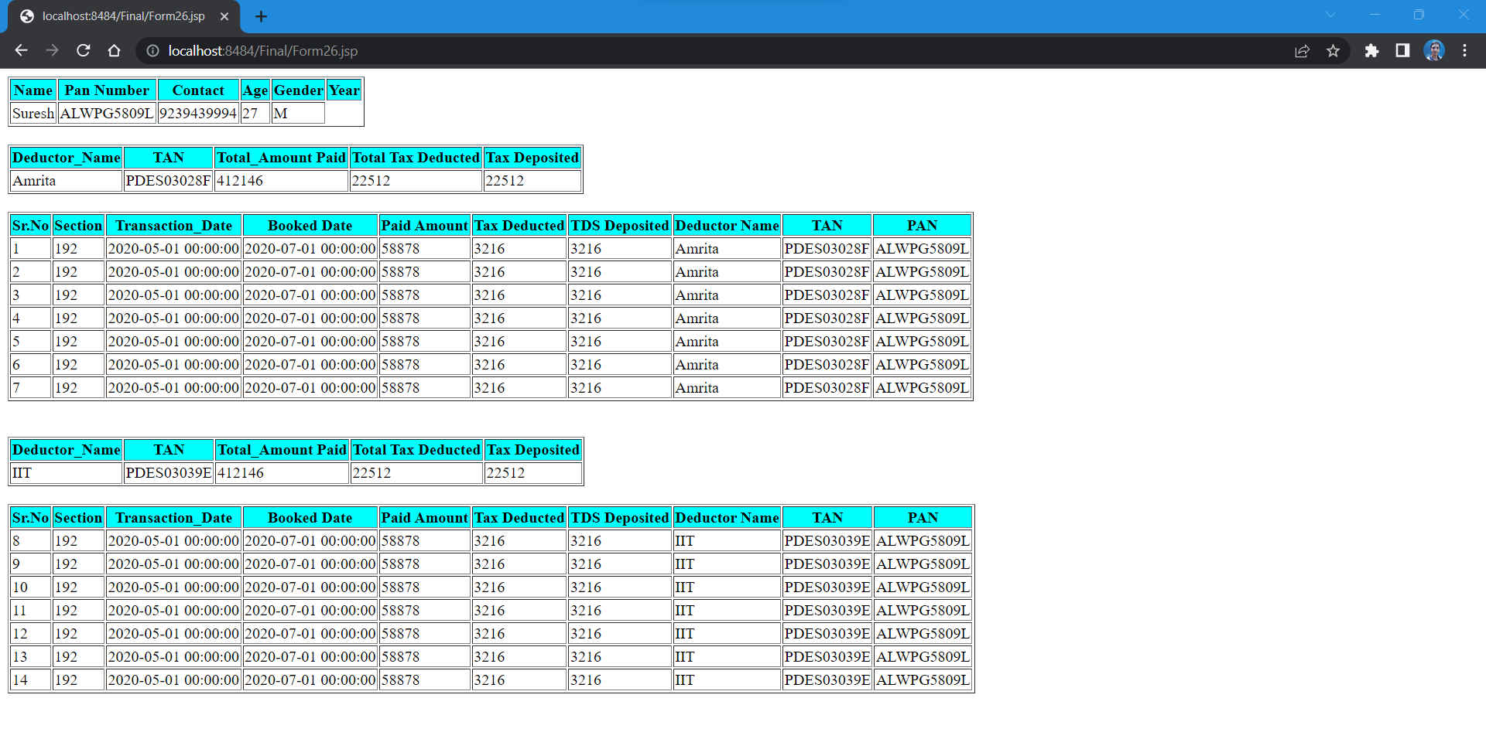
Front End Design

Slide 11
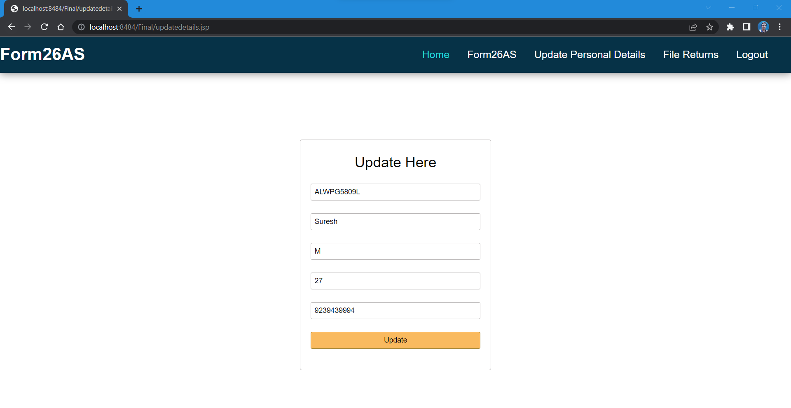
Connectivity After Retrieving Data

Slide 12
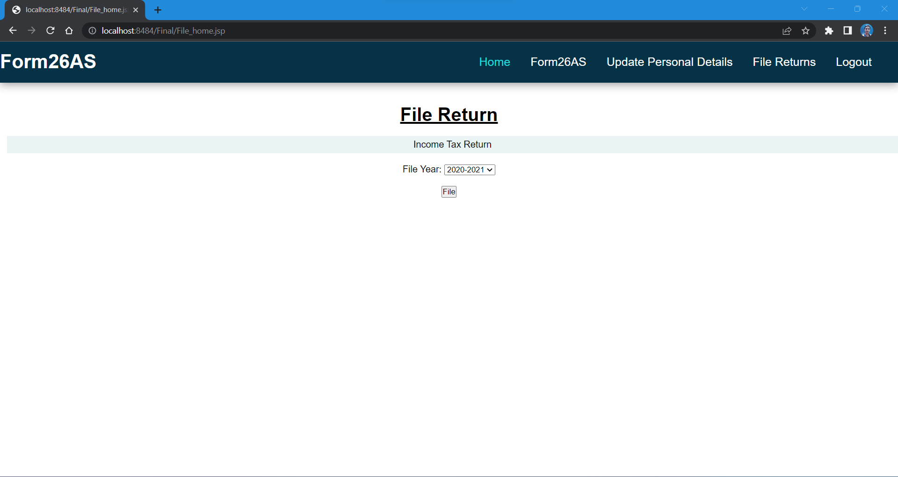
Connectivity After Retrieving Data

Slide 13
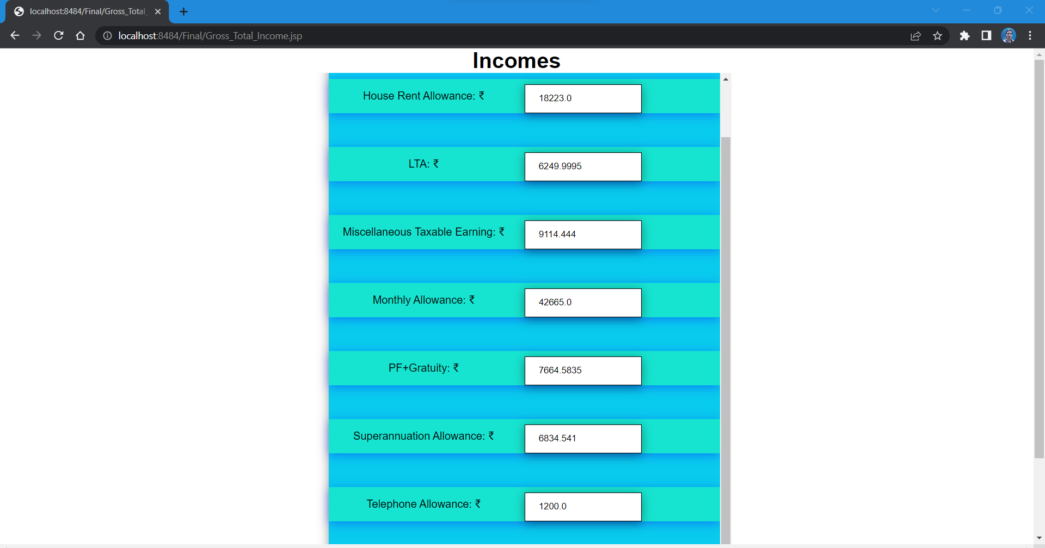
Connectivity After Retrieving Data

Slide 14
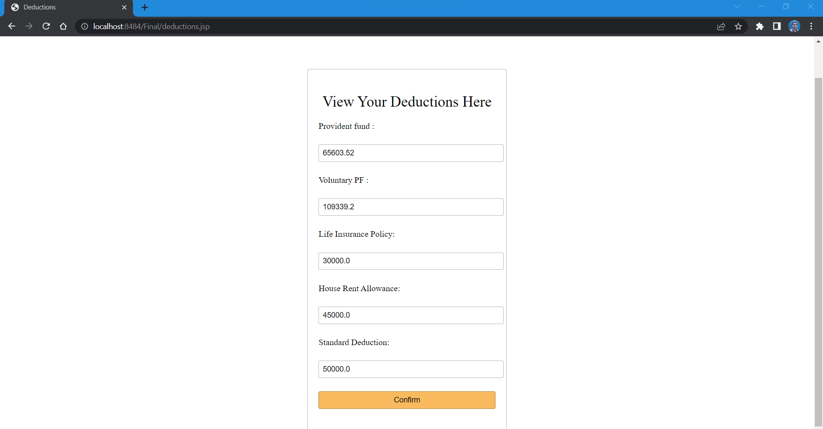
Connectivity After Retrieving Data

Slide 15
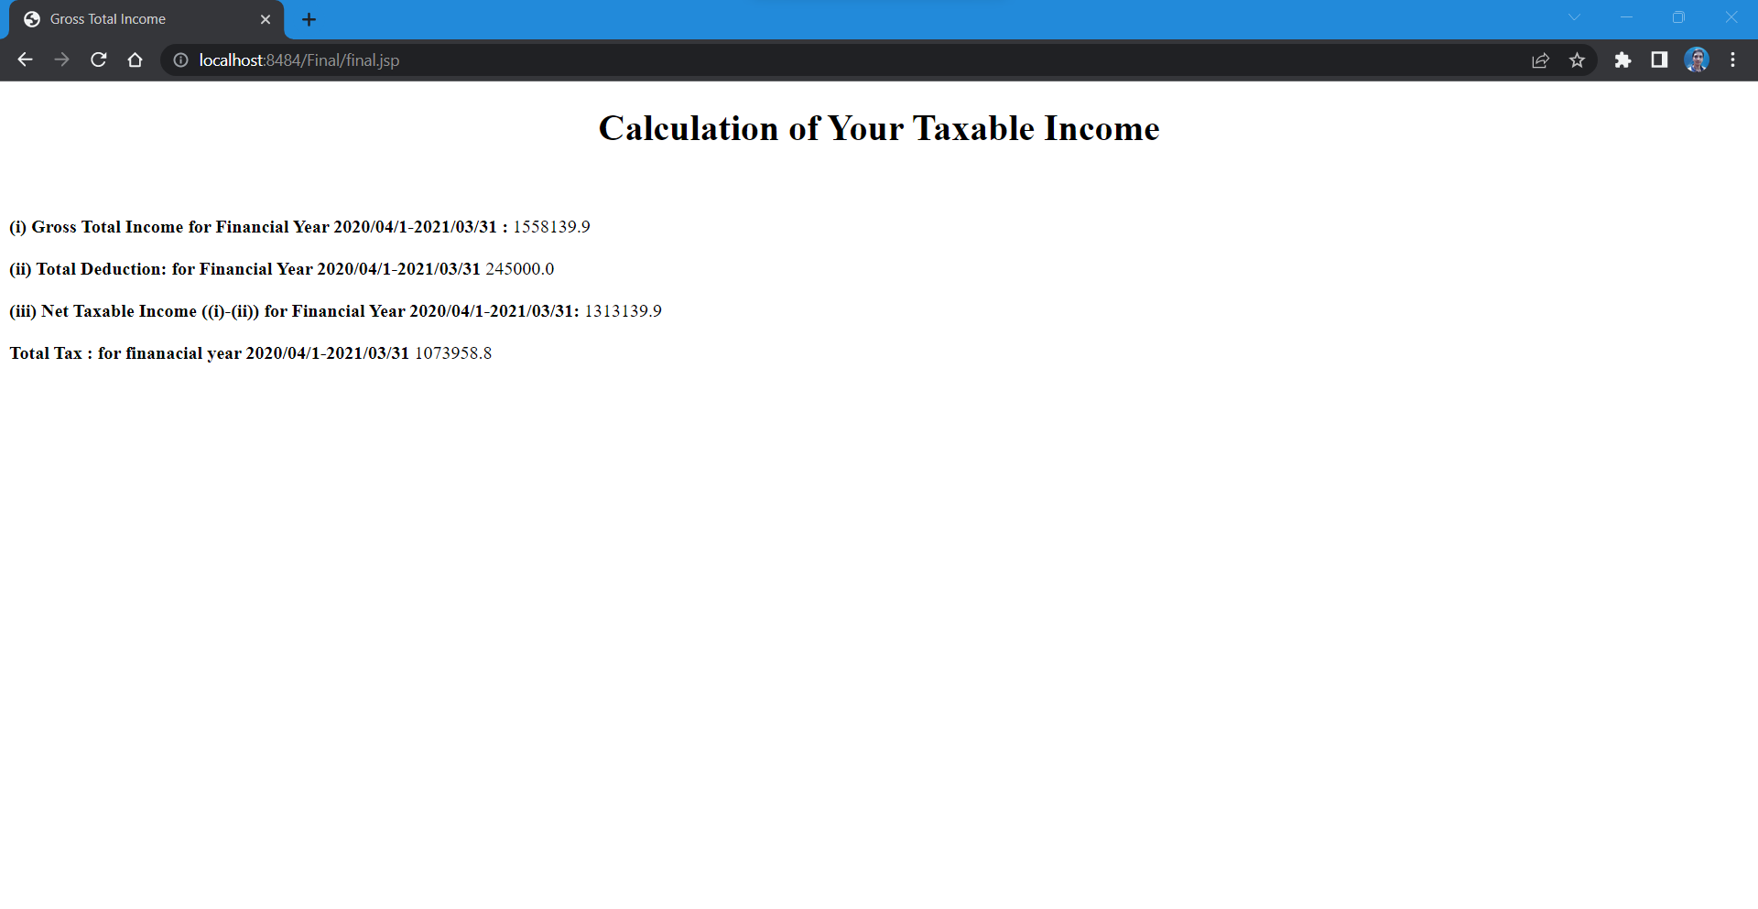
Connectivity After Retrieving Data

Slide 16
References
https://www.scconline.com/blog/post/tag/tax-database-management-system/
https://incometaxindia.gov.in/Pages/downloads/income-tax-return.aspx

Slide 17

Thank You

