Slide 1
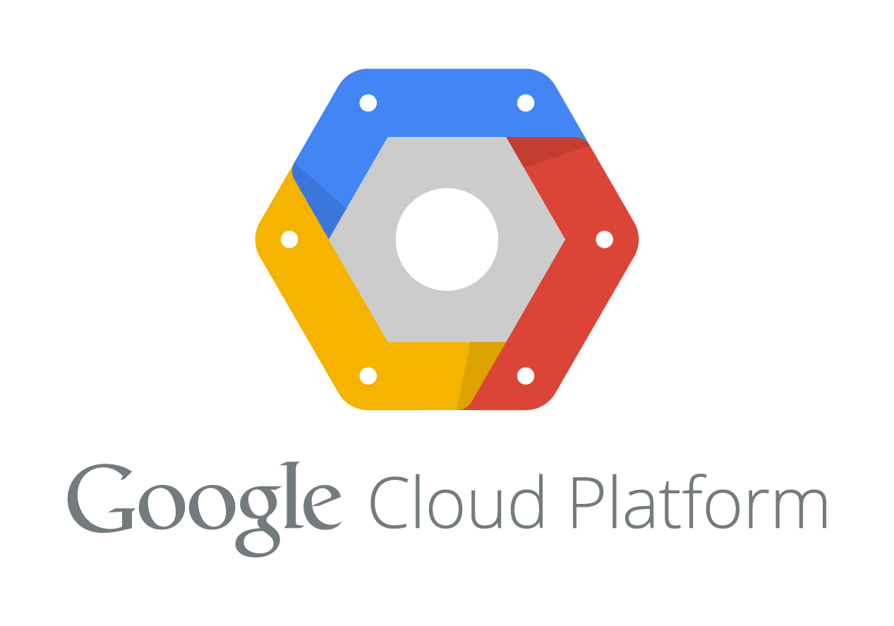
Migrating Ghost Blog to GCP Kubernetes
A High-Availability, Automated Solution for Efficiency and Scalability
Current Challenge: On-prem Ghost app with NGINX proxy and MySQL cluster across Test, Acceptance, Production environments
Goal: Migrate to public cloud Kubernetes, maximizing availability, isolation, and best practices
Proposed Benefits: Reduced ops overhead, auto-scaling, secure exposure, end-to-end automation
Presented by: [Karthikeyan] | Repo: https://github.com/karthik2fun/origoss.git

Slide 2
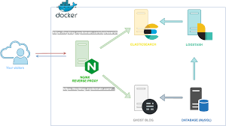
Current On-Prem Architecture
On-Prem Setup
  Ghost application hosted on VMs/containers
  NGINX as reverse proxy for traffic routing
  MySQL cluster for persistent data storage
  Environments: Test, Acceptance, Production (shared infrastructure, potential single points of failure)

Slide 3
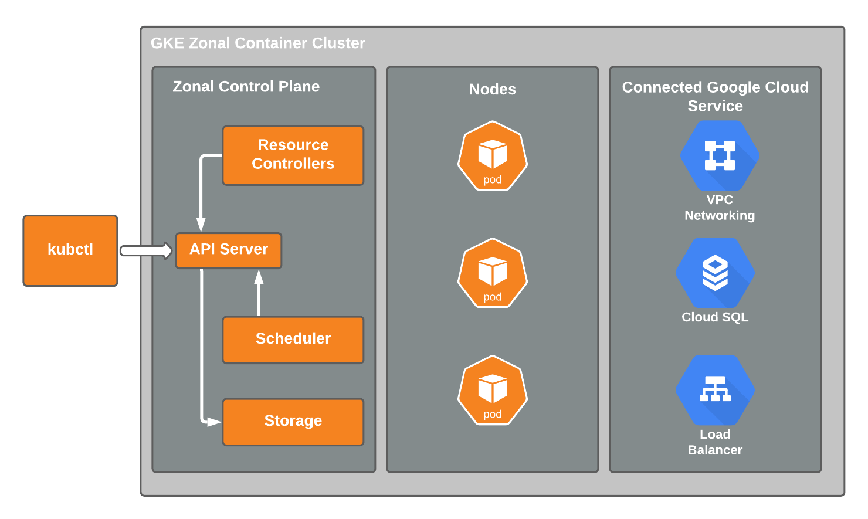
Proposed Cloud Architecture
High-Level Design:
  Google Kubernetes Engine (GKE) for managed Kubernetes
  Cloud SQL (MySQL) as external HA database with persistence
  NGINX Ingress for secure HTTPS exposure
  Separate GCP projects for Test, Acceptance, Production (workload isolation)
  Observability: Integrated Cloud Monitoring and Logging
  Focus: Maximize availability via regional clusters and auto-scaling

Slide 4
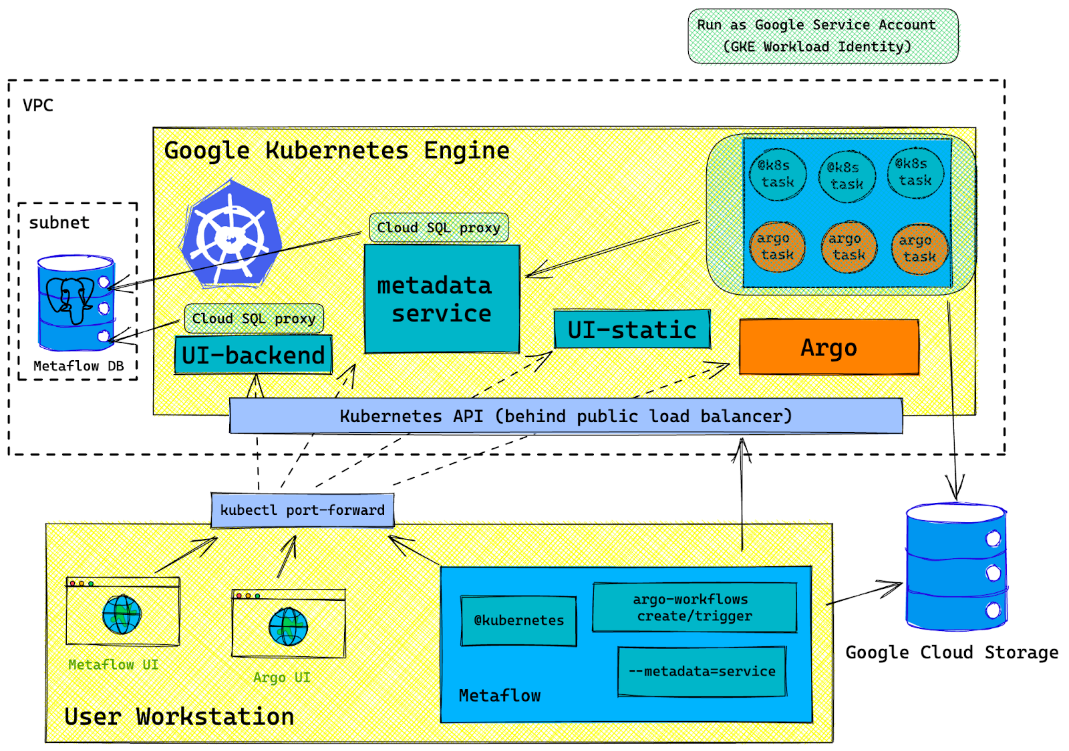
Key Components – Infrastructure
GKE: Managed Kubernetes as a Service – auto-upgrades, scaling, and security
Cloud SQL: External MySQL with automated backups, HA (multi-zone), and private access
Persistent Storage: PVCs for Ghost content (e.g., images/themes) backed by Persistent Disk
Alignment: Meets requirements for Kubernetes implementation, external DB, and persistence

Slide 5
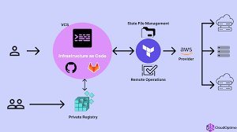
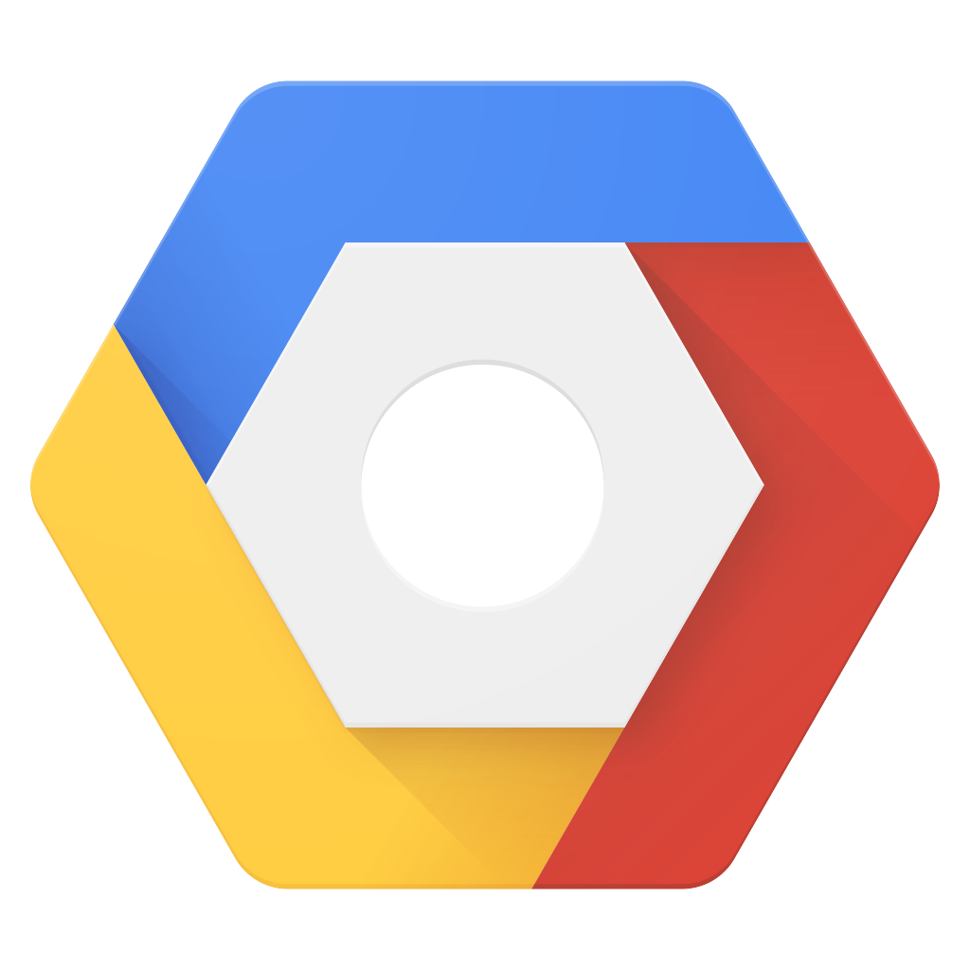
Key Components – Exposure and Automation
NGINX Ingress: Secure app exposure with HTTPS, load balancing
Argo CD: GitOps for declarative app deployments
Terraform: IaC for provisioning all infra from a single codebase
Alignment: Automates end-to-end process, incorporates IaC for reproducibility

Slide 6
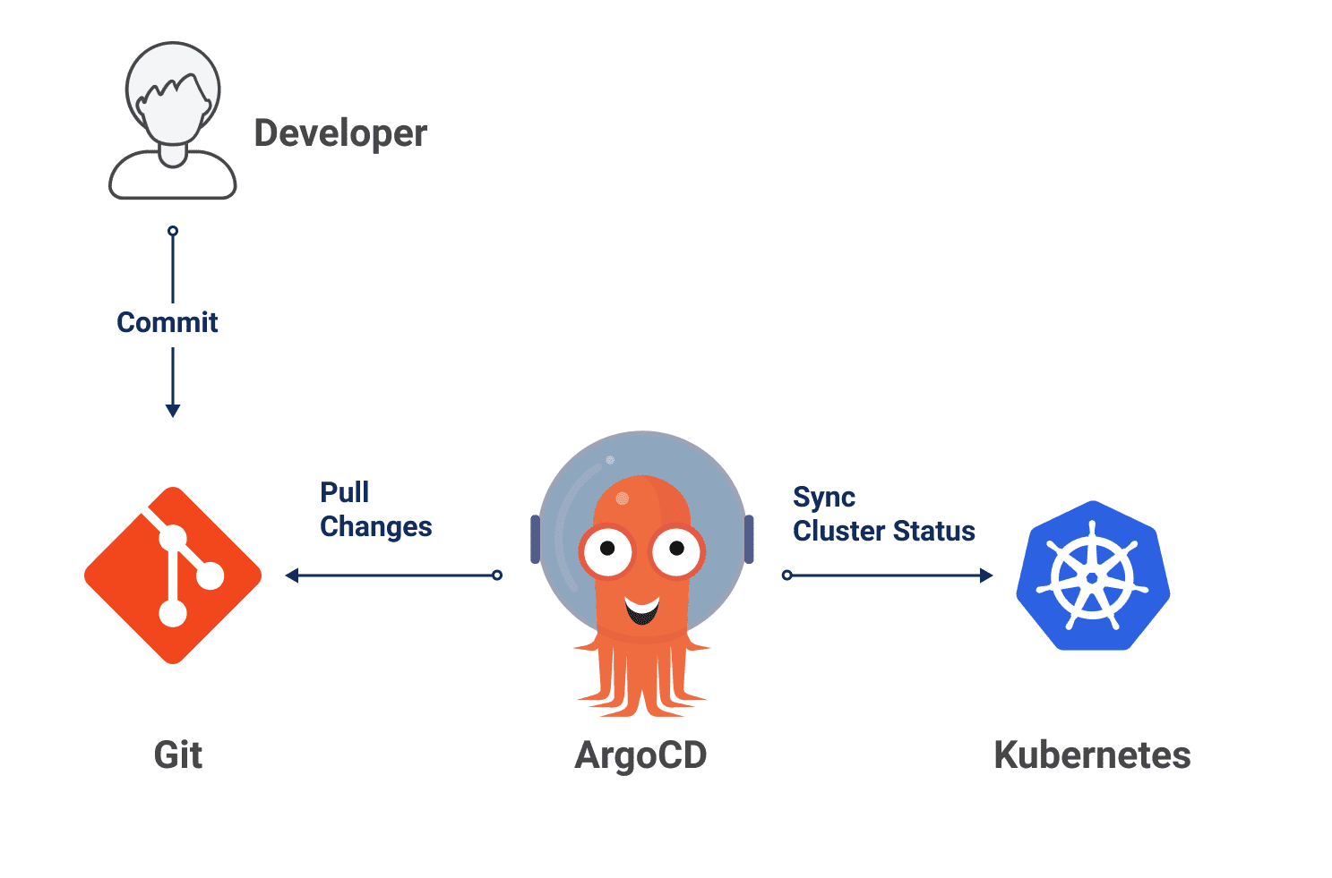
Deployment Process
Step-by-Step:
  Provision infra with Terraform (GKE, Cloud SQL, networking)
  Deploy Ghost via Helm charts in Argo CD (rolling updates, health probes)
  Git push triggers sync for apps across environments
  Benefits: Zero-downtime, version control, easy rollbacks

Slide 7
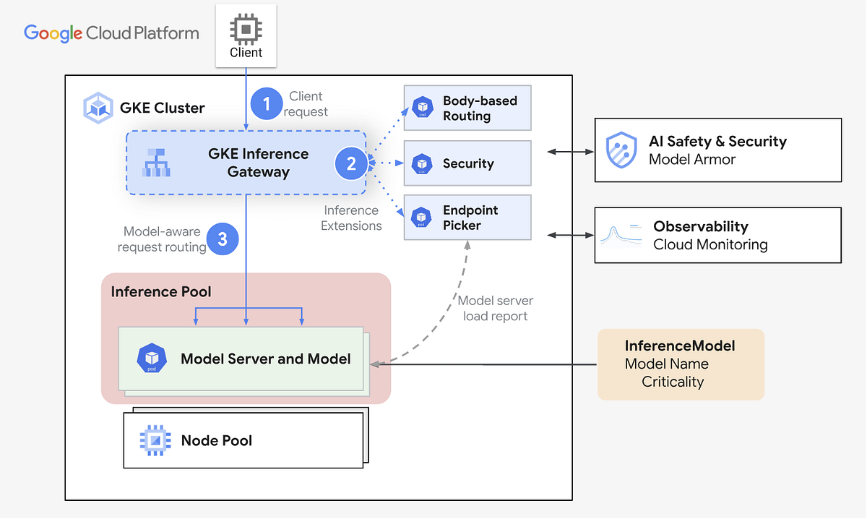
Security, High Availability, and Observability
Security: IAM roles, private VPC peering, Secrets Manager, HTTPS-only
HA: Regional GKE clusters, HA Cloud SQL, autoscaling pods
Observability (Extra): Cloud Monitoring for metrics, Logging for audits
Alignment: Enhances quality assurance and security per requirements

Slide 8
Future Enhancements and Estimates
Proposed Additions:
  Add Cert-Manager for auto-TLS: 1 day
  Integrate WAF (Cloud Armor): 2-3 days, for enhanced security
  Disaster Recovery (cross-region): 3-5 days
  Advanced Monitoring (Prometheus/Grafana): 2-4 hours

Slide 9
Why GCP?
~30% lower monthly cost
No Kubernetes control-plane fee
Stronger Kubernetes-native experience
Faster delivery with fewer moving parts
Simpler than AWS/Azure
GCP (Warsaw): ~€395 / month
AWS (Frankfurt): ~€550 / month

Slide 10
Q & A

