Slide 1
TITANIC SURVIVOR PREDICTION
USING LOGISTIC REGRESSION

Slide 2
INTRODUCTION
The sinking of the Titanic is one of the most imfamous shipwrecks in history.
In this challenge , we ask you to complete the analysis of what sorts of people were likely to survive
In particular , we ask you to apply the tools of machine learning to predict which passengers survived the tragedy

Slide 3
Goals And Objective
The purpose of this project is to document the process I went through
To create my predictions for titanic survivor prediction
The objective of this project was to build a classification model that could successfully determine whether a titanic passenger lived or died

Slide 4
LOGISTIC REGRESSION
Logistic regression is basically a supervised classification algorithm. In a classification problem , the target variable y , It can take only discrete values for given set of features x.
Some of the examples of classification problems are email spam or not spam , online transactions Fraud or not fraud .

Slide 5
IMPLEMENTATION
Importing the necessary libraries
Importing the dataset
Analyzing the dataset
Preprocessing the dataset
Building the model
Using Logistic Regression for making prediction

Slide 6
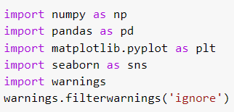
IMPORTING REQUIRED LIBRARIES

Slide 7

Loading datasets using pandas

Slide 8
Exploratory data analysis

Slide 9
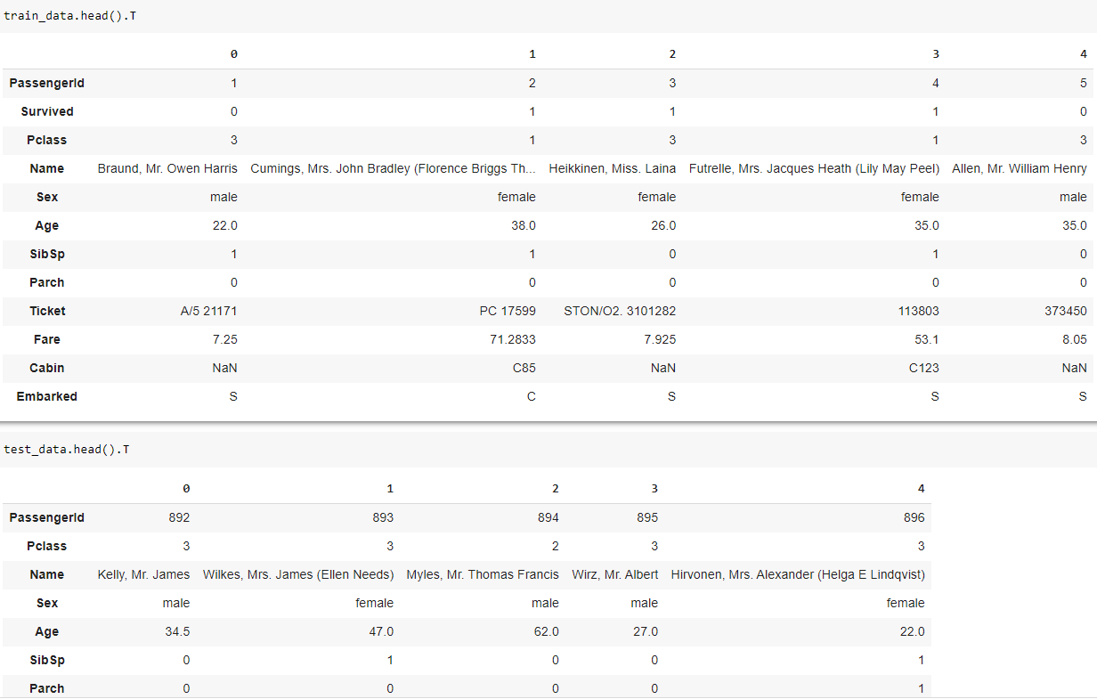
Checking features

Slide 10
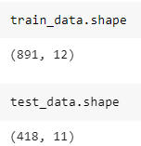
No. of features & no. of features

Slide 11
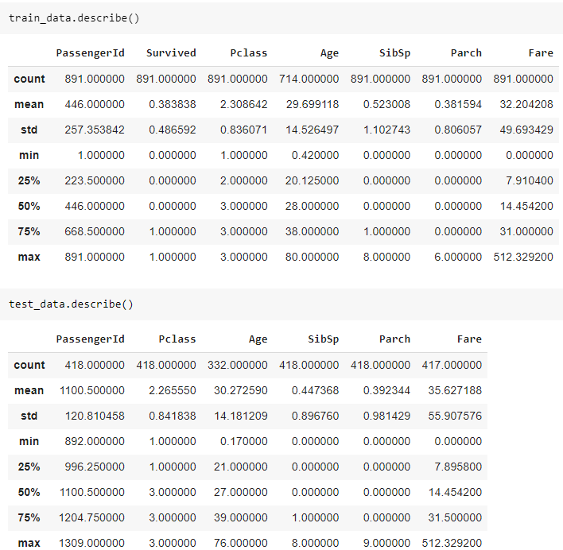
Basic Statistics on data

Slide 12
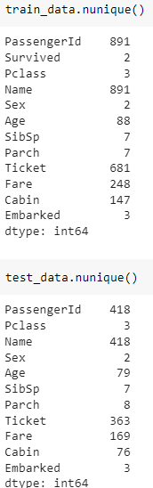
Unique values

Slide 13
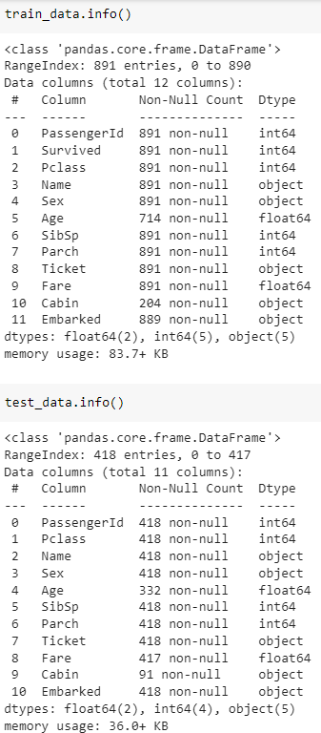
Info

Slide 14
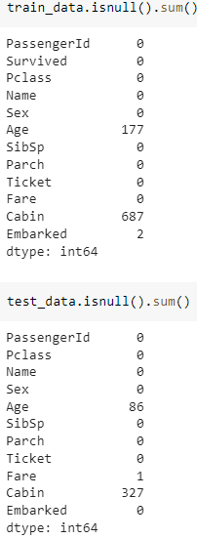
Null values count

Slide 15
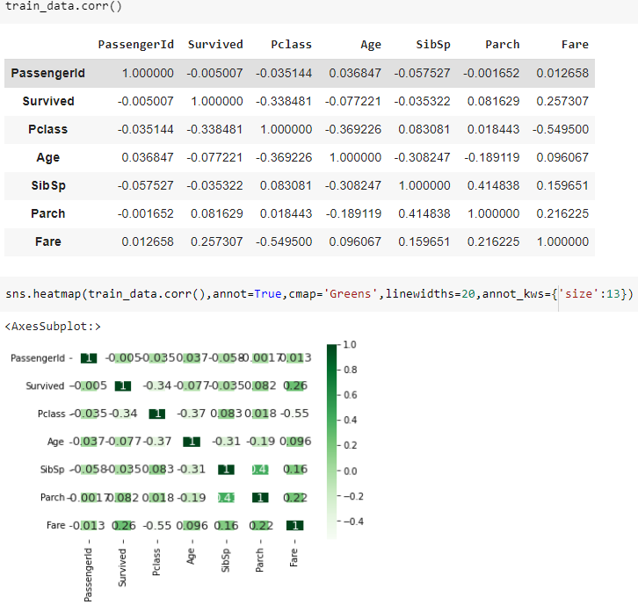
Correlation of train data

Slide 16
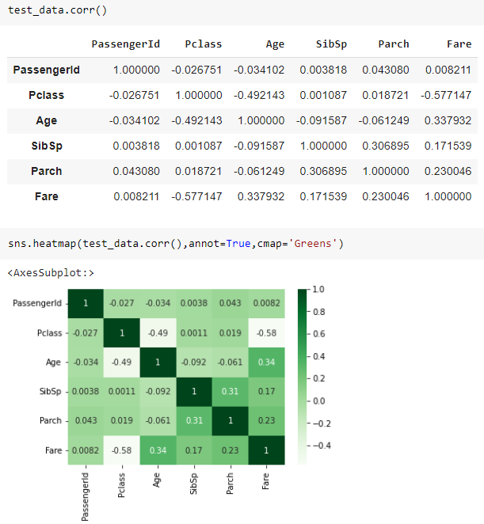
Correlation of test data

Slide 17
Data Preprocessing

Slide 18
why do we Drop Features
Reducing Overfitting
Impoving Model Performance
Reducing computational costs
Handling Multicollinearity

Slide 19
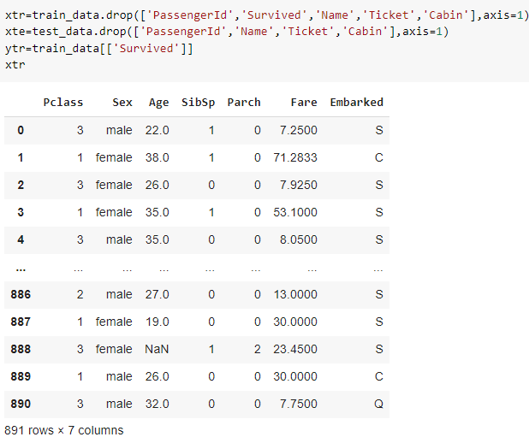
Droping features

Slide 20
Why do we separate columns
separating numerical and categorical columns is important because they require different types of preprocessing and handling in machine learning models. By treating them differently, we can improve the performance of the model and gain a better understanding of the data.

Slide 21
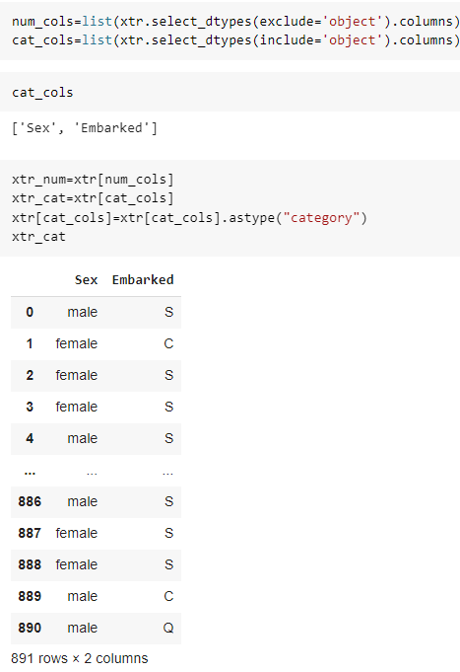
Separating numerical & categorical columns

Slide 22
Filling null values
There are several methods to fill null values in categorical data, and the choice of method depends on the data and the problem at hand.
The SimpleImputer is a class in scikit-learn library in Python that is used to impute missing values in a dataset using simple strategies. It works by replacing missing values with a constant value, the mean value, the median value, or the most frequent value (mode) of the column, depending on the chosen strategy.

Slide 23
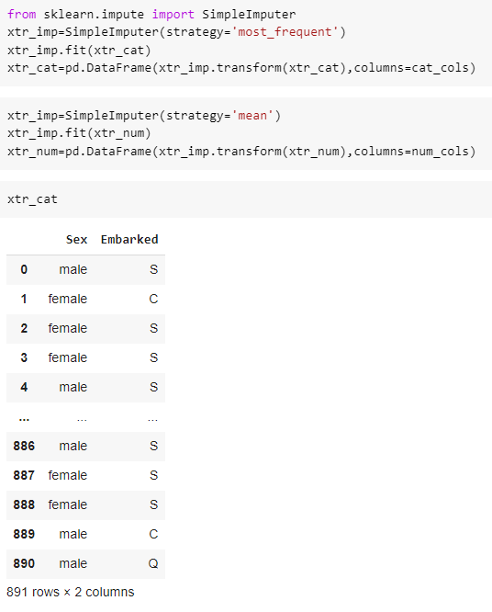
Filling null values

Slide 24
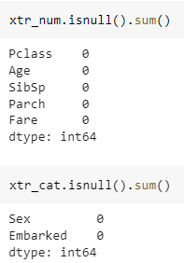
Checking null values count

Slide 25
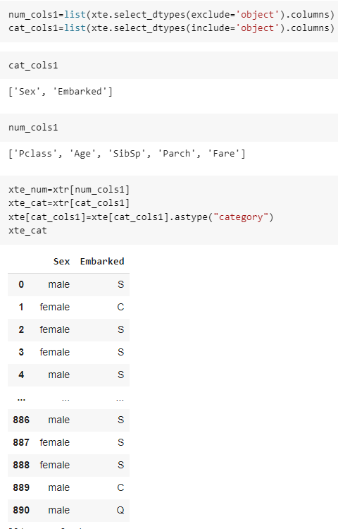

Slide 26
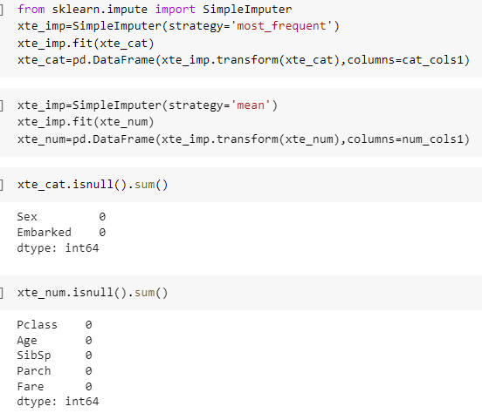

Slide 27
Why do we convert object columns into numbers ?
Because machine learning models typically require numeric data as input. Object columns contain non-numeric data, such as strings or categorical variables, that cannot be used directly as input to machine learning models.
Label Encoder :
LabelEncoder works by assigning a unique integer value to each category in a categorical variable. This allows categorical variables to be used as input to machine learning models that require numerical data.

Slide 28
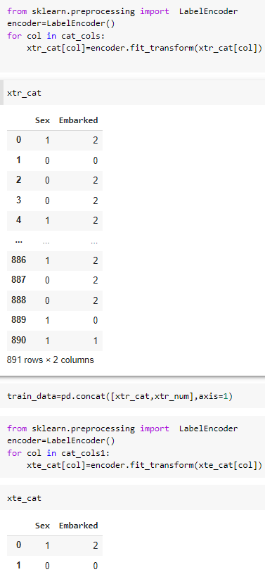
Converting categorical columns in to numerical

Slide 29
Why do we convert data between 0 to 1
In machine learning, scaling data between 0 and 1 is a common preprocessing step. This process is also known as normalization or min-max scaling. The main reason to perform this step is to ensure that all features have a similar scale, which can help machine learning models to learn patterns in the data more efficiently and accurately

Slide 30
MinMaxScaler
the MinMaxScaler works by scaling each feature in a feature vector to the range between 0 and 1. This can help to normalize the data and improve the performance of machine learning models that are sensitive to the scale of the features.

Slide 31
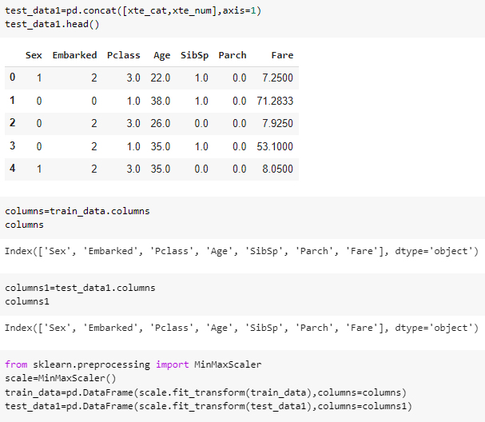
Concat columns & convert data bewteen 0 to 1

Slide 32
Why do we perform train_test_split ?
we perform a train-test split in machine learning to evaluate the performance of our model on new, unseen data and to avoid overfitting. It is a standard practice to split the data into a training set and a test set, and the evaluation on the test set is used to tune hyperparameters and evaluate the performance of the model.

Slide 33
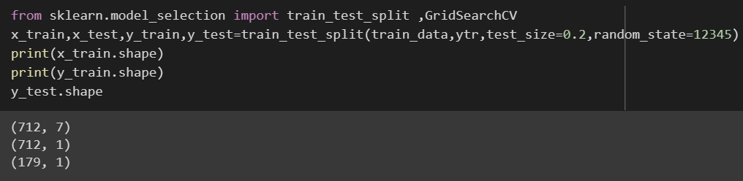
Train_test_split

Slide 34
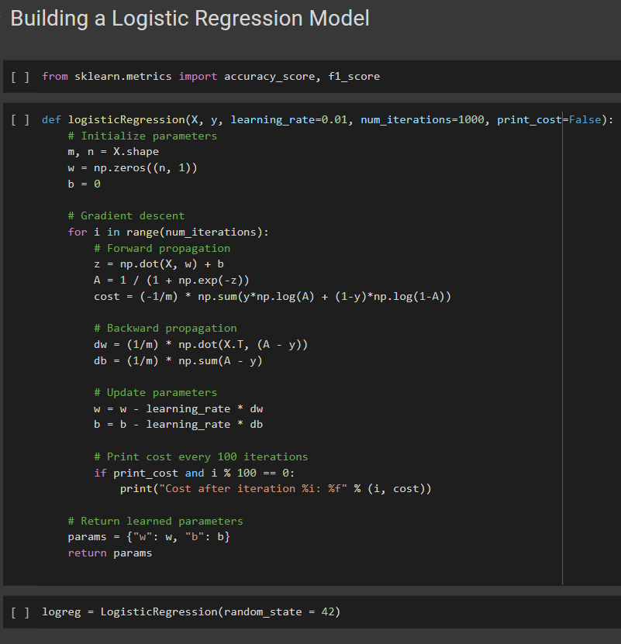

Slide 35
What are Hyperparameters
Hyperparameters are parameters that are set prior to the training of a machine learning model and cannot be learned from the data. They control various aspects of the training process, such as the size of the neural network, the learning rate, the regularization parameters, and so on

Slide 36
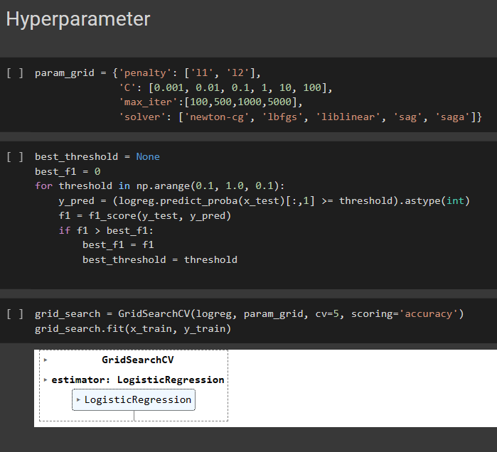

Slide 37
