Slide 1
LOGISTIC REGRESSION

Slide 2
DEFINITION
Logistic regression is used when the dependent variable is binary or categorical , and the goal is to predict the probability of an event occurring.

Slide 3
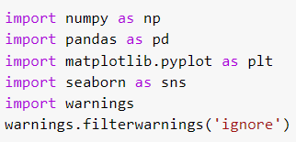
IMPORTING REQUIRED LIBRARIES

Slide 4

Loading datasets using pandas

Slide 5
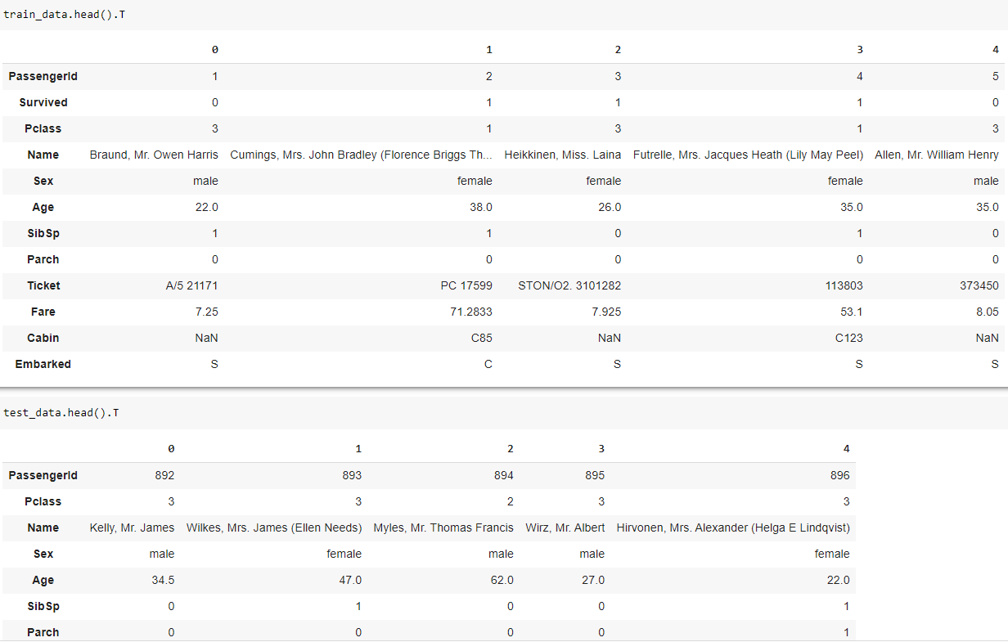
Checking features

Slide 6
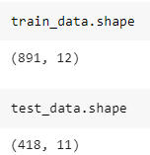
No. of features & no. of features

Slide 7
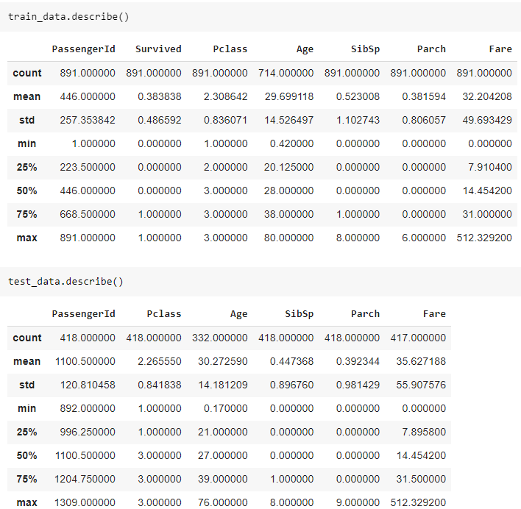
Describing regarding the data

Slide 8
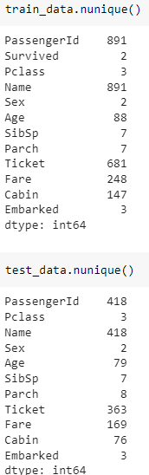
Unique values

Slide 9
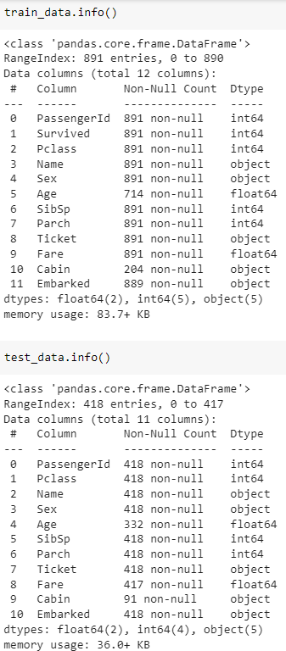
Info

Slide 10
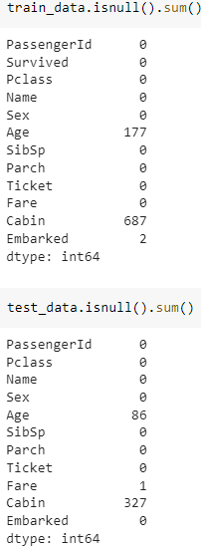
Null values count

Slide 11
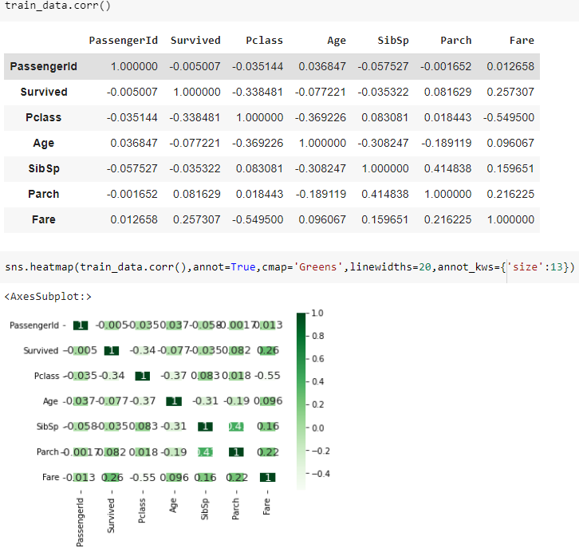
Correlation of train data

Slide 12
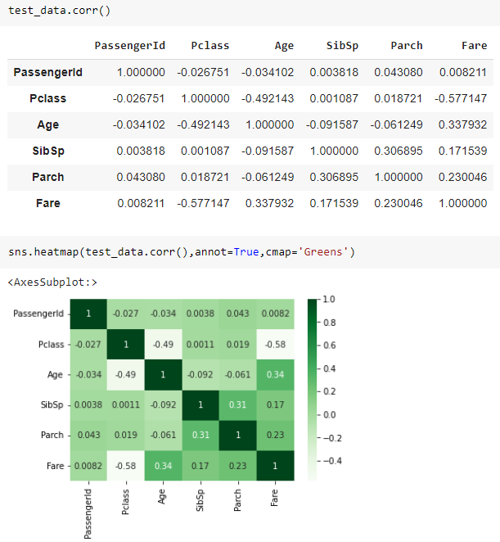
Correlation of test data

Slide 13
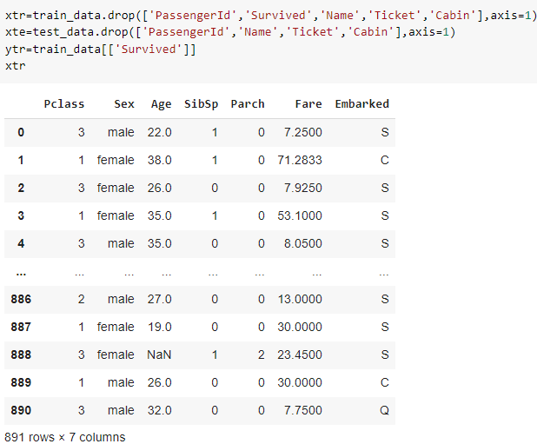
Droping features

Slide 14
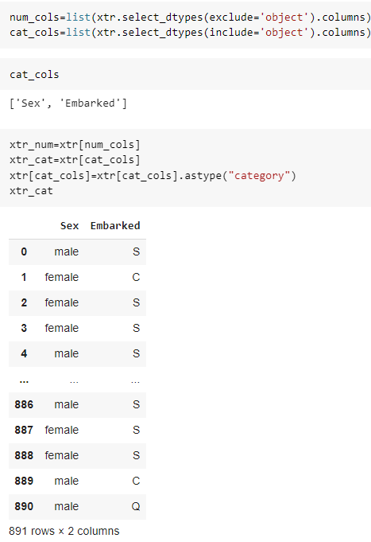
Seperating numerical & categorical columns

Slide 15
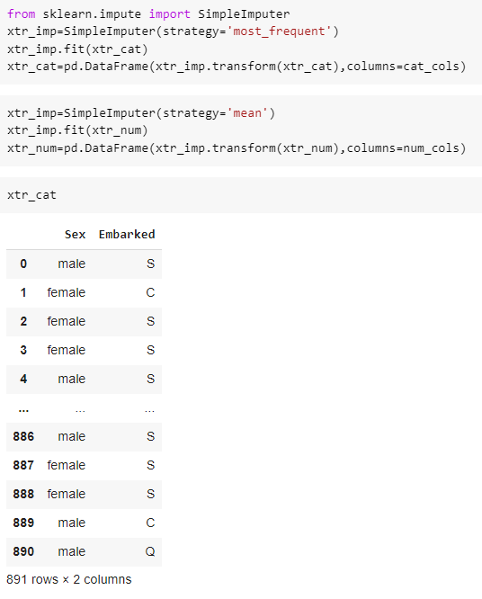
Filling null values

Slide 16
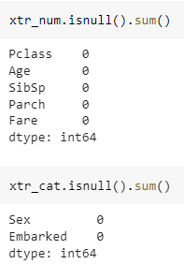
Checking null values count

Slide 17
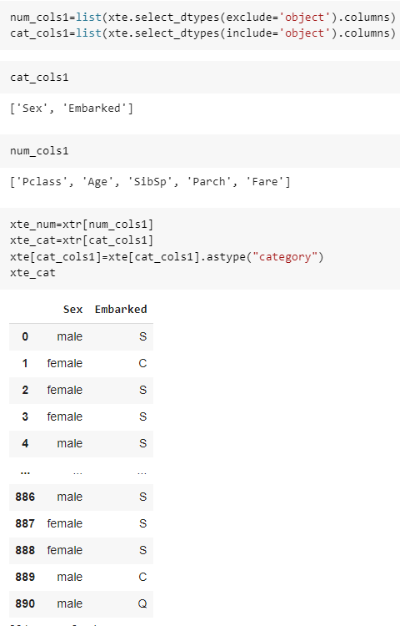

Slide 18
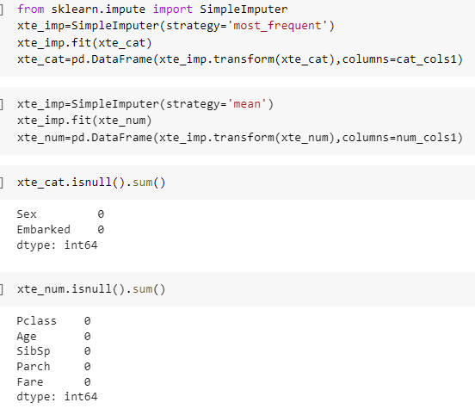

Slide 19
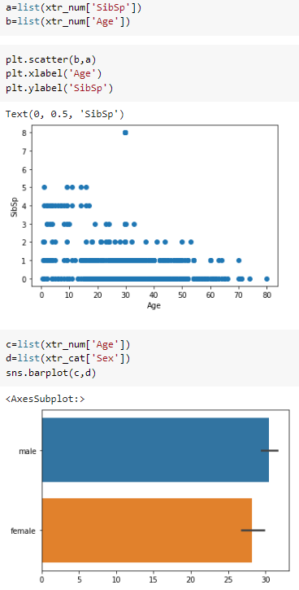

Slide 20
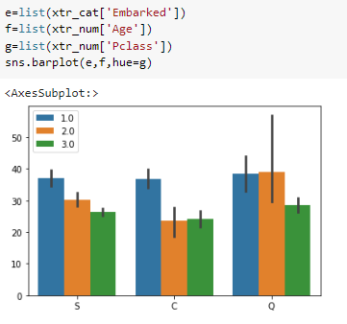

Slide 21
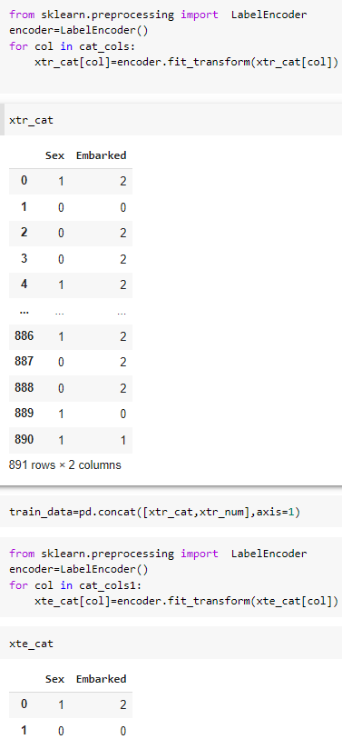
Converting categorical columns in to numerical

Slide 22
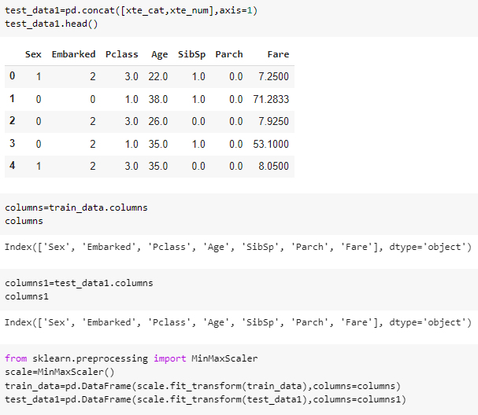
Concat categorical & numerical columns and convert data bewteen 0 to 1

Slide 23
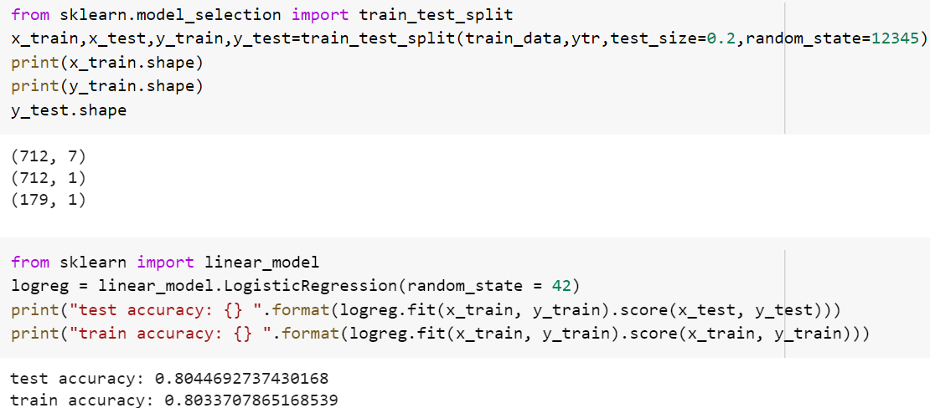
Train_test_split , building a linear Regression Model & evaluating accuracy

