Slide 1
SMART IRRIGATION SYSTEM
Team members:
1.Karthik.T
2.Kavya Lenin
3.Mahesh Raj.R
Department of CSE, KGiSL Institute of Technology, Coimbatore

Slide 2
SMART IRRIGATION SYSTEM
IRRIGATION: Irrigation is the application of controlled amounts of water to plants at needed intervals.
Irrigation helps to grow agricultural crops, maintain landscapes
Smart irrigation is the use of a device to operate irrigation structures so the change of flow of water from one bay, or set of bays, to another can occur in the absence of the irrigator.
The irrigator may need to spend time preparing the system at the start of the irrigation and maintaining the components so it works properly.

Slide 3
Abstract
IOT based SMART IRRIGATION SYSTEM can help in achieving optimum water resource utilization in the precision of farming landscape .This project mainly describes about an open source technology by sensing the ground parameter sensors such as HUMIDITY,TEMPERATURE,WIRELESS MOISTURE,WATER LEVEL. This was mainly a pure concept of IOT how the system monitor these sensors and tends to an result. The main aim of sensing the sensor was purely based on agriculture process. IOT is a bridging master of sensing using hardware. Wireless moisture sensor reduces the risk of laying wires in the land. Camera based and sound based bug detection help in securing the plants from bug. The complete system was based on development of sensing and monitoring the crops by concept of IOT. The System was based on irrigation so that the water flow can be controlled and reduced. The system only checks for the level of water by using these sensors and gives a effective result. Therefore, the system is predicting on application based sensors mainly to detect the water and save water in the field of agriculture.
Department of CSE, KGiSL Institute of Technology, Coimbatore

Slide 4
Area Introduction-Existing system
AGRICULTURAL AND MONITORING DRIP IRRIGATION USING IOT
Drip irrigation is quickly becoming the standard irrigation method for many applications such as home gardens and landscapes, greenhouses, vineyards, row crops and orchards.
In the existing they use sprinklers where to reduce the flow of water.
They directly send it to the roots of the crops or directly to the soil.
Department of CSE, KGiSL Institute of Technology, Coimbatore

Slide 5
Proposed System
ADVANTAGES OVER EXISTING SYSTEM
Crops do differ on water levels
Wireless moisture sensor reduces the risk of laying wires in the land
Camera based and sound based bug detection help in securing the plants from bugs.
HOW DO WE DIFFER FROM EXISTING PROJECT
Our goal is to set different level of water for different crops based on their water needs
Accurate and automatic bug detection
Department of CSE, KGiSL Institute of Technology, Coimbatore

Slide 6
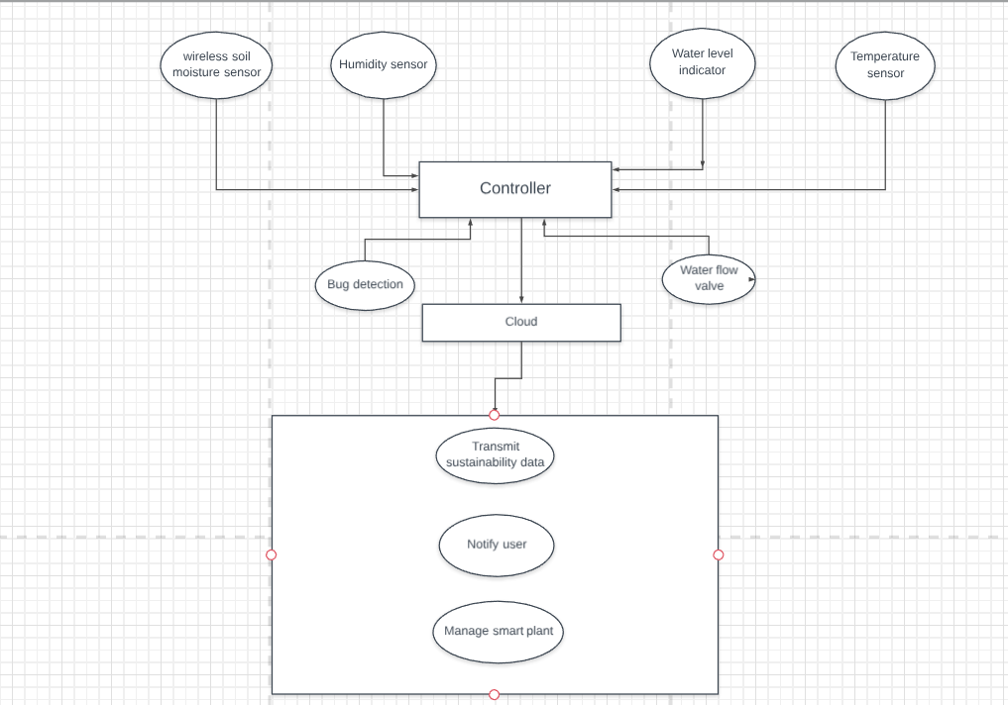
FLOW DIAGRAM

Slide 7
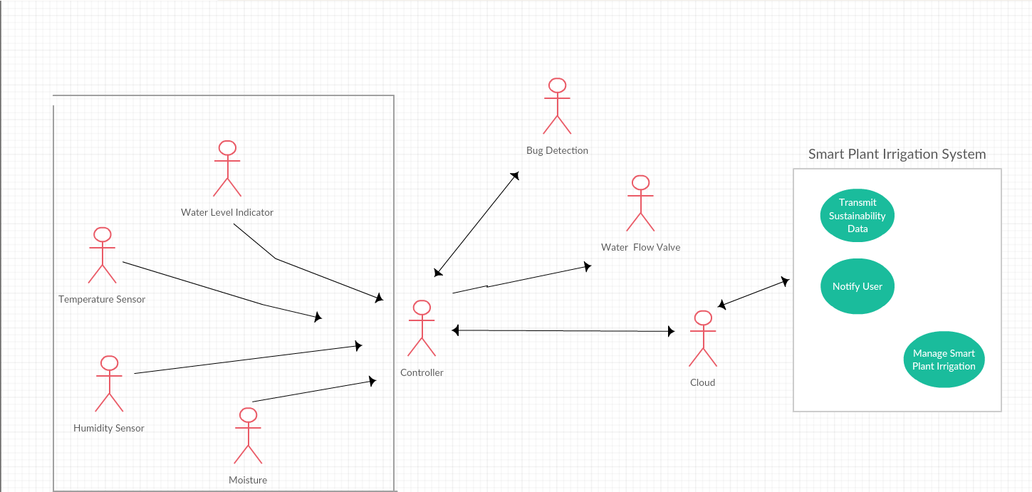
Working module

Slide 8
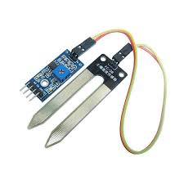
WIRELESS SOIL MOISTURE SENSOR(we are going to implement wireless sensor using NODEMCU integration with esp8266

Slide 9
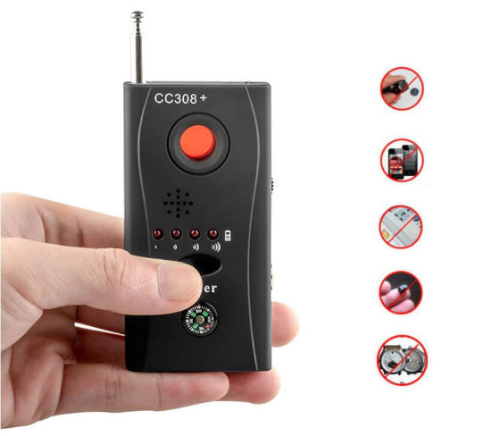
CC308 MULTIFUNCTION CAMERA

Slide 10
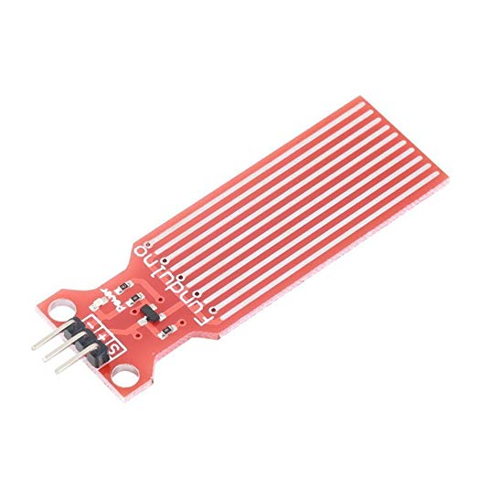
WATER LEVEL DETECTION

Slide 11
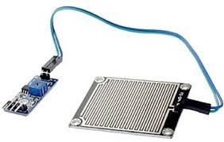
RAINDROP DETECTION SENSOR

Slide 12
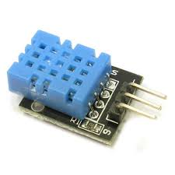
TEMPERATURE AND HUMIDITY SENSOR
DHT11 Temperature and Humidity Sensor. ThisDHT11 Temperature and Humidity Sensor features a calibrated digital signal output with the temperature and humidity sensor capability. It is integrated with a high-performance 8-bit microcontroller. Its technology ensures the high reliability and excellent long-term stability ...

Slide 13
MODULES
Sensors and controller integration
Bug detection module
Sensor data to cloud integration
Smart irrigation app module

Slide 14
Literature Review
References
www.ijana.in/papers/V9I6-8.pdf
www.iosrjournals.org/iosr-javs/papers/vol7-issue4/
An IOT based smart irrigation management system using Machine learning
and open source technologies.
Department of CSE, KGiSL Institute of Technology, Coimbatore

Slide 15
REVIEW
In Irrigation field, soil moisture , temperature are placed in the root of plants and microcontroller devices.
One algorithm was developed to measure the threshold value of sensors that was programmed into microcontroller to control water quantity.
Various sensors were placed in the field and mainly developed to propose the need of farmers and give information to them through cellular phone and if water reaches dangerous level the farmer should off the motor

Slide 16
THANK YOU

