Slide 1
A Network Flow-Based Approach for Post-Merger Airline Hub Consolidation
Robert Karp and Karthik Rao
Notes:
Both

Slide 2
Introduction
INTRODUCTION METHODS RESULTS DISCUSSION
Air Navigation serves to ensure safety and efficiency
Regulated by FAA [7]
Cause of concern for consumers
2013 Department of Justice (DOJ) complaint [15]
Post-merger network consolidation
http://www.bostonglobe.com/business/2013/04/02/airline-mergers-bring-stability-industry/OPsPBPjpwQU1oDwaudLUeK/igraphic.html
Notes:
Rob’s Slide (1)
Business efficiency + capacity utlization

Slide 3

Introduction
INTRODUCTION METHODS RESULTS DISCUSSION
Research examined 2008 Delta/Northwest merger
Evaluated with statistical and optimization techniques
Statistical technique (logistic regression) [6]
Network flow-based decision support tool (linear programming)
http://en.wikipedia.org/wiki/Delta_Air_Lines%E2%80%93Northwest_Airlines_merger
Notes:
Rob’s Slide (2)
For example: Logistic Regression
Solved through linear programming - optimization

Slide 4
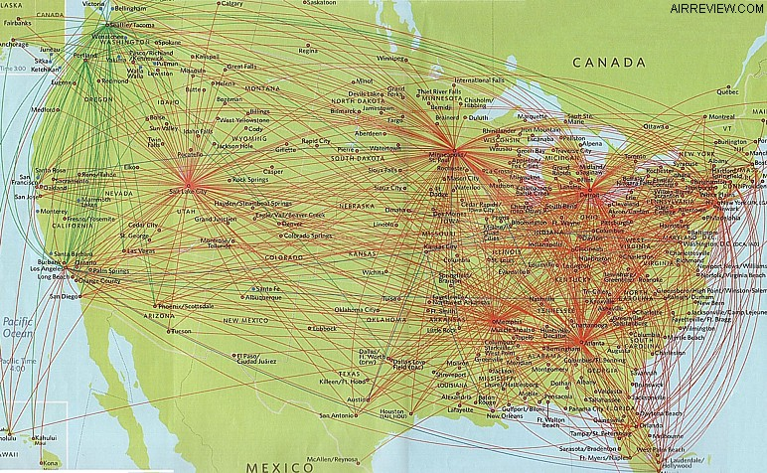
The Goals
INTRODUCTION METHODS RESULTS DISCUSSION
Design optimal post-merger network
Minimize network operational cost
Identify potential new hub cities/underutilized hubs
http://worldairlinenews.com/tag/a320211/
Delta/Northwest Post-Merger Network
Notes:
Karthik’s Slide (1)
Start with the picture:
Goal of this research is to use optimization techniques to understand how this done.
our 3 goals: bullets

Slide 5
Project Overview
INTRODUCTION METHODS RESULTS DISCUSSION
Data collection from Diio Mi
Design logistic regression
Design network-flow model for airline mergers
Linear programming formulation
Solving the linear programming problem
Comparative Analysis: Cost and Structure
Validated model through hub predictions
Notes:
Rob’s Slide (3)

Slide 6
1. Data Collection from Diio Mi
INTRODUCTION METHODS RESULTS DISCUSSION
Diio Mi database (Delta Air Lines)
Published by the Department of Transportation (DOT)
Airline performance metrics: Q2 2007/Q2 2013
Data Set 1: Passenger Demand
Metrics: passenger & revenue/route/day
Data Set 2: Capacity
Load factor & passenger demand by route
Notes:
Rob’s Slide (4)

Slide 7
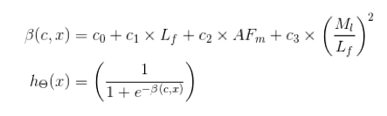
2. Logistic Regression
INTRODUCTION METHODS RESULTS DISCUSSION
Preliminary tool to model capacity reductions decisions
Industry Metrics:
L_{F} : Load Factor; AF_{m} : Average Fare/Mile; M₁: Percent Mainline
Decisions are route-specific; independent of network
Notes:
Karthik’s Slide (2)
Add the other picture: point out the factors in the equation
Define the metrics
These industry metrics were used as factors for the logistic regression model.
LF: percentage of airline that is filled at departure
Afm: average fare realized on a per mile basis for a given route
M1: percentage of aircrafts that are airline aircrafts

Slide 8
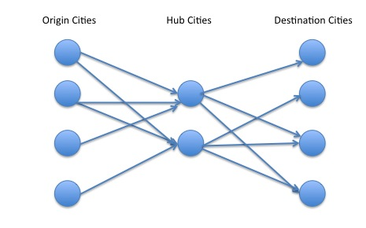
3. A Network Flow-Model for Airline Mergers
INTRODUCTION METHODS RESULTS DISCUSSION
Transportation problem
Tripartite graph
Flow Value (passengers): 148,052; Nodes: 212; Edges: 1,812
Origin
Destination
Hub
Source
Sink
Notes:
Rob’s Slide (5)
Choose a subset of the network:

Slide 9
3. Graph Attributes
INTRODUCTION METHODS RESULTS DISCUSSION
Capacity on an edge
Load factor
Passenger demand
Demand per node
(Flow in) – (Flow out) = const
Cost on an edge
Cost per seat
Origin
Hub
Destination
(15, $30)
(20, $35)
0
0 – Demand for node
15 – Capacity for edge 1
$30 – Unit cost for edge 1
20 – Capacity for edge 2
$35 – Unit cost for edge 2
Notes:
Karthik’s Slide (3)
Modify image with the hub representation
Cost per seat on a given route.

Slide 10
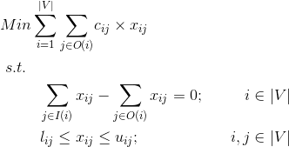
4. Linear Programming Formulation
INTRODUCTION METHODS RESULTS DISCUSSION
Optimization objective: minimize cost
Out-Edges (O(i))
Node I
Node J
e_{ij}
In-Edges (I(i))
X_{ij} – decision variables: flow on edge e_{ij} (node i to j)
Constraint 1: Preservation of flow for each node
Constraint 2: 0 ≤ X_{ij} ≤ capacity
Notes:
Karthik’s Slide (4)
Linear Programming formulation for the transportation network problem: just described
Optimization objective: minimize total cost from moving passengers from source to sink (flow through the network)
Start with the picture: flow on any given node
Preservation of flow

Slide 11
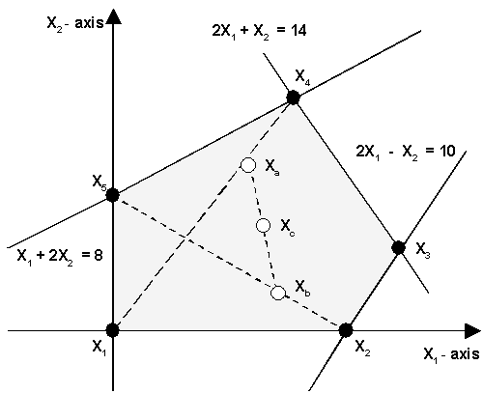
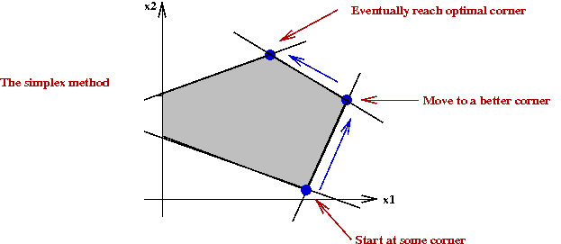
5. Solving the Linear Programming Problem
INTRODUCTION METHODS RESULTS DISCUSSION
Interior-Point Algorithm [14]
Moves from inside the created polyhedron
Polynomial Time
Simplex Algorithm [14]
Moves along edges of polyhedron
Exponential Time: Average polynomial run-time
http://home.ubalt.edu/ntsbarsh/opre640a/nonlinear.htm
http://www.seas.gwu.edu/~simhaweb/champalg/tsp/tsp.html
Notes:
Karthik’s Slide (5)
Solvers work on the polyhedral created by the constraints.
Practical both very competitive: theoretical properties better for worst case

Slide 12

6. Comparative Analysis: Cost
INTRODUCTION METHODS RESULTS DISCUSSION
Lin Prog Cost: 100%, 90%, 80%
Cost of flow from linear programming formulation
Delta’s Cost
Estimated cost of flow from post-merger Delta network
Notes:
Karthik’s Slide (6)
We considered different scenarios for upper bound capacities on the edges, which correspond to these three LF’s. shown in the 3 rows in the table
The the estimated cost of flow is based on Delta’s observed post-merger network, hence it is insensitive to the scenarios
All cases, LP cost finds a lower-cost solution for the post-merger network
this illstruates that an LP formulation is able to identify lower cost flow for the post-merger network. However we need to be careful about the cost comparisons because we may have not captured all the operational constraints.

Slide 13
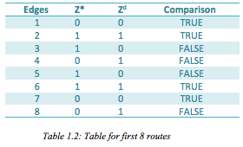
6. Comparative Analysis: Structure
INTRODUCTION METHODS RESULTS DISCUSSION
30% capacity reduction: YES (1) or NO (0)
Z*: Linear programming model prediction
Z^{d}: Actual Delta post-merger decision
Route by route comparison: 55% match accuracy
Notes:
Karthik’s Slide (7)
statistcal level this is fairly significant level, we might observe a higher match accuracy if we had considered the international network, aircraft utilization and geographical constraints.

Slide 14
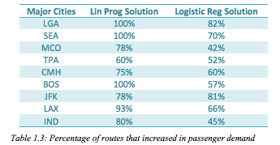
7. Cities That Gain Hub Status
INTRODUCTION METHODS RESULTS DISCUSSION
Potential hubs: La-Guardia, Seattle, Boston
100% of routes increase in capacity
Actual hubs: La-Guardia (2011), Seattle (2014)
Notes:
Rob’s Slide (6)
Another useful approach to analyze the results would be to evaluate the results at the macro level
Logistic Regression solution does not provide any consistent measure by which we can identify cities to be hubbed.
We identify cities that gain hub status by looking at what fraction of the routes into the hub increase in capacity. It if it is 100% we consider it a potential hub. This measure was based on pre-merger network data.
Now, look at table, based on the analysis from lin prog solution, three cities jump out that satisfy this criteria, LGA, SEA, BOS. In comparison, the logistic regression does show a onsistent threshold for hub status.
Talk about seattle and lga validation
Talk about bos

Slide 15
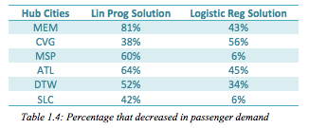
7. City That Lost Hub Status
INTRODUCTION METHODS RESULTS DISCUSSION
Potential de-hub: Memphis
At least 70% routes lost capacity
Actual de-hub: Memphis (2013)
Notes:
Rob’s Slide (7
Based on a threshold to suggest de-hubbing and hubbing cities – based on analysis from pre-merger data
We identify cities that lose hub status by looking at what fraction of the routes into the hub decrease in capacity. It if it is at least 70% we consider it a potential candidate for de-hub status. Again, This measure was based on pre-merger network data.
Now, looking at the table we focused on the six pre-merger delta/northwest hubs. It is evident that memphis is the only hub that meets this criteria.
Again, the linear porgramming solution shows a consistent threshold level for de-hubbing, while the logistic regression does not.
Talk about memphis actually being de-hubbed

Slide 16
Significance
INTRODUCTION METHODS RESULTS DISCUSSION
Publicly available analysis tool for mergers
Useful characterization to identify hub status
Capacity optimization for post-merger consolidation
Limitations
Geographic relationship of nodes (LGA and BOS)
Aircraft utilization
International network
Notes:
Karthik’s Slide (8)
Provide an analysis of mergers using publicly available data that does not rely on proprietary information and models from the airlines
Based on pre merger data the analysis tool provides a useful characterization of how to determine hub status for cities in a post-merger network.
Capacity adequately captures the considerations that go into post-merger network consolidation.
Aircraft utlization: relate to fleet strategy

Slide 17
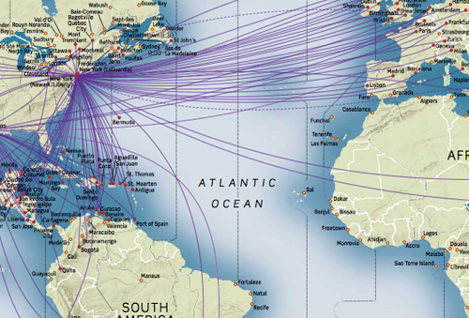
Future Research
INTRODUCTION METHODS RESULTS DISCUSSION
Expand model reach
International network
Class of service
Geographical considerations
Consumer preferences
Competitive scheduling
Passenger demand/fare changes
http://www.jaunted.com/files/6193/RouteMaps.jpg
Notes:
Rob’s Slide (8)

Slide 18
References
[1] Ahuja, Ravindra K., Thomas L. Magnanti, and James B. Orlin. Network Flows: Theory, Algorithms, and Applications. Englewood Cliffs, NJ: Prentice Hall, 1993. Print.
[2] Bazaraa, M. S., and John J. Jarvis. Linear Programming and Network Flows. New York: Wiley, 1977. Print.
[3] Chvátal, Vašek. Linear Programming. New York: W.H. Freeman, 1983. Print.
[4] Clark, Robert, and Nicolas Vincent. "Capacity-contingent Pricing and Competition in the Airline Industry." Journal of Air Transport Management 24 (2012): 7-11. Web.
[5] "Delta to Cut Flights, De-Hub Memphis." Memphis Daily News. Web. <http://www.memphisdailynews.com/news/2013/jun/5/delta-to-cut-flights-de-hub-mem/>.
[6] Holloway, Stephen. Straight and Level: Practical Airline Economics. Aldershot, Hants, England: Ashgate, 1997. Print.
[7] Liang, Jiajun. "What Are the Effects of Mergers in the U.S. Airline Industry? An Econometric Analysis on Delta-Northwest Merger." The Macalester Review 1.3 (2013). Print.
[8] "Max_flow_min_cost." Max_flow_min_cost — NetworkX 1.7 Documentation. Github. Web. <http://networkx.lanl.gov/reference/generated/networkx.algorithms.flow.max_flow_min_cost.html>.
[9] "News Archive." Delta Adds More Service to Support International Gateway in Seattle. Web. <http://news.delta.com/2013-12-17-Delta-Adds-More-Service-to-Support-International-Gateway-in-Seattle>.
[10] "News Archive." Delta Unveils Schedule for New Domestic Hub at New York's LaGuardia Airport. Web. <http://news.delta.com/index.php?s=20295&item=123849>.
[11] Nicolau, Juan Luis. "Testing Prospect Theory in Airline Demand." Journal of Air Transport Management 17.4 (2011): 241-43. Web.
[12] Obeng, K., and R. Sakano. "Airline Fare and Seat Management Strategies with Demand Dependency." Journal of Air Transport Management 24 (2012): 42-48. Web.
[13] "Overview — NetworkX." Overview — NetworkX. Github. Web. <https://networkx.github.io/>.
[14] "Solve Linear Programming Problems." Solve Linear Programming Problems. Mathworks. Web. <http://www.mathworks.com/help/optim/ug/linprog.html>.
[15] United States. Department of Justice. District Court for the District of Columbia. Case 1:13-cv-01236. 13 Aug. 2013. Web.

Slide 19
Recap
Major Findings
Successfully predicted three important hub status changes in the Delta post-merger network using a network transportation model
Acknowledgements
We would like to thank our mentors, Dr. David Steadman and Dr. Jayant Kalagnanam for all of their support and guidance throughout the project. Also, this project would not be possible without the continued support from our teachers and parents.

