Slide 1

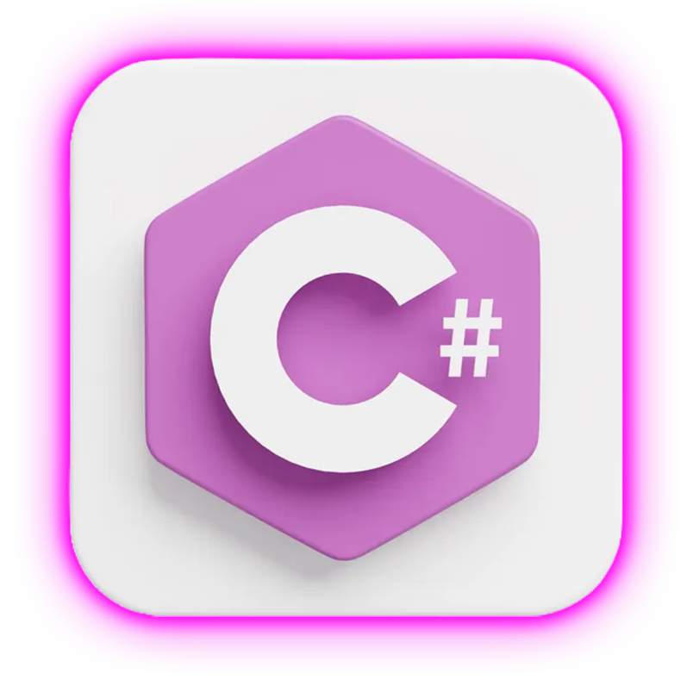
Linq for .Net Developers
LINQ Query & Method Syntax with Objects, XML, JSON, DataSets, and Entity Framework

Slide 2

Course Content
Linq Purpose
Linq to Object
Linq to XML
Linq to Dataset
Linq to Entities
Linq to Json
Standard Query Operators
Filters
Projection Operations
Set Operations
Sorting
Element Operations
Aggregate Operations
Quantifier Operations
Partitioning
Join Operations
Grouping

Slide 3
What is LINQ?
LINQ = Language Integrated Query
Not a database feature ❌
LINQ is a set of C# language features
Allows you to query, filter, transform, and aggregate data from different data sources
Linq
Object
XML
Dataset
Entities
Json

Slide 4
Types of Linq Syntax
Linq Query
Linq Method
Method Syntax
Query Syntax

Slide 5
Query Syntax vs Method Syntax
 | Query Syntax | Method Syntax
Operators Supported | Limited | Supports All
Select clause in syntax | Mandatory | Optional
Linq Operators | All in Lowercase | Starts with Uppercase
Compile Mode | Converted to Method Syntax | Its already in Method Syntax

Slide 6
Linq with Object
Object
Class
Custom Datatype

Slide 7
Standard Query Operators
Filters
Where, OfType
Projection Operations
Select, SelectMany, Zip
Set Operations
Distinct, DistinctBy, Except, ExceptBy, Intersect, IntersectBy, Union, UnionBy
Sorting
OrderBy, OrderByDescending, ThenBy, ThenByDescending, Reverse
Element Operations
First, FirstOrDefault, Last, LastOrDefault, Single, SingleOrDefault

Slide 8
Standard Query Operators
Aggregate Operations
Min, Max, Count, Sum, Average, Sequence
Quantifier Operations
All, Any, Contains
Partitioning
Skip, Take, SkipWhile, TakeWhile, Chunk
Join Operations
Join, LeftJoin, RightJoin, GroupJoin
Grouping
GroupBy, ToLookup

Slide 9
Congratulations for Complete the Course

