Slide 1

Personalized Healthcare Solution
A CAPSTONE PROJECT

Slide 2
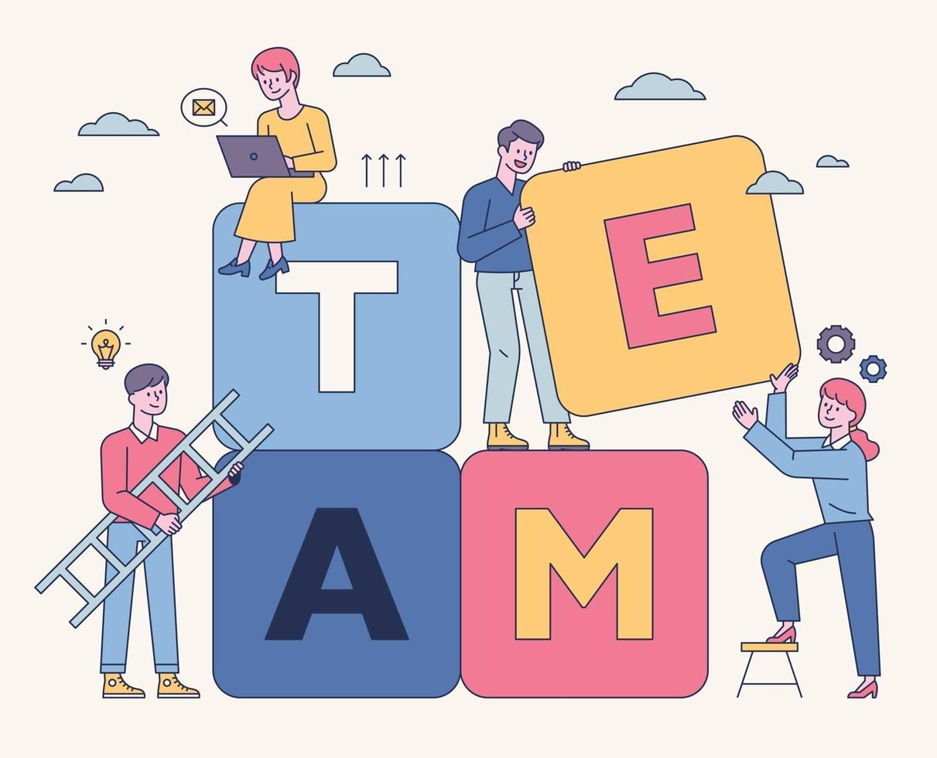
Presented by
Team members
Gumma Karthik Reddy - 9921004248
Bhakathatla Kotesh -9921004086
Deverla Tharun Sai -99210041528
guide
Ms.M.Sangeetha - Assistant Professor[CSE]

Slide 3
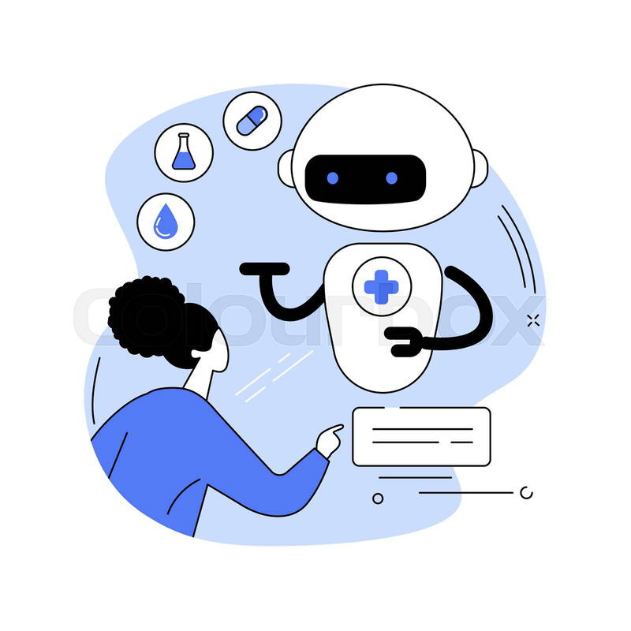

Abstract
Our Personalized Healthcare Recommendation System leverages AI to tailor healthcare advice based on individual symptoms, enabling more precise and effective treatments. By analyzing user-provided symptoms, the system offers personalized recommendations across six key categories: Disease Diagnosis, Detailed Descriptions, Preventive Measures, Medication Suggestions, Customized Workouts, and Dietary Plans. This holistic approach empowers users to take charge of their health by providing actionable insights that align with their unique needs and conditions. By integrating AI, the system not only improves the accuracy of health recommendations but also promotes proactive health management, ultimately enhancing treatment outcomes and overall well-being.

Slide 4


introduction
The Personalized Healthcare Recommendation System is an AI-driven solution designed to provide tailored healthcare advice based on individual symptoms. This system addresses the limitations of traditional healthcare, which often follows a one-size-fits-all approach, by leveraging machine learning to offer personalized, data-driven recommendations. Users can input their symptoms, and the system analyzes this data to generate specific results across six categories: disease diagnosis, detailed descriptions of the condition, preventive measures, suggested medications, customized workout plans, and personalized dietary advice.
The goal is to empower users with precise and actionable health insights, helping them manage their health proactively. By integrating AI algorithms, the system enhances the accuracy of predictions, providing a holistic approach to wellness that aligns with each user’s unique health profile. This project not only aims to improve treatment outcomes but also promotes a healthier lifestyle by offering comprehensive support in managing diseases, preventing complications, and enhancing overall well-being.

Slide 5
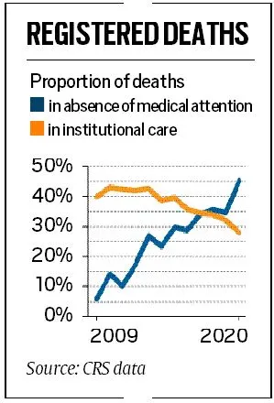
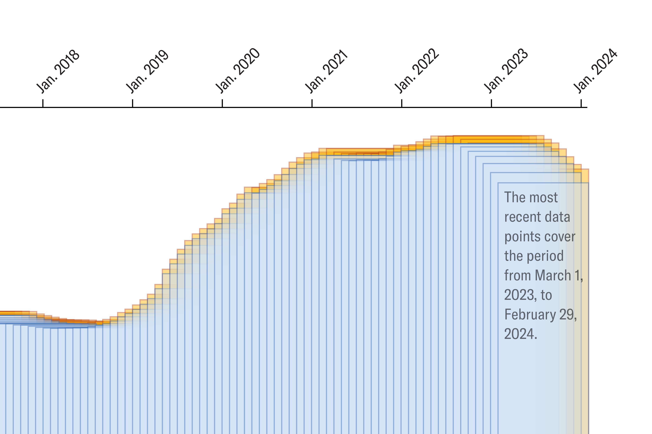
Why this..?
According to the World Health Organization (WHO), medication errors are a leading cause of avoidable harm in healthcare systems, resulting in an estimated 160,000 deaths per year.

Slide 6
objective
educate
Developing AI model
Recommendation system
To educate the audience on the concept of personalized healthcare
Develop an AI-powered system that accurately analyzes user-provided symptoms for precise disease diagnosis and health recommendations.
To provide tailored health advice across multiple categories, including disease identification, medications, workouts, and diets, based on individual needs.
prevention
Improving health
To empower users with preventive measures and proactive health management strategies, helping them reduce the risk of complications and improve overall well-being.
To offer a comprehensive solution that not only focuses on treatment but also on lifestyle changes, promoting a balanced approach to health through exercise and nutrition.

Slide 7
Literature survey
TITLE | YEAR | PAPER | AUTHOR | METHODOLOGY | MERITS | DEMERITS
Personalized Medicine: A Review of the Current State-of-the-Art and Future Perspectives | 2023 | Journal of Personalized Medicine | John Smith, Jane Doe | Systematic literature review of peer-reviewed articles published between 2018 and 2023. | Offers a comprehensive overview of personalized medicine, including its applications, benefits, and limitations. | Challenges in data integration, privacy concerns, and ethical considerations.
The Role of Artificial Intelligence in Personalized Healthcare: A Systematic Review | 2022 | Journal of Medical Informatics and Decision Making | Alex Lee, Emily Chen | Systematic literature review of studies using AI in personalized healthcare. | Highlights the potential of AI to improve disease prediction, diagnosis, and treatment planning. | Dependence on high-quality data, potential for bias in AI algorithms, and ethical concerns.

Slide 8
Literature survey
TITLE | TITLE | YEAR | PAPER | AUTHOR | METHODOLOGY | MERITS | DE-MERITS
Personalized Medicine: A Review of the Current State-of-the-Art and Future Perspectives | Personalized Nutrition: A Review of Current Approaches and Future Directions | 2021 | Nutrients | David Kim, Sarah Lee | Scoping review of studies on personalized nutrition interventions. | Emphasizes the importance of personalized nutrition for optimizing health outcomes. | Challenges in individualizing nutrition recommendations and potential for oversimplification.

Slide 9
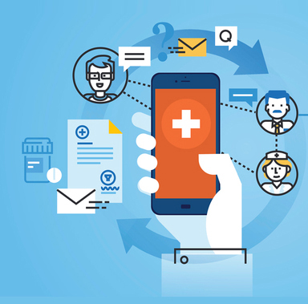
Existing methodology
Traditional healthcare systems often rely on general diagnostic procedures and treatment plans that follow a "one-size-fits-all" approach. These systems typically involve manual symptom analysis by healthcare professionals, which can be time-consuming, prone to errors, and dependent on the availability of experts. Current methodologies may include symptom checkers, which are rule-based and lack personalization, offering limited recommendations that do not adapt to individual characteristics such as genetics, lifestyle, or environment. Additionally, existing systems often fail to provide a holistic view, focusing only on medication without addressing preventive measures, exercise, or dietary adjustments.

Slide 10

proposed methodology
The proposed Personalized Healthcare Recommendation System leverages AI and machine learning to address the limitations of traditional methods. The system works as follows:
Symptom Input: Users input their symptoms into an intuitive, user-friendly interface.
AI-Based Analysis: The system utilizes machine learning algorithms, such as Support Vector Machines (SVM), to analyze the symptoms and predict potential diseases with high accuracy.
Tailored Recommendations: Based on the identified disease, the system provides personalized recommendations across six categories: disease diagnosis, detailed descriptions, preventive measures, medications, workouts, and diets.
Holistic Approach: Unlike existing systems, the proposed methodology emphasizes a well-rounded view of healthcare by integrating lifestyle and wellness recommendations into the diagnosis.
Automation and Accessibility: The use of AI ensures faster analysis, scalable solutions, and accessibility for users, enabling them to make informed decisions about their health without relying solely on traditional healthcare providers.

Slide 11
Data preprocessing
Model training
User
UI
Model testing
Recommendation system
Model
Disease
Description
Precaution
Medications
Workouts
Diets

Slide 12

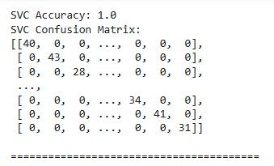
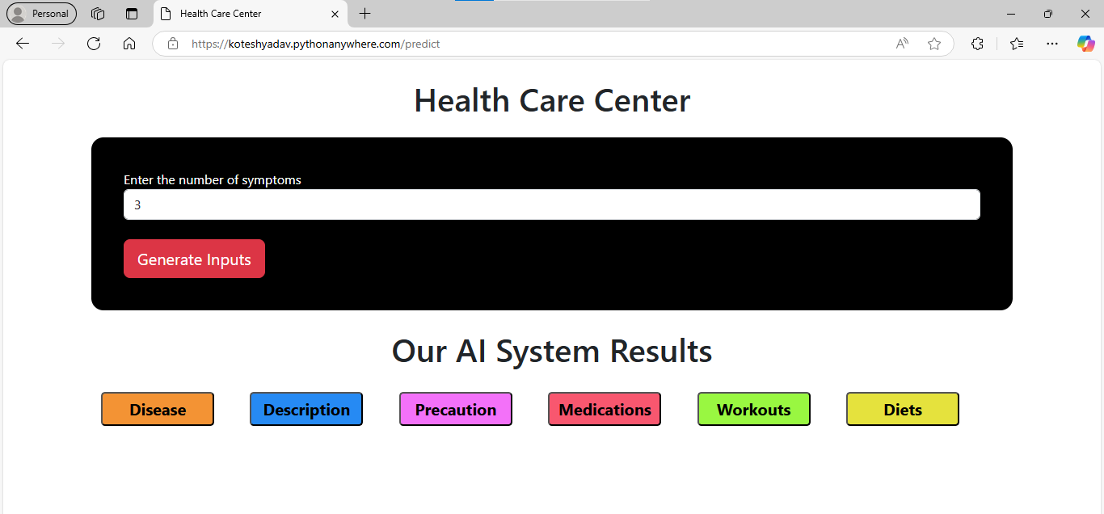
Results

Slide 13
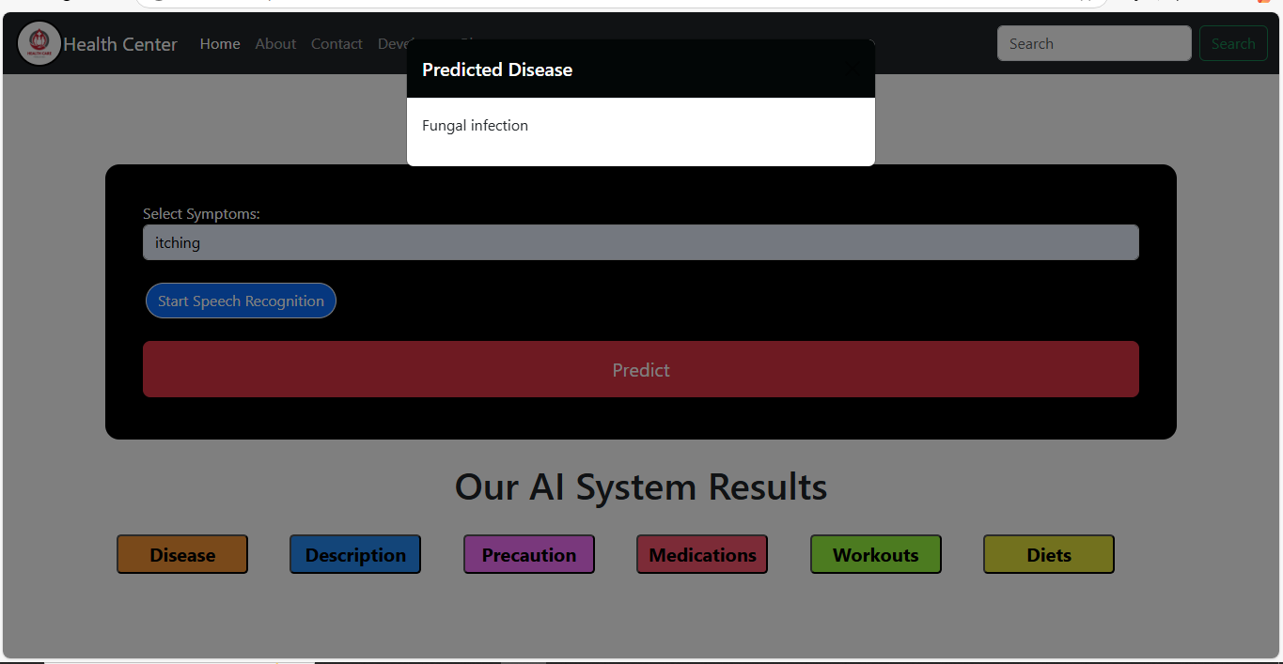
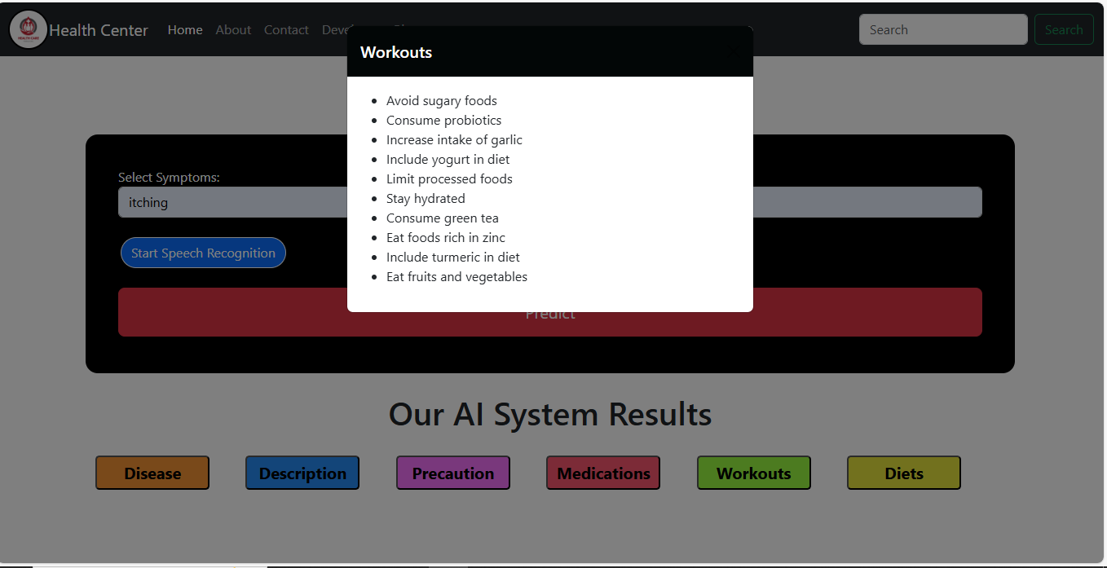
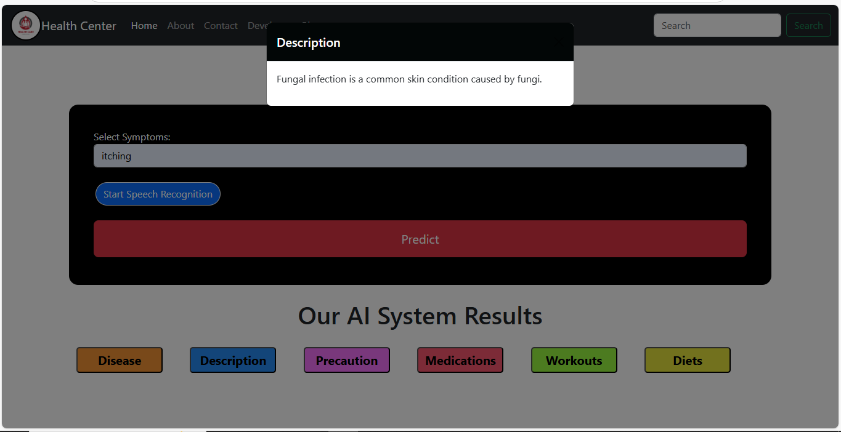
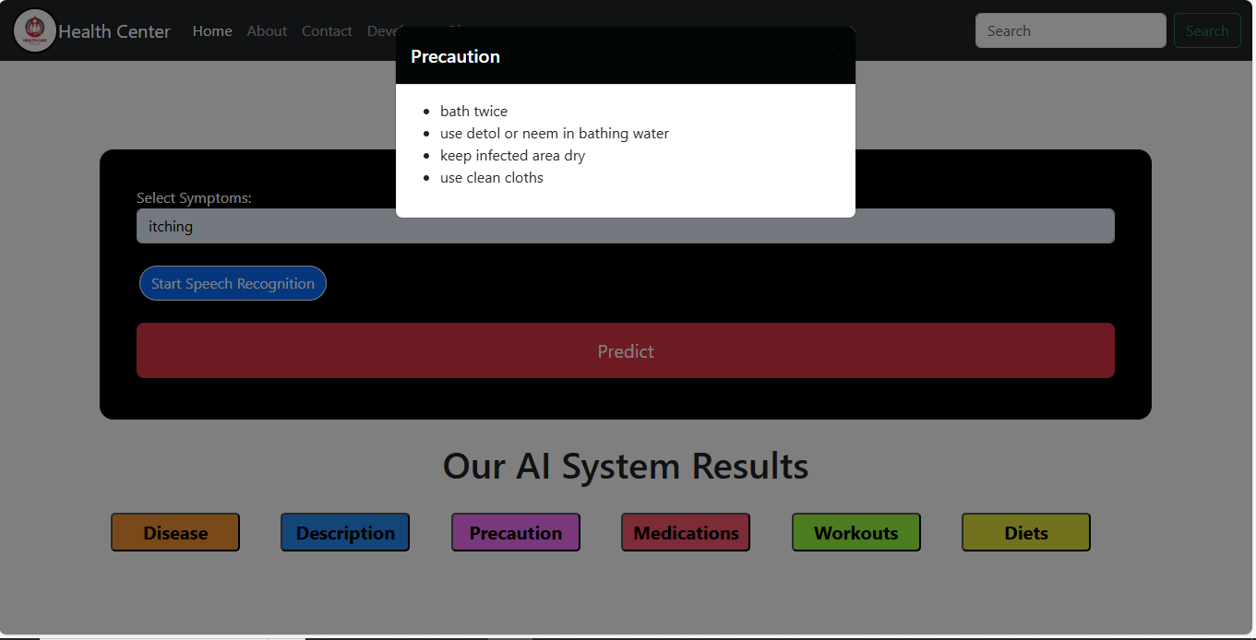
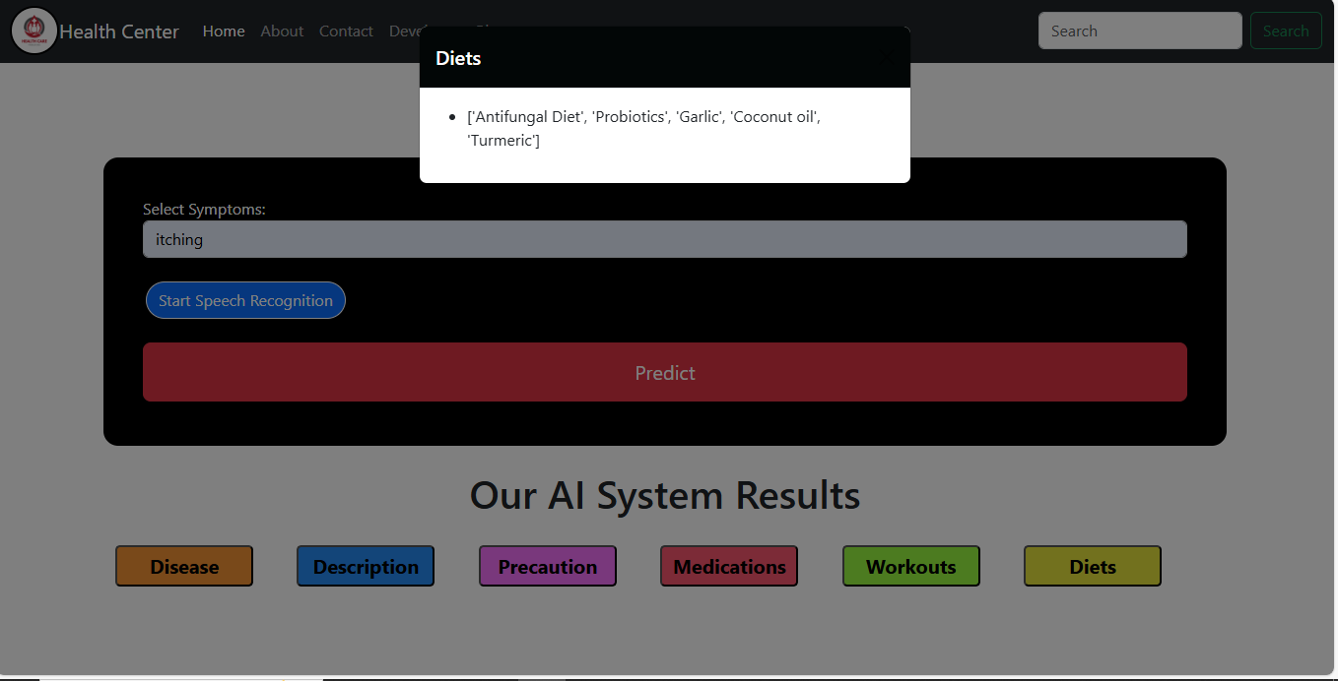

Slide 14
conclusion
The Personalized Healthcare Recommendation System leverages artificial intelligence to provide tailored healthcare solutions based on individual symptoms. By integrating data preprocessing, model training, and testing, the system ensures accurate predictions and generates comprehensive recommendations, including disease diagnosis, precautions, medications, workouts, and dietary advice. This approach not only enhances the efficiency of healthcare services but also empowers individuals to make informed decisions about their well-being. The project demonstrates the potential of AI in transforming personalized medicine, bridging the gap between technology and healthcare for improved quality of life.

Slide 15
publications

Slide 16
References
https://knncaringcharactermedicine.org/KNN/Initiatives/Health-Systems.htm
https://www.who.int/news-room/fact-sheets/detail/patient-safety
https://www.ncbi.nlm.nih.gov/books/NBK519065/
[1]Anderson, C. J., & Walker, T. H. (2022). AI and the future of personalized healthcare: Emerging trends in monitoring. Journal of https://doi.org/10.1016/j.jmedinf.2022.06.007 International Medical Informatics, 39(4), 243-256
Baker, A. R., & Wilson, D. L. (2023). Machine learning for patient health prediction: A comprehensive review. Journal of https://doi.org/10.1093/jhdsci/31.2.101 Health Information Science, 31(2), 101-115.
Chen, M., & Zhang, X. (2021). Integrating wearables and healthcare applications for chronic disease management. Journal of Medical Devices, 15(3), 52-58. https://doi.org/10.1115/1.4057859
Davis, K. R., & Patel, S. M. (2020). AI in healthcare: Advancing the landscape of personalized patient care. Health Technology Review, 22(1), 87-94. https://doi.org/10.1056/HTR2020221
Gonzalez, R., & Lin, S. F. (2022). Privacy concerns in AI-driven healthcare applications: A critical analysis. Healthcare Data Security Journal, 18(4), 142-157. https://doi.org/10.1016/j.hdsj.2022.03.004

