Slide 1

AI-Based Interview Training & Proctoring System
Smart Preparation Platform with Real Interview Simulation

Slide 2
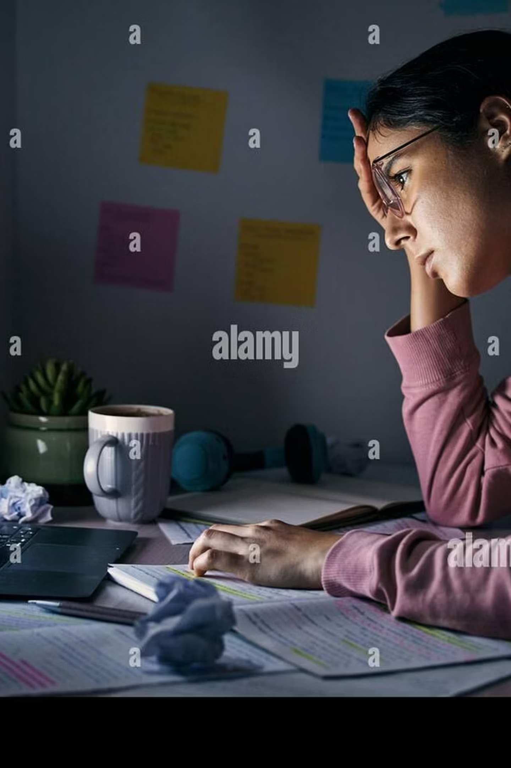
The Problem Students Face
No Real Practice
Students lack access to realistic interview simulations before facing actual recruiters.
Zero Feedback
Without performance insights, improvement is guesswork — not strategy.
Low Confidence
Unprepared candidates freeze under pressure, losing opportunities they deserve.
Cheating Risk
Online interviews lack integrity controls, undermining fairness for honest candidates.

Slide 3
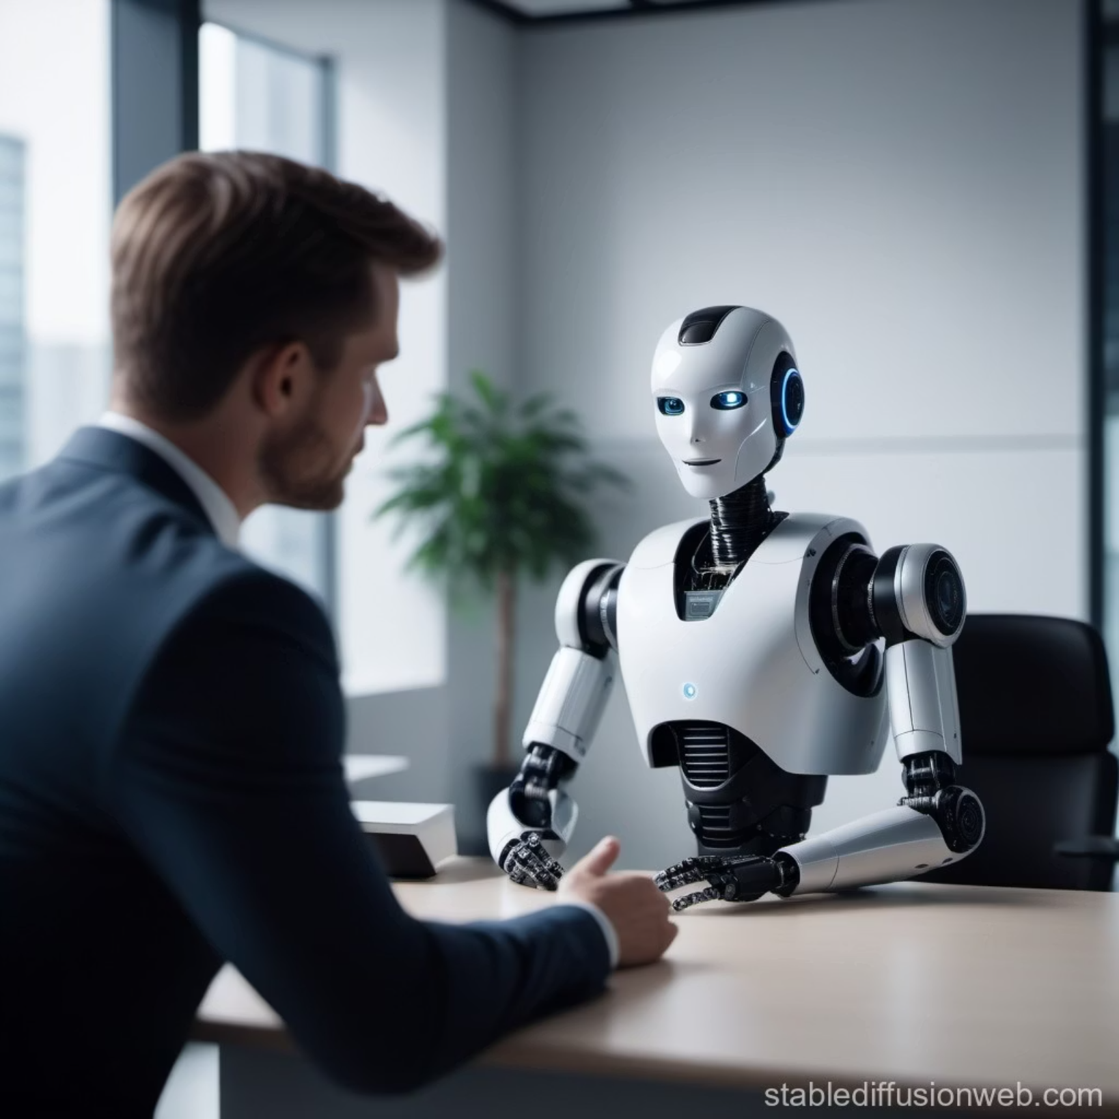

Our Solution
An end-to-end AI-powered platform that trains, tests, and evaluates candidates — just like a real recruiter would.
Resume-Based Interviews
Questions dynamically generated from the candidate's own resume.
Real-Time AI Feedback
Instant analysis of answers, confidence, and communication.
AI Proctoring
Anti-cheating system with face and eye tracking built in.
Emotion Detection
Monitors confidence and stress levels throughout the session.

Slide 4
Core Features
Daily Training
Weekly Mock Interview
Resume Analyzer
Structured practice across Aptitude, Technical, and HR domains — every single day.
Full-length simulated interviews to build stamina and real-world readiness.
AI scans your resume and generates personalized interview questions.
Multi-Round System
AI Proctoring
Screening → Technical → HR — mirroring actual hiring pipelines.
Continuous monitoring ensures integrity across every online session.

Slide 5
Training Module
Three Pillars of Preparation
Smart Progress Tools
Daily Streak System — builds consistent habits
Weak Topic Detection — flags areas needing focus
Progress Tracking — visual growth over time
Aptitude
Timed MCQ challenges with instant scoring and difficulty adaptation.
Technical
Concept-based questions with AI-generated feedback on accuracy and depth.
HR Practice
Speaking exercises evaluated for clarity, tone, and confidence.

Slide 6

Interview System
A structured 3-round pipeline that mirrors real hiring processes — with AI-powered personalization at every stage.
Round 2: Technical
Resume-based Q&A with AI follow-ups
Round 1: Screening
Round 3: HR
MCQ aptitude & tech filter
Behavioral interview with auto-eval
Each round auto-generates follow-up questions based on the candidate's resume and previous answers — creating a dynamic, personalized interview experience.

Slide 7
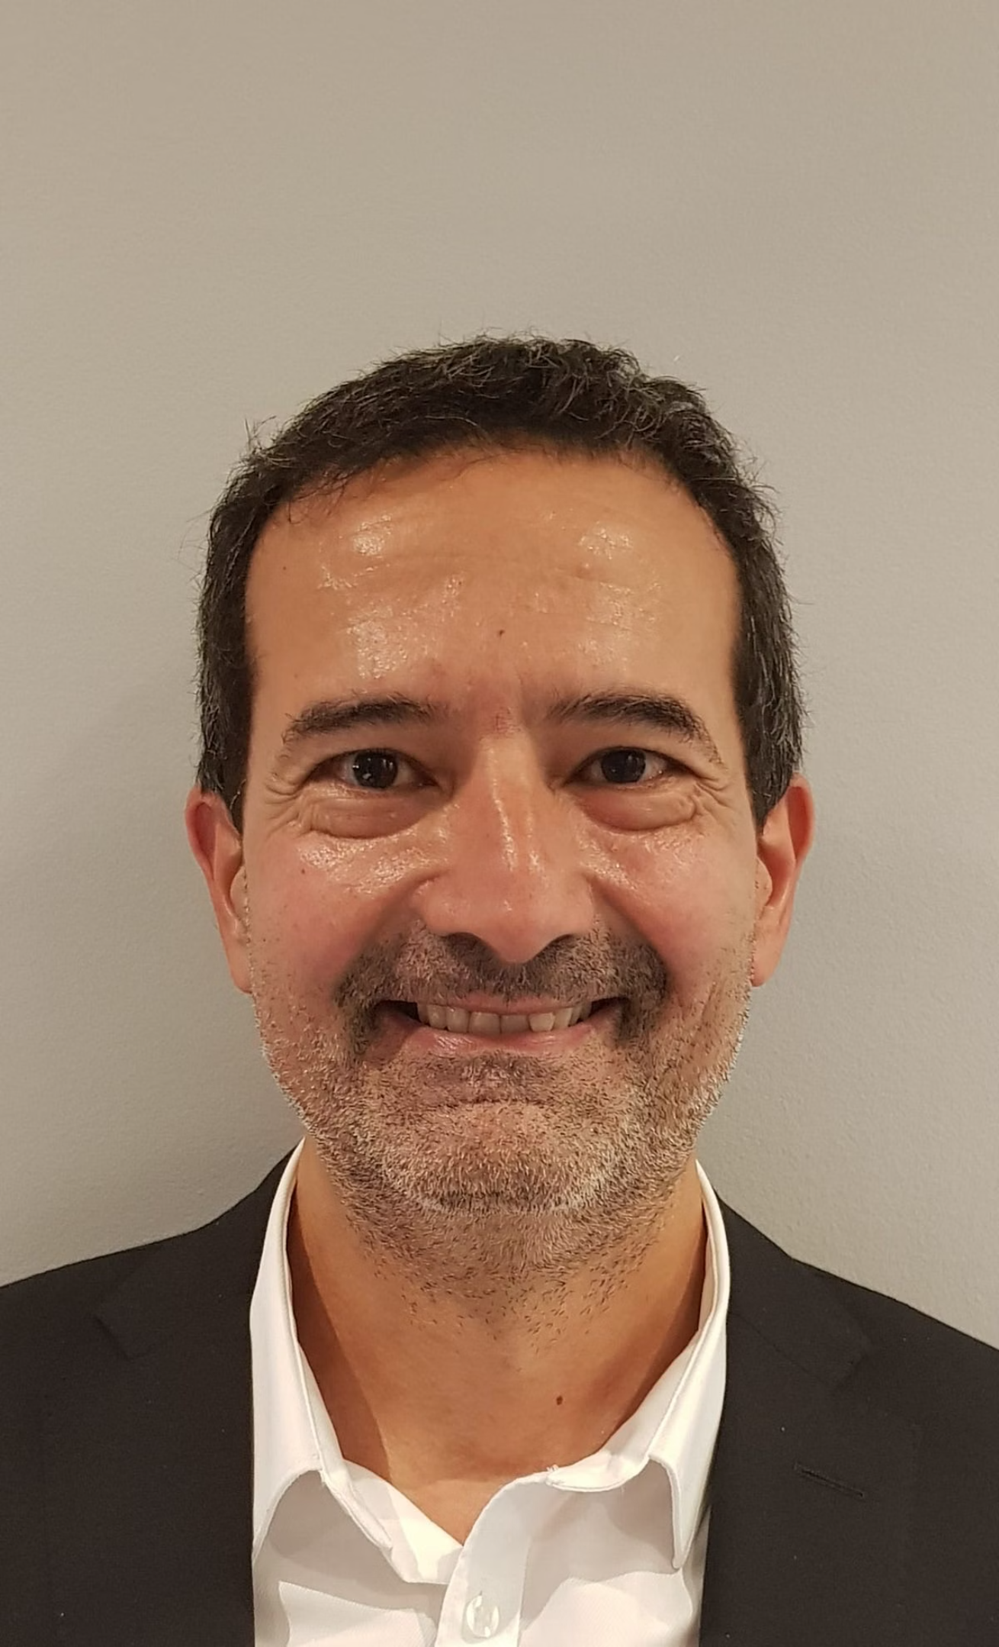
AI Proctoring System
Monitoring Capabilities
📷 Always-On Camera
Continuous face detection throughout the session.
👁️ Eye Tracking
Detects suspicious gaze patterns and off-screen activity.
👥 Multi-Face Detection
Flags presence of unauthorized individuals in frame.
Enforcement Rules: 3-warning system → Auto-termination on violation · Tab-switch detection active throughout

Slide 8
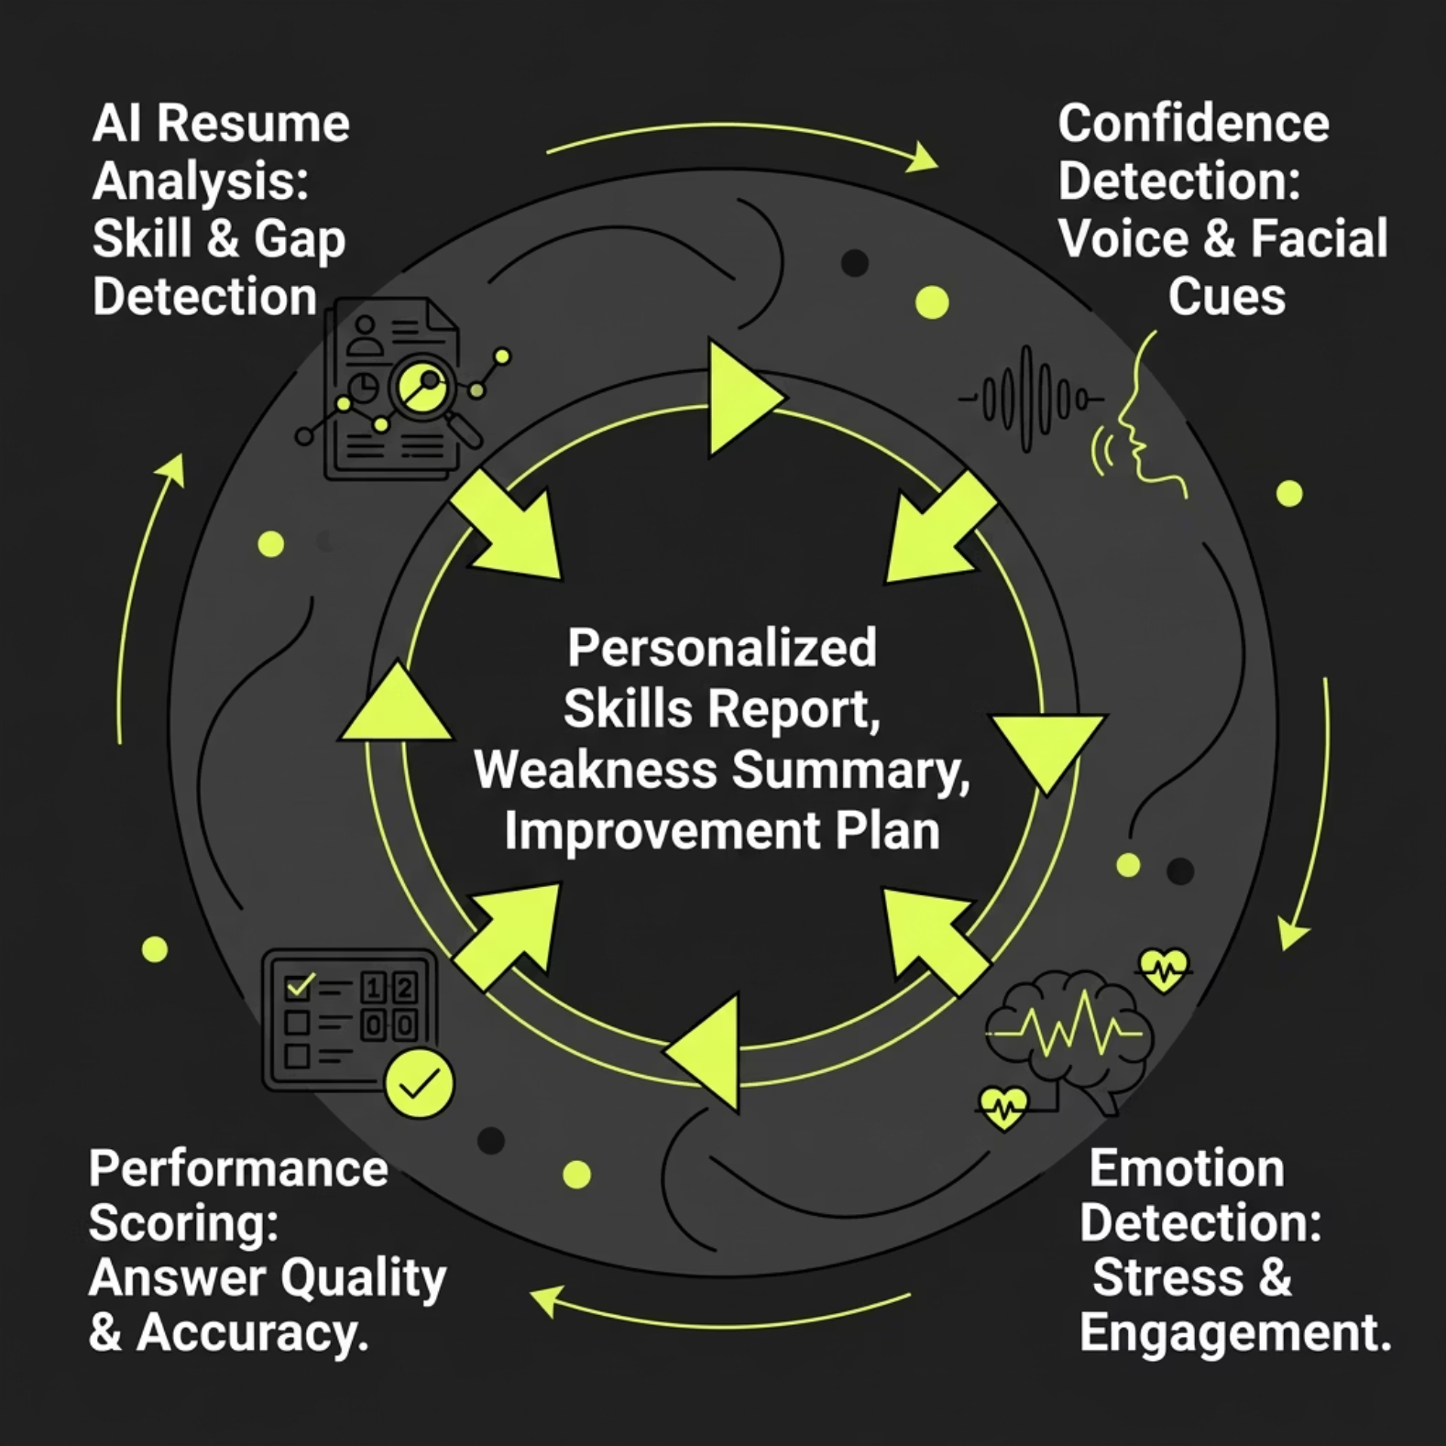

AI & Smart Analysis
What the AI Delivers
After every session, the system generates a comprehensive report covering:
Skills Inventory — strengths identified from your resume and answers
Weakness Summary — specific gaps to address before real interviews
Improvement Plan — personalized study recommendations

Slide 9

Result Dashboard
Every session ends with a clear, multi-dimensional scorecard — so candidates know exactly where they stand.
7.4
73%
3
Technical Score
Selection Probability
Score Dimensions
Out of 10 — measures answer accuracy and depth
AI-predicted likelihood of clearing a real interview
Technical, Confidence, and Integrity scores combined
✅ Status: Selected — Final result combines all three dimensions into a single actionable outcome.

Slide 10
Conclusion & What's Next
✅ What We Built
Real interview experience at scale
Confidence and skill improvement
Fair, proctored evaluation system
Job-ready graduates
🚀 Future Scope
Company-specific interview modes
Voice-based AI interviewer
Mobile app version

