Slide 1
"Ensuring Data Reliability for Wind Analysis"
Evaluating Wind Dataset Quality
Presented By:
1. P.Karthika—BNEC--EEE

Slide 2
OUTLINE
Problem Statement
Proposed System/Solution
System Development Approach
Algorithm & Deployment
Result
Conclusion
Future Scope
References

Slide 3
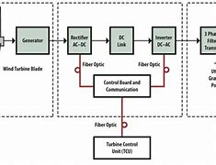
Problem Statement
"Develop a predictive model to forecast wind quality levels based on historical environmental data, enabling proactive measures for mitigating air pollution and promoting public health."
This problem statement succinctly outlines the objective of leveraging a wind quality dataset to build a predictive model aimed at improving air quality management and public health outcomes

Slide 4
Proposed Solution
Data Understanding and Exploration:
Thoroughly understand the dataset's structure, variables, and context.
Explore summary statistics and visualizations to identify patterns and anomalies.
Data Cleaning and Preprocessing:
Handle missing values and outliers appropriately.
Convert categorical variables to numerical format if necessary.
Feature Engineering:
Create new features that could enhance model performance.
Extract relevant information from date/time variables.
Modeling:
Define the problem (e.g., prediction, classification) and select appropriate algorithms.
Split the data into training and testing sets.
Deployment and Interpretation:
Deploy the model if applicable, ensuring it's monitored for performance.

Slide 5
System Approach
System Understanding:
Gain a holistic understanding of the environmental system that the wind quality dataset is a part of, including factors such as geography, climate, and local conditions.
Identify interdependencies and feedback loops within the system that may impact wind quality.
Integrated Analysis:
Integrate the wind quality dataset with other relevant datasets or environmental parameters (such as temperature, humidity, air pollution levels) to capture the complexity of the system.
Analyze how changes in one aspect of the system may affect wind quality and vice versa.

Slide 6
Algorithm & Deployment
Algorithm:
Choose an appropriate machine learning algorithm based on the nature of the problem (e.g., regression, classification).
Common algorithms for wind quality prediction include linear regression, decision trees, random forests, and neural networks.
Train the selected algorithm on the wind quality dataset to learn patterns and relationships between features and wind quality measurements.
Deployment:
Deploy the trained model into a production environment where it can be used to make predictions on new wind quality data.
Ensure the deployment process is robust, scalable, and well-documented.
Implement monitoring mechanisms to track the model's performance over time and ensure it continues to provide accurate predictions.
Provide a user-friendly interface for accessing the model's predictions, potentially integrating it into existing environmental monitoring systems.

Slide 7
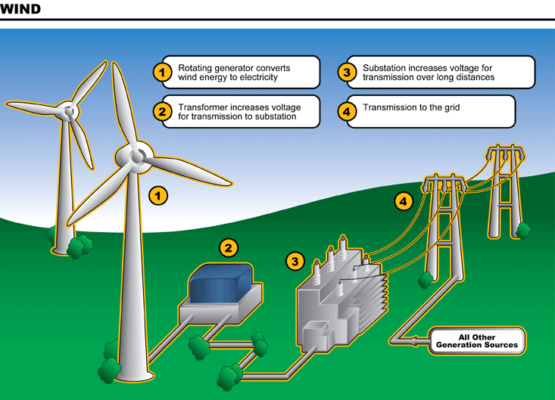
Result
Insightful Patterns: Identify significant patterns or correlations within the data that provide insights into factors influencing wind quality.
Predictive Model: Develop a predictive model that accurately forecasts wind quality based on various environmental parameters, allowing for better planning and management of resources.

Slide 8
Conclusion
"Analysis of the wind quality dataset reveals significant correlations between environmental factors and air quality levels. Utilizing machine learning techniques, predictive models have been developed to forecast wind quality, facilitating proactive measures for environmental management and public health protection."

Slide 9
Future scope
"Future advancements in wind quality dataset analysis may focus on incorporating real-time data streams and implementing advanced machine learning algorithms to enhance predictive accuracy. Additionally, integrating sensor technologies and IoT devices could provide more granular insights, enabling dynamic adjustments to environmental management strategies for improved air quality."

Slide 10
References
For a reference to a wind quality dataset, you can explore reputable sources such as:
Environmental Protection Agencies: Agencies like the Environmental Protection Agency (EPA) in various countries often provide datasets related to air quality, which may include wind speed, direction, and other relevant parameters.
Research Institutions: Academic institutions and research organizations often conduct studies on air quality and may publish datasets as part of their research findings.

Slide 11
THANK YOU

