Slide 1
Sales and purchase Management System
Name : Karthikayani.G
Department : cse

Slide 2
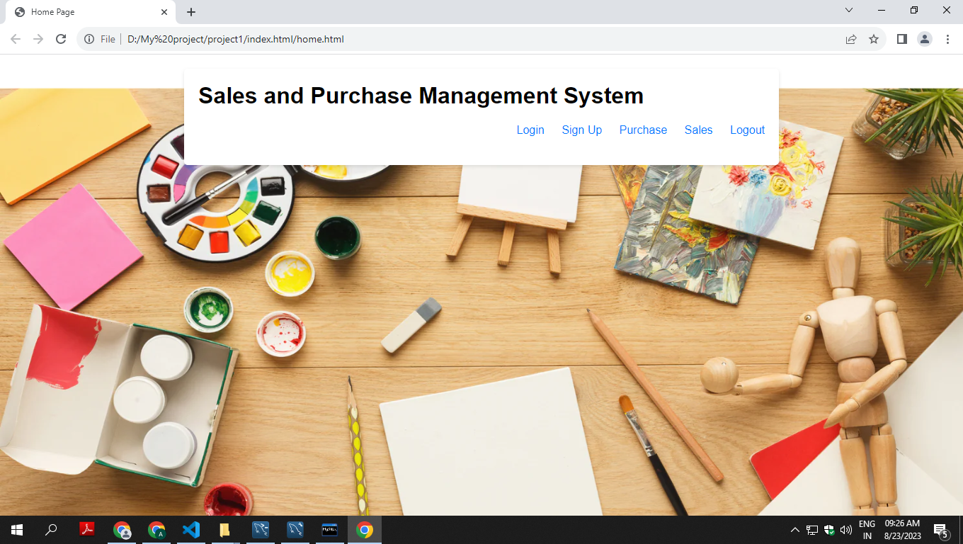
Home page

Slide 3
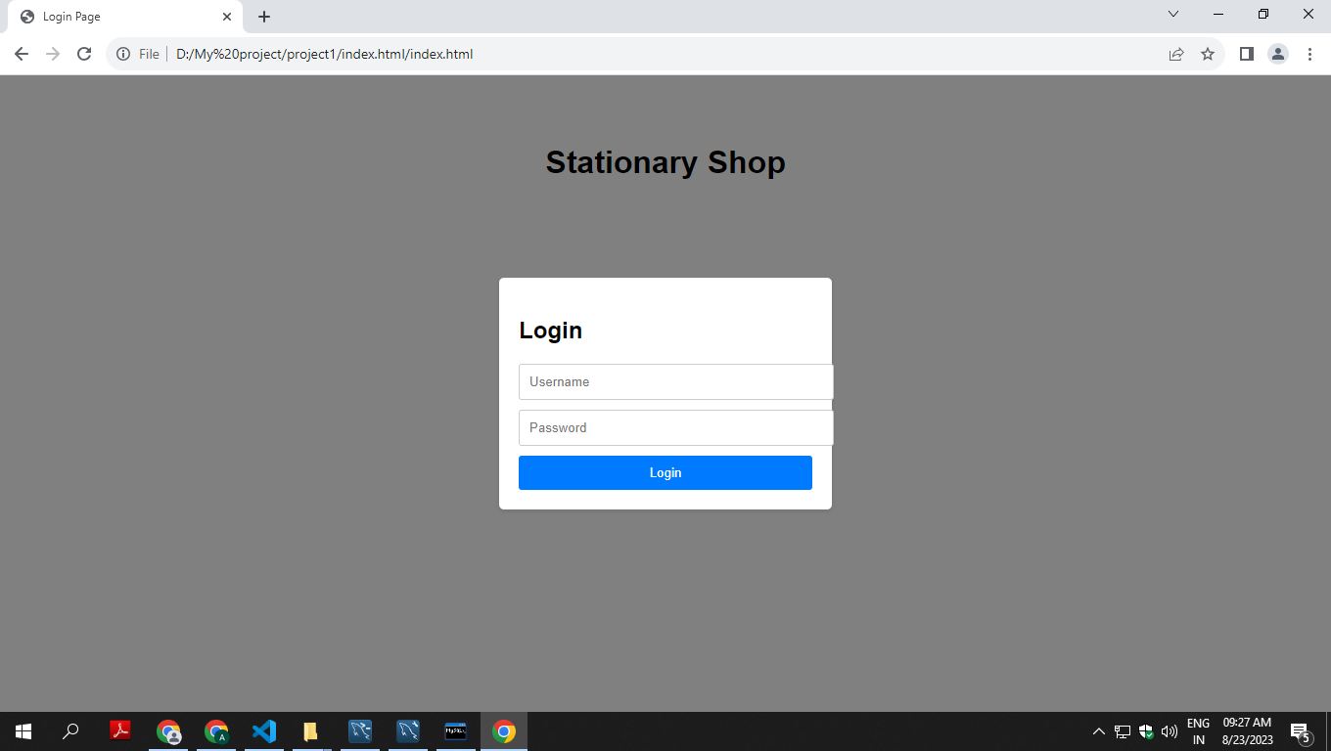
Login page

Slide 4
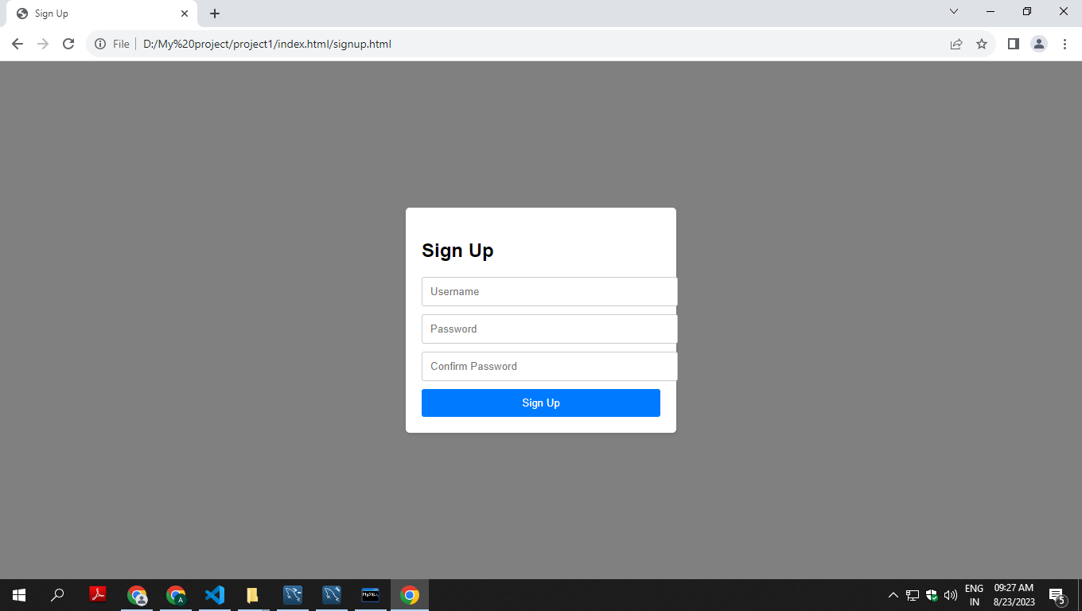
Sign up page

Slide 5
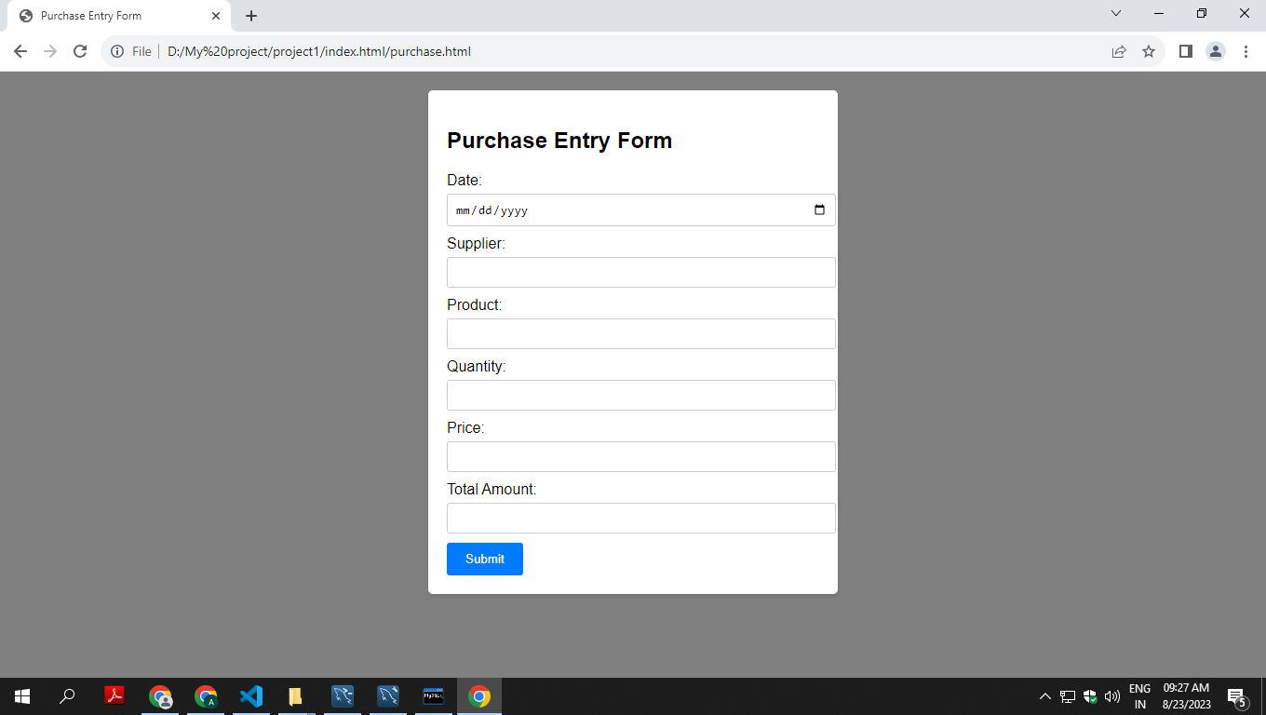
Purchase page

Slide 6
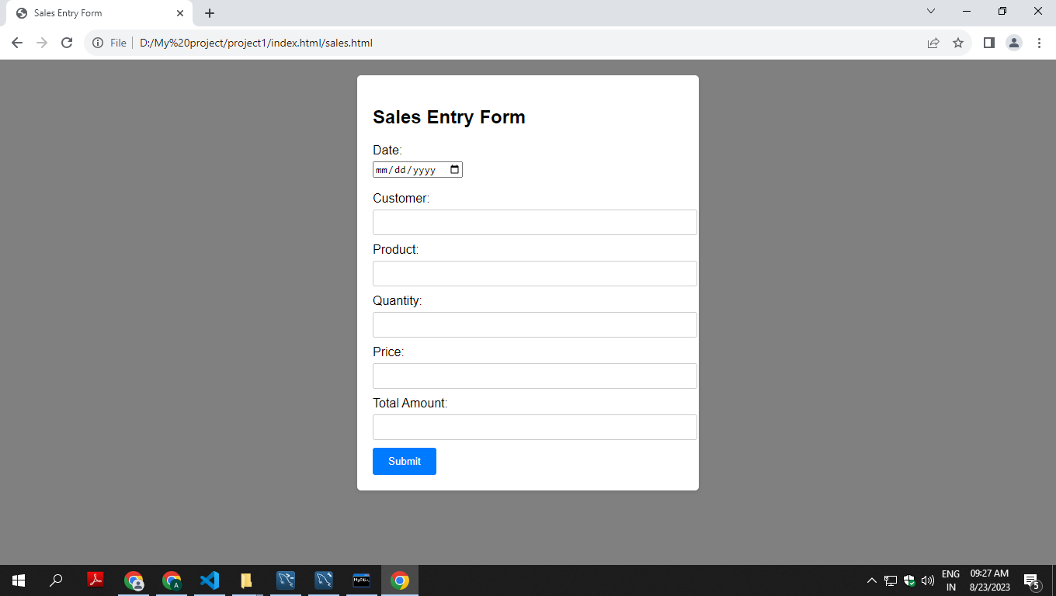
Sales page

Slide 7
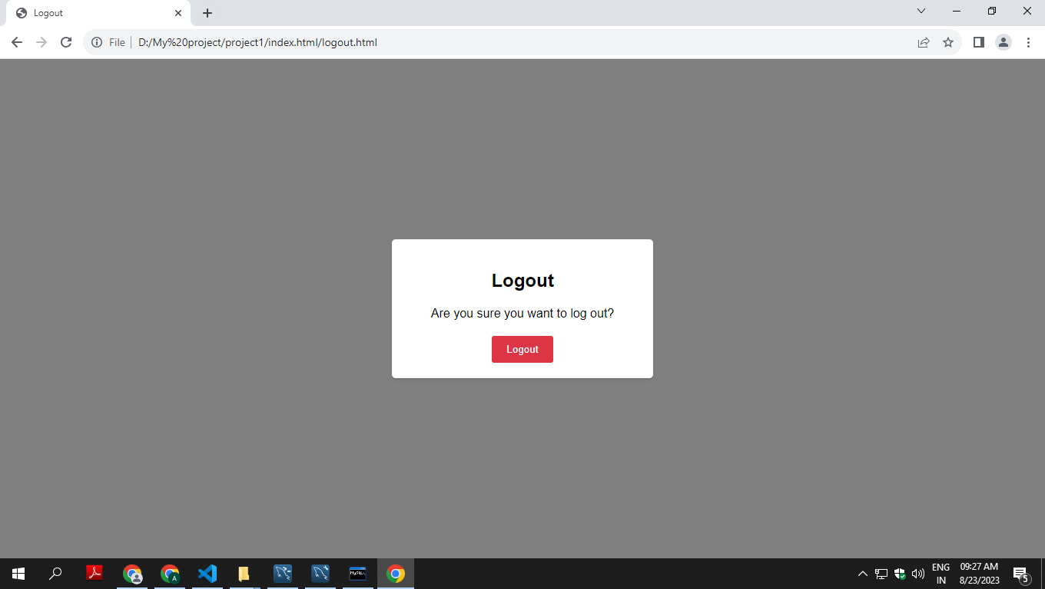
Logout page

