Slide 1
Digital Portfolio
STUDENT NAME: Kartika . G
REGISTER NO AND NMID:
DEPARTMENT: computer science
COLLEGE: COLLEGE/ UNIVERSITY:LRG woman's atrs and
science College

Slide 2


AGENDA
Problem Statement
Project Overview
End Users
Tools and Technologies
Portfolio design and Layout
Features and Functionality
Results and Screenshots
Conclusion
Github Link
3/21/2024 Annual Review

Slide 3

PROBLEM STATEMENT
The fundamental problem statement in front-end web development centers on creating and maintaining a seamless, intuitive, and performant user interface (UI) that effectively bridges the gap between the user and the underlying application logic.
This encompasses several key challenges:
Ensuring Cross-Browser and Cross-Device Compatibility:
Delivering a consistent and functional experience across a vast array of browsers, operating systems, screen sizes, and device capabilities (e.g., desktops, tablets, smartphones) is a constant challenge.
Optimizing Performance and Responsiveness:
Building UIs that load quickly, respond instantly to user interactions, and provide a smooth, fluid experience, even on less powerful devices or with limited network connectivity.

Slide 4

PROJECT OVERVIEW
HTML (HyperText Markup Language):
Provides the structural foundation of the web page. This includes defining headings, paragraphs, images, links, forms, and other content elements.
CSS (Cascading Style Sheets):
Controls the visual presentation and layout of the HTML elements. This involves styling aspects like colors, fonts, spacing, positioning, and responsive design for different screen sizes.
JavaScript:
Adds interactivity and dynamic behavior to the web page. This can include features like form validation, animations, interactive elements, data manipulation, and communication with back-end services through APIs.

Slide 5

WHO ARE THE END USERS?
In fundamental front-end web development, the user ends refer to the end-users or client-side users who directly interact with the website or web application. These are the individuals who access the website through their web browsers, such as Chrome, Firefox, Safari, or Edge.
The front end encompasses everything the user sees and interacts with, including:
User Interface (UI):
The visual layout, design elements, colors, fonts, images, and overall aesthetic of the website.
User Experience (UX):
The ease of navigation, responsiveness, interactivity, and overall satisfaction a user derives from interacting with the website.
Interactive Elements:
Buttons, forms, menus, sliders, animations, and any other features that allow users to input information or control the website's behavior.

Slide 6

TOOLS AND TECHNIQUES
HTML (HyperText Markup Language): Provides the structure and content of web pages. CSS (Cascading Style Sheets): Controls the visual presentation and styling of HTML elements, including layout, colors, and fonts. JavaScript: Adds interactivity, dynamic behavior, and complex logic to web pages, enabling user interactions and data manipulation.

Slide 7
POTFOLIO DESIGN AND LAYOUT
About
meProfile
SkillQualification
Email
idContact me
7

Slide 8
FEATURES AND FUNCTIONALITY
HTML (HyperText Markup Language):
Provides the structural foundation of web pages, defining content elements like headings, paragraphs, images, and links.
CSS (Cascading Style Sheets):
Controls the visual presentation of HTML elements, including colors, fonts, layouts, spacing, and responsiveness across different devices.
JavaScript:
Adds interactivity and dynamic behavior to web pages, enabling features like animations, form validation, real-time updates, and complex user interactions.

Slide 9


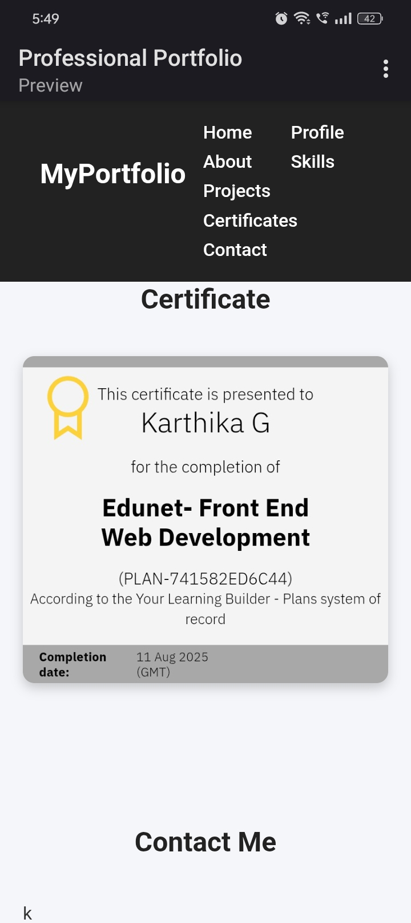

RESULTS AND SCREENSHOTS
3/21/2024 Annual Review
9

Slide 10
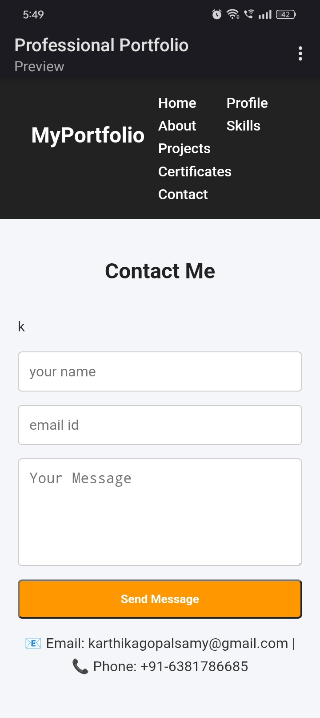
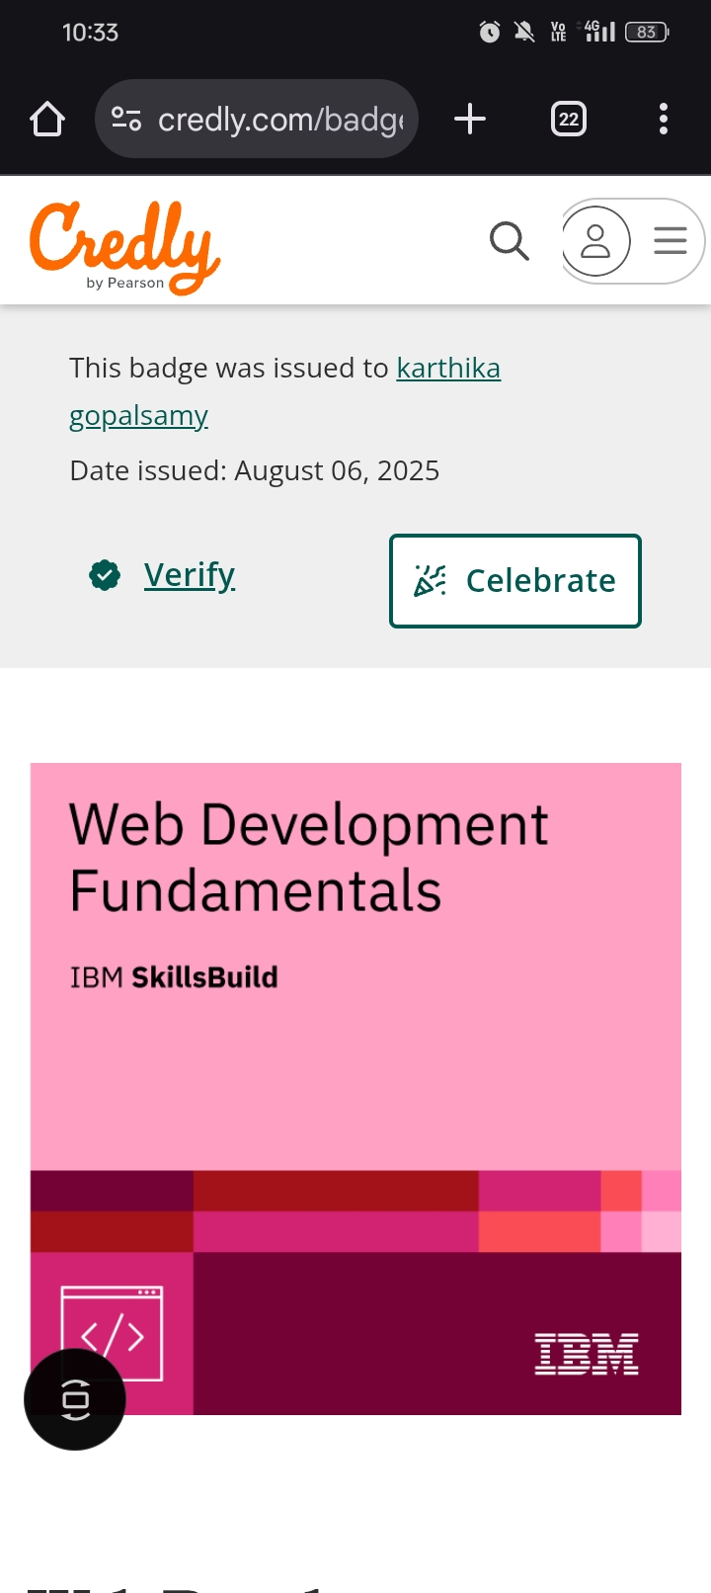

Slide 11
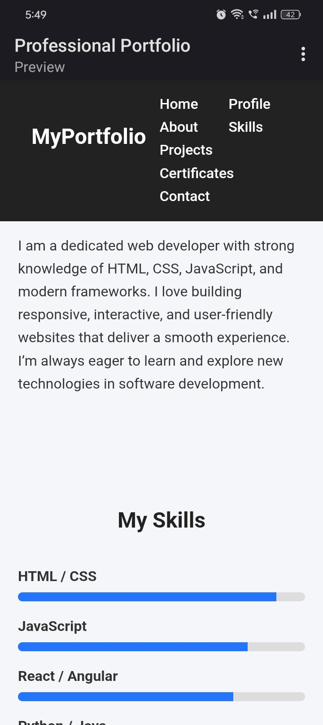

Slide 12
CONCLUSION
Fundamental front-end web development focuses on building the user-facing portion of websites and web applications. It is crucial for creating engaging and functional online experiences.
12

