Slide 1

TIM BERNERS LEE

Slide 2
About Our Circle
TOP MANAGEMENT : MEENAKSHI COLLEGE FOR WOMEN
STEERING COMMITTEE : DR.K.S.LAKSHMI
CO-ORDINATOR : Miss.MEENAKSHI LAKSHMANAN
FACILITATOR : Miss.ROOBINI M
LEADER : GOKILA S

Slide 3
ABOUT QCC MEETING
DEPARTMENT : COMPUTER SCIENCE
FREQUENCY OF MEETING : TWICE IN A WEEK
MEETING VENUE : SEMINAR AREA
DURATION OF MEETING : 2 HOURS.
ATTENDANCE : 100%
NAME OF THE CIRCLE : TIM BERNERS LEE

Slide 4
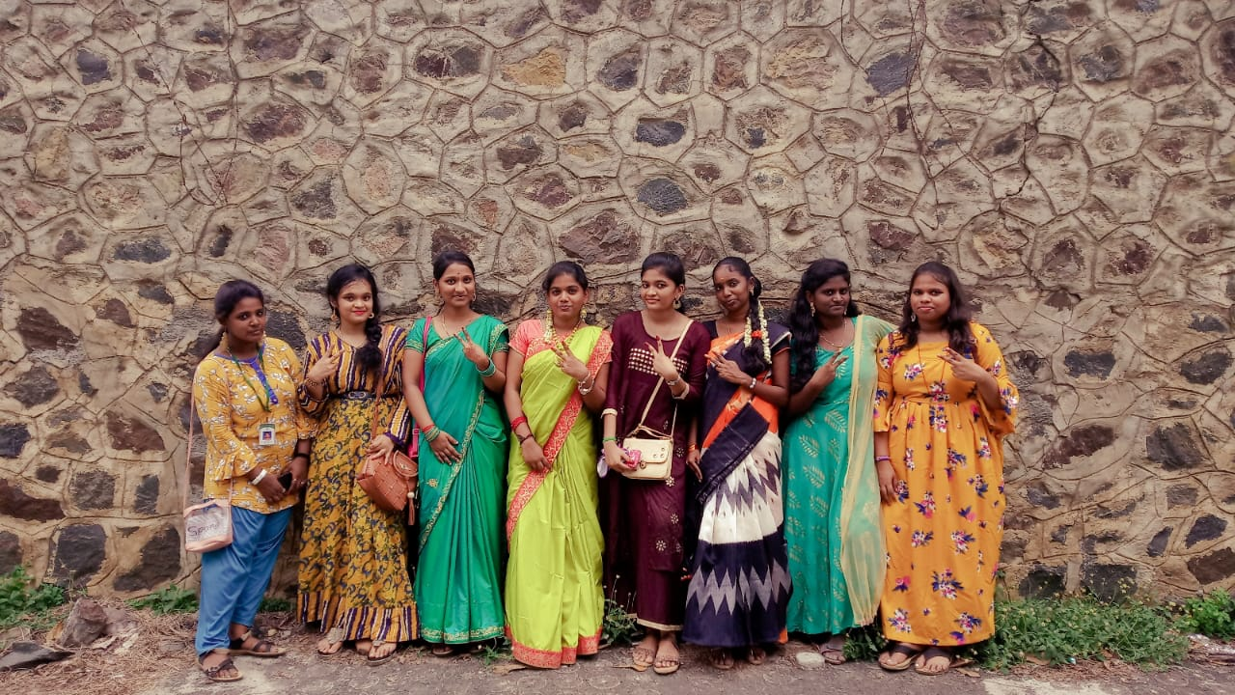
TEAM MEMBERS
LEADER: S.Gokila
MEMBERS:
K.B.Karthika D.MukilaDevi
M.Pavithra S.Ramya meenachi
S.Shalini S.Senthamarai
K.Tharini

Slide 5
OUR TEAM MOTTO

Slide 6


Slide 7

WORKING METHODOLOGY
>>PLAN
1. Understanding the current circumstance.
2. Establishing the activity plan and target.
3. Analyzing the problems.
4. Researching improvement plans.
>>DO
5.Implementing the plan.
>>CHECK
6. Verifying the result.
>>ACT
7. Standardizing and institutionalizing.

Slide 8

Problem

Slide 9
SL.NO | LIST OF PROBLEMS
1 | LACK OF SELF CONFIDENCE
2 | POOR MAINTENANCE OF CLASS ROOM BY STUDENTS
3 | POOR PERFORMANCE IN EXAMINATIONS
4 | LATE COMING OF STUDENTS
5 | LACK OF COMMUNICATION SKILLS
6 | POOR PERFORMANCE IN SPORTS
7 | LACK OF ETHICAL VALUES
8 | MENTAL HEALTH ISSUES FACED BY STUDENTS
9 | USAGE OF LIBRARY BY STUDENTS
10 | LESS INVOLVEMENT IN STUDIES
11 | NO TRANSPORT FACILITY
12 | HEAVY WORK LOAD FOR STUDENTS
13 | STAGE FEAR

Slide 10



PROBLEM CLASSIFICATION
CATEGORY ‘A’
CATEGORY ‘C’
Self involvement-QC CATEGORY ‘B’
members
Investment by management
CATEGORY ‘B’
Involvement of other departments

Slide 11
PROBLEMs SELECTED UNDER CATEGORY ‘A’
Lack of self confidence
Mental health issues
Lack of communication skills
Transport Facility
Poor participation in sports

Slide 12
WEIGHTAGE OF PROBLEMS
Problem No. Name | 1 | 2 | 3 | 4 | 5
Gokila.S | 2 | 5 | 2 | 3 | 3
Tharini.K | 2 | 5 | 2 | 3 | 2
Senthamarai.S | 1 | 5 | 1 | 1 | 4
Shalini.S | 1 | 5 | 1 | 1 | 2
Pavithra.M | 1 | 4 | 1 | 1 | 2
Ramya meenachi.S | 1 | 4 | 1 | 1 | 2
Karthika.K.B | 1 | 5 | 2 | 2 | 2
Mukiladevi.D | 1 | 5 | 2 | 3 | 3
Average | 10 | 38 | 12 | 15 | 20
5:Immediate Attention 1:Least Attention

Slide 13
PIE CHART FOR WEIGHTAGE OF PROBLEM
Problem | values
Lack of Self Confidence | 10
Mental health issues | 38
Lack of communication skills | 12
Transport Facility | 15
Poor participation in sports | 20

Slide 14
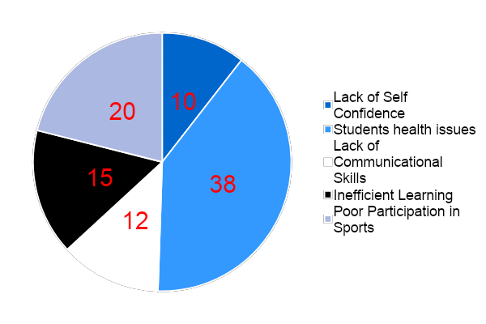
PIE CHART FOR WEIGHTAGE OF PROBLEM

Slide 15

BrainStorming
[] BRAINSTORMING IS A METHOD OF GETTING A GROUP OF PEOPLE TO GENERATE A LOT OF IDEAS IN A SHORT SPACE OF TIME.

Slide 16
STEPS IN BRAINSTORMING
IDEA GENERATION
IDEA CLARIFICATION
IDEA EVALUATION

Slide 17
TECHNIQUES OF BRAINSTORMING
FREE WHEELING BRAINSTORMING
ROUND ROBIN BRAINSTORMING
SLIP METHOD OF BRAINSTORMING
We used Free Wheeling Brainstorming in our OQCC

Slide 18
MEENAKSHI COLLEGE FOR WOMEN(AUTONOMOUS)
ACTIVITY SCHEDULE
Theme:Mental Health issues faced by students
TARGET:40% TO 80%
SL.NO | ACTIVITY |  | Feb-20
 |  |  | 2 | 4 | 5 | 6 | 7 | 9 | 11 | 13 | 17 | 19 | 22 | 24 | 27 | 28
1 | IDENTIFICATION OF PROBLEMS | PLAN
 |  | ACTUAL
2 | SELECTION OF PROBLEMS | PLAN
 |  | ACTUAL
3 | DEFINITION OF PROBLEMS | PLAN
 |  | ACTUAL
4 | ANALYSIS OF PROBLEMS | PLAN
 |  | ACTUAL
5 | IDENTIFICATION OF CAUSES | PLAN
 |  | ACTUAL
6 | FINDING OUT ROOT CAUSE | PLAN
 |  | ACTUAL
7 | DATA ANALYSIS | PLAN
 |  | ACTUAL
8 | DEVELOPING SOLUTION | PLAN
 |  | ACTUAL
9 | IMPLEMENTATION | PLAN
 |  | ACTUAL
10 | CHECKING | PLAN
 |  | ACTUAL

Slide 19
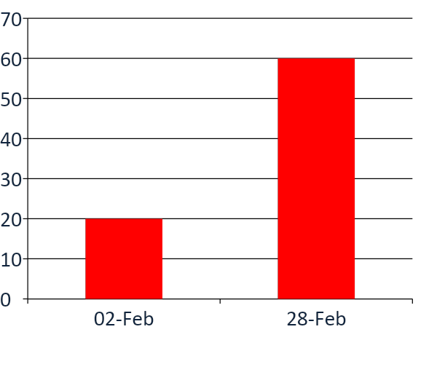
TARGET TO BE ACHIEVED
Before QC

Slide 20
SURVEY SHEET
NAME:
CLASS:
Why students have Mental health issues?
REASONS | RATING
Difficulty in organizing work
Examinations stress
Relationship Problems
Mood disorder
Others
Ratings:
5 | 4 | 3 | 2 | 1
Strongly agree | Agree | Neutral | Disagree | Strongly Disagree

Slide 21
RATING FOR SURVEY
Reasons | Rating
Difficulty in organizing work | 35
Examinations stress | 40
Relationships problem | 40
Mood disorder | 45
Others | 25

Slide 22

PROBLEM
STUDENT’S MENTAL HEALTH ISSUES

Slide 23

REASON FOR SELECTING THE PROBLEM
Mental health issues include lack of self esteem, failure, stress and lack of confidence.
Emotional health issue include anxiety, depression and mood swings.
Mood/behavioural changes.
Unusual sleeping habits, such as being up all night and sleeping during the day.

Slide 24

Mental illness, also called mental health disorders, refers to a wide range of mental health conditions — disorders that affect your mood, thinking and behavior. Examples of mental illness include depression, anxiety disorders, schizophrenia, eating disorders and addictive behaviors.

Slide 25
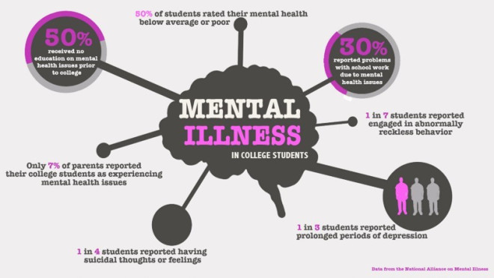
How to Find Mental Health issues
Students who feel sad, fearful, or experience difficulty coping with daily stress, may show symptoms that require professional attention. If symptoms arise, getting immediate help from experts is very important for the mental health of college students.

Slide 26
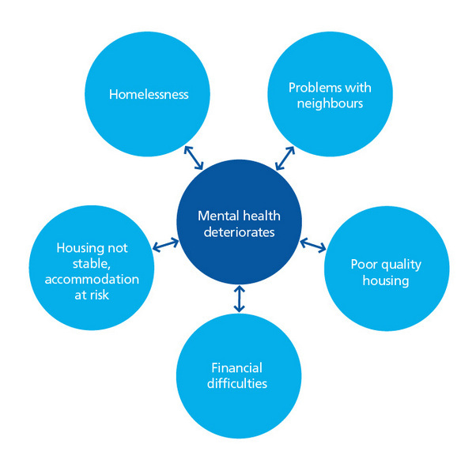
CAUSES OF MENTAL HEALTH ISSUES
Examinations.
Deadline of projects.
Returning to study.
Pressure of combining
paid work and study.

Slide 27

Types of MENTAL Health Issues
Mood disorders
Anxiety problem
Personal problems
Inferiority complex
Socio phobic

Slide 28

Problems Faced by Students:
Disorganization.
Failing to manage money.
Homesickness.
Poor grades
Poor sleep habits.

Slide 29
Goals
Allowing students redo their work
Help with strategies to manage anxiety
Pre planning for group discussions voluntarily

Slide 30
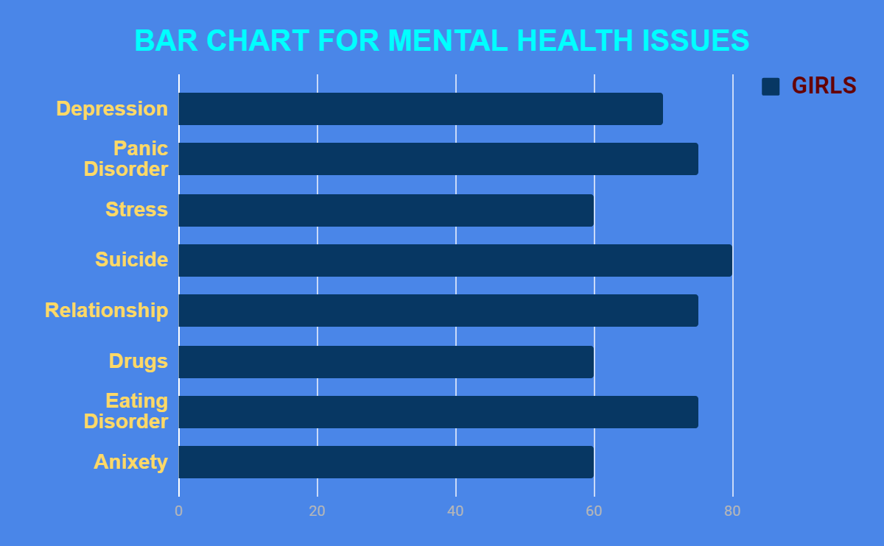

Slide 31

Cause and Effect Diagram
The fishbone diagram is a tool for analyzing Process dispersion. This tool is meant for analyzing the root cause of the problem.

Slide 32
STRESS
ANXIETY
PEER PRESSURE
LACK OF CONCENTRATION
INTERVIEW
EXAM FEAR
DIFFICULTY
SLEEPING
MENTAL
HEALTH
ISSUES
TROUBLE FOCUSING
ELEVATED MOOD
FAILURE
FEELING
WORTHLESS
LACK OF INTEREST
LACK OF
SELF ESTEEM
DEPRESSION
BIPOLAR

Slide 33
WHAT? | WHY? | WHO? | WHERE? | WHEN? | HOW?
Doing Mediation | To get Fresh Mind and relaxation | Faculty | In Lab | Twice a week | By speaking about the own interest .
Counselling | To make awareness of Mental Health issues | Faculty | In Class room | Once a week | By allotting a period in the timetable.
Diverting mind in Volunteer Works | To get to know about Environment | Parents & Faculty | In home & classroom | When required | By making them to join in all kind of compulsory works.
Communicate with Family/Friend | To Know there Relationship | Team members | Classroom & seminar hall | Daily | By giving a situation and make them react according to it .

Slide 34
IMPLEMENTATION

Slide 35
MEENAKSHI COLLEGE FOR WOMEN(AUTONOMOUS)
ACTIVITY SCHEDULE
THEME: MENTAL HEALTH ISSUSES FACED BY STUDENTS
TARGET:40% TO 80%
SL.NO | ACTIVITY |  | Feb-20
 |  |  | 2 | 4 | 5 | 6 | 7 | 9 | 11 | 13 | 17 | 19 | 22 | 24 | 27 | 28
1 | IDENTIFICATION OF PROBLEMS | PLAN
 |  | ACTUAL
2 | SELECTION OF PROBLEMS | PLAN
 |  | ACTUAL
3 | DEFINITION OF PROBLEMS | PLAN
 |  | ACTUAL
4 | ANALYSIS OF PROBLEMS | PLAN
 |  | ACTUAL
5 | IDENTIFICATION OF CAUSES | PLAN
 |  | ACTUAL
6 | FINDING OUT ROOT CAUSE | PLAN
 |  | ACTUAL
7 | DATA ANALYSIS | PLAN
 |  | ACTUAL
8 | DEVELOPING SOLUTION | PLAN
 |  | ACTUAL
9 | IMPLEMENTATION | PLAN
 |  | ACTUAL
10 | CHECKING | PLAN
 |  | ACTUAL

Slide 36
TARGET ACHIEVED
After qc

Slide 37
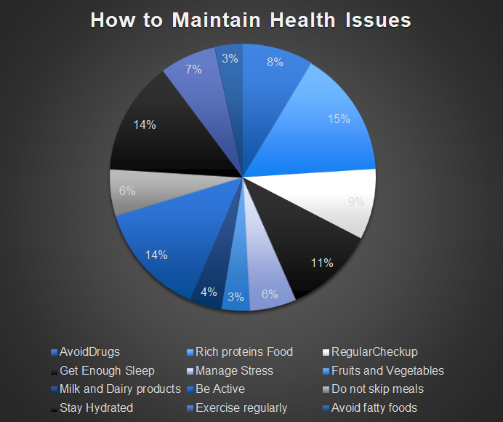

Slide 38
Remedies For Reducing Mental Health Issues
Exercise: Try a fitness classes like Yoga and Meditation.
Sleeping: Set a goal for yourself to be in bed by the same time between 8 to 9 hours every night.
Mental Health : Practice Relaxation techniques like Exercise , Meditation and Deep breathing when you feel stressed.
Don’t be too hard on yourself when your expectations are went wrong.

Slide 39
STUDENTS ADVICED TO FOLLOW UP THE
IMPLEMENTATION OF MENTAL HEALTH ISSUE = 90
STUDENTS WHO BENEFITED BY
FOLLOWING THE ADVICE AND GUIDELINES = 70

Slide 40


Slide 41
PROOF FOR THE SOLUTION
Proof for the solution here is that we have used QC tools in our planning and implementation process. Our implementation and guidelines helped many of the students to recovered from their mental issue.
Among 90 students 70 of them were benefited.
YOU DON'T HAVE TO BE AN EXPERT TO TALK ABOUT MENTAL HEALTH- YOU JUST HAVE TO CARE

Slide 42
Tangible benefits
Good sleep is achieved
Started participating in all activities voluntarily
Improved performance in tests
Sugar levels are reduced

Slide 43
Intangible Benefits
Improved self confidence
Personality development has improved
Friendliness and patience has developed
Improved clear and active mind

Slide 44
QC TOOLS USED
PDCA CYCLE
MILESTONE CHART
TARGET ACHIEVEMENT DIAGRAM
CAUSE AND EFFECT DIAGRAM
BAR CHART.
PIE CHART
5W1H

Slide 45


Slide 46


