Slide 1
Advanced Kubernetes Concepts
Total Duration: 3 Hours (180 minutes)
Architecture, Networking, and Scheduling
Presenter: Karthikeyan Vaiyapuri

Slide 2
Agenda
Introduction & Kubernetes Basics
Kubernetes Architecture Deep Dive
Networking in Kubernetes
Control Plane Components
CNI, DNS, and Services
What is Kubernetes and Why Use It?
Worker Node Components
Core Concepts: Containers, Pods, Nodes
High-Level Architecture
Pod Lifecycle and Scheduling
Lab: Scheduling with Taints/Tolerations
Phases, States, and the Scheduler
Hands-on exercise to control pod placement.

Slide 3
Part 1: Introduction & Kubernetes Basics

Slide 4



What is Kubernetes?
Kubernetes (K8s) is an open-source container orchestration platform.
It automates the deployment, scaling, and management of containerized applications.
Why use it?
High Availability:
Scalability:
Portability:
No single point of failure; automatically restarts and reschedules failed containers.
Scale applications up or down based on demand, manually or automatically.
Runs on-premises, in public clouds (AWS, Azure, GCP), or in hybrid environments. It provides a consistent application layer.

Slide 5
Kubernetes Basics: Core Concepts
1
2
3
Container:
Pod:
Node:
A lightweight, standalone, executable package that includes everything needed to run a piece of software (code, runtime, system tools, libraries).
The smallest and simplest deployable unit in Kubernetes. A Pod represents a single instance of a running process in your cluster.
A worker machine in a Kubernetes cluster. It can be a virtual machine (VM) or a physical machine.
Each Node runs the necessary services to manage Pods and is managed by the Control Plane.
A Pod can contain one or more containers that are co-located, share resources (like networking and storage), and are managed as a single unit.
Example: A Docker container running an NGINX web server.

Slide 6
Core Kubernetes Resource
S.No | Resoures | Functionality
1. | Deployment | Manages ReplicaSets and provides declarative updates for Pods. Handles rolling updates, rollbacks, and scaling
2. | ReplicaSet | Ensures a specified number of Pod replicas are running. Managed automatically by Deployments
3. | Pod | Smallest deployable unit containing one or more containers with shared storage and network

Slide 7
Core Statefulset Resource
S.No | Resoures | Functionality
1. | StatefulSet | Manages Pods with persistent identity, ordered deployment/scaling, and stable network identities
2. | PersistentVolume (PV) | Cluster-wide storage resource provisioned by administrator
3. | PersistentVolumeClaim (PVC) | Request for storage by users, automatically bound to PVs
4. | StorageClass | Defines different storage tiers and provisioning policies

Slide 8
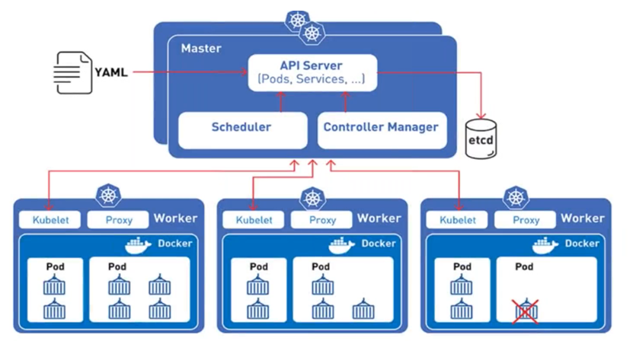
High-Level Kubernetes Architecture
A Kubernetes cluster consists of at least one Control Plane and one or more Worker Nodes.
Control Plane:
Worker Nodes:
The "brain" of the cluster. It makes global decisions about the cluster (e.g., scheduling) and detects/responds to cluster events.
The "muscle" of the cluster. They run the actual applications inside containers.

Slide 9
Part 2: Kubernetes Architecture Deep Dive

Slide 10
Control Plane Components
The Control Plane manages the state of the cluster. Its components are critical for cluster operations.
API Server (kube-apiserver):
1
The front-end for the control plane. It exposes the Kubernetes API, which is how users, management devices, and CLIs interact with the cluster.
etcd:
2
A consistent and highly-available key-value store used as Kubernetes' backing store for all cluster data. Think of it as the cluster's database.
Scheduler (kube-scheduler):
3
Watches for newly created Pods with no assigned Node and selects a Node for them to run on based on resource requirements, policies, and affinity rules.
Controller Manager (kube-controller-manager):
4
Runs controller processes. These controllers watch the state of the cluster and work to move the current state towards the desired state. (e.g., Node controller, Replication controller).

Slide 11
Worker Node Components
Worker Nodes are where your application Pods are scheduled and run.
Kubelet:
Kube-proxy:
Container Runtime:
An agent that runs on each Node. It ensures that containers described in PodSpecs are running and healthy. It communicates with the API server.
A network proxy that runs on each Node. It maintains network rules on nodes and enables network communication to your Pods from network sessions inside or outside of your cluster.
The software responsible for running containers. Kubernetes supports several container runtimes, such as containerd, CRI-O, and historically, Docker.

Slide 12
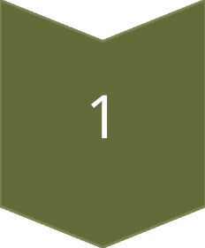
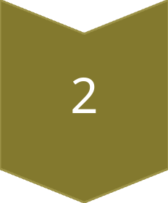
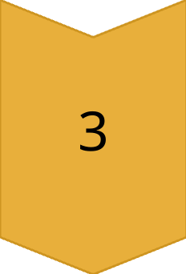
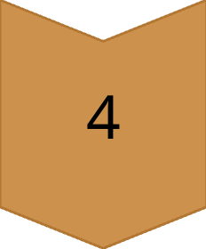
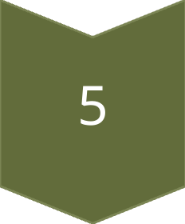
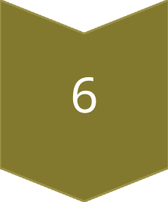
How It All Works Together
User Request
A user (or CI/CD system) sends a request to the API Server to create a new Pod (e.g., using kubectl apply -f pod.yaml).
API Server & etcd
The API Server authenticates the request and writes the Pod's configuration to etcd.
Scheduler Assignment
The Scheduler sees the new Pod with no assigned Node. It evaluates all Worker Nodes and assigns the Pod to a suitable one. It updates the Pod's definition in etcd via the API server.
Kubelet Action
The Kubelet on the assigned Node sees the Pod is assigned to it.
Container Runtime Execution
The Kubelet instructs the Container Runtime to pull the required container images and start the containers.
Kube-proxy Networking
Kube-proxy updates the network rules on the Node to ensure the new Pod is reachable.

Slide 13
Part 3: Networking in Kubernetes

Slide 14
The Kubernetes Networking Model
1
2
Kubernetes imposes a fundamental set of requirements on any network implementation:
All Pods can communicate with all other Pods without NAT (Network Address Translation).
All Nodes can communicate with all Pods (and vice-versa) without NAT.
The IP address that a Pod sees itself as is the same IP address that others see it as.
This creates a flat, clean network space where every Pod gets its own unique IP address across the entire cluster.

Slide 15
CNI (Container Network Interface)
What is it?
How it works?
Popular CNI Plugins:
CNI is a standard/specification for writing plugins to configure network interfaces for Linux containers.
When a Kubelet needs to set up networking for a new Pod, it calls a CNI plugin. The plugin is responsible for:
Assigning an IP address to the Pod's network interface.
Setting up the necessary routes to make the Pod reachable from other Pods and Nodes.
Calico,Flannel, Cilium, Weave Net.
Each offers different features for performance, security, and network policy.

Slide 16
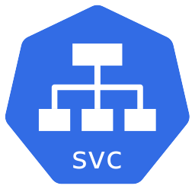
Services: Exposing Your Application
Pods are ephemeral—they can be created and destroyed.
A Service is an abstraction that defines a logical set of Pods and a policy by which to access them.
Types of Services:
ClusterIP (default):
NodePort:
LoadBalancer:
Exposes the Service on an internal IP in the cluster. This makes the Service only reachable from within the cluster.
Exposes the Service on each Node’s IP at a static port. A ClusterIP Service, to which the NodePort Service routes, is automatically created.
Exposes the Service externally using a cloud provider's load balancer. NodePort and ClusterIP Services are automatically created, to which the external load balancer will route.

Slide 17
DNS and Service Discovery
How does one Pod find another using a Service? Through DNS.
Kubernetes provides a built-in DNS service (usually CoreDNS) that automatically creates DNS records for Services.
A Pod in the default namespace can reach a service named my-service simply by connecting to my-service.
A Pod in another namespace (e.g., staging) can reach it at my-service.default.svc.cluster.local.

Slide 18
Part 4: Pod Lifecycle and Scheduling

Slide 19
The Pod Lifecycle
A Pod's status field is a PodStatus object, which has a phase field.
The phase of a Pod is a high-level summary of where the Pod is in its lifecycle.
Phases:
Pending:
1
The Pod has been accepted by the cluster, but one or more of its containers has not been created yet.
This includes time waiting to be scheduled and time spent downloading images.
Running:
2
The Pod has been bound to a node, and all of its containers have been created.
At least one container is still running, or is in the process of starting or restarting.

Slide 20
Phases Continued ...
Succeeded:
3
All containers in the Pod have terminated in success, and will not be restarted.
Failed:
4
All containers in the Pod have terminated, and at least one container has terminated in failure.
Unknown:
5
The state of the Pod could not be obtained, typically due to a communication error with the node where the Pod should be running.

Slide 21
The Kubernetes Scheduler in Detail
The scheduler's role is to assign Pods to Nodes. This is a two-step process:
1
2
Filtering:
Scoring:
The scheduler finds the set of feasible Nodes for a Pod. For example, if a Pod requests 2 CPU cores, the scheduler will filter out any Nodes with less than 2 available cores.
The scheduler ranks the feasible Nodes and picks the one with the highest score. It calculates the score based on a set of rules, like preferring nodes that already have the required container image downloaded or spreading pods across different nodes.

Slide 22
Part 5: Lab - Scheduling and Taints/Tolerations

Slide 23
Agenda
Goal
Learn how to influence where Kubernetes schedules your Pods.
Key Concepts:
Taint: Applied to a Node. It marks the node so that it repels certain Pods.
Toleration: Applied to a Pod. It allows the Pod to be scheduled on a Node with a matching Taint.
User case:
Dedicating a set of nodes for a specific group of users or for running workloads with special hardware (like GPUs).

Slide 24
Part 6: Wrap-up

Slide 25
Summary & Key Takeaways
Architecture:
1
Kubernetes uses a Control Plane (brain) and Worker Nodes (muscle) to manage containerized applications.
Networking:
2
The CNI model provides a flat network where every Pod gets a unique IP. Services provide stable endpoints for accessing ephemeral Pods.
Scheduling:
3
The scheduler intelligently places Pods on Nodes. We can influence this process with tools like Taints and Tolerations.
Kubernetes is a powerful, declarative system for robust application management.

Slide 26
Thank you
&
Q&A

