Slide 1
FITFLEX: YOUR PERSONAL FITNESS COMPANION
TEAM MEMBERS ISWARIYA.G
KAVIYA.S
KARTHIKA.V
ANUSHREE.P
NANDHINI.V

Slide 2
Components of Fitness
Cardiovascular Endurance – Ability of the heart and lungs to supply oxygen (running, cycling, swimming).
Muscular Strength – The power muscles can exert (weightlifting, push-ups).
Muscular Endurance – Ability to sustain repeated effort (planks, squats).
Flexibility – Range of motion in joints (yoga, stretching).
Body Composition – Ratio of fat to lean mass.

Slide 3
Benefits of Staying Fit
Improves mental health and reduces stress.
Enhances immune system.
Promotes better sleep and energy levels.
Strengthens bones, joints, and muscles.
Helps in weight management.
Reduces risk of chronic diseases like diabetes, hypertension, obesity.

Slide 4
Types of Fitness Activities
Aerobic: Running, brisk walking, dancing, swimming.
Strength Training: Gym workouts, resistance bands, bodyweight exercises.
Flexibility: Yoga, Pilates, stretching.
Balance Training: Tai Chi, stability ball, balance board.
Everyday Activities: Walking, cycling, stair climbing, gardening.

Slide 5
Nutrition & Diet
Balanced Meals: Carbohydrates, proteins, fats in correct proportions.
Hydration: 8–10 glasses of water per day.
Natural Foods: Fruits, vegetables, whole grains, nuts, seeds.
Avoid: Junk food, excessive sugar, fried snacks, processed foods.
Meal Timing: Eat smaller frequent meals to maintain energy levels.

Slide 6
Mental Health & Wellness
Stress Management: Meditation, deep breathing, journaling.
Social Health: Spending time with loved ones, building positive relationships.
Work-Life Balance: Prioritize hobbies and relaxation.

Slide 7
Rest & Recovery
Muscles grow during rest, not workouts.
Sleep: 7–9 hours daily.
Include rest days in exercise routine.
Stretching & Cool-downs after workouts prevent injuries.

Slide 8
Tips for a Healthy Lifestyle
Exercise at least 30 minutes a day, 5 days a week.
Stay hydrated and avoid late-night heavy meals.
Maintain good posture.
Reduce alcohol and tobacco consumption.
Go for regular health check-ups.

Slide 9
Conclusion
Fitness is a holistic lifestyle, not just gym workouts.
Balance exercise, nutrition, mental health, and rest.
Stay consistent, set realistic goals, and enjoy the journey toward health.

Slide 10
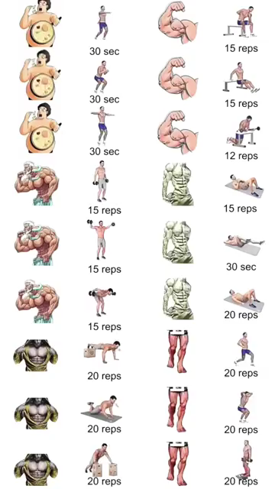
Demo Video

