Slide 1
Farmers Buddy
Software Engineering
Mini Project
Project Mentor
Mr.Biju R Mohan
Asst. Professor
IT Dept, NITK Surathkal
Karthik V Bellur(07IT20)
Praveen Jain(07IT36)
Veeresh B(07IT64)

Slide 2
Functional Requirements
Individual profile management for all kinds of users
Information about various government loan and insurance schemes to farmers
Information about today’s Mandi crop prices
Private firms and Multinational companies can upload the products offered by them.
Information about trainings held for farmers and also request for training
Officers can add/delete/update various crop/fertilizer/location/schemes/soil/market information to/from the database
Farmers can specify which crops/fertilizers/schemes they are currently using which will be useful for analysis and generating reports
Officers can access various reports related to farmers details
Farmers/Students can get their queries answered by Agricultural Officers
Details of Soil/Crop/Location/Fertilizer analysis will be made available to Farmers

Slide 3
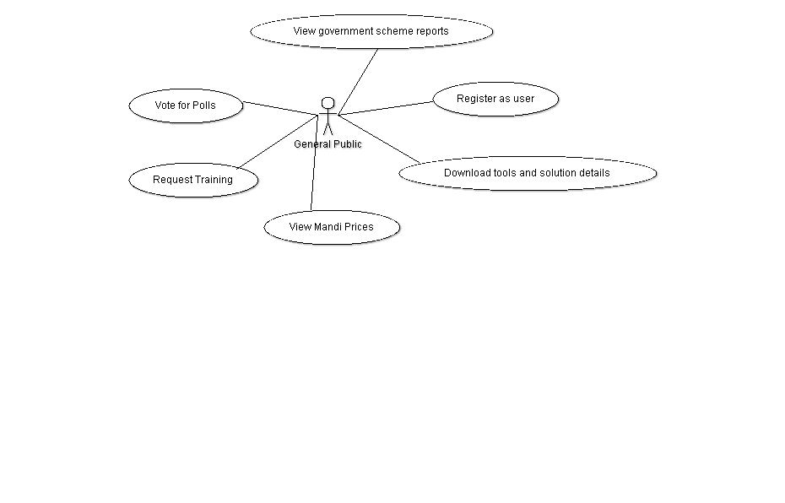
Use Case Diagrams
User : General Public

Slide 4
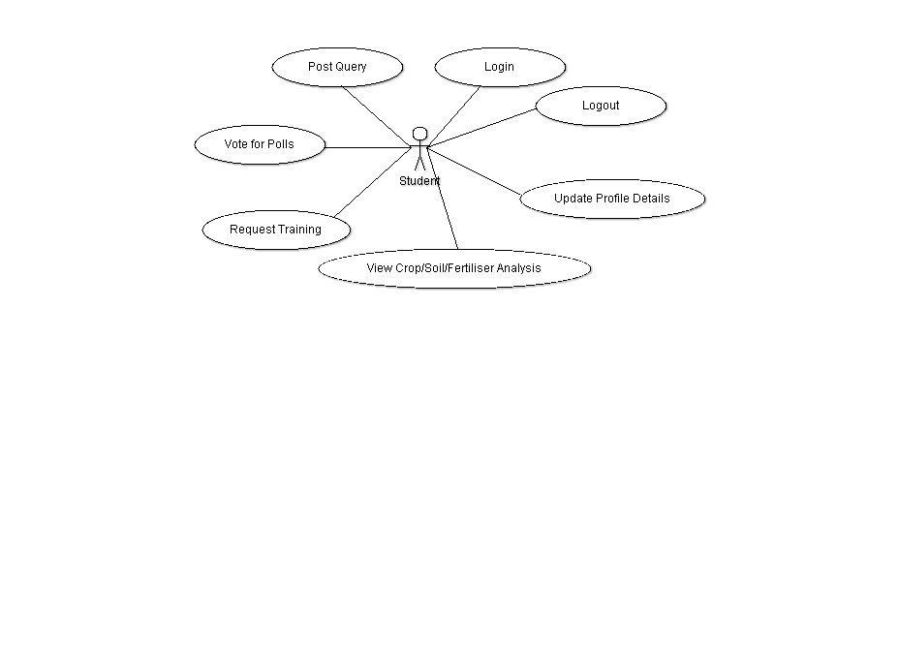
User : Student

Slide 5
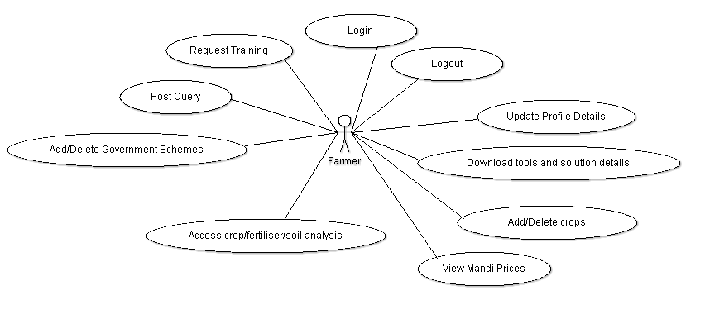
User : Farmer

Slide 6
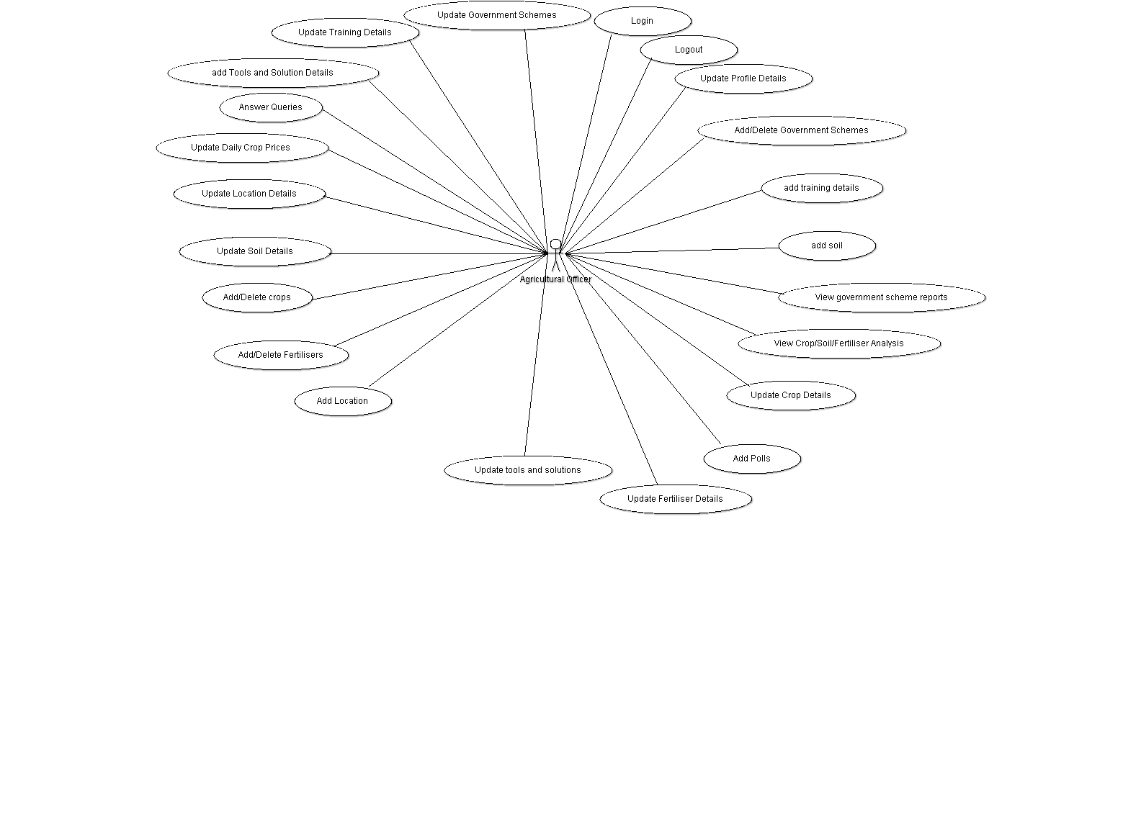
User : Agricultural Officer

Slide 7
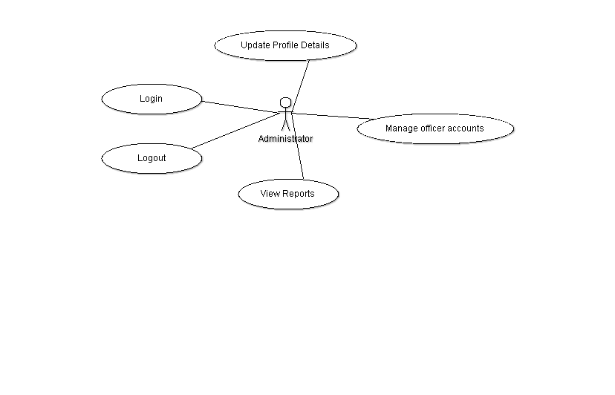
User : Administrator

Slide 8
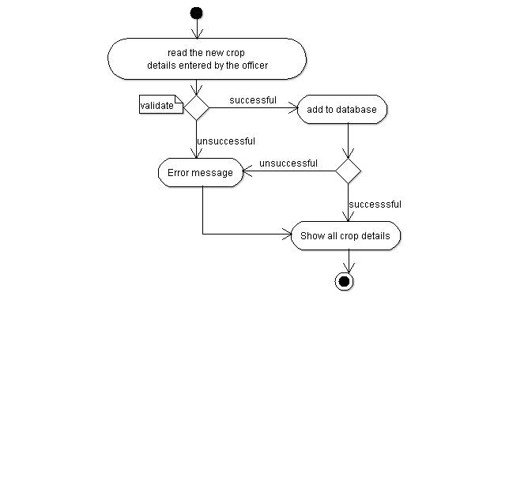
Analysis Diagram
Activity Diagram : addNewCrop()

Slide 9
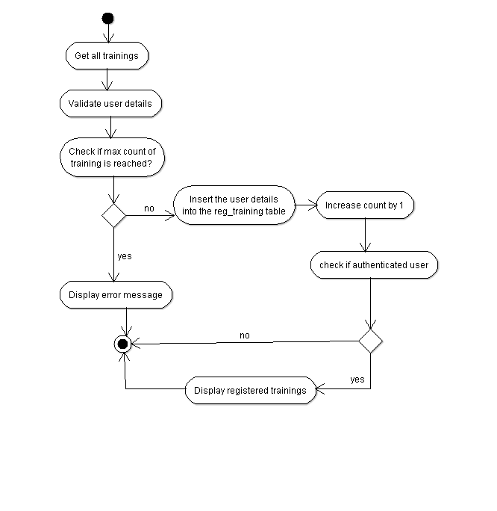
Activity Diagram : registerForTraining()

Slide 10
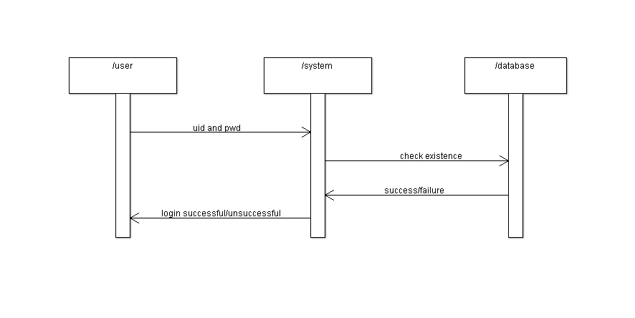
Sequence Diagram : Login UseCase

Slide 11
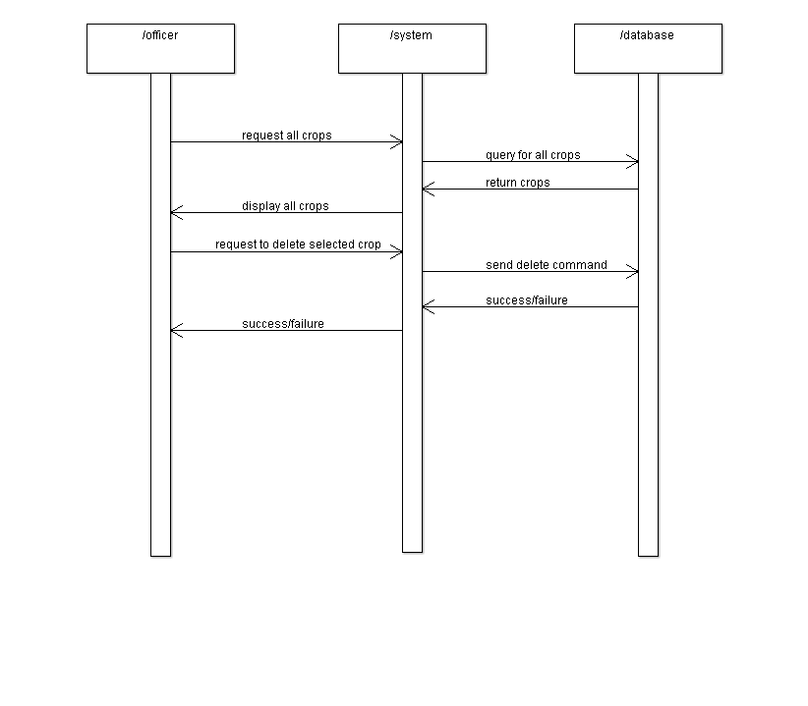
Sequence Diagram : Delete Crop

Slide 12
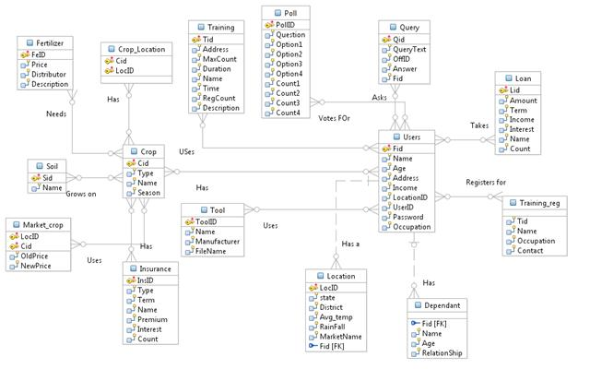
Design Diagram
DB Diagram

Slide 13
Design Patterns Applied
1] MVC Design Pattern
Struts2 based on MVC
“Separation of concerns”
Our App follows MVC architecture
Also, we designed 2 different view layers without touching the business code
2] Decorator/Wrapper/Adapter
Attach additional responsibilities to an object dynamically
CSS(Cascading Style Sheets) - adding styles to plain html which includes text content, images, tables, etc
Jasper Report Generator tool – display report generated in the form of a pdf by using struts2 plugin as a result type

Slide 14
3] Iterator
Provide a way to access the elements of an aggregate object sequentially without exposing its underlying representation.
JAVA Iterator API for traversing all kinds of Collections – maps, lists and sets
4] Bridge
Decouple an abstraction from its implementation so that the two can vary independently.
Separated the interface of DAO from its concrete implementation and used iBatis DAOManager in the Service Layer for automated Dependency Injection of the DAO’s leading to Inversion ofControl(IOC)
5] Command
The command pattern encapsulates a function as an object.
In JUnit, test cases are represented as command objects that implement the interface Test

Slide 15
6] Chain of Responsibility/Intercepting Filter
Avoid coupling the sender of a request to its receiver by giving more than one object a chance to handle the request. Chain the receiving objects and pass the request along the chain until an object handles it.
Struts 2 Interceptors – Ex: AuthInterceptor
7] DispatcherView
Some of the responsibilities of a Controller include managing the choice of and dispatching to an appropriate View. This behavior may be partitioned into a separate component, referred to as a Dispatcher
The FrontController provided by struts2 i.e. the FilterDispatcher provides a “Dispatcher” result type which dispatches control to the specified result page based on the result name.

Slide 16
8] Data Access Object(DAO)
An object that encapsulates and abstracts access to data from a persistent store or an external system
Using dao interfaces and their concrete implementations. Each dao interacts with the DB using sql and populates data into objects. The Action class and dao objects are connected using Business Service Objects(BSO’s)
9] Mediator
Define an object that encapsulates how a set of objects interact. Mediator promotes loose coupling by keeping objects from referring to each other explicitly, and it lets you vary their interaction independently.
The Business Service Objects connects the Action and DAO Objects and thereby reduces the coupling between them. This lets the concrete implementation of DAO class methods to vary irrespective of their usage in the Action classes. The DAO object is abstracted from the Action class using the Service layer

Slide 17
Important Coding Details
We have incorporated the 2 main O.O. design principles mentioned in the GoF book –
Programming to an interface and not to an implementation
Favour Object Composition over inheritance
Also, we have used a lot of design patterns and frameworks, thus incorporating reusablility

Slide 18
Frameworks/Tools/Technologies Used : All Open Source
1. Struts 2 – J2EE Application Framework based on MVC design pattern for building web-applications.
JSP-1
Action
Service
DAO
DB
JSP-2
JSP-3
Application WorkFlow
Model : Action classes, Data Access Objects(DAO’s) and Business Service Objects(BSO’s)
View : JSP’s, freemarker and velocity templates provided by Struts2 and
JSON (Javascript Object Notation) to enable AJAX(Asynchronous JavaScript and XML).
Controller : FilterDispatcher provided by Struts2.

Slide 19
2. iBatis– A set of XML encoded SQL Map files–one for each database table–holds SQL templates that are executed as prepared statements and map the expected results to Java domain classes.
Since we have written all our sql code in xmls, it results in Elimination of dependencies between our application and infrastructural JDBC code by externalising all JDBC code as xml configurations. Also JDBC code is automated using best practices by the framework eliminating SQL injection.
3. HTML/JSP/CSS - for designing views and applying markup
4. Javascript - Used for client-side validation, creation of dynamic links and drop-down menu design
5. AJAX - AJAX functionality at required places using JSON – a lightweight data–exchange format
Ex:- Used to check if a UserID has already been taken by a user or is available

Slide 20
6. Log4j – Apache log4j is a Java-based logging utility used for logging with various levels of logging.
7. SVN(Subversion) – Popular Versioning/Revision Control System used for SCM(Software Configuration Management).
8. MySQL – MySQL is a relational database management system (RDBMS) that runs as a server providing multi-user access to a number of databases. One major advantage of Using MySQL is that it is most popular and is ported to run on almost all major operating systems.
9. JASPER – Report Generation tool used for dynamic generation of PDF’s using predefined compiled JASPER templates
10. JUnit – Unit Testing Framework used for WhiteBox Testing. Used in our app for testing a few DAO’s.
11. Eclipse - Used IDE for development.

Slide 21
12. DBCP – Connection Pooler. Connection pooling can improve the response time of any application that requires DB connections, especially Web-based applications.
13. Apache Tomcat – Lightweight (Web Server + Servlet Container)
Other Features
1. Security: Elimination of –
SQL injection.
Cross-site hacking.
Password Encryption using built-in SHA algorithm.
Session Management and Interceptors for secure pages.
2. Portability
No Vendor locking – does not use any vendor(a particular app container) specific features. No framework intrusiveness into business code.
Browser compatibility

Slide 22
3. Maintainability : By separating dao interface and implementation and adding Business Service Objects(BSO’s)
4. XML Usage – Advantage of using xml’s is that any change in its content does not need re-building of the whole application
XMLs used for –
Writing SQL statements
Configuration of Struts2 framework
Configuration of Log4j framework
Server-side Validation of form data
Designing JASPER templates for report generation

Slide 23
Testing Methods Applied
1. WhiteBox Testing
Using junit testing framework for testing dao’s . 5 steps-
Each class used for testing extends junit.framework.TestCase
Insert object state into DB
Query for same object
Assert object validity by applying domain, sequence and range contraints
using variations of assert keyword
Delete the object state from the DB and do cleanup
2. BlackBox Testing
Manual testing of each screen/view by giving valid and invalid inputs and
documenting the output success/error messages.

Slide 24
Conclusion
The whole project was a nice experience. We learnt a lot of cross-cutting concerns of applications in general – like validation and how using frameworks drastically reduces effort required, development time, cost involved and ultimately results in better design and code.
Use of MVC design pattern allowed “plug and play” of the view layer without affecting business code. As a result we were able to change the whole look and feel(JSP+CSS) of the application without touching the business code.
We learnt how using design patterns in our design/code helps in solving recurring problems while incorporating “best practices”.
We have used current hot, industry specifications like J2EE, jasper reporting, log4j, AJAX, etc. Also following best practices like heavily using xml where ever possible has kept the maintainability and extensibility high.
All in all, we got an idea of how much effort/time/cost it takes to design and build an application using appropriate frameworks.

Slide 25
Future Enhancements
Integration of SSL functionality to deliver secure login using https protocol
User customizable look and feel – using various templates
Introduction of a discussion forum – using JForum
Porting to advanced and highly availability run-times on clouds like Google App Engine
Localization and internationalization – Struts2 support
Adding more formats of report generation like excel (xlsx), CSV, etc.
Implementation of Cache in the server side for faster serving of request. This can be both JSP cache and data cache from database.
Use of UI frameworks like – dojo/jquery/flex enables UI layer widget level reusability and browser independent UI code.
Usage of iBatis in our application for externalizing sql code in xml’s is the first step towards using Object-Relational Mapping(ORM) tools – like Hibernate. Usage of such ORM frameworks in the business layer enables richer domain model and better/quicker DB design

Slide 26
Thank You!!

