Slide 1
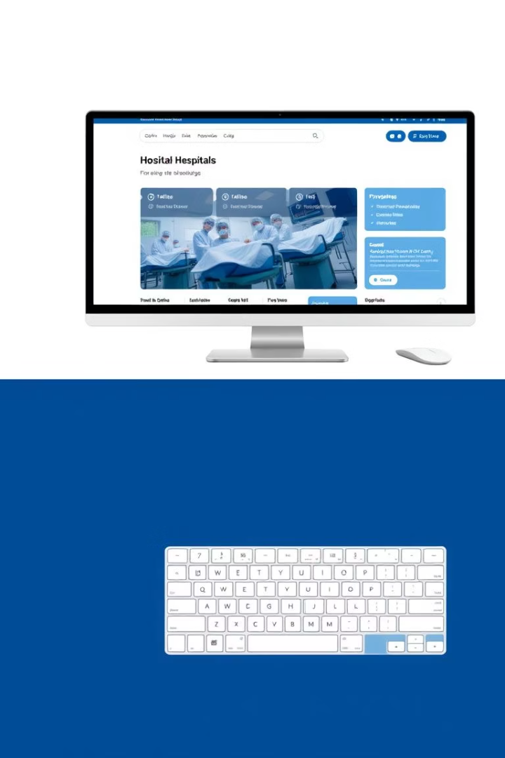
Hospital Management System GUI
A Java-Based Desktop Application for Efficient Hospital Management

Slide 2
TEAMMEMBER DETAILS:-
AP22110011218 B KARTHIK
AP22110011238 Y SAI HARISH
AP22110011241 P BALASWITHA
AP22110011243 S MOULI

Slide 3

Introduction
Objective
Purpose
Develop a user-friendly GUI to manage hospital operations including patient records, doctor info, and appointment scheduling.
Streamline administrative tasks, improve data organization, and ensure efficient scheduling within the hospital environment.
Technologies
Java with Swing for the GUI
MySQL database management
JDBC for connectivity between Java and MySQL

Slide 4
System Overview
Description
Key Features
Tabbed interface organizing patients, doctors, and appointments.
Use of JTabbedPane for intuitive navigation.
Real-time synchronization with MySQL database.
CRUD functionalities: add, update, delete, view records.
Robust input validation and error handling.

Slide 5
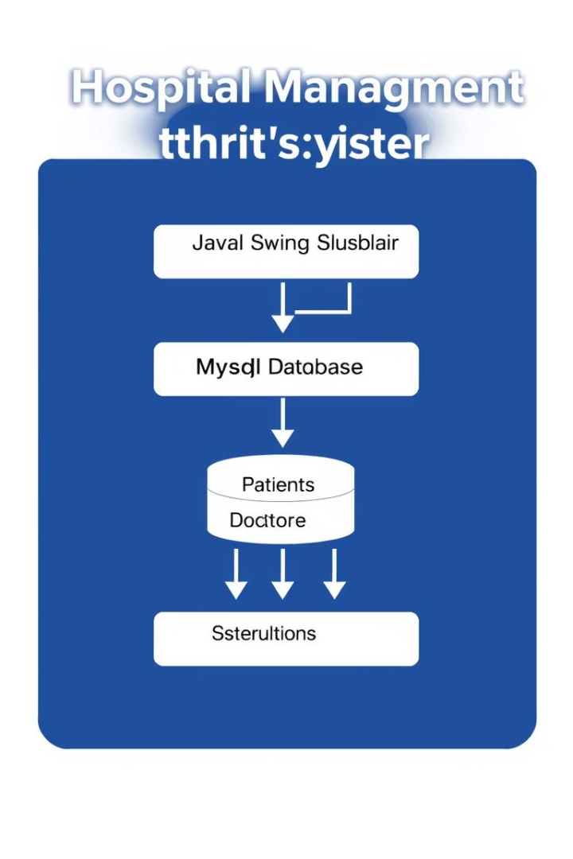
System Architecture
Frontend
Backend
Java Swing components like JFrame, JTable, JTextField, and JComboBox provide interactive GUI elements.
MySQL stores structured data across patients, doctors, and appointments tables with defined relations.
Connectivity
JDBC library facilitates communication between the Java application and the MySQL database.

Slide 6
Key Functionalities
Patient Management
Doctor & Appointment Management
Add patients with name, age, and gender fields.
Manage doctor details including specialization; update or delete as needed.
Update and delete patient records safely including linked appointments.
Book and cancel appointments with validation on doctor availability and date formats.

Slide 7
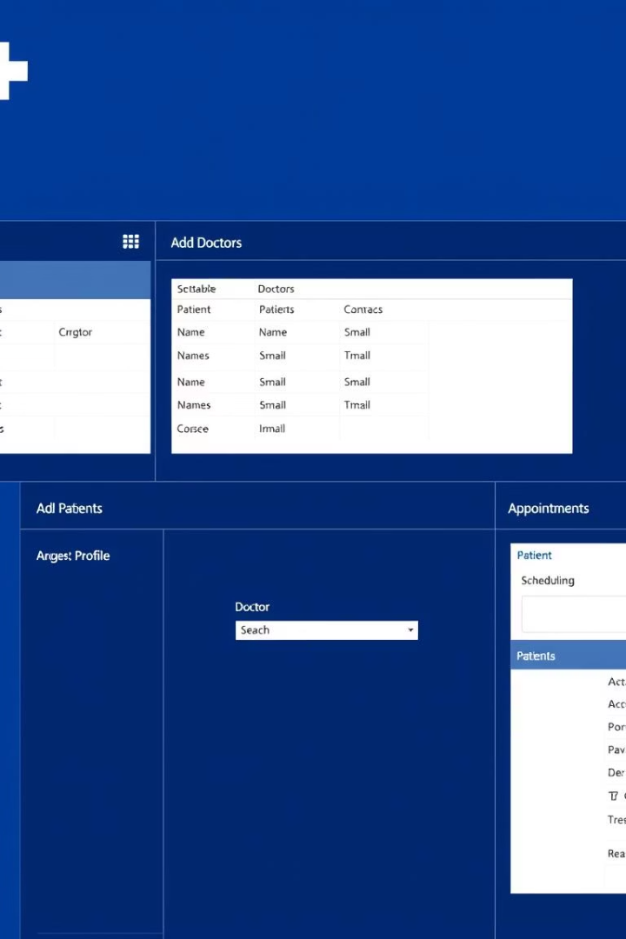



User Interface
Patients Tab
Doctors Tab
Appointments Tab
Displays patient records in a tabular view, with forms for adding, updating, and deleting entries.
Manages doctors' profile info and specializations through interactive forms and lists.
Supports booking and cancellation with combo boxes and date inputs to ensure accurate scheduling.

Slide 8
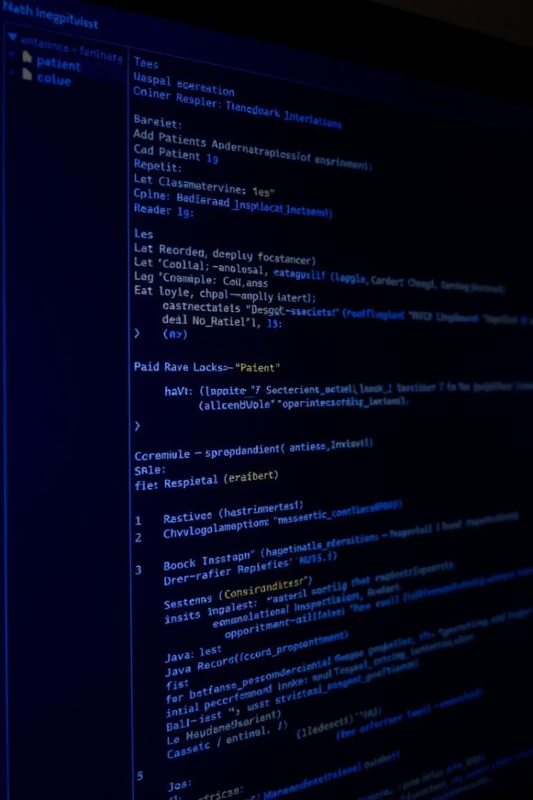
Implementation Details
1
Code Structure
2
Database Interaction
Main class extends JFrame and uses DefaultTableModel for handling table data.
JDBC connects to MySQL via secure prepared statements to prevent SQL injection.
3
Error Handling
Input validations for age and date formats, with exception handling for SQL and number format errors.

Slide 9
Implementation Details
1
Code Structure
2
Database Interaction
Main class extends JFrame and uses DefaultTableModel for handling table data.
JDBC connects to MySQL via secure prepared statements to prevent SQL injection.
3
Error Handling
Input validations for age and date formats, with exception handling for SQL and number format errors.

Slide 10
Advantages and Limitations
Advantages
Limitations
Intuitive tabbed interface simplifies navigation.
Lacks user authentication and role management.
Real-time data updates increase reliability.
Designed for single-user desktop use only.
Scalable database design supports future growth.
Missing advanced features like appointment time slots and notifications.

Slide 11





Future Enhancements
User Authentication
Add admin and staff role-based access for secure multi-user environments.
Time Slot Booking
Implement granular appointment scheduling to improve efficiency and resource management.
Search and Filters
Enable powerful filtering and searching capabilities across patient, doctor, and appointment records.
Web App Migration
Transition to a Java Spring web-based platform for better accessibility and scalability.
Notifications
Integrate email and SMS alerts to reduce no-shows and improve communication.

Slide 12


