Slide 1
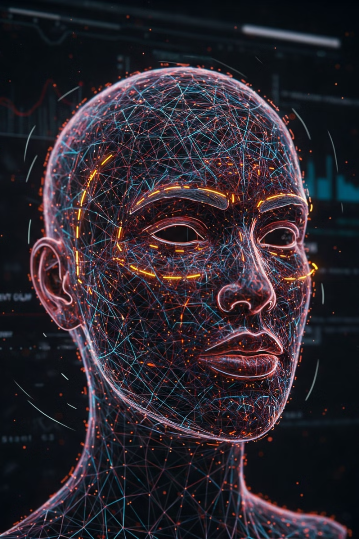

Face Recognition Model in Python: A Deep Dive
This presentation explores the fundamentals of face recognition, delves into its implementation using Python, and showcases real-world applications like presidential identification and automated attendance systems.
by Chamanthi Karthik

Slide 2
Introduction to Face Recognition
What is Face Recognition?
Importance of Face Recognition
Face recognition is the automated process of identifying or verifying individuals based on their facial features. This involves detecting, analyzing, and comparing unique patterns in facial images or video frames.
Enhanced Security: Access control, surveillance, law enforcement
Convenience: Mobile phone unlocking, social media tagging
Personalization: Targeted advertising, customized experiences

Slide 3
How Face Recognition Works: Key Techniques
1
Face Detection
2
Feature Extraction
The first step involves identifying human faces within an image or video frame. Techniques like Haar Cascades, HOG, and CNNs are commonly used for this purpose.
Once faces are detected, unique facial features (e.g., eye distance, nose shape, jawline) are extracted. Methods like LBP and SIFT help identify these distinguishing characteristics.
3
Face Encoding
4
Face Comparison
The extracted features are transformed into a unique numerical representation called a face embedding. Deep learning models like FaceNet, DeepFace, and VGGFace excel at this task.
Finally, encodings of unknown faces are compared with known faces in a database to determine similarity. Techniques like Euclidean distance and cosine similarity are employed for comparison.

Slide 4

Implementation in Python: Required Libraries
OpenCV
OpenCV (Open Source Computer Vision Library) is a powerful library for image and video processing, providing functions for basic image manipulation, feature detection, and more.
dlib
dlib is a comprehensive machine learning library that offers state-of-the-art algorithms for face detection, landmark detection, and face recognition.
face_recognition
The face_recognition library is built on top of dlib and provides a user-friendly Python interface for face recognition and manipulation tasks.
NumPy
NumPy is the fundamental library for numerical computing in Python, offering tools for array manipulation, mathematical operations, and data analysis.

Slide 5





Face Recognition Pipeline: Steps in Python
Face Detection
Face Alignment (Optional)
Face Encoding
Face Comparison
Use a suitable detector (e.g., dlib's HOG detector) to locate faces in the image. This step identifies potential faces within the image.
Generate a unique 128-dimensional face embedding for each detected face using a deep learning model. This representation captures the essence of a face.
Compare the encodings of unknown faces with known faces in a database. This step determines the similarity between faces based on their embeddings.
Adjust the detected faces to a standard position for consistent feature extraction. Aligning features like eyes and mouth ensures uniform comparison.

Slide 6
Application 1: Presidential Face Recognition System
Data Collection
1
Gather a dataset of images and videos of US presidents from historical archives and sources. This dataset provides training data for the model.
2
Training
Train a face recognition model on the collected dataset to learn distinctive facial features of each president. This step teaches the model how to recognize individual presidents.
Testing
3
Evaluate the model's performance on a separate test set to assess its accuracy in identifying presidents from unseen images or videos. This step ensures the model generalizes well to new data.
4
Integration
Integrate the trained model into a user interface that allows users to upload images or videos of historical figures and identify potential presidents. This step makes the system accessible and user-friendly.

Slide 7
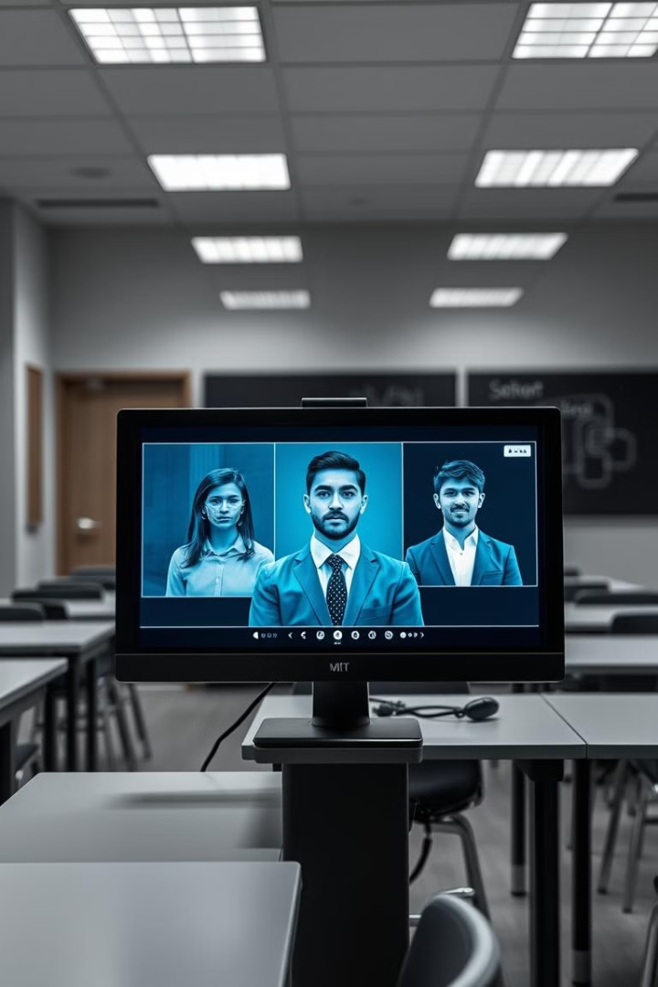




Application 2: Face Recognition-Based Attendance System
Enrollment
Students or employees register by providing a set of face images to the system. This step creates a database of known faces for attendance tracking.
Attendance Marking
The system captures images of attendees during class or work hours using a webcam or other video source. This step collects data for attendance verification.
Face Recognition
The system analyzes captured images and identifies individuals by comparing them to the enrolled faces. This step identifies attendees based on their facial features.
Attendance Recording
Attendance data is automatically recorded and stored in a database, providing a reliable record of attendance for students or employees. This step ensures accurate and efficient attendance tracking.

Slide 8



Conclusion and Future Enhancements
Accuracy & Robustness
Improve the accuracy and reliability of face recognition in challenging conditions like low lighting, occlusion, and variations in pose.
1
Privacy & Security
2
Develop more privacy-preserving face recognition techniques that safeguard sensitive data and protect individuals' privacy.
Multi-Modal Integration
3
Integrate face recognition with other biometric modalities like voice recognition and fingerprint recognition for enhanced security and identification.

