Slide 1
What’s Happening Around Me WHAM- v 1.0
Northeastern University
Powered by:
Joy
e
Roop
Karthik
Sandeep
© JeRKS-2015

Slide 2
Agenda
Northeastern University
Problem statement
The Problem
The Solution
WHAM: The application
Features
Business impact
Architecture of project
Results and Tests
What went right
What could have been better
Operational and management Manual
SHOWDOWN!
© JeRKS-2015

Slide 3
Problem Statement
Northeastern University
WHAM v 1.0

Slide 4

The Problem
Northeastern University
Im bored !!! let me head out somewhere
Naaah not the usual restaurants, shopping malls and theaters
How about some cool events like Concerts, Farmer market, Disco party etc
Okay lets go to Eventbrite and check out events... but wait, no map ... That’s sad ☹
Can I create my own parties and
activities and invite my friends?

Slide 5
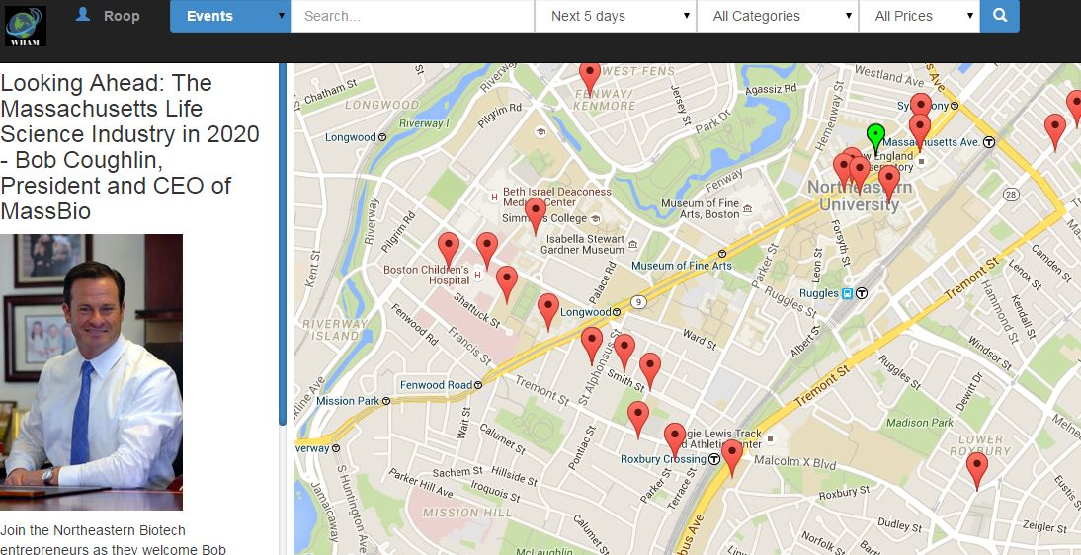

The Solution
Northeastern University
An application which
displays all the events and
activities around me.
guides me how to reach the
event using maps…
can give me in depth details about an event
can allow me create my own events and activities
Introducing WHAM!

Slide 6
Feature List -1
Northeastern University
WHAM is a fully responsive web application
Allows users to register and login with our app to save profile and preferences
Users can use the WHAM application to explore events around them
Maps integration to display the accurate location of an event
Not just that, it gives direction, ETA and distance from current location to event venue
WHAM allows to filter events based on their own areas of interest

Slide 7
Feature List -2
Northeastern University
WHAM allows its registered users to create their own events
Search based on various filters like Event name, Address, Price, Category etc.
User can DISLIKE a particular event which they are not interested in.
User also can summarize the events visited by them in the history page.

Slide 8
Why do we care? Business Impact
Northeastern University
Providing platform for smaller enterprises.
Display advertisements for users. Only registered users can escape from ads menace.
Generate revenue from endorsement links and click through to other sites.
$$$$ from paid events created in WHAM.

Slide 9
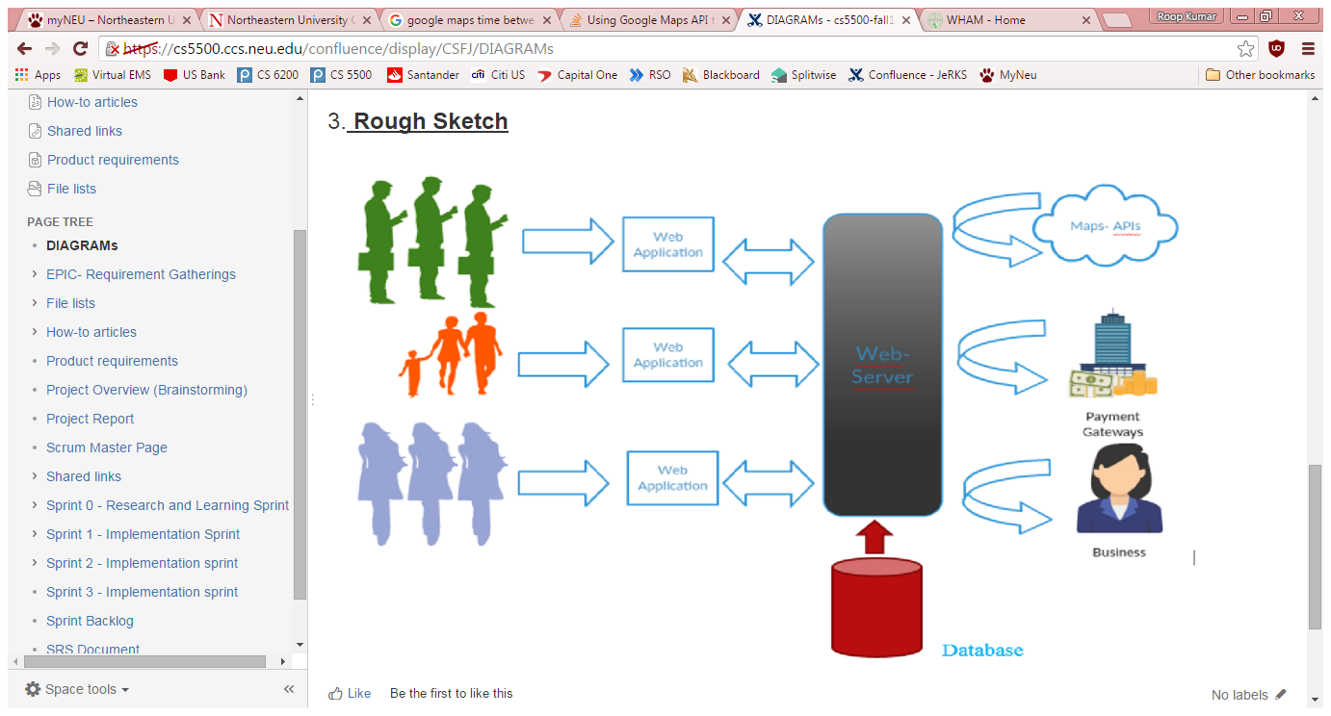
How we designed it…1 Architecture of project
Northeastern University
Overview:

Slide 10
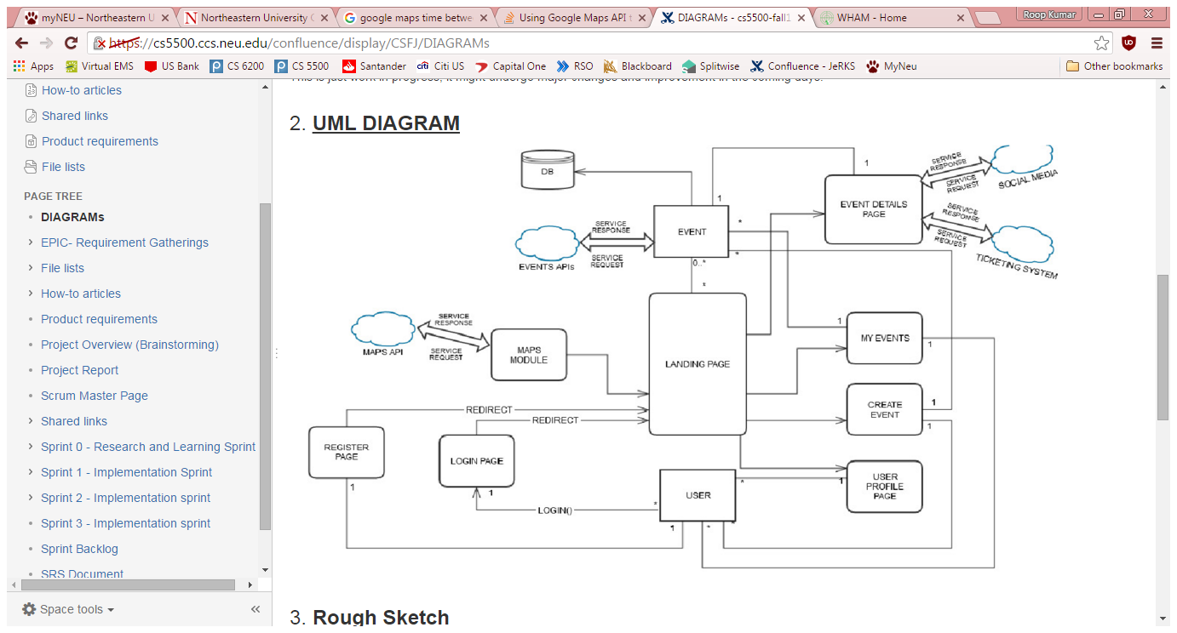
How we designed it…2 Architecture of project
Northeastern University
UML Diagram

Slide 11
How we designed it…3 Architecture of project
Northeastern University
Software stack used
Framework: Spring Web MVC
IDE: Eclipse
Programing -JAVA, JS, HTML, ANGULAR, JPA
Testing - JUnit
Database - MySQL
Continuous Integration - Jenkins
Hosting - OpenShift

Slide 12
How robust is our code Results and Tests
Northeastern University
Lines of codes written
~16K lines of code
No of UI test cases
UI tests cases : 196
No of tests run : 196
No of test passed : 186
No of test failed: 10
No of back end test cases: 98
No of tests run on Jenkins: 25
No of tests run on eclipse : 73
No of total test passed: 94
No of total test failed: 4
TOTAL TESTS : 293 TEST PASSING %: 95.22
Link to ALL REPORTS
Link to BUG FOUND/FIXES

Slide 13
Did we really satisfy our client
Northeastern University
No of requirements we came up with during requirement specification
61
No of requirements we implemented in our sprints.
52
LINK : SRS Document
LINK : Sprint Backlog Tasks
LINK : Sprint Pages

Slide 14
So, what went right…
Northeastern University
Had a release !!!!!
Major requirements of clients such as user login, events on maps, user preferences were fulfilled
Additional features like create user events and dislike features were added
Hybrid data from more than 1 data sources like EventBrite, EventFul and Database Events
Followed Agile incremental style development methodology
Retrospective post sprints helped in estimating status of application
We got the MAVEN project deployed on Openshift

Slide 15
And What could have been better…..
Northeastern University
More documented coding
Knowledge transfer on technologies used
More pair programming
Learning curve of technical knowledge of tools used like Openshift, Spring MVC, Jenkins while working in agile environments
Lack of documentation from Openshift
Using JIRA could have helped in tracking tasks

Slide 16

How do we use your application? Operational and management Manual
Northeastern University
Here is a video that explains how to get started and where to find help.

Slide 17
SHOWDOWN!!
Northeastern University
LIVE SITE:
jerks-cs5500.rhcloud.com

Slide 18
THANK YOU!
Northeastern University
MIKE ROCKS!!!

