Slide 1
WIRE LESS NOTICE BOARD
Ch.Karthik
Ch.Vaishnavi
Ch.Navya
Ch.Sai
Ch.Naveen

Slide 2
Purpose of notice board:
Now a days conveying messages at large using notice boards are widely used ones ranging from schools to organizations. We know the significance of notice boards in public areas like bus stands, railway stations, airports, and banks, etc. But day to day changing these boards is a very difficult task and a waste of time.This notice board displays the information on LCD display whatever you send from the mobile.

Slide 3
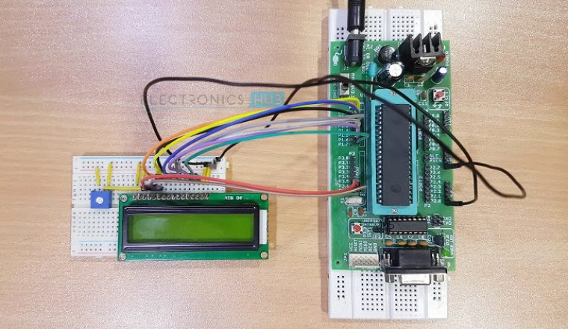

Slide 4
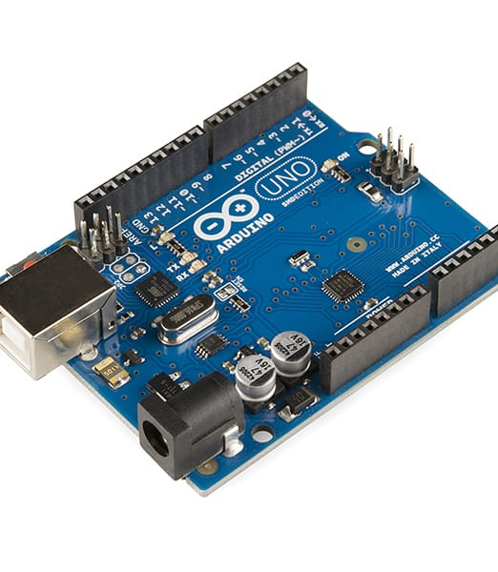
Ardunio:
Arduino is a prototype platform (open-source) based on easy-to-use hardware and software. It consists of a circuit board, which can be programmed (referred to as a microcontroller) and a ready-made software called Arduino IDE (Integrated Development Environment), which is used to write and upload the computer code to the physical board.

Slide 5
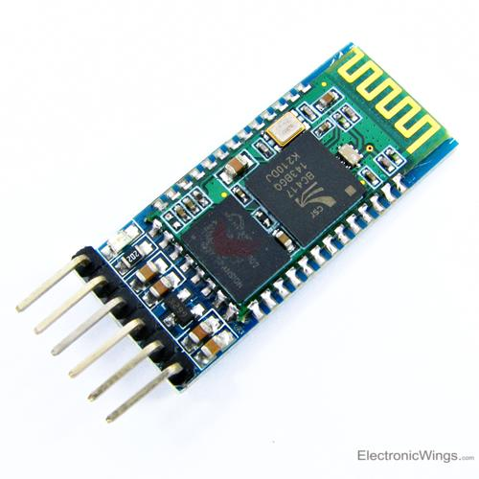
Bluetooth module:
It is used for many applications like wireless headset, game controllers, wireless mouse, wireless keyboard and many more consumer applications.
It has range up to <100m which depends upon transmitter and receiver, atmosphere, geographic & urban conditions.
It is IEEE 802.15.1 standardized protocol, through which one can build wireless Personal Area Network (PAN). It uses frequency-hopping spread spectrum (FHSS) radio technology to send data over air.

Slide 6
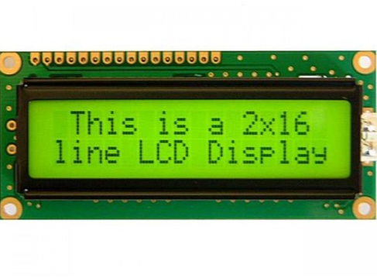
LCD Display:
LCD (Liquid Crystal Display) is a type of flat panel display which uses liquid crystals in its primary form of operation.
LEDs have a large and varying set of use cases for consumers and businesses, as they can be commonly found in smartphones, televisions, computer monitors and instrument panels.

Slide 7
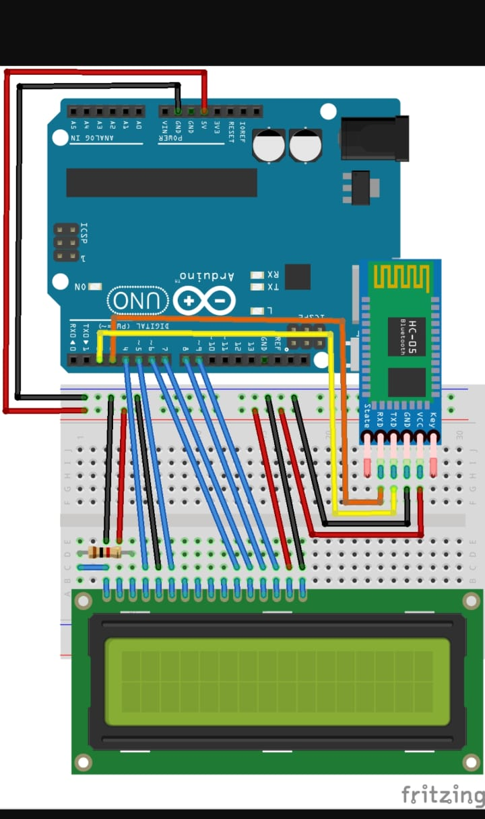
Circuit diagram:
We connected both ardunio, breadboard, ardunio,bluetooth module and LCD display through the jumper wires.

