Slide 1
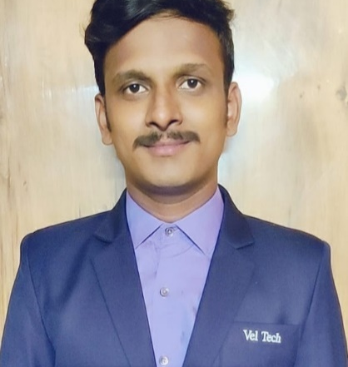

Karthik Chittabathini
Analyst/Software Engineer
Bachelor of Technology,
Computer Science Engineering : 2018-2022.
Completed Azure Fundamentals certification(AZ-900)
Chennai
chittabathinikarthik@gmail.com
Skills
+91 7550245985
C# | Basics, OOPS, Exception Handling ,Arrays ,Collection and Generics, Delegates and Events, File Io and Serialization.
.NET Framework | Architecture which includes CTS,CLS,FCL,BCL and CLR.
Ado.net | Basics Architecture
Database | SQL
Tools | GIT, POSTMAN
UI Technology | HTML5 ,CSS & Angular
Add On Skills | Communication Skills, Team Management.
A4
Full Stack Developer
Understanding of RDMS concepts using SQL Server.
Practical understanding of C# and SQL concepts using Visual Studio and SQL Server
Hands on experience in developing applications using .NET Framework, ADO.NET Core
Understanding of HTML5 , CSS and Angular Cli
Azure cloud fundamentals knowledge
Completed case study on Pharmacy Management System which is a Web based System where doctor can easily find required drugs from the website. This project will break the old fashioned way of buying drugs from the supplier directly. In this project the doctor can directly buy required drugs from supplier in just one click and then the order will be processed by the admin. It saves a lot of time to doctor. Doctor needs to Login. By Login doctor can decide which service he/she has needs.
Technologies used:
ANGULAR
ASP.NET CORE
Microsoft SQL Server
Video Link : Click
GitHub Link

