Slide 1
Efficient Data Flow Graph Modeling using Free Poisson Law for Fault-Tolerant Routing in Internet of Things
Dr.P.B.Pankajavalli
Principal Investigator – DST ICPS
Department of Computer Science
Bharathiar University
Coimbatore, India
G.S.Karthick
Senior Research Fellow – DST ICPS
Department of Computer Science
Bharathiar University
Coimbatore, India

Slide 2
Presentation Outline
Introduction
Related Works
Proposed Method
Network Modeling and Routing Procedure
Efficient Data Flow Graph Modeling using Free Poisson Law (EDFGMA-FPL) Algorithm for Fault-Tolerant Routing
Experimental Results and Performance Evaluation
Conclusion
Acknowledgment
References

Slide 3
Introduction
Wireless Sensor Network (WSN) consists of finite sensor devices which are dispersed geographically usually in an indoor or outdoor predefined environment.
The objective of WSN is to collect environmental data and the location of the nodes may be previously known or unknown a priori.
Nodes in the network communicate with all devices and based on the application such communication describes a mesh or star topology.

Slide 4
Related Works
While designing the wireless sensor networks the concentration should be made on sensor nodes to improve its functional time.
While designing processes, many failures may occur among sensor nodes due to volatility during the broadcast, environmental impact, problems in hardware, radio nosiness, interruption of other nodes, and battery exhaustion.
Moreover, there is a failure in the base station due to hardware disfunction, software problems, and planned attacks.
Therefore, it is significant to design the wireless sensor network which must be able to tolerate the fault which is done by building a fault tolerance system, which contains less likelihood of false alarms and more likelihood of fault credentials.

Slide 5
Related Works
Yinghua tong et al. (2020) suggested the Static Backup and Dynamic Timing Monitoring (SBDTM) fault tolerance method, which was based on the Markov model with reliability calculation.
Jenn-Wei Lin et al. (2019) suggested a bipartite-flow graph (BFG) can model to find the likelihoods of faults between the fault and un-fault cluster head.
Rong et al. (2012) introduced a framework namely Adaptively Fault-tolerant Topology Control (AFTC) to allocate resources in the network.
Bari et al. (2012) suggested a novel Integer Linear Program (ILP) tolerates the fault by accurately considering the less number of relay nodes and sensor nodes in the network by effective the load balancing condition.

Slide 6
Related Works
In general, efficient cluster-based routing is employed for data transmission in WSN.
When CH fails, data sensed by the sensor nodes cannot be transmitted by this faulty CH.
Consequently, the gateway or sink has not sensed the data in the IoT sufficiently.
Hence, processing information in the field was deeply affected.
This contribution focuses on paired fault-tolerant cluster routing in a routing graph and introduces a new approach to solving this problem.

Slide 7
Proposed Method
Static sink used in IoT applications leads to clusters close to the sinks dying out faster as CH forms a fixed route for data routing, which results in network failure.
To mitigate the fault oriented constraints in CH, a specific Data Flow Graph Modeling with Free Poisson Law is used here which follows the cluster head selection as well as routes data to mobile sink or the static CH by overcoming the fault in the links.

Slide 8
Network Modeling and Routing Procedure
Network contains a collection of sensor nodes that are dispersed uniformly over a network.
The groupings of sensors are formed according to CH. The Base Station is located on every sensor zone.
All CH and BS will not adjust over the entire cycle.
SN’s are uniform, however, each node that is allotted to a well-defined ID which depends upon the transmission range.
In WSN, the following properties apply to network models:
SNs are forever static and their position is unchanged; whereas, these nodes collect data from the surrounding area that is then transmitted to BS via wireless communication.
All SN abstracts the ID of the redundant information is fused.
Nevertheless, they cause failure if those sensor nodes have zero energy.
Hence the nodes are continuously adjust their power level as the level of transmitting power decreases.

Slide 9
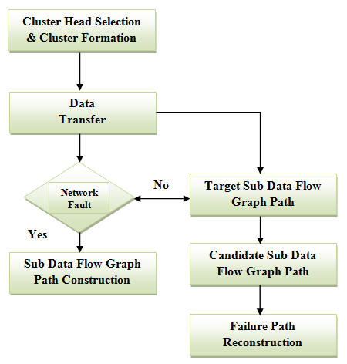
Efficient Data Flow Graph Modeling using Free Poisson Law (EDFGMA-FPL) Algorithm for Fault-Tolerant Routing

Slide 10
Experimental Results and Performance Evaluation
In this research work, the network is composed of different sensors with a versatile population of between 100 and 500 sensor nodes that has been dispersed randomly in a mesh network around an area of 1000 by 1000 m2.
The Network Simulator-2 (NS2) is utilized for the simulation of the proposed and existing algorithms.
The experimental analysis was conducted and the achieved results were evaluated with the results of contemporary fault-tolerant techniques discovered in the literature, including the BFG, DFTA, and SBDTM algorithms.

Slide 11
Experimental Results and Performance Evaluation
The proposed EDFGMA-FPL algorithm is compared and evaluated with the recent algorithms using the below-mentioned performance metrics:
Packet Delivery Ratio
Average Delay
Dissipated Energy
Latency
Throughput

Slide 12
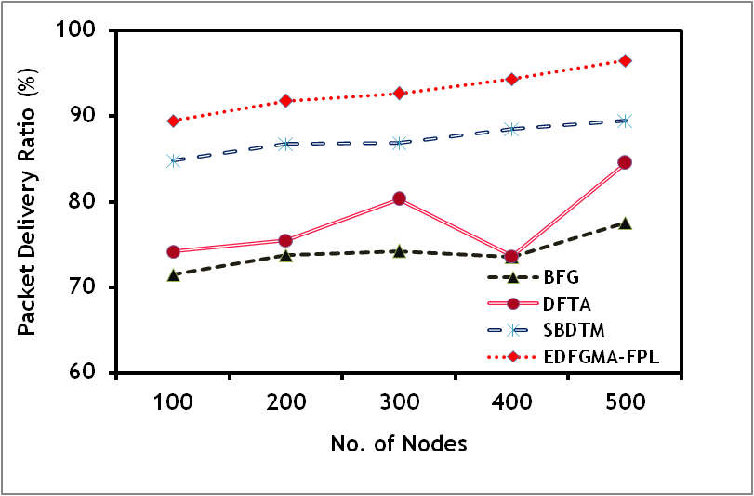
Packet Delivery Ratio vs Number of Nodes

Slide 13
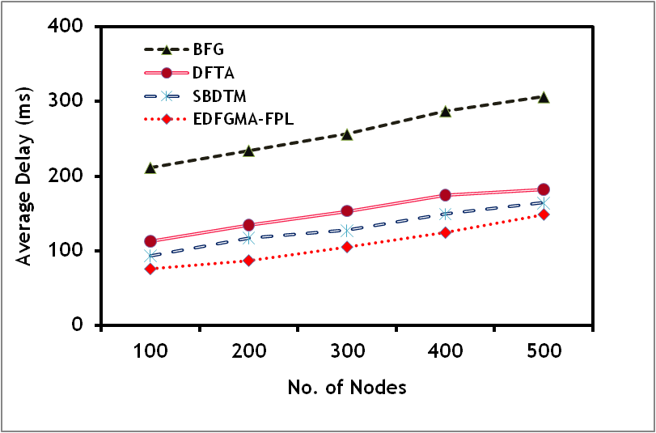
Average Delay vs Number of Nodes

Slide 14
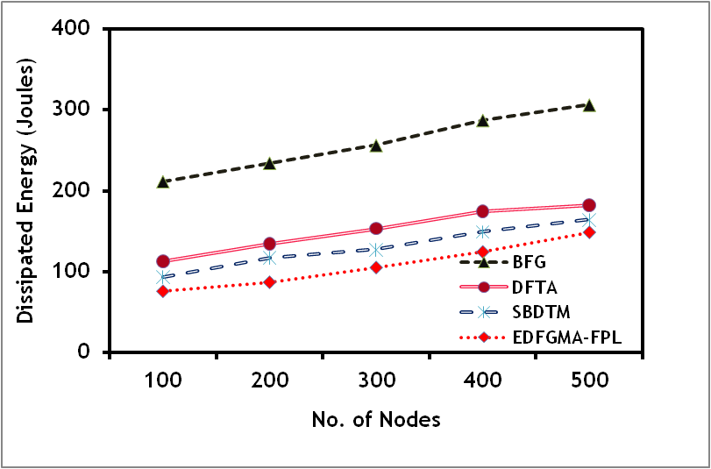
Dissipated Energy vs Number of Nodes

Slide 15
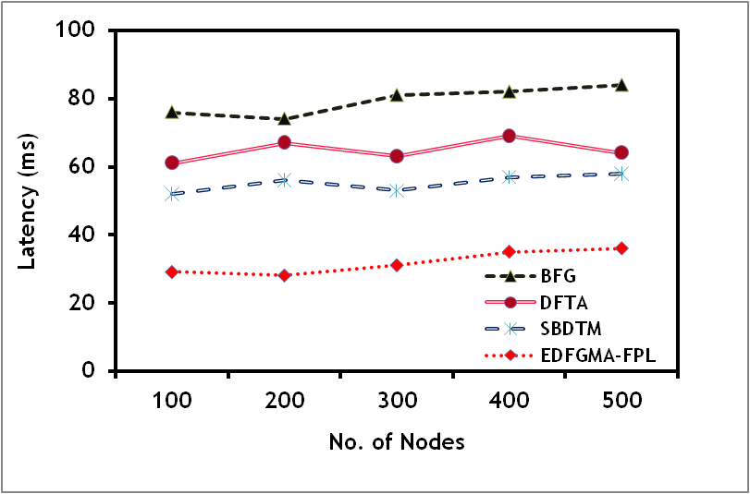
Latency vs Number of Nodes

Slide 16
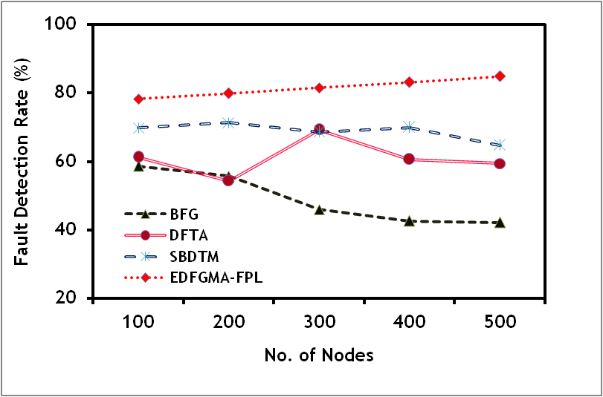
Fault Detection Rate vs Number of Nodes

Slide 17
Conclusion
This research work has been focused on resolving the problems of the IoT and WSN fault-tolerant cluster routing for the heterogeneous property of sensor nodes.
The proposed EDFGMA-FPL algorithm is developed to improve the routing by reducing the fault in the network. The cluster and cluster head formation is discussed with the energy dissipation model.
The assumption is made to construct the occurrence of a fault in the network and then it is overcome by the proposed EDFGMA-FPL algorithm.
The proposed EDFGMA-FPL algorithm tolerates the CH faults effectively by constructing a data flow graph model using free poisson law and it achieves 81.45% of fault detection rate.

Slide 18
Acknowledgment
The work of P. B. Pankajavalli and G. S. Karthick were supported by the Department of Science and Technology—Interdisciplinary Cyber-Physical Systems (DST-ICPS), New Delhi, India, under Grant DST/ICPS/CPS-Individual/2018/193.

Slide 19
References
Singh M, Lal, N, Sethi, M & Poonia, S 2010, ‘A tree based routing protocol for mobile sensor networks (MSNs)‘, International Journal on Computer Science and Engineering, vol. 1, no. 1, pp. 55-60.
Tripathi, A, Gupta, HP, Dutta, T, Mishra, R & Shukla, KK 2018, ‘Coverage and connectivity in WSNs: A survey, research issues and challenges‘, IEEE Access, vol. 6, pp. 26971-26992.
Shahzad, MK & Cho, TH 2017, ‘An energy-aware routing and filtering node (ERF) selection in CCEF to extend network lifetime in WSN‘, IETE Journal of Research, vol. 63, pp. 368-380.
Tong, Yinghua, Liqin Tian, Lianhai Lin & Zhigang Wang 2020, ‘Fault Tolerance Mechanism Combining Static Backup and Dynamic Timing Monitoring for Cluster Heads‘, IEEE Access, vol. 8, pp. 43277-43288.
Hu, Shihong & Guanghui Li 2018, ‘Fault-tolerant clustering topology evolution mechanism of wireless sensor networks‘, IEEE Access, vol. 6, pp. 28085-28096.
Lin, Jenn-Wei, Pethuru Raj Chelliah, Meng-Chieh Hsu & Jia-XinHou 2019, ‘Efficient fault-tolerant routing in IoT wireless sensor networks based on bipartite-flow graph modeling‘, IEEE Access, vol. 7, pp. 14022-14034.
Michaelides, Michalis, P, Christos Laoudias & Christos G Panayiotou 2014, ‘Fault tolerant localization and tracking of multiple sources in WSNs using binary data‘, IEEE Transactions on Mobile Computing, vol. 13, no. 6, pp. 1213-1227.
Rong Duh, D, Pei Li, S & Cheng, V 2013, ‘Distributed Fault-Tolerant Event Region Detection of Wireless Sensor Networks‘, International Journal of Distributed Sensor Networks, pp. 1-8.
Rong-rong, Y, Bin, L, Ya-qian, L & Xiao-chen, H 2012, ‘Adaptively fault tolerant topology control algorithm for wireless sensor networks‘, Journal of China Universities of Posts and Telecommunications, vol. 19, no. 2, pp. 13-18.
Bari, A, Jaekel, A, Jiang, J & Xu, Y 2012, ‘Design of fault tolerant wireless sensor networks satisfying survivability and lifetime requirements‘, Computing Communications, vol. 35, no. 3, pp. 320-333.

