Slide 1

BeatBard – A Discord Bot
MAJOR PROJECT - I
Under The Guidance of
Dr. G.S Karthick,
Assistant Professor Department of Software Systems
PSG College of Arts & Science
Coimbatore - 641 014
PRESENTED BY
KARTHIK CHOCKALINGAM V (20MSS017)
Department of Software Systems
PSG College of Arts & Science
Coimbatore - 641 014

Slide 2
ABSTRACT:
Discord is an instant messaging and VoIP social platform used to communicate with voice calls, video calls, text messaging, media and files in private chats or as part of communities called "servers".
A server is a collection of persistent chat rooms and voice channels which can be accessed via invite links.
The primary objective of the project is to design and implement a set of features that facilitate community interaction and simplify administrative tasks.
The bot will possess capabilities such as channel moderation, user management, music services and customizable commands and responses.

Slide 3
EXISTING SYSTEM STUDY:
Basic Music Playback:
Bots can join voice channels and play music from a predefined playlist. Users can request songs using simple commands.
Fixed Prefix :
Bots responds to commands with a predefined prefix (“ / ”). This means that all commands must start with this prefix.
Basic Commands:
It has basic commands like ‘/play’ and ‘/resume’ to control music playback, and ‘/stop’ to stop playback and disconnect the bot from the voice channel.

Slide 4
PROPOSED SYSTEM STUDY:
Advanced Music Features:
Adding features like queue management, skipping songs and tuning volume. (e.g., ‘!queue, !skip’, ‘!volume’).
Dynamic Prefix:
Allow server administrators to set custom command prefixes on a per-server basis. This makes it more customizable
for each server that BeatBard joins.
Text-Based Commands:
Enable text-based commands for controlling the bot, such as sending a direct message to the bot with a command to
play a specific song or change settings.
Documentation & Help Commands:
Create a comprehensive help system with detailed documentation accessible through ‘!help’ commands.
This should explain how to use all the bot's features.

Slide 5
HARDWARE SPECIFICATIONS:
PROCESSOR : AMD Ryzen 5 4600H
HARD DISK : 1 TB
RAM : 8 GB
SYSTEM TYPE : 64-bit operating system, x64-based processor

Slide 6
SOFTWARE SPECIFICATIONS:
OPERATING SYSTEM : Windows 11
THIRD PARTY TOOLS : Discord , Discord Developer Portal
LANGUAGES USED : Python (discord.py) , API’s (Rapid API)

Slide 7
MODULES OF THE PROJECT:
Input Module
events
commands
tokens
Output Module

Slide 8
Input Module:
events
Discord bot events are like notifications that tell your bot when something interesting happens on a Discord server like,
User Joined
User Left
Role Changes
Bans and Kicks
Bot Ready etc.…
commands
Discord bot commands are like magic words that you can type to make your bot do things.
Trigger
Response
Prefix
Help

Slide 9
tokens
Discord bot tokens are like secret keys that grant your bot access to the Discord platform.
Secret Key
API Key
Output Module:
Message Output
The most common form of output for a Discord bot is sending text messages to text channels within a Discord server.
Voice Output
If the bot is used for music or voice-related functions, the output might involve the bot joining a voice channel and playing audio.
Direct Messages (DMs)
Bots can send direct messages to specific users, providing personalized information or responses.

Slide 10
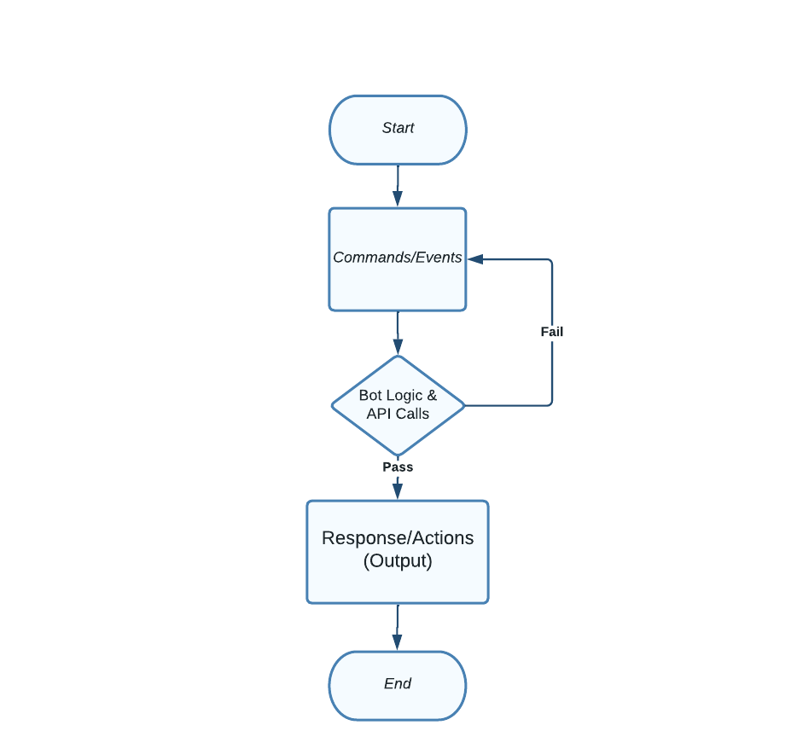
SYSTEM FLOW DIAGRAM:

Slide 11
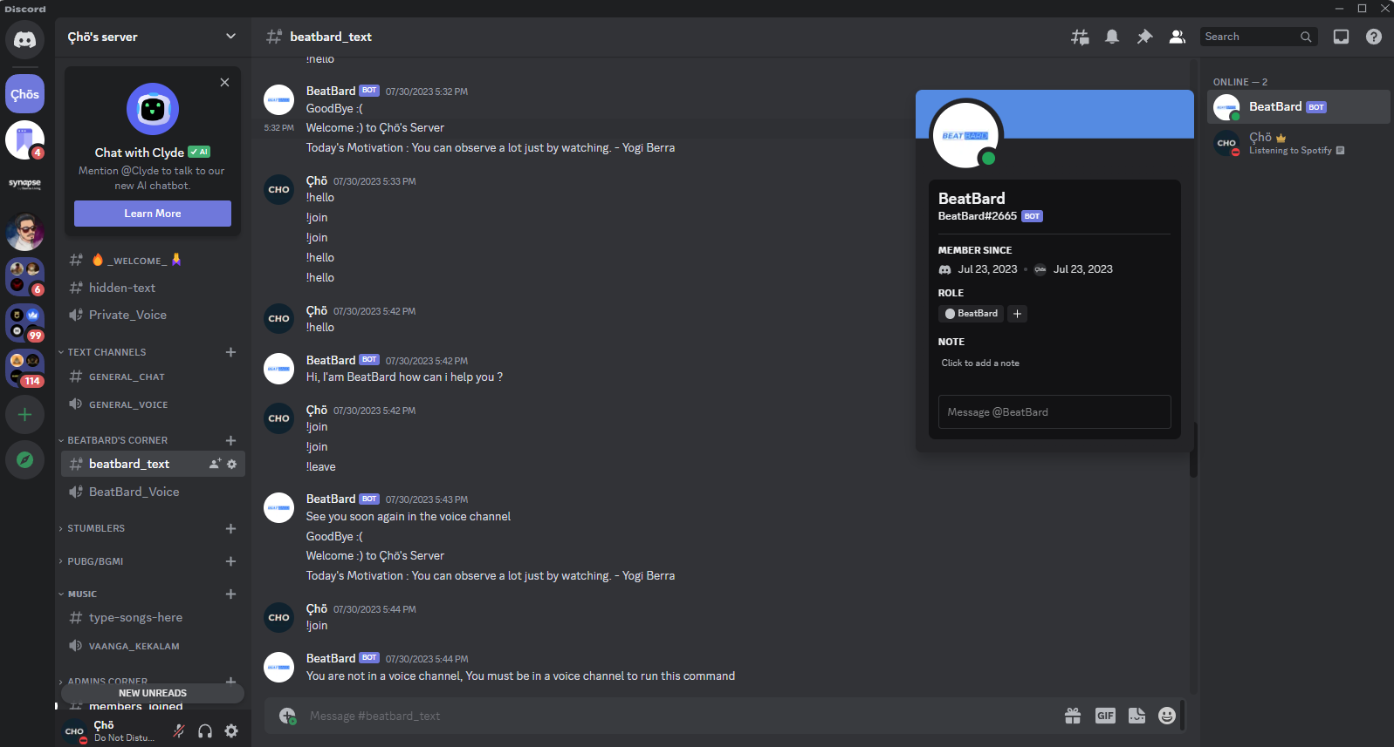
UI DESIGN:

Slide 12
THANK YOU

