Slide 1
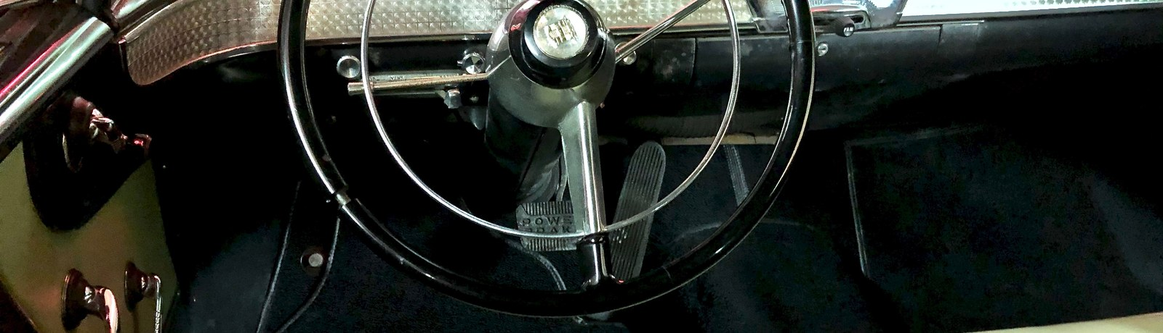
Drowsiness Detection for Driver Safety
Mini Project - First Review (Review 1)
Based on: "A Survey on State-of-the-Art Drowsiness Detection Techniques" - IEEE Access, 2019
[Student Name] | Guide: [Guide Name]
1

Slide 2
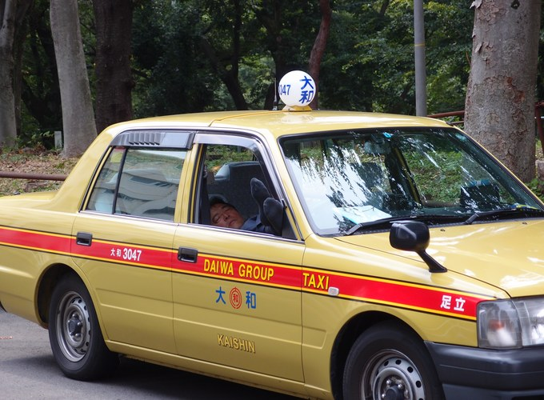
Problem
• Road safety Drowsy driving causes ~100,000 accidents & 1,500+ deaths per year (NHTSA).
• Causes Lack of sleep, long journeys, alcohol, stress.
• Need Detect drowsiness early and alert the driver before an accident.
Drowsy driver behind the wheel
2

Slide 3
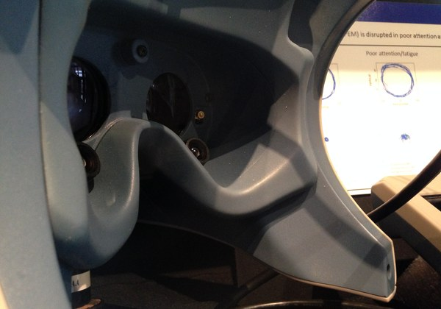
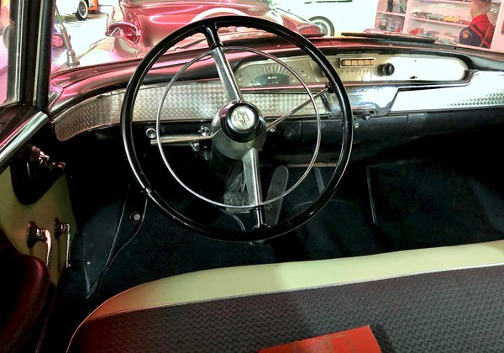
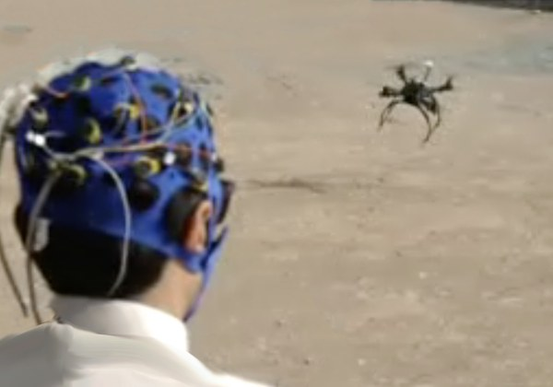
Detection Techniques
Behavioral
Vehicular
Physiological
Camera + vision
Eye closure, yawning
Car sensors
Steering, lanes
Body signals
EEG / ECG / HR - most accurate
3

Slide 4
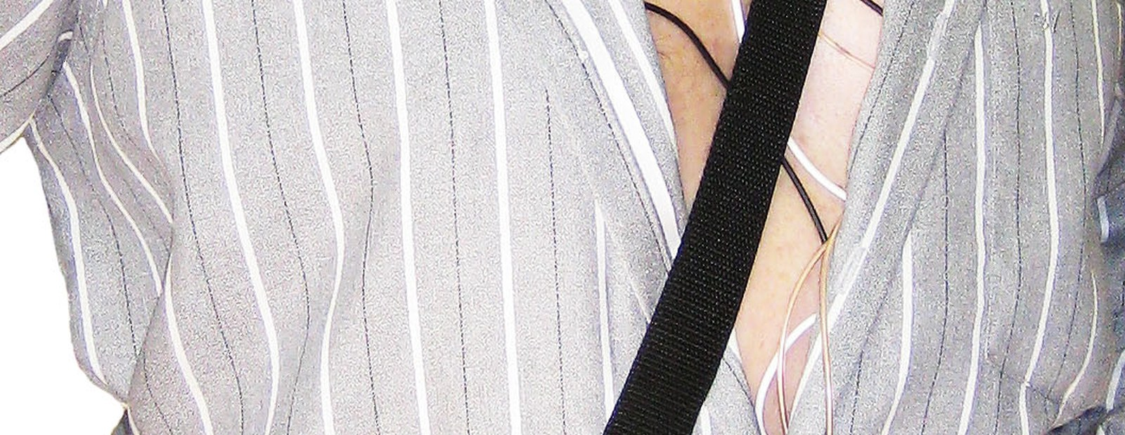
Proposed System
Monitoring equipment used for signal acquisition
• Hybrid approach Combine physiological + behavioral signals for better accuracy.
• Real-time alert Detect drowsiness and warn the driver immediately.
4

Slide 5
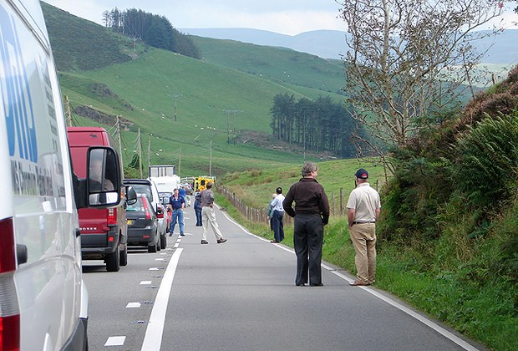
Key Findings
Most accurate
Hybrid works
Best classifier
Physiological signals (EEG / ECG) give the most stable results.
Combining signals (ECG + EEG) improves accuracy.
SVM = easy & common; HMM = lowest error; CNN = best for images.
Accident caused by fatigue
No single method is perfect - a hybrid system is the way forward for driver safety.
5

Slide 6
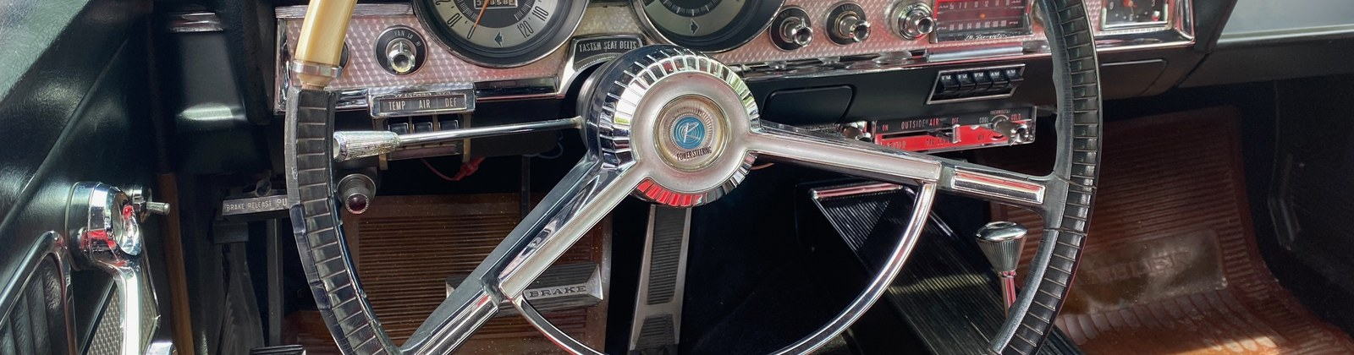
Conclusion & Future Work
• Done Studied 41 papers on drowsiness detection techniques.
• Plan Build a hybrid (physiological + behavioral) system.
• Goal Accurate, real-time alerting for safer driving.
Next steps:
1. Design & collect data
2. Implement hybrid detection
3. Test & evaluate accuracy
Thank you
6

