Slide 1
DevOps Roadmap for <Project>
CI/CD + Traceability + Dashboard + Monitoring
Oct 2017

Slide 2
DevOps Roadmap for <Project>
Automatic Monitoring & Reporting
Proactive monitoring of service availability
Splunk integration with VersionOne
3
Traceability, Dashboard
Jenkins integration with Jira / Version One
Integrated dashboard via Hygieia / Splunk
We are here
2
Automation
DevOps - Implement CI and CD
Adopt DevOps Culture
1
Continually change the culture in adopting the automation

Slide 3
Next steps – Traceability, Dashboard
Stage 1 (Traceability)
Stage 2 (Dashboard)
Jenkins integration with Jira / Version One
Integrated dashboard via Hygieia / Splunk

Slide 4
Stage 1 – Traceability
Bitbucket
Repo = AnnuityService
IIB Toolkit
Jira
Dashboard
Shows all comments
TBD
Jira
Project = AnnuityService
Issue = AnnuityService-1
Modify & Push code with comment [AnnuityService-1]
Jenkins
For release = 2017NOV
1 comment for each step
Build successful
Deploy in Dev successful
Consolidated dashboard – per release
Update Jira for [AnnuityService-1]

Slide 5

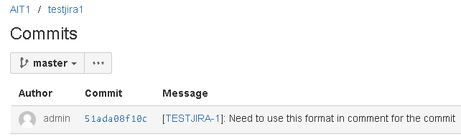

Stage 1 – Traceability
Script to update the Jira Issue (Can be modified to update VersionOne:
Bitbucket repository

Slide 6

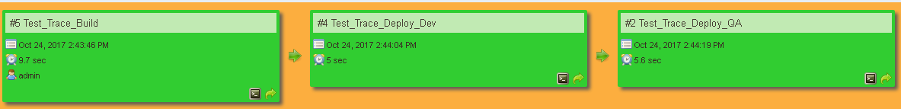
Stage 1 – Traceability
JIRA – Issue created
Jenkins – Build pipeline

Slide 7



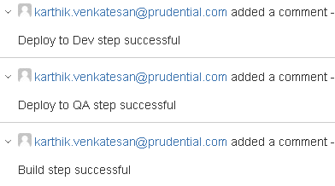
Stage 1 – Traceability
Jenkins – Console output writing to Jira
JIRA – Issue updated with comments for each stage

Slide 8
Stage 2 – Dashboard
Jenkins – Console output writing to Jira
JIRA – Issue updated with comments for each stage

