Slide 1

COMP-SCI 5590 - 0001 Special Topics
Loop structures, conditional statements, strings, List, Tuples, Functions

Slide 2
Objective
loops: for and while statements.
interactive loop and sentinel loop: implementations using while statement
Nested loop
Reading from a file in loop
Tuples
Set
dictionaries
Use case

Slide 3
For Loops: A Quick Review
Suppose we want to write a program that can compute the average of a series of numbers entered by the user.
A series of numbers could be handled by some sort of loop. If there are n numbers, the loop should execute n times.
We need a running sum. This will use an accumulator.

Slide 4
For Loops
n = eval(input("How many numbers do you have? "))
sum = 0.0
for i in range(n):
x = int(input("Enter a number >> "))
sum = sum + x
print("\nThe average of the numbers is", sum / n)
Note that sum is initialized to 0.0 so that sum/n returns a float!

Slide 5
For Loops: Expected Result
How many numbers do you have? 5
Enter a number >> 32
Enter a number >> 45
Enter a number >> 34
Enter a number >> 76
Enter a number >> 45
The average of the numbers is 46.4

Slide 6
Indefinite Loops
We can’t use a definite loop unless we know the number of iterations ahead of time. We can’t know how many iterations we need until all the numbers have been entered.
The indefinite or conditional loop keeps iterating until certain conditions are met.

Slide 7
Indefinite Loop: Example
Here’s an example of a while loop that counts from 0 to 10:
i = 0 while i <= 10: print(i) i = i + 1

Slide 8
Interactive Loops
One good use of the indefinite loop is to write interactive loops. Interactive loops allow a user to repeat certain portions of a program on demand.

Slide 9
Interactive Loops: Example
moredata = "yes"
sum = 0.0
count = 0
while moredata[0] == 'y':
x = int(input("Enter a number >> "))
sum = sum + x
count = count + 1
moredata = input("Do u have more numbers(yes or no)? ")
print("\nThe average of the numbers is", sum / count)

Slide 10
File Loops
Many languages don’t have a mechanism for looping through a file like this. Rather, they use a sentinel!
We could use readline in a loop to get the next line of the file.
At the end of the file, readline returns an empty string, “”

Slide 11
File Loops: Example
fileName = input("What file are the numbers in? ")
infile = open(fileName,'r')
sum = 0.0
count = 0
line = infile.readline()
while line != "":
sum = sum + eval(line)
count = count + 1
line = infile.readline()
print("\nThe average of the numbers is", sum / count)

Slide 12
Nested Loops
At the top level, we will use a file-processing loop that computes a running sum and count.
In the next level in we need to update the sum and count in the body of the loop.
Since each line of the file contains one or more numbers separated by commas, we can split the string into substrings, each of which represents a number.
Then we need to loop through the substrings, convert each to a number, and add it to sum.
We also need to update count.

Slide 13
Nested Loops: Example
fileName = input("What file are the numbers in? ")
infile = open(fileName,'r')
sum = 0.0
count = 0
line = infile.readline()
while line != "":
for xStr in line.split(","):
sum = sum + eval(xStr)
count = count + 1
line = infile.readline()
print("\nThe average of the numbers is", sum / count)

Slide 14
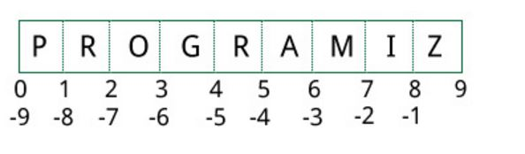
Lists
CHANGEABLE Sequences of Data
Syntax:
list_name = [item1, item2]
Lists are created by using square brackets:
breakfast = [ “coffee”, “tea”, “toast”, “egg” ]
Indexing mechanism:
It starts from 0
From back it starts from -1

Slide 15
Basic Operations
Python Expression | Results | Description
len([1, 2, 3]) | 3 | Length
[1, 2, 3] + [4, 5, 6] | [1, 2, 3, 4, 5, 6] | Concatenation
['Hi!'] * 4 | ['Hi!', 'Hi!', 'Hi!', 'Hi!'] | Repetition
3 in [1, 2, 3] | True | Membership
for x in [1, 2, 3]: print x, | 1 2 3 | Iteration

Slide 16
Python List Methods
append() | Add an element to the end of the list
extend() | Add all elements of a list to the another list
insert() | Insert an item at the defined index
remove() | Removes an item from the list
pop() | Removes and returns an element at the given index
clear() | Removes all items from the list
index() | Returns the index of the first matched item
count() | Returns the count of number of items passed as an argument
sort() | Sort items in a list in ascending order
reverse() | Reverse the order of items in the list
copy() | Returns a shallow copy of the list

Slide 17
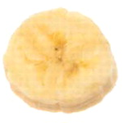
The Repetition Operator and Iterating over a List
Repetition operator: makes multiple copies of a list and joins them together
The * symbol is a repetition operator when applied to a sequence and an integer
Sequence is left operand, number is right
General format: list * n
You can iterate over a list using a for loop
Format: for x in list:

Slide 18
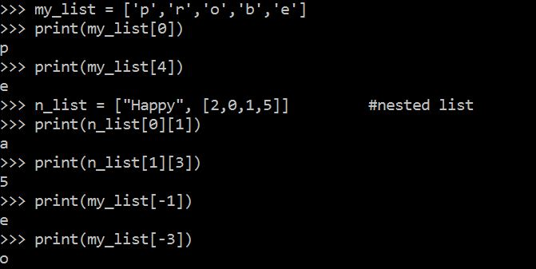
Indexing
Index: a number specifying the position of an element in a list
Enables access to individual element in list
Index of first element in the list is 0, second element is 1, and n’th element is n-1
Negative indexes identify positions relative to the end of the list
The index -1 identifies the last element, -2 identifies the next to last element, etc.

Slide 19
List Slicing
Slice: a span of items that are taken from a sequence
List slicing format: list[start : end]
Span is a list containing copies of elements from start up to, but not including, end
If start not specified, 0 is used for start index
If end not specified, len(list) is used for end index
Slicing expressions can include a step value and negative indexes relative to end of list

Slide 20
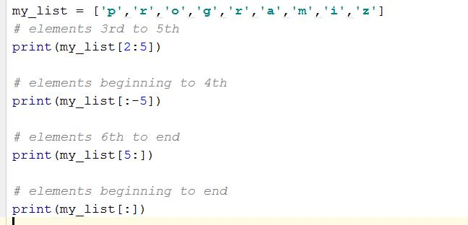
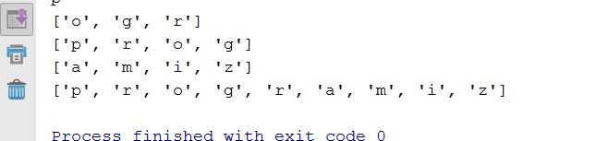
Slicing Examples
Output
Input

Slide 21
List Methods and Useful Built-in Functions (cont’d.)
insert(index, item): used to insert item at position index in the list
sort(): used to sort the elements of the list in ascending order
remove(item): removes the first occurrence of item in the list
reverse(): reverses the order of the elements in the list
del statement: removes an element from a specific index in a list
General format: del list[i]
min and max functions: built-in functions that returns the item that has the lowest or highest value in a sequence
The sequence is passed as an argument

Slide 22
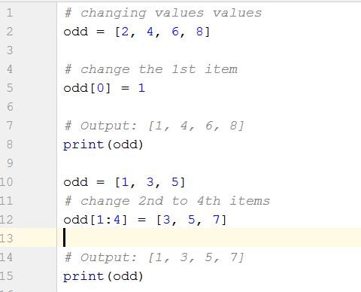

Changing Elements
List are mutable, meaning, their elements can be changed tuple.
We can use assignment operator (=) to change an item or a range of items.
list[1] = new_value can be used to assign a new value to a list element
Must use a valid index to prevent raising of an IndexError exception
Output

Slide 23
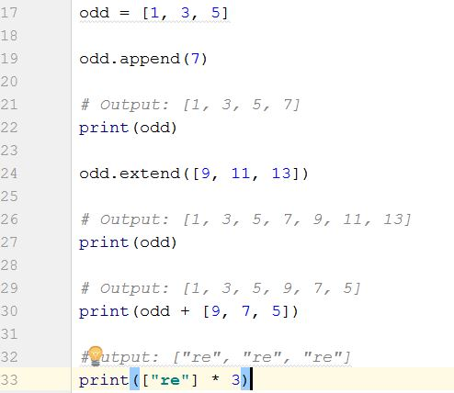
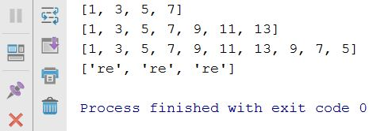
Addition
We can add one item to a list using append() method or add several items using extend()method
Output
We can also use + operator to combine two lists. This is also called concatenation.

Slide 24
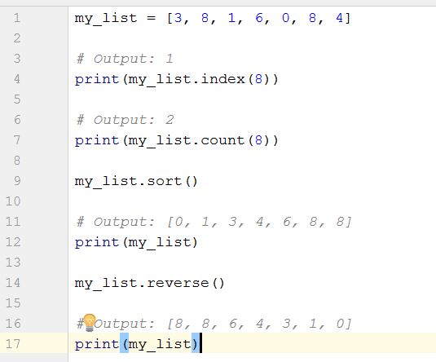
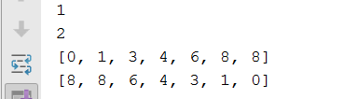
Other built in function Examples
Output

Slide 25
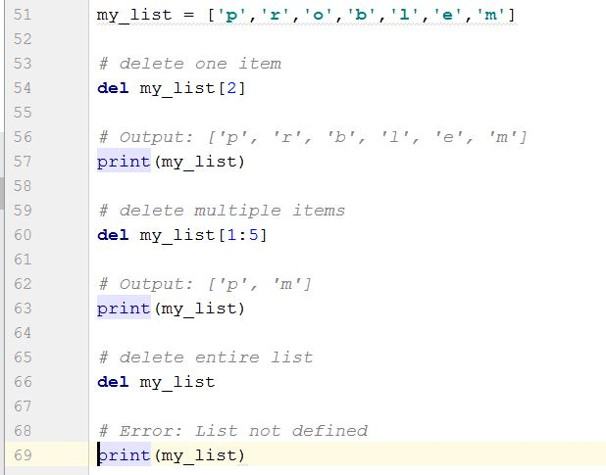
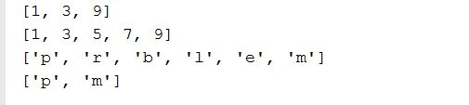
Deletion
Output

Slide 26
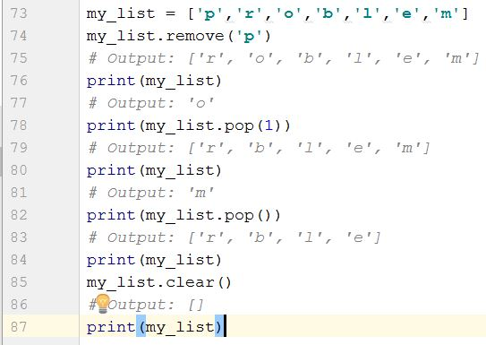
Continued…
We can use remove() method to remove the given item
or pop() method to remove an item at the given index.
The pop() method removes and returns the last item if index is not provided.
This helps us implement lists as stacks (first in, last out data structure).
We can also use the clear() method to empty a list.

Slide 27
Finding Items in Lists with the in Operator
You can use the in operator to determine whether an item is contained in a list
General format: item in list
Returns True if the item is in the list, or False if it is not in the list
Similarly you can use the not in operator to determine whether an item is not in a list

Slide 28
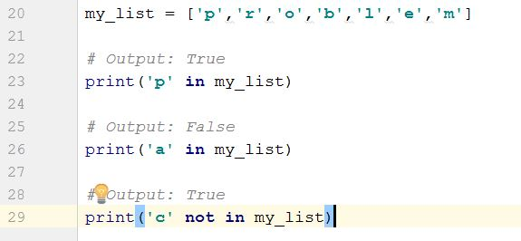

Continued…
Output

Slide 29
Two-Dimensional Lists
Two-dimensional list: a list that contains other lists as its elements
Also known as nested list
Common to think of two-dimensional lists as having rows and columns
Useful for working with multiple sets of data
To process data in a two-dimensional list need to use two indexes
Typically use nested loops to process

Slide 30
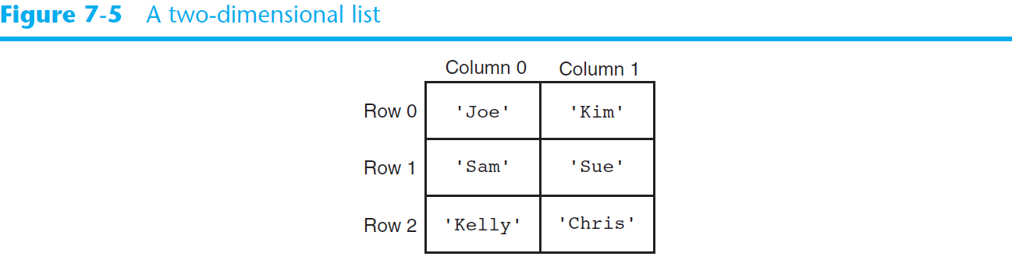
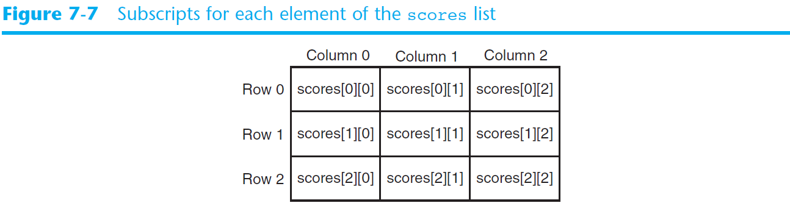
Two-Dimensional Lists (cont’d.)

Slide 31
Tuples
UNCHANGABLE Sequences of Data
Syntax:
tuple_name = (item1, item2)
Enclosed in parentheses:
Example: tuple1 = (“This”, “is”, “a”, “tuple”)
They have elements which are indexed starting at 0
A tuple with a single element must have a comma inside the parentheses:
a = (11,)

Slide 32
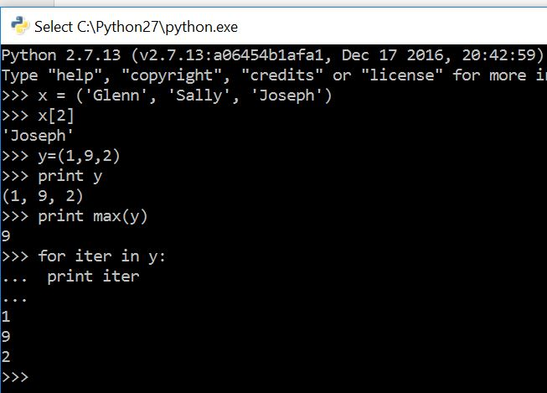
Tuples
X[2] prints the third element in the tuple
Notice max function

Slide 33
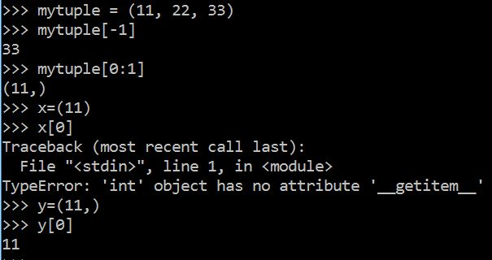
More examples
Notice -1 index
(11) Acts as integer whereas (11,) acts as sequence

Slide 34
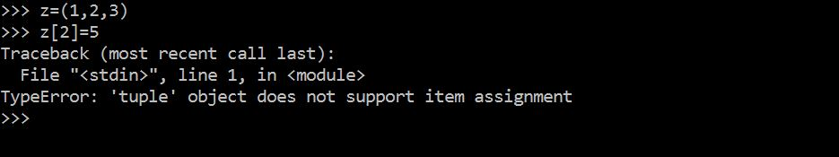
..but.. Tuples are "immutable"
Unlike a list, once you create a tuple, you cannot alter its contents - similar to a string

Slide 35
Operations
Tuples support operations as lists
Subscript indexing for retrieving elements
Methods such as index
Built in functions such as len, min, max
Slicing expressions
The in, +, and * operators
Tuples do not support the methods:
Append, remove, insert, reverse, sort

Slide 36
Basic Operations
Suppose
>>> tup1=(1,2,3)
>>>>tup2=(4,5,6)
>>>tup3=(‘Hi’,)
Python Expression | Results | Description
len(tup1) | 3 | Length
tup1 + tup2 | (1, 2, 3, 4, 5, 6) | Concatenation
tup3* 4 | ('Hi!', 'Hi!', 'Hi!', 'Hi!') | Repetition
3 in tup1 | True | Membership
for x in tup1: print x, | 1 2 3 | Iteration

Slide 37
Indexing, Slicing
Suppose
>>> L=(‘welcome’ , ’to’ , ’python’)
Python Expression | Results | Description
L[2] | ‘python’ | Offsets start at zero
L[-2] | ‘to' | Negative: count from the right
L[1:] | [‘to', ‘python'] | Slicing fetches sections
Same as String

Slide 38
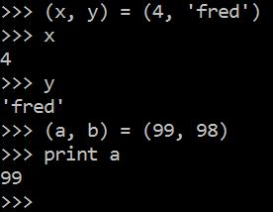
Tuples and Assignment
We can also put a tuple on the left hand side of an assignment statement
We can even omit the parenthesis

Slide 39
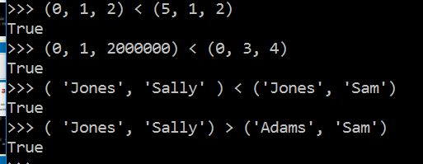
Tuples are Comparable
The comparison operators work with tuples and other sequences If the first item is equal, Python goes on to the next element, and so on, until it finds elements that differ.

Slide 40
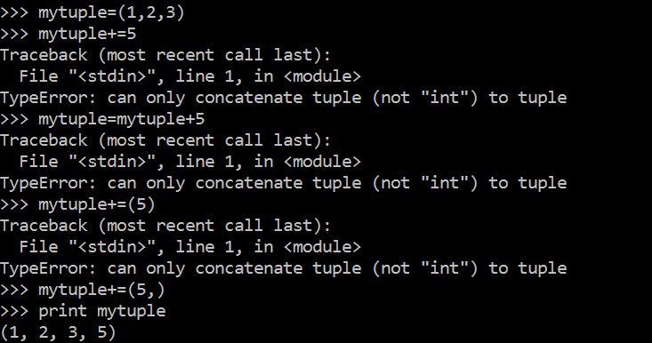
Concatenation
This is how concatenation works

Slide 41
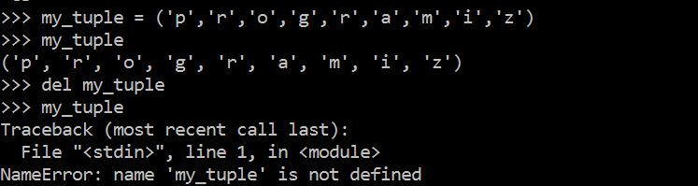
Deleting Tuple
As tuple is already deleted

Slide 42
Tuples are more efficient than lists
We generally use tuple for heterogeneous (different) datatypes and list for homogeneous (similar) datatypes.
Since tuple are immutable, iterating through tuple is faster than with list. So there is a slight performance boost. They are more simpler in nature.
Tuples that contain immutable elements can be used as key for a dictionary. With list, this is not possible.
If you have data that doesn't change, implementing it as tuple will guarantee that it remains write-protected.

Slide 43
SETS

Slide 44
Sets
Set: object that stores a collection of data in same way as mathematical set
All items must be unique
Set is unordered
Elements can be of different data types
Sets are mutable and it contains immutable elements
e.g.:
>>> aset = {11, 22, 33}
>>> bset = aset
>>> aset = aset | {55}
>>> aset {33, 11, 22, 55}
>>> bset {33, 11, 22}

Slide 45
Creating a Set
set function: used to create a set
For empty set, call set()
For non-empty set, call set(argument) where argument is an object that contains iterable elements
{'Alice', 'Bob', 'Carol'}
{'Dean'} is a singleton
argument can be a list, string, or tuple
If argument is a string, each character becomes a set element
If argument contains duplicates, only one of the duplicates will appear in the set

Slide 46
Len, add, update function
len function: returns the number of elements in the set
>>> myset = {'Apples', 'Bananas', 'Oranges'}
>>> len(myset) → 3
add method: adds an element to a set
>>> myset.add(‘strawberry’)
>>> print(myset) -> {'Apples', 'Bananas', 'Oranges’, ‘strawberry’}
update method: adds a group of elements to a set
Argument must be a sequence containing iterable elements,
and each of the elements is added to the set
>>> myset.update(‘1’,’2’)
>>> print(myset) -> {'Apples', 'Bananas', 'Oranges’,’1’,’2’}

Slide 47
Deleting Elements From a Set
Remove and discard methods: remove the specified item from the set
The item that should be removed is passed to both methods as an argument
Behave differently when the specified item is not found in the set
remove method raises a KeyError exception
discard method does not raise an exception
>>> myset.remove(‘Apples’)
>>> print(myset) -> {'Bananas', 'Oranges’)}
clear method: clears all the elements of the set

Slide 48
For Loop, in, and not in Operators With a Set
A for loop can be used to iterate over elements in a set
General format: for item in set:
The loop iterates once for each element in the set
The in operator can be used to test whether a value exists in a set
Similarly, the not in operator can be used to test whether a value does not exist in a set

Slide 49
Sets do not support indexing
>>> myset = {'Apples', 'Bananas', 'Oranges'}
>>> myset {'Bananas', 'Oranges', 'Apples'}
>>> myset[0] Traceback (most recent call last): File "<pyshell#2>", line 1, in <module> myset[0] TypeError: 'set' object does not support indexing

Slide 50
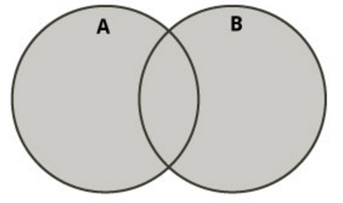
Boolean operations on sets (I)
Union of two sets
Contains all elements that are in set A or in set B
>>> aset = {11, 22, 33}
>>> bset = {12, 23, 33}
Union of two sets
>>> aset | bset {33, 22, 23, 11, 12}

Slide 51
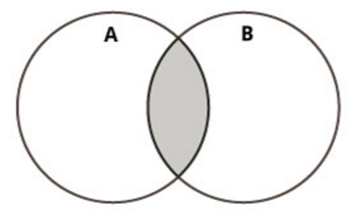
Boolean operations on sets (II)
Intersection of two sets
Contains common elements that are in both sets A and B
>>> aset = {11, 22, 33}
>>> bset = {12, 23, 33}
Intersection of two sets:
>>> aset & bset {33}

Slide 52
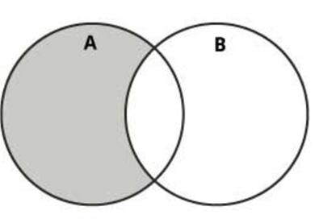
Boolean operations on sets (III)
Difference of two sets
Contains all elements that are in A but not in B
>>> aset = {11, 22, 33}
>>> bset = {12, 23, 33}
Difference:
>>> aset – bset {11, 22}

Slide 53
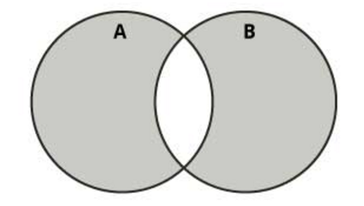
Boolean operations on sets (IV)
Symmetric difference of two sets
Contains all elements that are either
in set A but not in set B or
in set B but not in set A
>>> aset = {11, 22, 33}
>>> bset = {12, 23, 33}
Symmetric difference:
>>> aset ^ bset {11, 12, 22, 23}

Slide 54
DICTIONARIES

Slide 55
Dictionaries
A dictionary is a container that keeps associations between keys and values.
Keys are unique, but a value may be associated with several keys.
Values
Keys
John
$15,000
Ann
$12,000
Mike
Mary
$30,000

Slide 56

Creating Dictionaries
Each key/value pair is separated by a colon.
You enclose the key/value pairs in braces.
To create an empty dictionary:
Use {}
Use built-in function dict()
Use a for loop to iterate over a dictionary
General format: for key in dictionary:

Slide 57
Sets and dictionaries
When the braces contain key/value pairs, they denote a dictionary, not a set. The only ambiguous case is an empty {}. By convention, it denotes an empty dictionary, not an empty set. You can create a duplicate copy of a dictionary using the dict function:
oldSalaries = dict(salaries)
salaries = { “John": 15000, “Ann": 30000, “Mike": 12000, “Mary": 15000 }

Slide 58
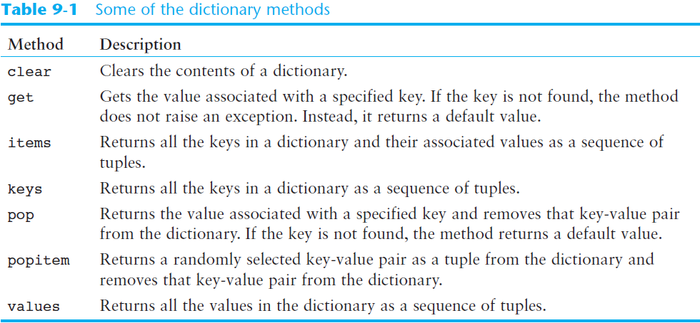
Some Dictionary Methods (cont’d.)

Slide 59

Accessing Dictionary Values
The subscript operator [] is used to return the value associated with a key.
The statement:
print(“Ann’s salary is", salaries[“Ann"])
prints 30000
Note that the dictionary is not a sequence-type container like a list.
Even though the subscript operator is used with a dictionary, you cannot access the items by index or position.
A value can only be accessed using its associated key

Slide 60
Searching For Keys
The key supplied to the subscript operator must be a valid key in the dictionary or a KeyError exception will be raised.
To find out whether a key is present in the dictionary, use the in (or not in) operator:
if “Ann" in salaries : print(“Ann’s salary is", salaries[“Ann”]) else : print(“Ann’s salary is not in my list.”)

Slide 61
Dictionaries are mutable
>>> age = {'Alice' : 25, 'Bob' : 28}
>>> saved = age
>>> age['Bob'] = 29
>>> age {'Bob': 29, 'Alice': 25}
>>> saved {'Bob': 29, 'Alice': 25}

Slide 62
Adding Elements to an Existing Dictionary
To add a new key-value pair:
dictionary[key] = value
If key exists in the dictionary, the value associated with it will be changed

Slide 63
Displaying Contents
>>> age = {'Alice' : 25, 'Carol': 'twenty-two’}
>>> age.items() dict_items([ ('Alice', 25), ('Carol', 'twenty-two')])
>>> age.keys() dict_keys([ 'Alice', 'Carol'])
>>> age.values() dict_values([25, 'twenty-two'])

Slide 64
Updating Dictionaries
>>> age = {'Alice': 26 , 'Carol' : 22}
>>> age.update({'Bob' : 29})
>>> age {'Bob': 29, 'Carol': 22, 'Alice': 26}
>>> age.update({'Carol' : 23})
>>> age {'Bob': 29, 'Carol': 23, 'Alice': 26}

Slide 65
Returning a value
>>> age = {'Bob': 29, 'Carol': 23, 'Alice': 26}
>>> age.get('Bob') 29
>>> age['Bob'] 29

Slide 66
Removing a specific item
>>> a = {'Alice' : 26, 'Carol' : 'twenty-two’}
>>> a {'Carol': 'twenty-two', 'Alice': 26}
>>> a.pop('Carol’) 'twenty-two’
>>> a {'Alice': 26}

Slide 67
Remove a random item
>>> age = {'Bob': 29, 'Carol': 23, 'Alice': 26}
>>> age.popitem() ('Bob', 29)
>>> age
{'Carol': 23, 'Alice': 26}
>>> age.popitem() ('Carol', 23)
>>> age {'Alice': 26}

Slide 68
Number of Elements and Mixing Data Types
len function: used to obtain number of elements in a dictionary
clear method: deletes all the elements in a dictionary, leaving it empty
Format: dictionary.clear()
Values stored in a single dictionary can be of different types

Slide 69

Different Ways Of Doing The Same Thing
Lists
prerequisites = ["COP 2271c", "Introduction to Computation and Programming", 3]
print(prerequisites[2]) # Prints the element at index 2
Sets
cheesePizza = {"Creamy garlic", "Parmesan sauce", "Cheese", "Toasted Parmesan"}
if "Toasted Parmesan" in cheesePizza:
Dictionaries
salaries = {"John": 15000, "Ann": 30000, "Mike": 12000, "Mary": 15000 }
print("Ann’s salary is", salaries["Ann"])

Slide 70
Use case: Car Rental

Slide 71
Use case: Car Rental
The goal of this use case is to calculate the money one should pay when renting a car.
Surely this money will be affected by the kind of car, distance, kind of petrol, number of days…
So in this use case, there is a couple of questions that a user answers then the amount of money one should pay will be printed.

Slide 72
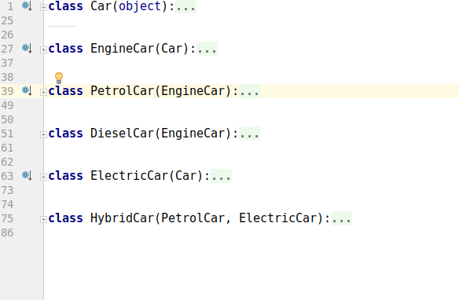
Module cars
It contains six classes which helps to choose various features of a car for hiring

Slide 73
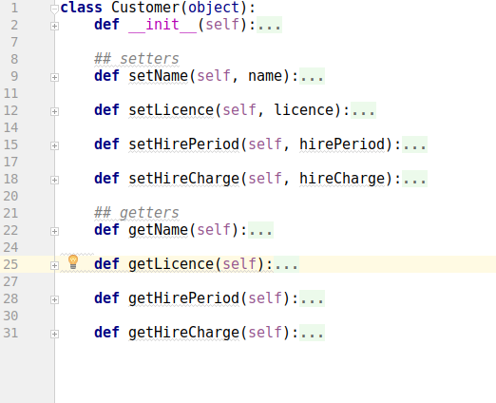
Module customer
This module includes some classes about the detailed information of the customer

Slide 74
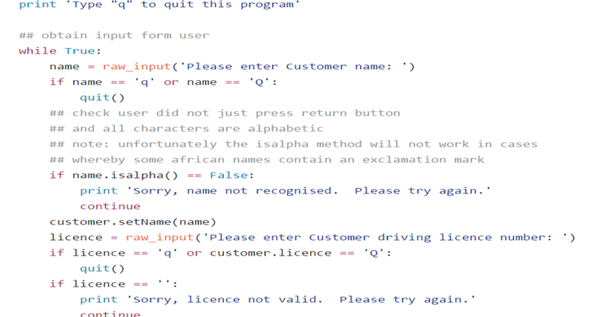
Getting information of the customer

Slide 75
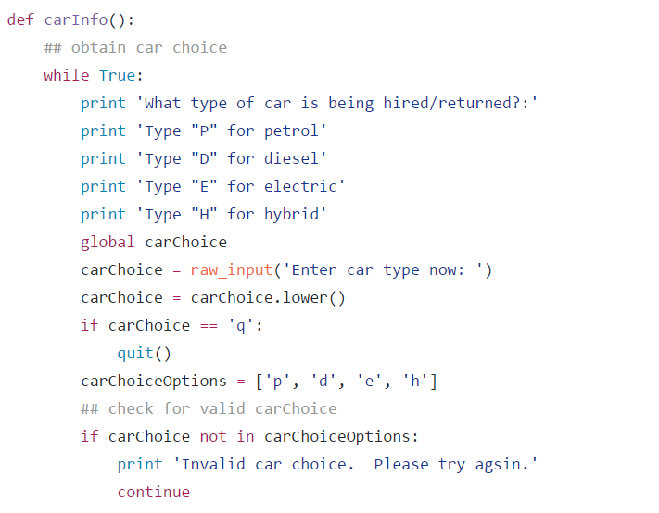
Choosing one of the car options available

Slide 76
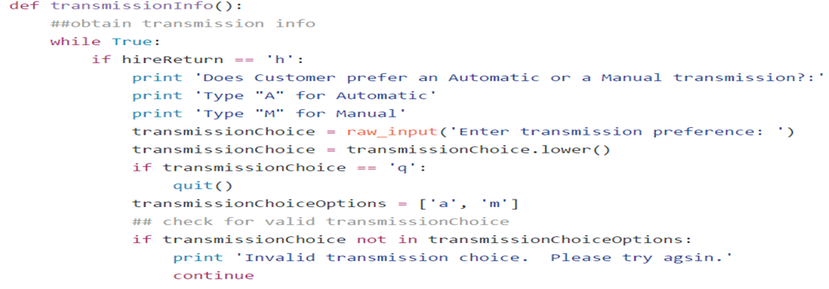
Automatic or Manual car

Slide 77
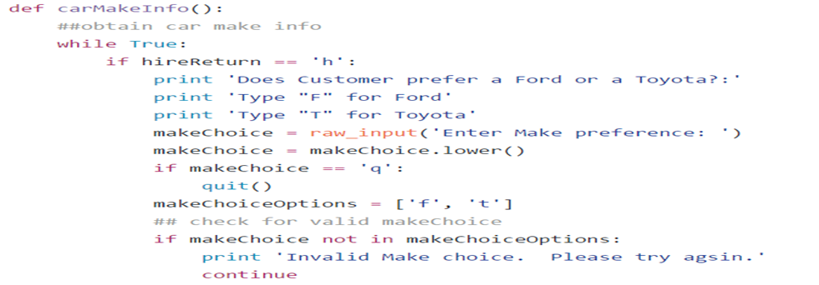
Ford Or Toyota

Slide 78
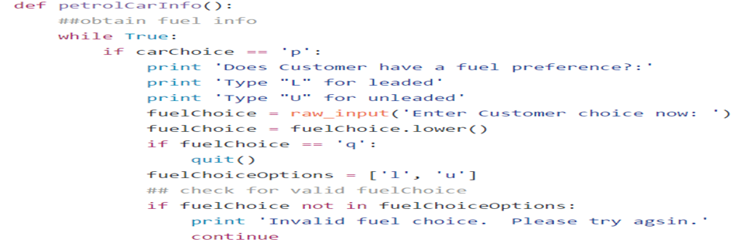
Fuel Preference

Slide 79
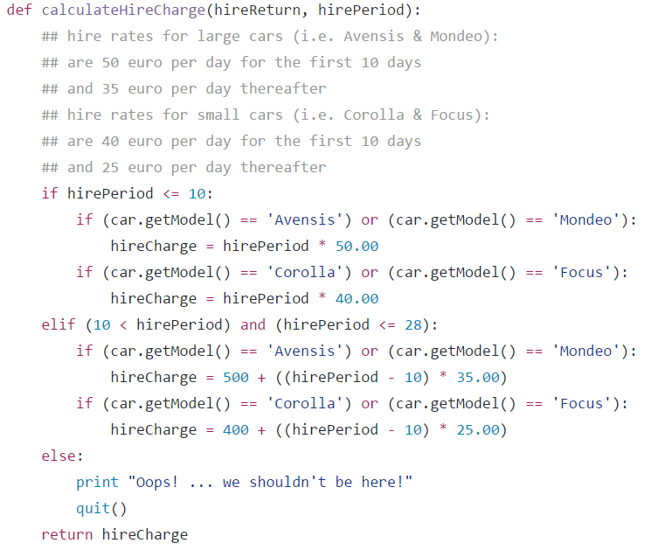
Rates of hiring

Slide 80
References
https://github.com/wade12/ProgrammingForBigDataCA2CarRental/blob/master/carRentalApp.py
http://www.w3resource.com/python-exercises/python-conditional-statements-and-loop-exercises.php
https://www.learnpython.org/

Slide 81
Thank you

