Slide 1

Python Programming
Classes and Web Scraping

Slide 2
Feedback is greatly appreciated!

Slide 3

Objective
Classes
Object Oriented Concepts
Instances
Init
self
Private, Protected, Public
Inheritance
Scientific Python
Numpy Package
Web scraping
Notes:
3

Slide 4
Defining a Class
A class is usually used to model the real-world entity
It wraps up data and functions into one unit
The class also stores some data items that are shared by all the instances of the class
Objects are Instances of a class
https://www.w3schools.com/python/python_classes.asp

Slide 5
Methods in Classes
Define a method in a class by including function definitions within the scope of the class block
There is usually a special method called __init__ in most classes. It is called the default constructor

Slide 6
A simple class def: student
__init__ is the default constructor
class student: “““A class representing a student ””” def __init__(self,n,a): self.full_name = n self.age = a def get_age(self): return self.age
self refers to the object itself,
like this in Java.

Slide 7
Object Oriented Concepts
Object Oriented Design focuses on
Encapsulation:
dividing the code into a public interface, and a private implementation of that interface
Polymorphism:
the ability to overload standard operators so that they have appropriate behavior based on their context
Inheritance:
the ability to create subclasses that contain specializations of their parents

Slide 8
It’s all objects…
Everything in Python is really an object.
We’ve seen hints of this already… “hello”.upper() list3.append(‘a’) dict2.keys()
These look like Java or C++ method calls.
New object classes can easily be defined in addition to these built-in data-types.
In fact, programming in Python is typically done in an object oriented fashion.

Slide 9
Creating and Deleting Instances

Slide 10
Instantiating Objects
Just use the class name with ( ) notation and assign the result to a variable
__init__ serves as a constructor for the class. Usually does some initialization work
The arguments passed to the class name are given to its __init__() method
So, the __init__ method for student is passed “Bob” and 21 and the new class instance is bound to b:
b = student(“Bob”, 21)

Slide 11
Constructor: __init__
An __init__ method can take any number of arguments.
Like other functions or methods, the arguments can be defined with default values, making them optional to the caller.
However, the first argument self in the definition of __init__ is special…

Slide 12
Self
The first argument of every method is a reference to the current instance of the class
By convention, we name this argument self
In __init__, self refers to the object currently being created; so, in other class methods, it refers to the instance whose method was called
Similar to the keyword this in Java or C++

Slide 13
Self
Although you must specify self explicitly when defining the method, you don’t include it when calling the method.
Python passes it for you automatically
Defining a method: Calling a method:
(this code inside a class definition.)
def set_age(self, num): >>> x.set_age(23) self.age = num

Slide 14
Deleting instances: No Need to “free”
When you are done with an object, you don’t have to delete or free it explicitly.
Python has automatic garbage collection.
Python will automatically detect when all of the references to a piece of memory have gone out of scope. Automatically frees that memory.
Generally works well, few memory leaks

Slide 15
Definition of student
class student: “““A class representing a student ””” def __init__(self,n,a): self.full_name = n self.age = a def get_age(self): return self.age

Slide 16
Syntax for Access
>>> f = student(“Bob Smith”, 23)
>>> f.full_name # Access attribute
“Bob Smith”
>>> f.get_age() # Access a method
23

Slide 17
Two Kinds of Attributes
The non-method data stored by objects are called attributes
Data attributes
Variable owned by a particular instance of a class
Each instance has its own value for it
These are the most common kind of attribute
Class attributes
Owned by the class as a whole
All class instances share the same value for it
Called “static” variables in some languages
Good for (1) class-wide constants and (2) building counter of how many instances of the class have been made

Slide 18
Data Attributes
Data attributes are created and initialized by an __init__() method.
Simply assigning to a name creates the attribute
Inside the class, refer to data attributes using self
for example, self.full_name
class teacher: “A class representing teachers.” def __init__(self,n): self.full_name = n def print_name(self): print self.full_name

Slide 19
Class Attributes
Because all instances of a class share one copy of a class attribute, when any instance changes it, the value is changed for all instances
Class attributes are defined within a class definition and outside of any method
Since there is one of these attributes per class and not one per instance, they’re accessed via a different notation:
Access class attributes using self.__class__.name notation –
This is just one way to do this & the safest in general.
class sample: >>> a = sample() x = 23 >>> a.increment() def increment(self): >>> a.__class__.x self.__class__.x += 1 24

Slide 20
Data vs. Class Attributes
class counter: overall_total = 0 # class attribute def __init__(self): self.my_total = 0 # data attribute def increment(self): counter.overall_total = \ counter.overall_total + 1 self.my_total = \ self.my_total + 1
>>> a = counter() >>> b = counter() >>> a.increment() >>> b.increment() >>> b.increment() >>> a.my_total 1 >>> a.__class__.overall_total 3 >>> b.my_total 2 >>> b.__class__.overall_total 3

Slide 21
Inheritance

Slide 22
Inheritance
Basic syntax for a derived class definition:
class DerivedClassName(BaseClassName):
<statement-1>
. . .
<statement-N>
As stated before, all methods are virtual by default
If a method in DerivedClassName above has the same name and parameters as BaseClassName, the method in the derived class will be implemented when its called

Slide 23
Subclasses
A class can extend the definition of another class
Allows use (or extension ) of methods and attributes already defined in the previous one.
New class: subclass. Original: parent, ancestor or superclass
To define a subclass, put the name of the superclass in parentheses after the subclass’s name on the first line of the definition. Class Cs_student(student):
Python has no ‘extends’ keyword like Java.
Multiple inheritance is supported.

Slide 24
Redefining Methods
To redefine a method of the parent class, include a new definition using the same name in the subclass.
The old code won’t get executed.
To execute the method in the parent class in addition to new code for some method, explicitly call the parent’s version of the method.
parentClass.methodName(self, a, b, c)
The only time you ever explicitly pass ‘self’ as an argument is when calling a method of an ancestor.

Slide 25
Definition of a class extending student
Class Student: “A class representing a student.”
def __init__(self,n,a): self.full_name = n self.age = a
def get_age(self): return self.age
Class Cs_student (student): “A class extending student.” def __init__(self,n,a,s): student.__init__(self,n,a) #Call __init__ for student
self.section_num = s def get_age(self): #Redefines get_age method entirely print “Age: ” + str(self.age)
Passing another class as parent

Slide 26
Private Variables
Programmers that use python typically use an underscore as a prefix to private variables
Ex: __color

Slide 27
Private Data and Methods
Any attribute/method with 2 leading under-scores in its name (but none at the end) is private and can’t be accessed outside of class
Note: Names with two underscores at the beginning and the end are for built-in methods or attributes for the class

Slide 28
Private,Protected and Public
Name | Notation | Behaviour
name | Public | Can be accessed from inside and outside
_name | Protected | Like a public member, but they shouldn't be directly accessed from outside.
__name | Private | Can't be seen and accessed from outside

Slide 29
Example
class MyClass(): def __init__(self): self.__superprivate = "Hello" self._semiprivate = "world!" mc = MyClass() print (mc.__superprivate) Traceback (most recent call last): File "<stdin>", line 1, in <module> AttributeError: myClass instance has no attribute '__superprivate' print (mc._semiprivate) world! print (mc.__dict__) {'_MyClass__superprivate': 'Hello', '_semiprivate': ', world!'}

Slide 30
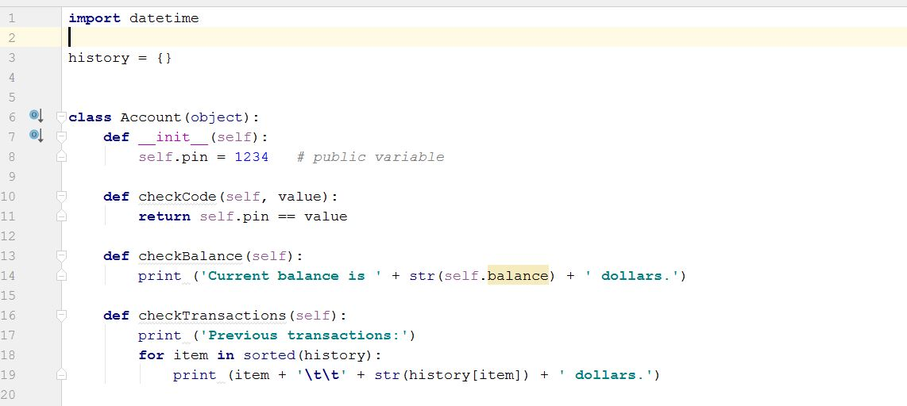
Use case 1- Bank Account
Class Declaration
Default Constructor
Member Functions

Slide 31
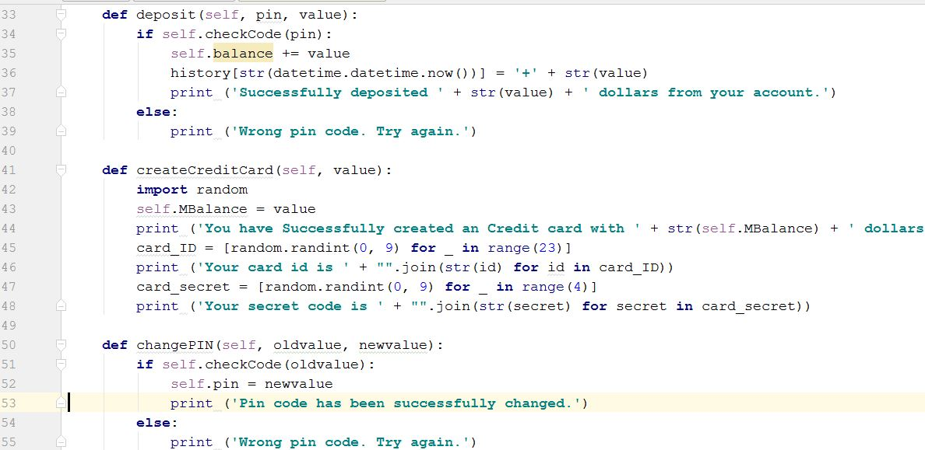
Other Functions of Account Class

Slide 32
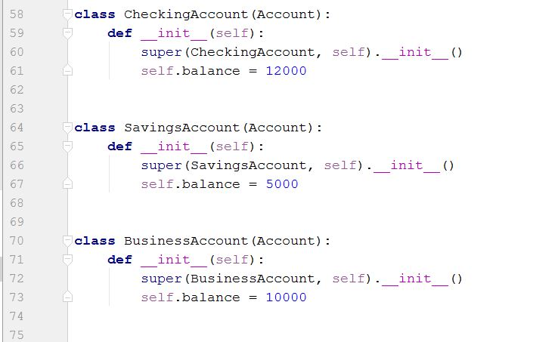
Inheritance: “Account” is passed in class declaration

Slide 33
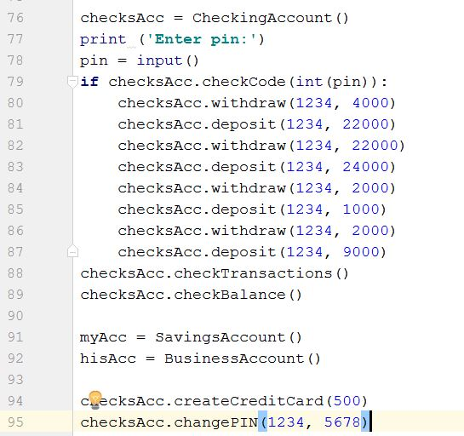
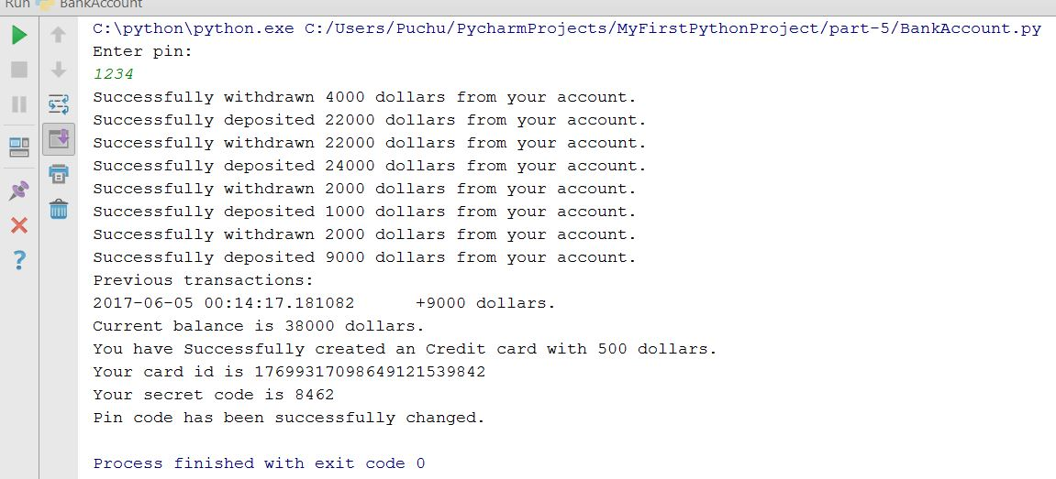
Output
Instance Creation

Slide 34
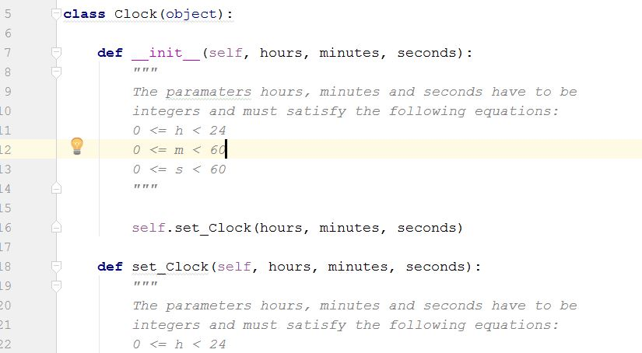
Use Case 2 - Multiple Inheritance
Clock Class

Slide 35
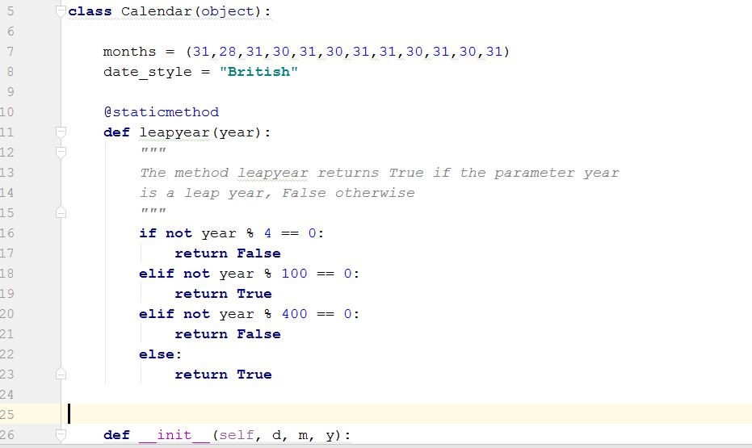
Calendar Class

Slide 36
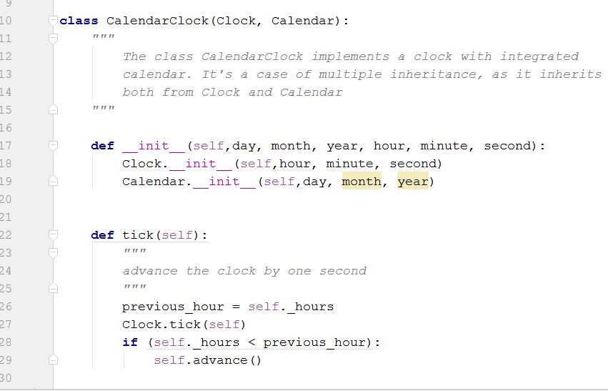
Calendar Class
Clock Class
We have created one class CalenderCLock to inherit both Clock and Calendar class features
Notice the super class constructor calling

Slide 37
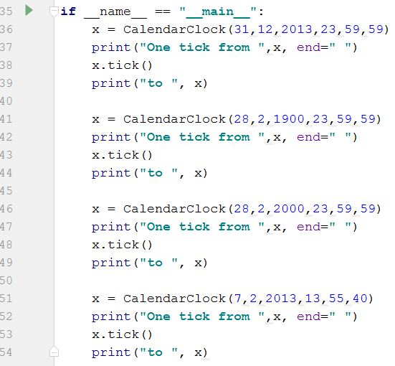
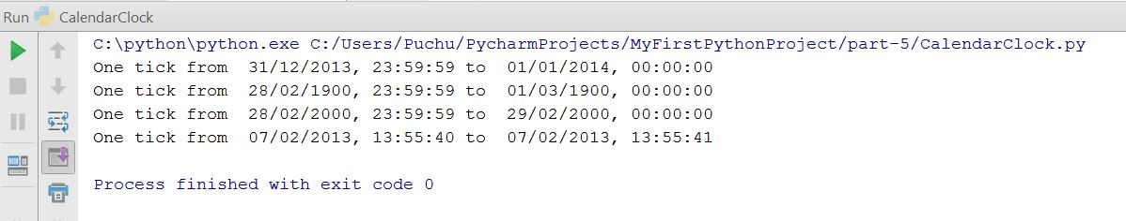
Output

Slide 38
Scientific Python Packages
numpy - mainly useful for its N-dimensional array objects
pandas - Python data analysis library, including structures such as data frames
matplotlib - 2D plotting library producing publication quality figures
scikit-learn - the machine learning algorithms used for data analysis and data mining tasks

Slide 39
Numpy
Extra features required:
fast, multi-dimensional arrays
libraries of reliable, tested scientiﬁc functions
plotting tools
NumPy is at the core of nearly every scientific Python application or module since it provides a fast N-d array datatype that can be manipulated in a vectorized form.
39

Slide 40
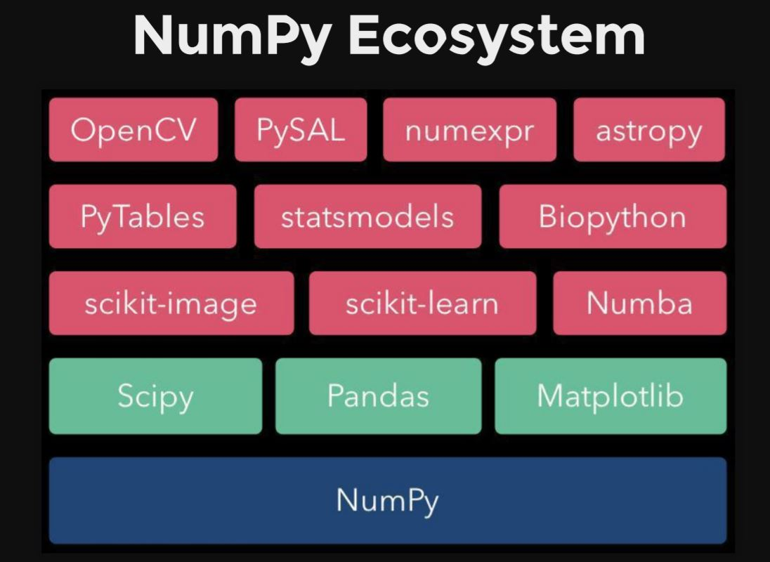
NumPy N-dimensional Array manipulations
Fundamental package for scientific computing with Python
N-dimensional array object
Linear algebra, Fourier transform, random number capabilities
Building block for other packages (e.g. SciPy)
Open source

Slide 41
Arrays – Numerical Python (Numpy)
Lists ok for storing small amounts of one-dimensional data
>>> a = [1,3,5,7,9]
>>> print(a[2:4])
[5, 7]
>>> b = [[1, 3, 5, 7, 9], [2, 4, 6, 8, 10]]
>>> print(b[0])
[1, 3, 5, 7, 9]
>>> print(b[1][2:4])
[6, 8]
>>> a = [1,3,5,7,9]
>>> b = [3,5,6,7,9]
>>> c = a + b
>>> print c
[1, 3, 5, 7, 9, 3, 5, 6, 7, 9]
But, can’t use directly with arithmetical operators (+, -, *, /, …)
Need efﬁcient arrays with arithmetic and better multidimensional tools
Numpy
Similar to lists, but much more capable, except ﬁxed size
>>> import numpy

Slide 42
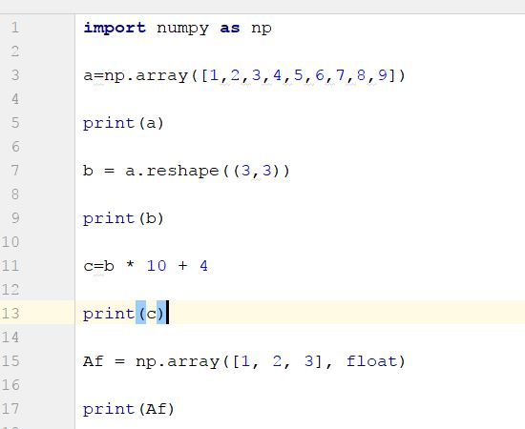
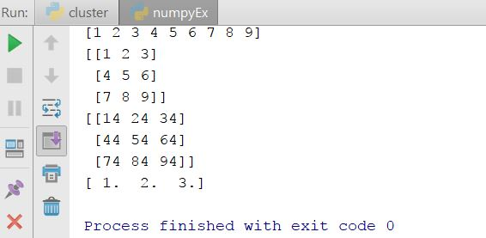
Import numpy – Basic Operations

Slide 43
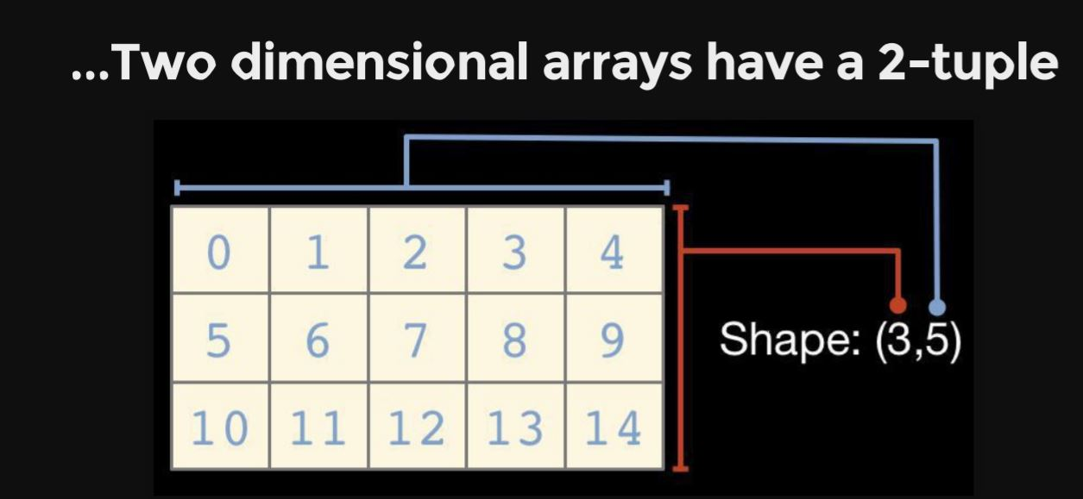
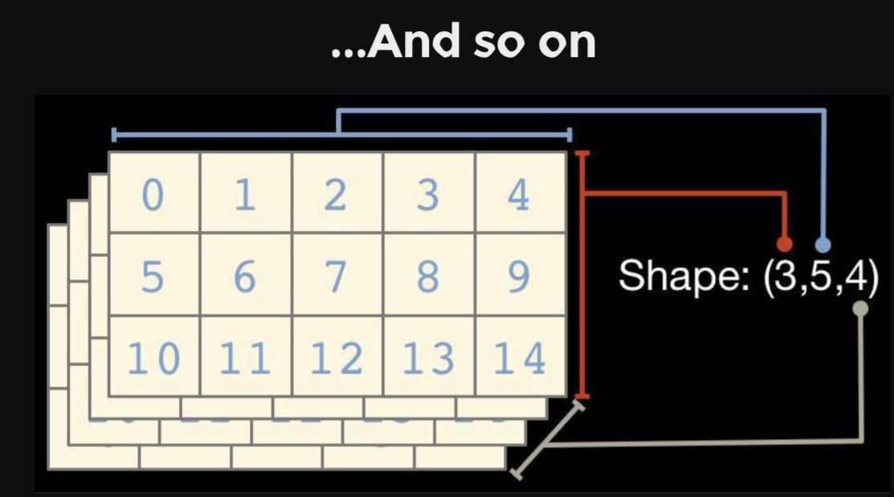
Reshape functions

Slide 44
numpy.ndarray.dtype
Numpy array comprises elements of single data type
Important attributes
dtype.byteorder — big or little endian
dtype.itemsize — element size of this dtype
dtype.name — a name for this dtype object
dtype.type — type object used to create scalars
There are many others...

Slide 45
others
Input | Description | Output
np.arange(10) | Range of values | [0 1 2 3 4 5 6 7 8 9]
np.linspace(0,1,5) | By Specifying the number of elements | [ 0. 0.25 0.5 0.75 1. ]
np.zeros((2,2)) | Zero-initialized | [[ 0. 0.] [ 0. 0.]]
np.ones((2,2)) | One-initialized | [ 1. 1.] [ 1. 1.]]
np.empty((2,2)) | uninitialized | [[ 0. 0.] [ 0. 0.]]
np.eye(3) | Constant diagonal value | [[ 1. 0. 0.] [ 0. 1. 0.] [ 0. 0. 1.]]
np.diag([1,2,3,4]) | Multiple diagonal values | [[1 0 0 0] [0 2 0 0] [0 0 3 0] [0 0 0 4]]

Slide 46
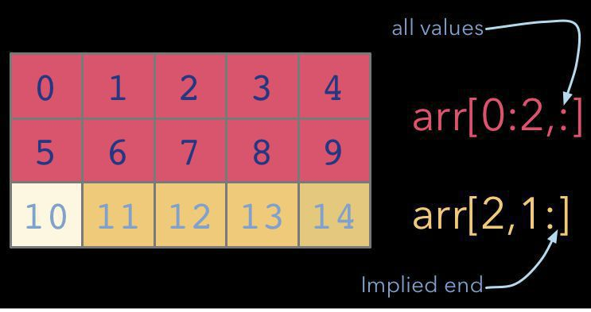
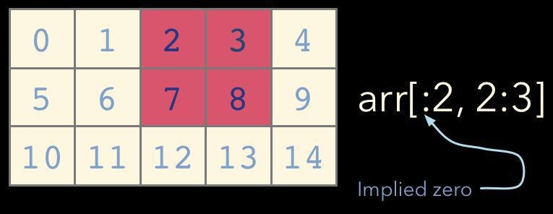
Indexing and Slicing as usual lists

Slide 47
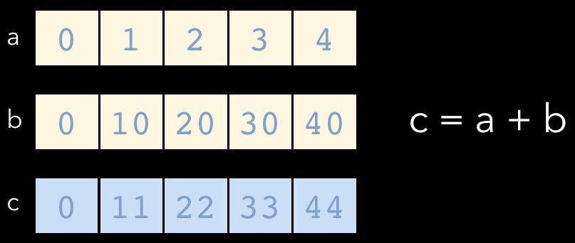
Universal Functions (ufuncs)
NumPy ufuncs are functions that operate element-wise on one or more arrays
ufuncs dispatch to optimized C inner-loops based on array dtype

Slide 48
NumPy has many built-in ufuncs
comparison: <, <=, ==, !=,
>=, >
arithmetic: +, -, *, /, reciprocal, square
exponential: exp, expm1, exp2, log, log10, power, sqrt
log1p,
log2,
trigonometric: sin, cos, tan, acsin, arccos,
atctan
hyperbolic: sinh, cosh, tanh, acsinh, arccosh,
atctanh
bitwise operations: &, |, ~, ^, left_shift, right_shift
logical operations: and, logical_xor, not, or
predicates: isfinite, isinf, isnan, signbit
other: abs, ceil, floor, mod, modf, round, trunc
sinc,
sign,

Slide 49
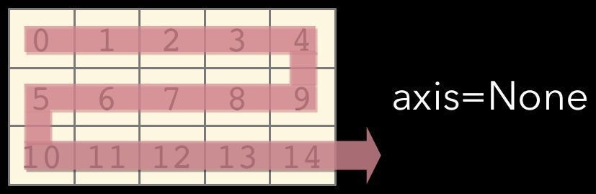
Axis
Array method reductions take an optional axis parameter that specifies over which axes to reduce
axis=None reduces into a single scalar
In [7]: a.sum ()
Out[7]: 105
axis=None is the default

Slide 50
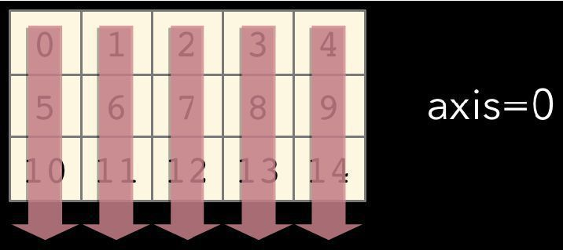
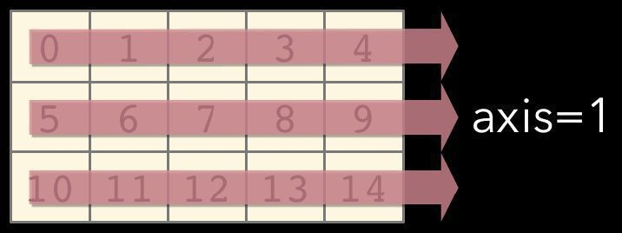
axis=0 reduces into the zeroth dimension
In [8]: a.sum(axis=0 )
Out[8]: array([15, 18, 21, 24,
27])
axis=1 reduces into the first dimension
In [9]: a.sum(axis= 1) Out[9]: array([10, 35, 60])

Slide 51
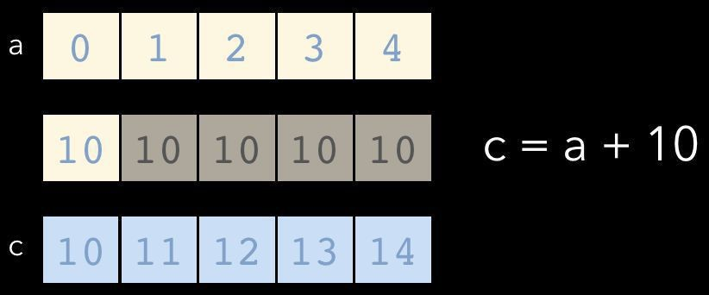
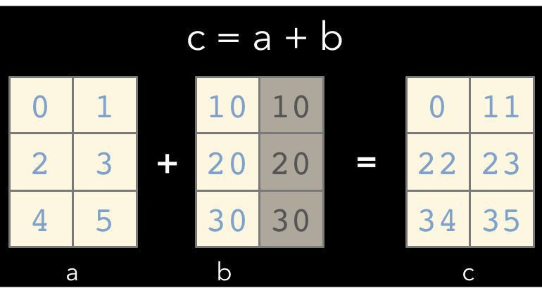
Broadcasting
A key feature of NumPy is broadcasting, where arrays with different, but compatible shapes can be used as arguments to ufuncs
Here an array of shape (3,
In this case an array scalar is broadcast to an array with shape (5, )
1) is broadcast to an array with shape
(3, 2)

Slide 52
Array Methods
Predicates
a.any(),
Reductions
a.all()
a.mean(),
a.argmin(),
a.argmax(),
a.trace(),
a.cumsum(),
Manipulation
a.cumprod()
a.argsort(),
a.transpose(),
a.reshape(...),
a.ravel(),
a.fill(...),
a.clip(...)
Complex Numbers
a.real, a.imag,
a.conj()

Slide 53
NumPy Functions
Input | Output | Desc
np.random.random((2,3)) | [[ 0.0028206 0.73486004 0.07416516] [ 0.69691992 0.65554942 0.67732808]] | Random
np.random.normal(loc=1.0, scale=2.0, size=(2,2)) | [[ 0.3378941 2.44143865] [-0.88674669 0.90112657]] | Random with loc and scale
np.savetxt("a_out.txt", a) |  | Save to file
np.loadtxt("a_out.txt") |  | Load from file

Slide 54
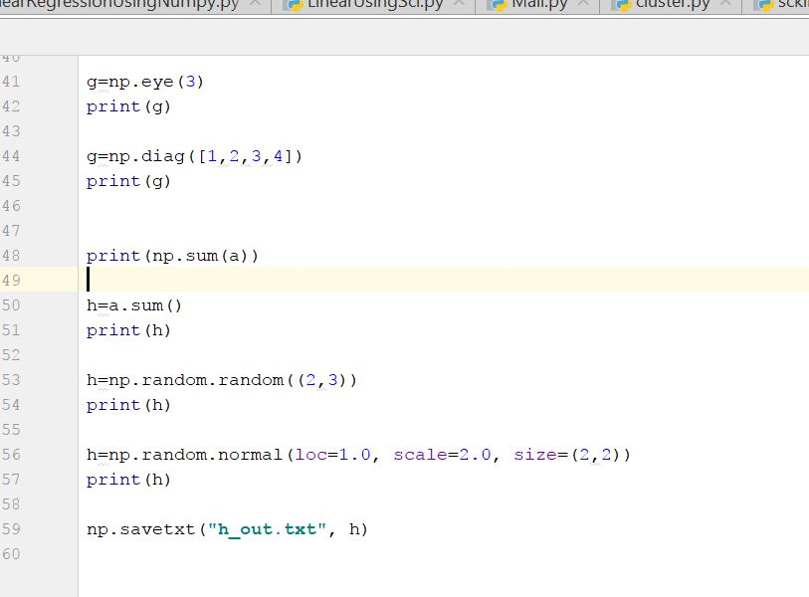
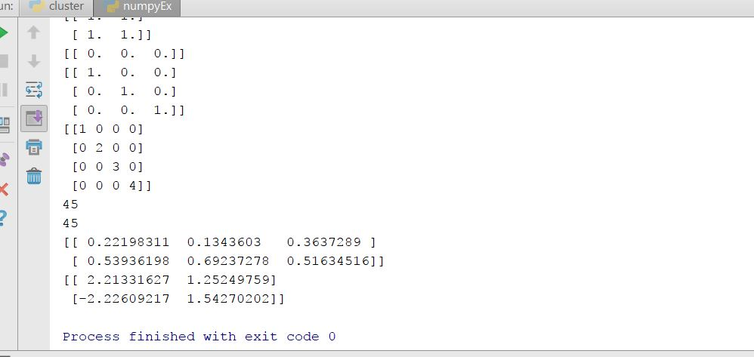
NumPy Use case 3: numpyEx.py
Different functions of numpy and their output

Slide 55
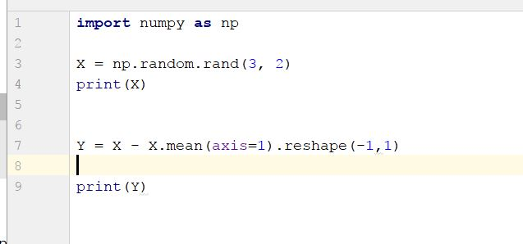
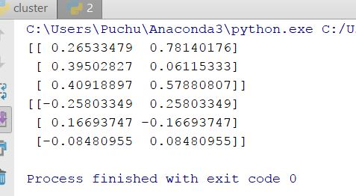
Use case 4
Creating random matrix
Calculating mean for each row and then broadcasting to each element
output

Slide 56
Web Scraping
A computer software technique of extracting information from websites. (Wikipedia)
for business, hobbies, research...
Look for right URLs to scrap.
Look for right content from webpages.
Saving data into data store.

Slide 57
Web Scraping
This technique mostly focuses on the transformation of unstructured data (HTML format) on the web into structured data

Slide 58
Beautiful Soup library
Python third-party library for extracting data from html and xml files
Works with html.parser, lxml, html5lib
Provides ways to navigate, search and modify the parse tree based on the position in the parse tree, tag name, tag attributes, CSS classes using regular expressions, user defined functions etc.
Excellent tutorial with examples at http://www.crummy.com/software/BeautifulSoup/bs4/doc/
Supports Python 2 and 3

Slide 59
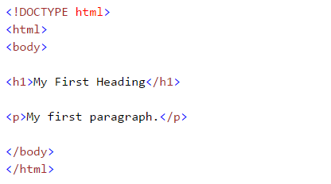
Get familiar with HTML (Tags)
While performing web scarping, we deal with html tags.
Thus, we must have good understanding of them

Slide 60
Get familiar with HTML (Tags)
This syntax has various tags as elaborated below:
<!DOCTYPE html> : HTML documents must start with a type declaration
HTML document is contained between <html> and </html>
The visible part of the HTML document is between <body> and </body>
HTML headings are defined with the <h1> to <h6> tags
HTML paragraphs are defined with the <p> tag

Slide 61
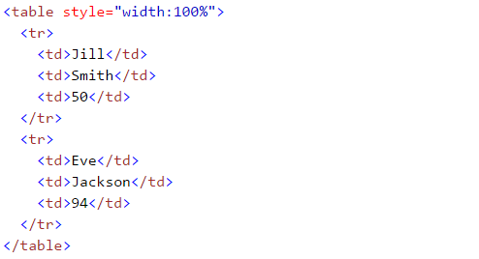
Get familiar with HTML (Tags)
HTML links are defined with the <a> tag, “<a href=“http://www.test.com”>This is a link for test.com</a>”
HTML tables are defined with<Table>, row as <tr> and rows are divided into data as <td>

Slide 62
Installation
pip install beautifulsoup4 or easy_install beautifulsoup4
See: http://www.crummy.com/software/BeautifulSoup/
On installing libraries: http://docs.python.org/2/install/

Slide 63
Example
import Requests
from bs4 import BeautifulSoup
html = requests.get("http://sampleshop.pl")
bsObj = BeautifulSoup(html.content, "html.parser")
print(bsObj.h1)

Slide 64


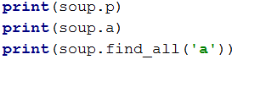


Simple ways to navigate data structure

Slide 65
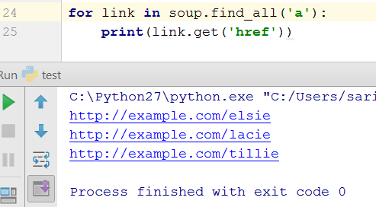
Extracting all the URLs found within a page’s <a> tags
.
<a> tag defines a hyperlink which is used to link from one page to another page
href attribute indicates the link destination

Slide 66
Basic functions: Getting headers, titles, body
soup.text
soup.head
soup.title
soup.body
soup.findall(‘a’)
soup.final(‘div’,{‘class’:’noprint’})

Slide 67
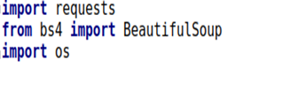
Use case: Wikipedia
The goal here is to extract all the data related to a keyword from Wikipedia, then save those data in a file.
Libraries to be imported:

Slide 68
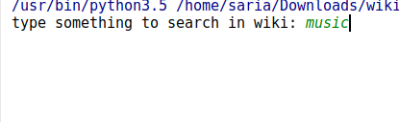
.
Keyword for searching in the wiki
search = input('type something to search in wiki: ') limit = input('how many results do you want to get?: ') if not os.path.exists(search): print("Creating file " + search) file2 = open(search+'.txt','a+',encoding='utf-8') search_spider(search, limit)
1. Create a file in the project with the keyword being searched
2. This function call the search api in wiki to find all the pages with the keyword that user has identified

Slide 69
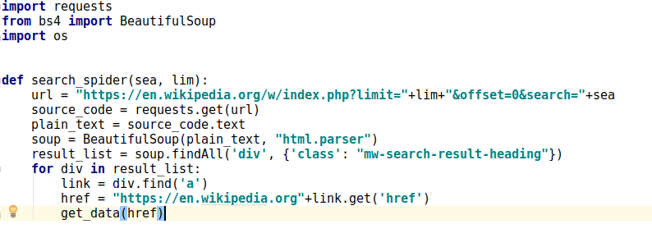
Search the wiki with specified keyword
1. Search the wiki for the keyword
2. Using BeautifulSoap to parse the html
3. Including all the div with this class in the result
4. Analyzing the first result

Slide 70
Get the data and save the result in the file
1. Get the url of the result, ex: Barack Obama
def get_data(url): source_code = urllib.request.urlopen(url) plain_text = source_code soup = BeautifulSoup(plain_text, "html.parser") body = soup.find('div', {'class': 'mw-parser-output'}) file2.write(str(body.text)) print(body.text)
2. Parse the html page using BeautifulSoup
3. Open the created text file
4. Finding all the div with this class name
5. Writing the cleaned text in the file

Slide 71
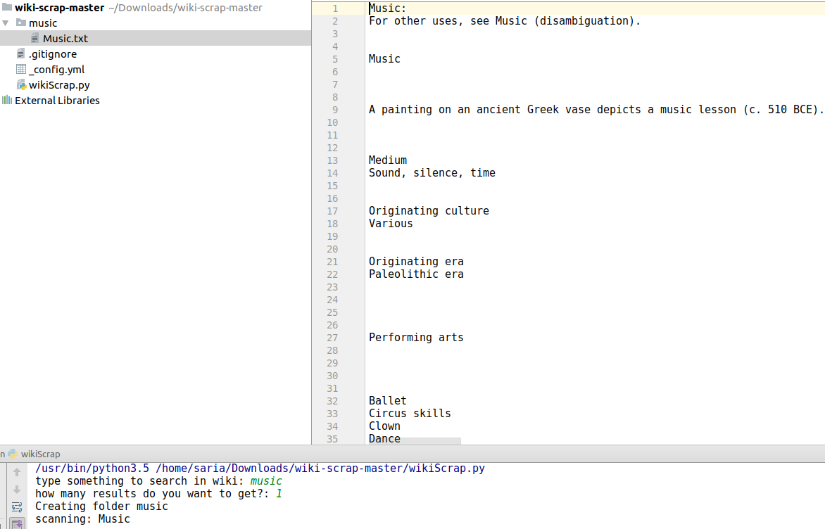
Result

Slide 72
References
https://github.com/saria85/PythonProgramming-summer2017
https://beautiful-soup-4.readthedocs.io/en/latest/
http://www.w3resource.com/pythonexercises/https://www.slideshare.net/milkers/beautiful-soup?qid=64c9989d-94f7-4811-b3102cd7cfcb272e&v=&b=&from_search=6
https://www.learnpython.org/

