Slide 1
Regression Models
Notes:
13

Slide 2
Types of
Regression Models
Regression
Models
Notes:
19
This teleology is based on the number of explanatory variables & nature of relationship between X & Y.

Slide 3
Types of
Regression Models
1 Explanatory
Regression
Variable
Models
Simple
Notes:
20
This teleology is based on the number of explanatory variables & nature of relationship between X & Y.

Slide 4
Types of
Regression Models
1 Explanatory
Regression
2+ Explanatory
Variable
Models
Variables
Simple
Multiple
Notes:
21
This teleology is based on the number of explanatory variables & nature of relationship between X & Y.

Slide 5
Types of
Regression Models
1 Explanatory
Regression
2+ Explanatory
Variable
Models
Variables
Simple
Multiple
Linear
Notes:
22
This teleology is based on the number of explanatory variables & nature of relationship between X & Y.

Slide 6
Types of
Regression Models
1 Explanatory
Regression
2+ Explanatory
Variable
Models
Variables
Simple
Multiple
Non-
Linear
Linear
Notes:
23
This teleology is based on the number of explanatory variables & nature of relationship between X & Y.

Slide 7
Types of
Regression Models
1 Explanatory
Regression
2+ Explanatory
Variable
Models
Variables
Simple
Multiple
Non-
Linear
Linear
Linear
Notes:
24
This teleology is based on the number of explanatory variables & nature of relationship between X & Y.

Slide 8
Types of
Regression Models
1 Explanatory
Regression
2+ Explanatory
Variable
Models
Variables
Simple
Multiple
Non-
Non-
Linear
Linear
Linear
Linear
Notes:
24
This teleology is based on the number of explanatory variables & nature of relationship between X & Y.

Slide 9
Linear Regression Model
Notes:
26

Slide 10
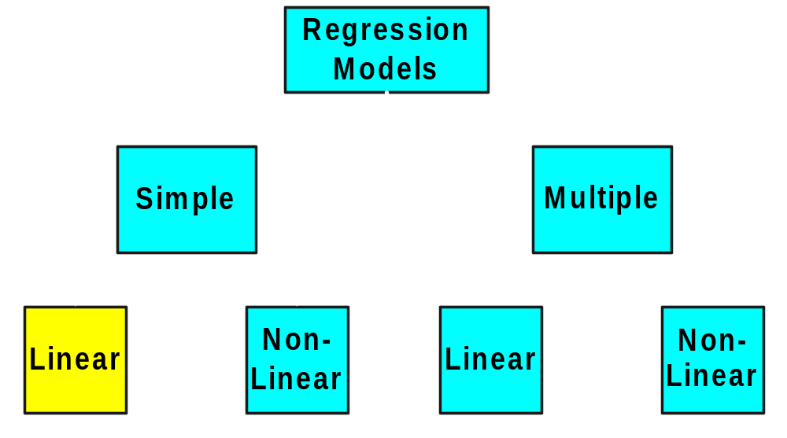
Types of
Regression Models
Notes:
27
This teleology is based on the number of explanatory variables & nature of relationship between X & Y.

Slide 11
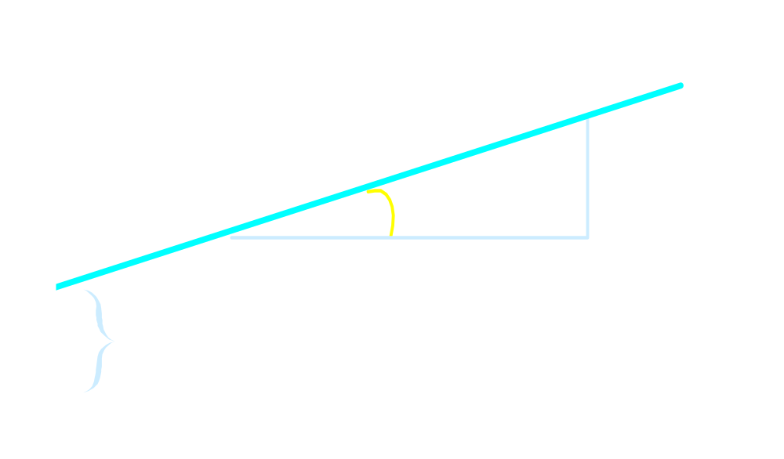

Linear Equations
Notes:
28

Slide 12
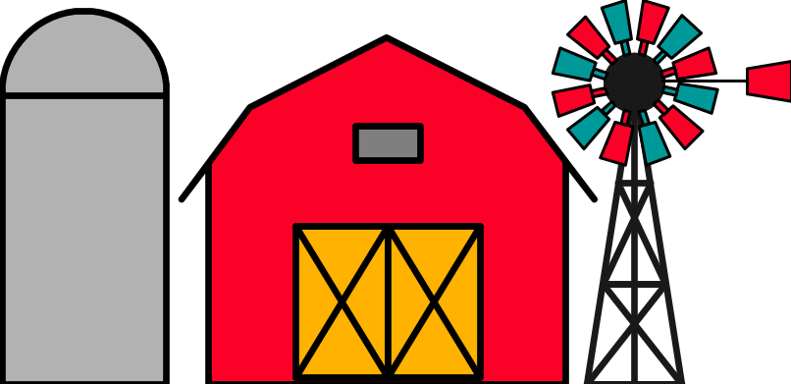
Parameter Estimation Thinking Challenge
You’re a Vet epidemiologist for the county cooperative. You gather the following data:
Food (lb.) Milk yield (lb.)
4 3.0
6 5.5
10 6.5
12 9.0
What is the relationship
between cows’ food intake and milk yield?
© 1984-1994 T/Maker Co.
Notes:
62

Slide 13
Linear Regression Model
1. Relationship Between Variables Is a Linear Function
Population
Y-Intercept
Population Slope
Random Error
Y
=
β
+
β
X
+
ε
i
0
1
i
i
Dependent (Response) Variable
Independent (Explanatory) Variable

Slide 14
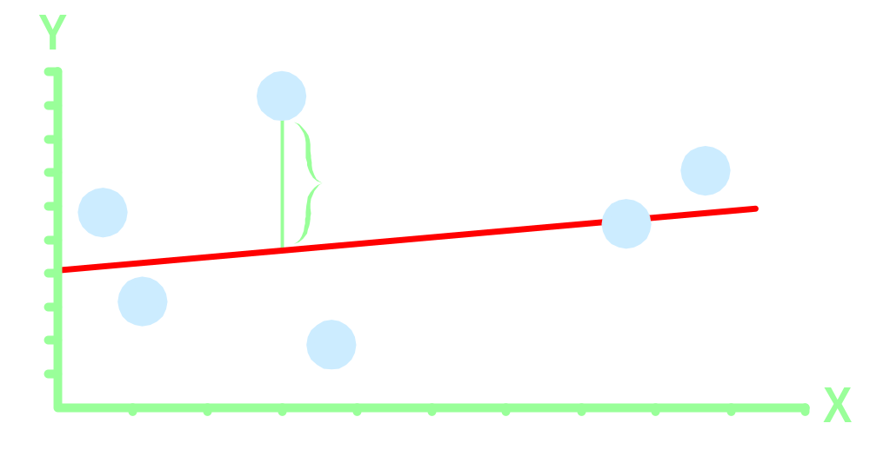
Population Linear Regression Model
Observedvalue
ε_{i} = Random error
Observed value
Notes:
35

Slide 15
Regression Models
Relationship between one dependent variable and explanatory variable(s)
Use equation to set up relationship
    Numerical Dependent (Response) Variable
    1 or More Numerical or Categorical Independent (Explanatory) Variables
Used Mainly for Prediction & Estimation

Slide 16
Estimating Parameters:
Least Squares Method
Notes:
40

Slide 17
Scatter plot
1. Plot of All (X_{i}, Y_{i}) Pairs
2. Suggests How Well Model Will Fit
Y
60
40
20
0
X
0
20
40
60

Slide 18
Thinking Challenge
How would you draw a line through the points? How do you determine which line ‘fits best’?
Y
60
40
20
0
X
0
20
40
60
Notes:
42

Slide 19
Thinking Challenge
How would you draw a line through the points? How do you determine which line ‘fits best’?
Slope changed
Y
60
40
20
0
X
0
20
40
60
Intercept unchanged
Notes:
43

Slide 20
Thinking Challenge
How would you draw a line through the points? How do you determine which line ‘fits best’?
Slope unchanged
Y
60
40
20
0
X
0
20
40
60
Intercept changed
Notes:
44

Slide 21
Thinking Challenge
How would you draw a line through the points? How do you determine which line ‘fits best’?
Slope changed
Y
60
40
20
0
X
0
20
40
60
Intercept changed
Notes:
45

Slide 22
Least Squares
1. ‘Best Fit’ Means Difference Between Actual Y Values & Predicted Y Values Are a Minimum.
Notes:
49

Slide 23
Least Squares
1. ‘Best Fit’ Means Difference Between Actual Y Values & Predicted Y Values is a Minimum. But Positive Differences Off-Set Negative ones. So square errors!
Notes:
50

Slide 24
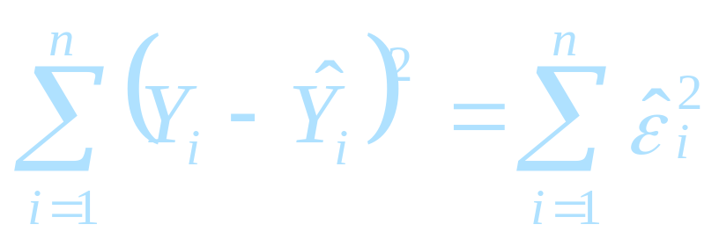
Least Squares
1. ‘Best Fit’ Means Difference Between Actual Y Values & Predicted Y Values Are a Minimum. But Positive Differences Off-Set Negative. So square errors!
2. LS Minimizes the Sum of the Squared Differences (errors) (SSE)
Notes:
51

Slide 25
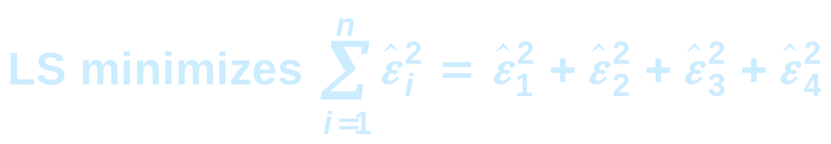
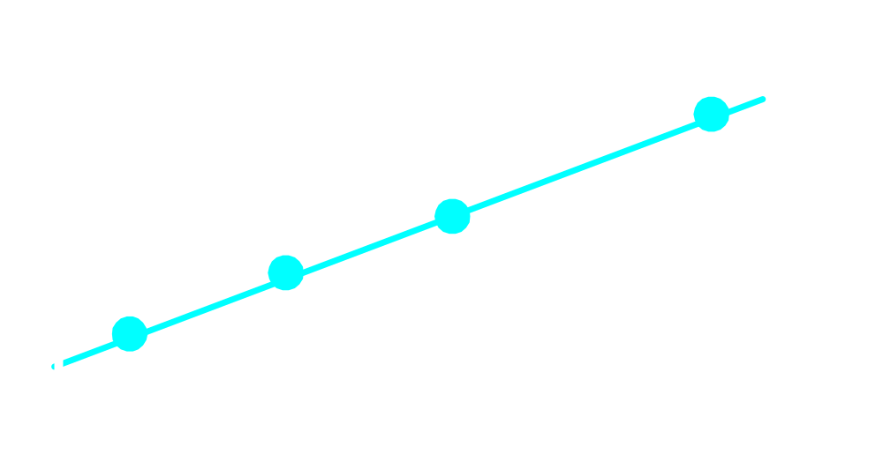
Least Squares Graphically
Notes:
52

Slide 26
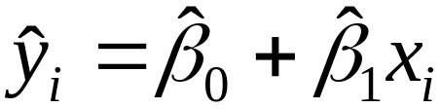
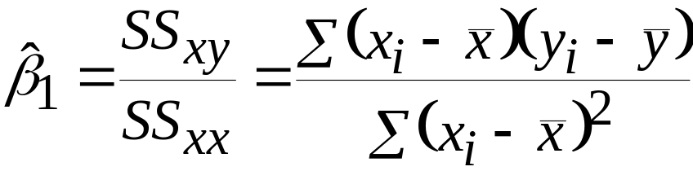
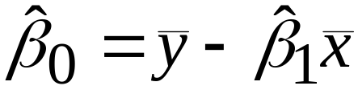
Coefficient Equations
Prediction equation
Sample slope
Sample Y - intercept

Slide 27
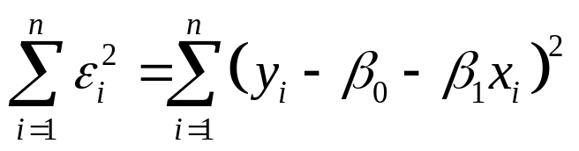
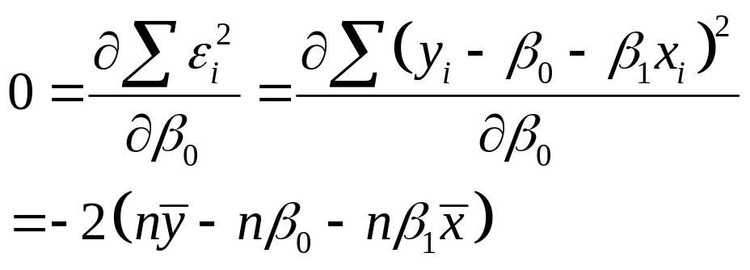
Derivation of Parameters (1)
Least Squares (L-S):
Minimize squared error

Slide 28
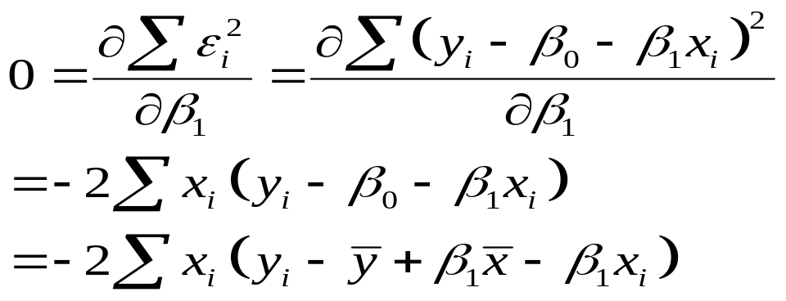
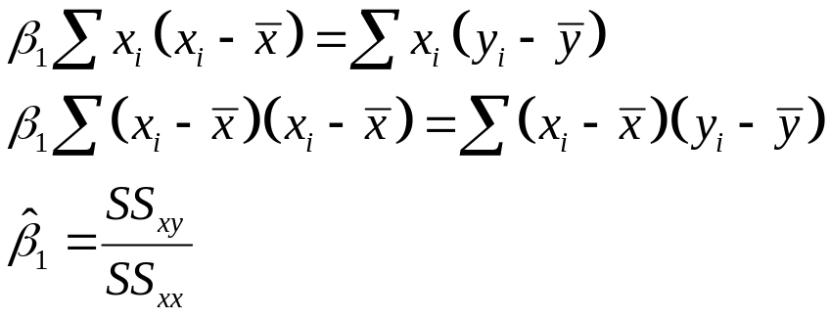
Derivation of Parameters (1)
Least Squares (L-S):
Minimize squared error

Slide 29
Parameter Estimation Thinking Challenge
You’re a Vet epidemiologist for the county cooperative. You gather the following data:
Food (lb.) Milk yield (lb.)
4 3.0
6 5.5
10 6.5
12 9.0
What is the relationship
between cows’ food intake and milk yield?
© 1984-1994 T/Maker Co.
Notes:
62

Slide 30

Scattergram
Milk Yield vs. Food intake*
M. Yield (lb.)
Food intake (lb.)
Notes:
65

Slide 31
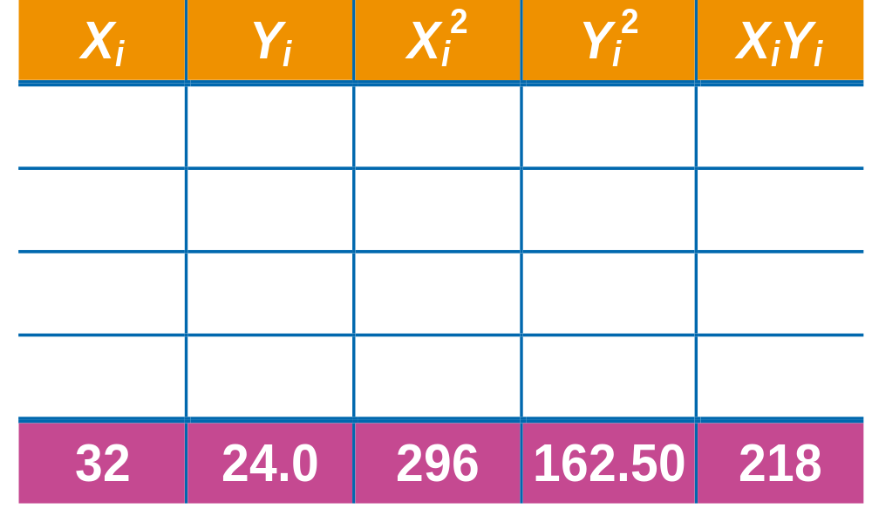
Parameter Estimation Solution Table*
Notes:
66

Slide 32
Parameter Estimation Solution*
Notes:
67

Slide 33
Linear Multiple Regression Model
Notes:
9

Slide 34
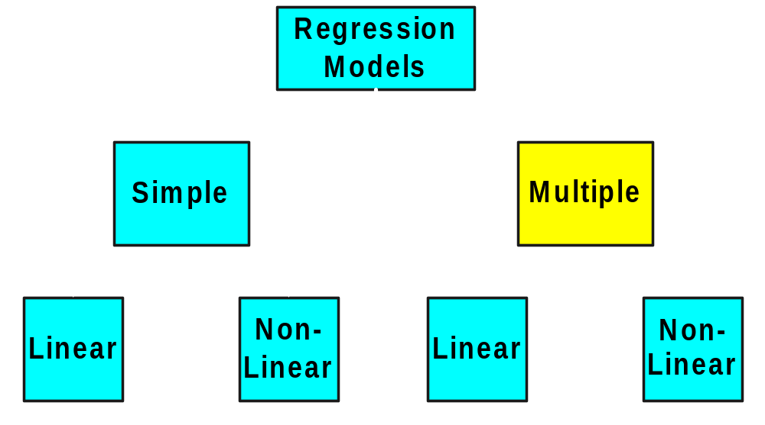
Types of
Regression Models
Notes:
27
This teleology is based on the number of explanatory variables & nature of relationship between X & Y.

Slide 35
Regression Modeling Steps
Specify the model and estimate all unknown parameters
Evaluate Model
Use Model for Prediction & Estimation

Slide 36
Linear regression Model specification:
Decide what you want to do and select the dependent variable
List all potential independent variables for your model
Notes:
9

Slide 37
Linear Multiple Regression Model
1. Relationship between 1 dependent & 2 or more independent variables is a linear function
Population
Y-intercept
Population slopes
Random error
Dependent (response) variable
Independent (explanatory) variables
Notes:
11

Slide 38
Parameter Estimation:
You gather the observations for all variables and estimate model parameters
Notes:
15

Slide 39

Multiple Linear Regression Equations
Too
complicated
by hand!
Ouch!
Notes:
16

Slide 40
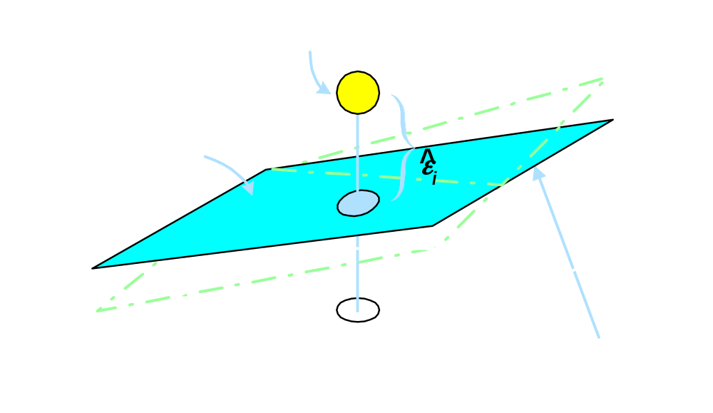
Sample Multiple Regression Model
Bivariate model
Notes:
13

Slide 41
Parameter Estimation Example
You’re a Vet epidemiologist for the county cooperative. You gather the following data:
Milk Food weight
1 1 2
4 8 8
1 3 1
3 5 7
2 6 4
4 10 6
What is the linear relationship
between cows’ food intake, weight and milk yield?
© 1984-1994 T/Maker Co.
Notes:
62

Slide 42
Model Specification Example
Dependent variable is milk yield (lb)
Independent variables for our model are Food intake (lb.) and weight (X100 lb.)
Notes:
9

Slide 43
Model Evaluation
Notes:
21

Slide 44
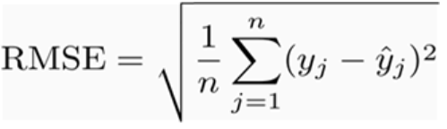
RMSE (Root Mean Square Error)
It represents the sample standard deviation of the differences between predicted values and observed values

Slide 45
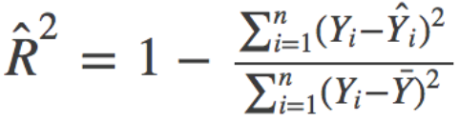
R Squared (R²)
R Squared is used for explanatory purposes
how well your selected independent variable(s) explain the variability in your dependent variable(s)
        R Squared

Slide 46
Use case: house prices

Slide 47
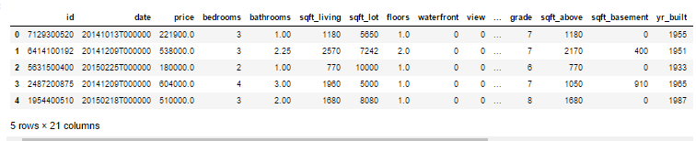
House prices data set

Slide 48
Step 1: Acquire the data and create our environment
import pandas as pd
import numpy as np
import matplotlib.pyplot as plt
plt.style.use(style='ggplot')
plt.rcParams['figure.figsize'] = (10, 6)
train = pd.read_csv('train.csv')
test = pd.read_csv('test.csv')
print(train.SalePrice.describe())
count 1460.000000
mean 180921.195890
std 79442.502883
min 34900.000000
25% 129975.000000
50% 163000.000000
75% 214000.000000
max 755000.000000

Slide 49
Step 2: Explore the data and engineer Features
Next, we'll check for skewness,
  is a measure of the shape of the distribution of values.
to log-transform the target variable when it is skewed
One reason for this is to improve the linearity of the data

Slide 50
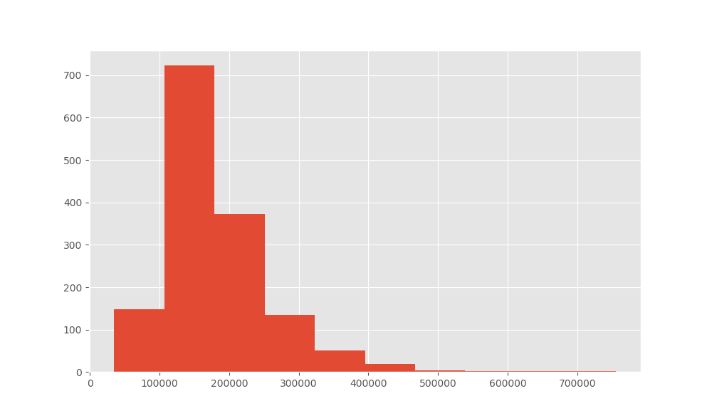
Visualize the skewness of the target
print(train.SalePrice.skew())
plt.hist(train.SalePrice)
plt.show()
Note that the distribution has longer tail on the right
It Positively skewed

Slide 51
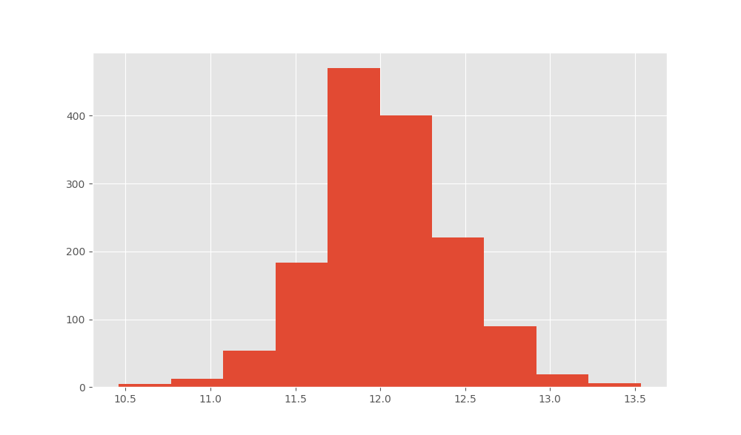
Log transform the target
target = np.log(train.SalePrice)
print('skew is', target.skew())
plt.hist(target)

Slide 52
Correlation of the numerical features and the target
Now that we've transformed the target variable, let's consider our features.
First, we'll check out the numerical features and make some plots
The first five features are the most positively correlated with SalePrice
the next five are the most negatively correlated

Slide 53
correlation
numeric_features = train.select_dtypes(include=[np.number])
corr = numeric_features.corr()
print(corr['SalePrice'].sort_values(ascending=False)[:5],'\n')
print(corr['SalePrice'].sort_values(ascending=False)[-5:])
SalePrice 1.000000
OverallQual 0.790982
GrLivArea 0.708624
GarageCars 0.640409
GarageArea 0.623431
Name: SalePrice, dtype: float64
YrSold -0.028923
OverallCond -0.077856
MSSubClass -0.084284
EnclosedPorch -0.128578
KitchenAbvGr -0.135907

Slide 54
Digging deeper in OveralQual
Let's dig deeper on OverallQual
[ 7 6 8 5 9 4 10 3 1 2]
We can create a pivot table to further investigate the relationship between OverallQual and SalePrice

Slide 55
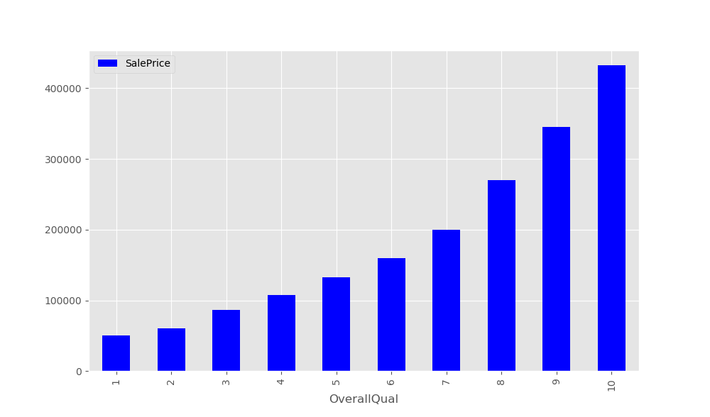
Pivottable OveralQual
quality_pivot = train.pivot_table(index='OverallQual’,
values='SalePrice',aggfunc=np.median)
quality_pivot.plot(kind='bar',color ='blue')
plt.show()
Notice that the median sales price strictly increases as Overall Quality increases

Slide 56
Handling Null Values
Feature Null Count
PoolQC 1453
MiscFeature 1406
Alley 1369
Fence 1179
FireplaceQu 690
LotFrontage 259
GarageCond 81
GarageType 81
GarageYrBlt 81
GarageFinish 81
GarageQual 81
BsmtExposure 38
BsmtFinType2 38
BsmtFinType1 37
BsmtCond 37
BsmtQual 37
nulls = pd.DataFrame(train.isnull().sum().sort_values(ascending=False)[:25])
nulls.columns = ['Null Count']
nulls.index.name = 'Feature'
print(nulls)

Slide 57
Handling Null Values
Before we prepare the data for modeling, we need to deal with the missing data
fill the missing values with an average value
data = train.select_dtypes(include=[np.number]).interpolate().dropna()
print(sum(data.isnull().sum() != 0))
0

Slide 58
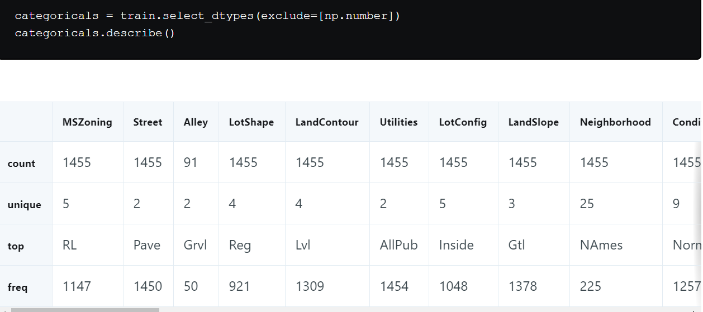
Wrangling the non-numeric Features

Slide 59
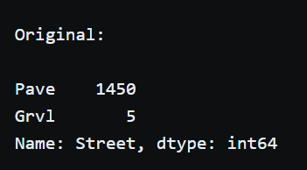
Transforming and engineering features
Street column is categorical data
We need to convert it to numeric

Slide 60
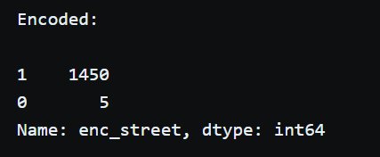
Transforming and engineering non-numeric features
pd.get_dummies() method will do this

Slide 61
Step 3 : Build a linear model
y = np.log(train.SalePrice)
x = data.drop(['SalePrice','Id'],axis=1)
from sklearn.model_selection import train_test_split
X_train, X_test,y_train, y_test = train_test_split(x,y,random_state=42,test_size=.33)
from sklearn import linear_model
lr1 = linear_model.LinearRegression()
model = lr1.fit(X_train,y_train)

Slide 62
Evaluate the performance and visualize results
r-squared value is a measure of how close the data are to the fitted regression line
It takes a value between 0 and 1,
1 meaning that all of the variance in the target is explained by the data.
In general, a higher r-squared value means a better fit
Model.score() method returns the r-squared value

Slide 63
Model evaluation
RMSE: Interpreting this value is somewhat more intuitive that the r-squared value.
The RMSE measures the distance between our predicted values and actual values
print(model.score(X_test,y_test))
prediction = model.predict(X_test)
from sklearn.metrics import mean_squared_error
print('rmse',mean_squared_error(y_test,prediction))
Output:
R Squared 0.862
rmse 0.023

Slide 64
References
https://towardsdatascience.com/linear-regression-with-example-8daf6205bd49
https://www.dataquest.io/blog/kaggle-getting-started/
https://en.wikipedia.org/wiki/Linear_regression
https://towardsdatascience.com/linear-regression-detailed-view-ea73175f6e86

