Slide 1
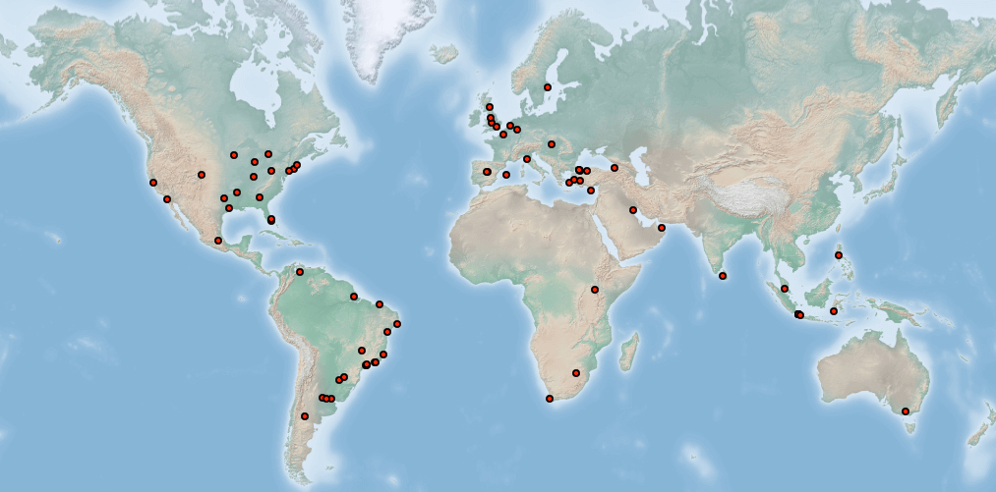
Twitter Data Analysis

Slide 2
Tweepy
Tweepy is a Python API to access Twitter Data.
Documentation is available at http://docs.tweepy.org/en/latest/
Create an account to http://apps.twitter.com and get consumer key and access token.

Slide 3
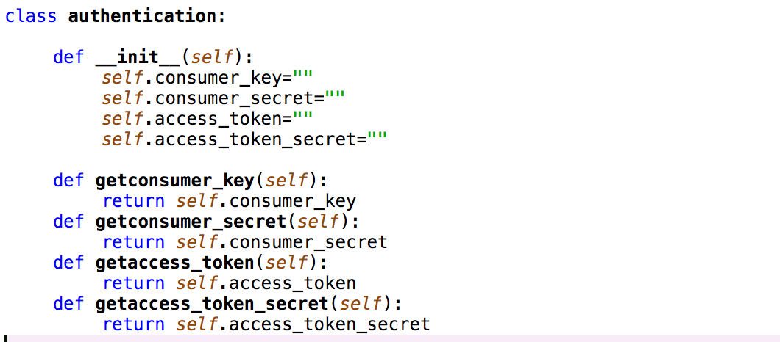
Authentication
Create Authentication file by using the tokens and keys generated from the http://apps.twitter.com

Slide 4
Twitter Streaming API
API Calls from Twitter :
api = tweepy.API(auth)
streamListener = TwitterStreamListener()
myStream = tweepy.Stream(auth=api.auth, listener=streamListener)
myStream.filter(track=['programming'], async=True)
streamListener = TwitterStreamListener()
Add your wrapper and your listener to the stream object
myStream = tweepy.Stream(auth=api.auth, listener=streamListener)
Optional : Filter your tweet by a Hashtag or word
myStream.filter(track=['programming'], async=True)

Slide 5
Basemap
It’s a matplotlib extension, so it has got all its features to create data visualizations.
Documentation is available at https://matplotlib.org/basemap/

Slide 6
Basemap Plotting
def get_tweet(tweet):
if tweet.coordinates is not None:
x,y = map(tweet.coordinates['coordinates'][0], tweet.coordinates['coordinates'][1])
map.plot(x, y, 'ro', markersize=2)
plt.draw
map = Basemap(projection='merc, llcrnrlat=-80, urcrnrlat=80, llcrnrlon=-180,urcrnrlon=180,lat_ts=20, resolution='l')
map.bluemarble(scale=0.3)
﻿# Set interactive mode ON
plt.ion()
# Display map
plt.show()

Slide 7
Sentiment Analysis
TextBlob is a Python (2 and 3) library for processing textual data
analysis= TextBlob(cleanedTweet)
analysis.sentiment.polarity < 0 means Negative
0<=analysis.sentiment.polarity <=0.2 means Neutral

