Slide 1
Classify MNIST Digits Dataset : Tensorflow implementation

Slide 2
Dataset Introduction
Representing Dataset in Tensorflow
Download the MNIS dataset
Model Discussion : Show Accuracy Differences between Gradient Descent Optimizer and Adam Optimizer

Slide 3
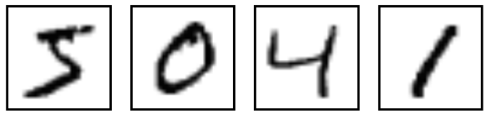
MNIST Dataset introduction
MNIST is a simple computer vision dataset. It consists of images of handwritten digits.
The dataset contains 60,000 examples for training and 10,000 examples for testing.
Every MNIST data point has two parts: an image of a handwritten digit and a corresponding label. We'll call the images "x" and the labels "y".
It also includes labels for each image, telling us which digit it is. For example, the labels for the below image are 5, 0, 4, and 1.

Slide 4
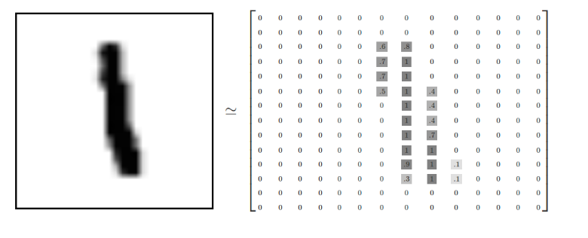
MNIST Dataset introduction
Each image is 28 pixels by 28 pixels. We can interpret this as a big array of numbers
We can flatten this array into a vector of 28x28 = 784 numbers
Entire Dataset is available at http://yann.lecun.com/exdb/mnist/

Slide 5
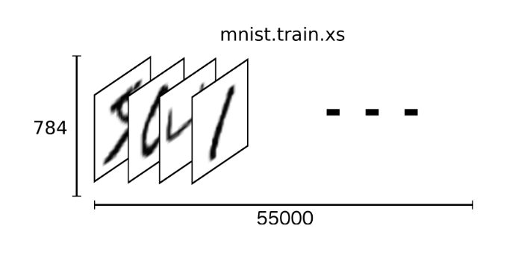
Representing Dataset in Tensorflow
MNIST Dataset is a tensor (an n-dimensional array) with a shape of [55000, 784]
The first dimension is an index into the list of images
The second dimension is the index for each pixel in each image

Slide 6
Model
Download the MNIS :
import tensorflow as tf
from tensorflow.examples.tutorials.mnist import input_data
Initializing parameters for the model
batch =100
learning_rate=0.01
training_epochs=10
Creating Placeholders
x = tf.placeholder(tf.float32, shape=[None, 784])
y_ = tf.placeholder(tf.float32, shape=[None, 10])

Slide 7
Model
Creating Variables
W = tf. Variable(tf.zeros([784,10]))
b = tf. Variable(tf.zeros([10]))
Initializing the model
y = tf.nn.softmax(tf.matmul(x,W) + b)
Softmax is a generalization of logistic regression. Softmax helps in multi-classification models where a given output can be a list of many different things. It provides values between 0 to 1 that in addition give you the probability of the output belonging to a particular class.

Slide 8
Model
Defining Cost Function
cross_entropy = tf.reduce_mean(-tf.reduce_sum(y_ * tf.log(y), reduction_indices=[1]))
This is the cost function of the model – a cost function is a difference between the predicted value and the actual value that we are trying to minimize to improve the accuracy of the model.
Determining the accuracy of parameters
correct_prediction = tf.equal(tf.argmax(y,1), tf.argmax(y_,1))
accuracy = tf.reduce_mean(tf.cast(correct_prediction, tf.float32))

Slide 9
Model
Implementing Gradient Descent Algorithm
train_op = tf.train.GradientDescentOptimizer(learning_rate).minimize(cross_entropy)
This is the cost function of the model – a cost function is a difference between the predicted value and the actual value that we are trying to minimize to improve the accuracy of the model.
Determining the accuracy of parameters
correct_prediction = tf.equal(tf.argmax(y,1), tf.argmax(y_,1))
accuracy = tf.reduce_mean(tf.cast(correct_prediction, tf.float32))

Slide 10
Model
Executing the model
sess.run([train_op], feed_dict={x: batch_x, y_: batch_y})
Print accuracy of the model
if epoch % 2 == 0:
print "Epoch: ", epoch
print "Accuracy: ", accuracy.eval(feed_dict={x: mnist.test.images, y_: mnist.test.labels})
print "Model Execution Complete"

Slide 11
Summary
AdamAverage uses moving averages of the parameters.
In Gradient Descent if you take too big of a step with gradient descent you can end up jumping over the minimum.
Adam optimizer has momentum, that is, it doesn't just follow the instantaneous gradient, but it keeps track of the direction it was going before with a sort of velocity
Gradient Descent – 30-50% Accuracy
Adam Optimizer – 98% Accuracy

