Slide 1
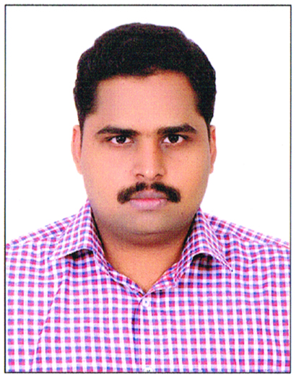

Know your mentor – Karthikeyan Rajendran
Selenium, RPA, REST, Cucumber, DevOps, Docker
TECH
Java, JavaScript, Gherkin, Python
LANG
8+ years in Automation Industry, 40+ Team Size, 4+ Frameworks
EXPERIENCE
Script less Automation, Selenium Community
CONTRIBUTIONS

