Slide 1
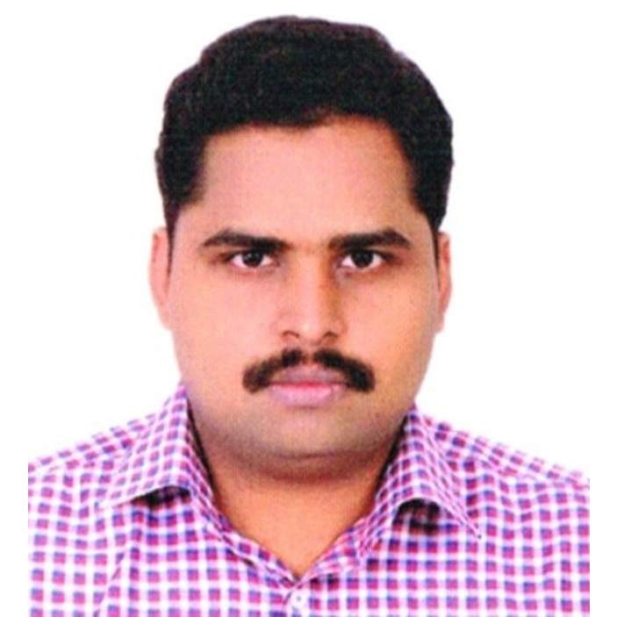
Karthikeyan Rajendran
Automation Test Specialist
Email: karthike.selene@gmail.com
Phone: 919751118372
Located at: Madipakkam, Chennai
Linkedin: https://www.linkedin.com/in/karthikeyan-test-automation-specialist/

Slide 2
About Me
Hardcore Quality Analyst and Automation Architect
Knows lot of tools
Team Building
I understand and excel in 20+ Software testing tools and programming languages. It helps me to be versatile.
Loves to teach, mentor and build others. I have genuine interest in seeing others grow and contribute to others’ growth

Loves Agile
Verticals
Hobbies
I am a huge fan of finding bugs early and fixing them early.
I have very strong working knowledge in BFSI, Ecommerce, HRM, CMS and healthcare.
Loves cycling and fitness activities.
I teach Automation testing at a renowned institute
Learner for Life!

Slide 3
Testing Tools / Software
Selenium WebDriver
95%
I’ve got good dexterity in many software tools.
Core Java
90%
REST Assured (API Testing)
90%
Cucumber JVM
90%
Postman
85%
CI / CD Jenkins
85%
Docker
85%
JMeter
75%
Taurus
75%
Git
75%
BDD / ATDD
70%
Python / JavaScript / SQL
40%
Cypress
40%
RPA – UiPath
40%

Slide 4
Career Snapshot
My career in one slide
Growth Analysis
Promoted 5 times in 6 years
Performance Tests
Performance Tests
Tools / Test types
DevOps | CI/CD
RPA
DevOps | CI/CD
Automation Testing (Selenium)
Other activities
Reusable Test Automation Framework creation
Internal Automation Training
Domain knowledge
BFSI (Insurance)
ECommerce
Healthcare
HRMS
Insurance
Treasury / Cash Management (BFSI)
Systems tested
ERP Systems
Drupal
Magento
WP
Cake PHP
Testing type
Manual Testing
Manual Testing
Manual Testing
Test Applications
Custom Insurance Tools
Custom ERP Applications
Content Management Systems
Custom BFSI Applications
Feb 2012
Sep 2013
March 2015
Aug 2016
Oct 2017
Oct 2018
Jr. Test Analyst
CMC Limited
Test Analyst
CMC Limited
Sr. Test Analyst
CMC Limited
Automation Test Engineer
Ameex Technologies
Sr. Automation Test Engineer
Ameex Technologies
Automation Test Specialist
Ameex Technologies

Slide 5
Values
That I appreciate
Patience
Humble
Productivity
Building Others
Patience actually pays off
Everyone is a genius
I aim to make proper use of time
Others’ success is my success

