Slide 1
SUPPLY CHAIN DIAGNOSTIC · POST-ACQUISITION VALUE CREATION
Delivery Performance & Logistics Restructuring
An operational diagnostic of a Brazilian e-commerce logistics network — finding the underperforming hubs, sizing the value at stake, and laying out the fix.
96,469
92.1%
R$1,351,431
27
orders analysed
on-time delivery
revenue at risk
states profiled
Brazilian E-Commerce Public Dataset by Olist · Portfolio analytics project

Slide 2
EXECUTIVE SUMMARY
The network is reliable on average — but concentrated risk is quietly bleeding margin and reviews
S
Situation
A PE firm rolled up several small Brazilian logistics partners. It now needs to standardise operations, improve delivery reliability, and protect margin across the combined network.
C
Complication
Headline on-time is healthy at 92.1%, which masks the real problem: late deliveries are concentrated in a small set of high-volume sellers and a few weak regions — and each late order badly damages the customer.
K
Key findings
609 "fix-immediately" sellers carry 40.7% of revenue at a 15.9% late rate. Transit (last-mile) is 74% of lead time, and late delivery cuts average review from 4.29 to 2.57.
R
Recommendation
Attack the concentrated tail: fix or re-route the high-volume late sellers, consolidate fulfilment closer to demand, and renegotiate 3PL terms. Closing the gap to benchmark removes ~23% of all late deliveries.
Olist E-Commerce (2016–2018) · delivered orders only
2

Slide 3





APPROACH
A five-step diagnostic, from raw transactions to a costed action plan
1
2
3
4
5
Model the data
Build delivery KPIs
Diagnose & score
Size the value
Recommend
7 Olist tables modelled into a single-fact star schema (110K order-items) — seller, product, customer & date dimensions.
On-time %, delay, transit vs processing time, segmented by state, category and product size.
Seller performance matrix, a 0–100 supply-chain risk score, and a four-way root-cause decomposition.
Quantify revenue at risk and model the upside of closing the gap to benchmark.
Translate findings into hub, 3PL and seller-incentive actions a PE operating team can execute.
Built in SQL (PostgreSQL star schema), Python/pandas for analysis, and Power BI for the management dashboard.
Olist E-Commerce (2016–2018) · delivered orders only
3

Slide 4

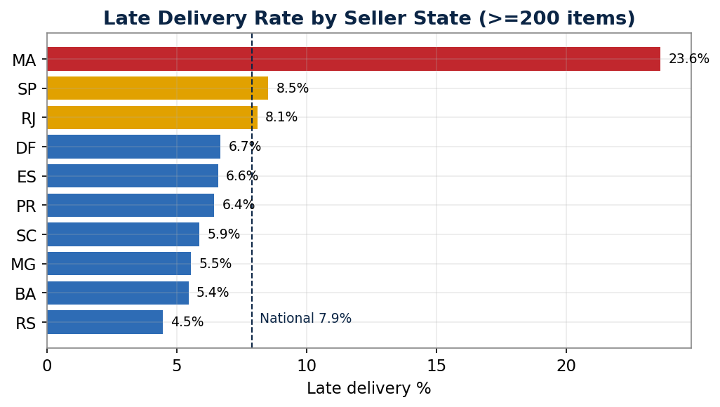
DELIVERY PERFORMANCE · THE BASELINE
On-time looks strong, but lateness is uneven across regions
92.1%
7.9%
12.5d
9.2d
R$ 1,351,431
On-time delivery
Late delivery
Avg delivery time
Avg transit (last-mile)
Revenue at risk
What the chart says
Maranhão (MA) is a clear outlier at 23.6% late
São Paulo carries the most volume and sits right at the national line
Most states beat the 7.9% benchmark — the problem is the tail, not the average
Olist E-Commerce (2016–2018) · delivered orders only
4

Slide 5
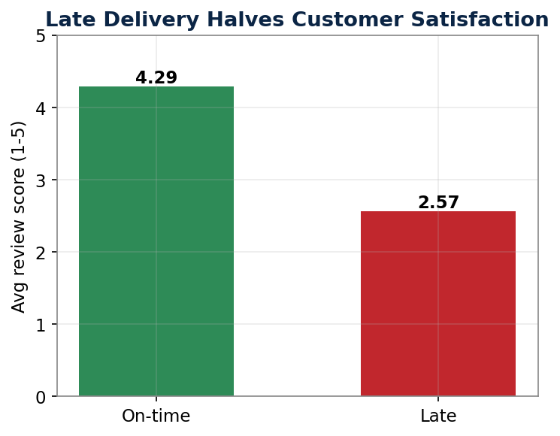

WHY IT MATTERS · CUSTOMER IMPACT
A late delivery doesn't just slip a date — it halves the review
4.29 → 2.57
Average review score collapses when an order arrives late.
9% → 54%
Share of 1–2★ reviews jumps almost six-fold on late orders.
8.8%
of revenue (R$ 1,351,431) sits on orders that were delivered late.
Implication: late delivery is the network's single biggest driver of customer dissatisfaction — and the leading indicator of churn. Reliability is a revenue lever, not just an ops metric.
Olist E-Commerce (2016–2018) · delivered orders only
5

Slide 6
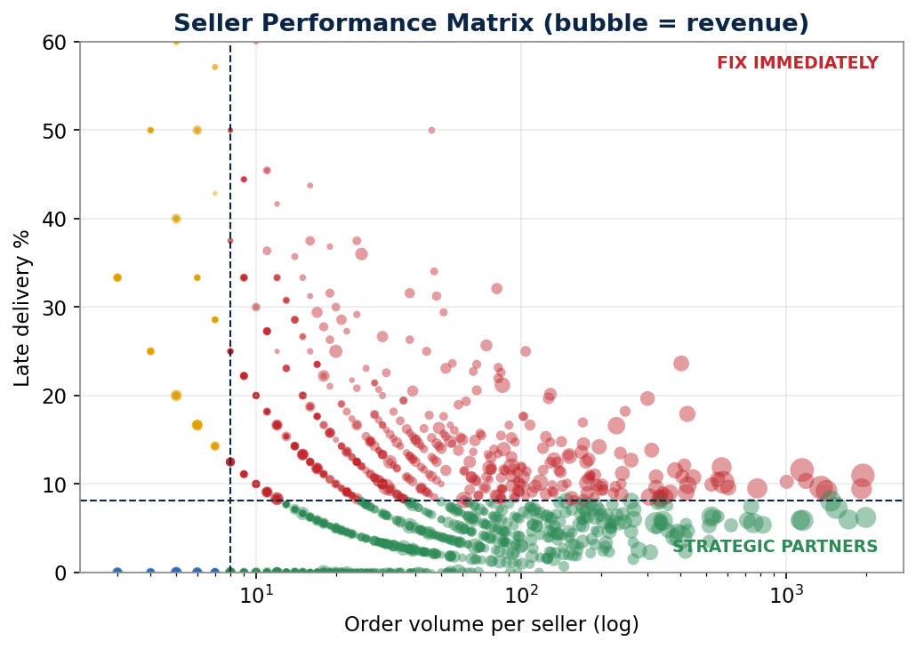
ADVANCED FRAMEWORK · SEGMENTATION
Seller Performance Matrix: where to act, and where to protect
Strategic Partners
Fix Immediately
912 sellers · 53.2% rev · 2.7% late
609 sellers · 40.7% rev · 15.9% late
Protect & grow. The reliable revenue core.
High volume, poor delivery. The priority lever.
Monitor
Maintain
271 sellers · 1.8% rev · 46.9% late
1178 sellers · 4.4% rev · good
Low volume, unreliable. Watch, don't over-invest.
Low volume, reliable. Keep steady.
Olist E-Commerce (2016–2018) · delivered orders only
6

Slide 7
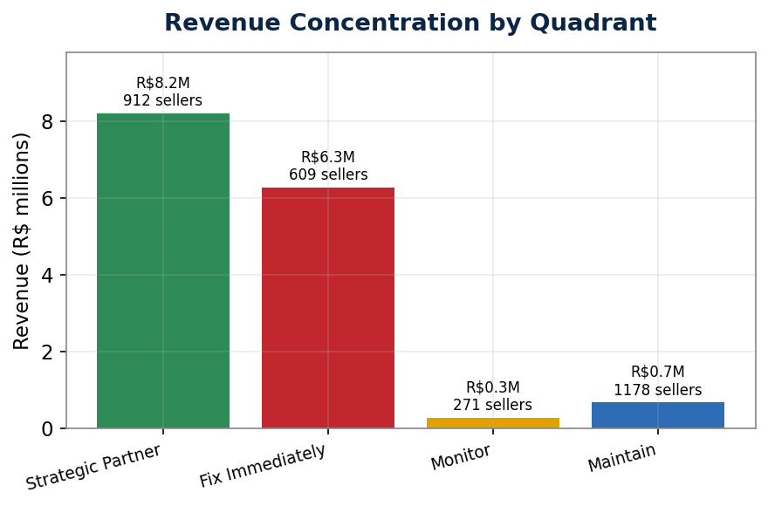
WHERE THE VALUE IS
Two-fifths of revenue runs through sellers that deliver late
40.7%
of total revenue flows through the 609 'Fix Immediately' sellers — the highest-leverage population in the network.
The good news: leverage is concentrated.
Fixing a few hundred high-volume sellers — not thousands — moves the whole network. Their revenue base is R$ 6,273,394.
The watch-out: don't chase the tail.
The 'Monitor' group looks alarming at 46.9% late but is <2% of revenue — cheap to manage, wrong place to spend effort.
Olist E-Commerce (2016–2018) · delivered orders only
7

Slide 8
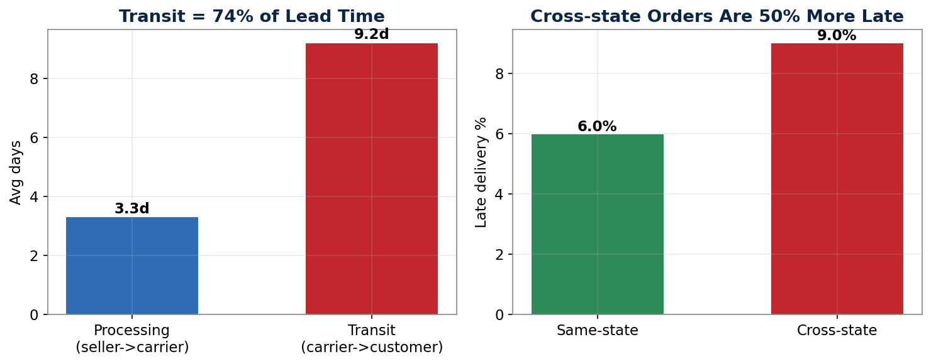

ROOT-CAUSE ANALYSIS
The bottleneck is the last mile — and distance, not product size
Geography is the primary driver
Last-mile is the time sink
Cross-state orders are late 9% vs 6% same-state. Long-haul routes dominate the failure cases.
Transit is 74% of total lead time; seller processing is only ~3.3 days. The carrier leg is where it's lost.
Seller execution is real & separable
Product size is a minor factor
Within São Paulo alone, sellers range from 4% to 14% late — same geography, different discipline.
Heavy items are only slightly more late than light ones. Not the lever to pull first.
Olist E-Commerce (2016–2018) · delivered orders only
8

Slide 9
RECOMMENDATIONS
Four moves, sequenced from quick wins to structural change
Seller performance program
0–3 months
Put the 609 'Fix Immediately' sellers on SLAs with incentives for on-time hand-off and penalties for repeat misses. Fastest, cheapest lever.
Renegotiate 3PL contracts
3–6 months
Transit owns 74% of lead time. Re-tender carrier contracts on the worst long-haul lanes; tie pricing to delivery-window adherence.
Redesign delivery zones
6–9 months
Cross-state shipping drives lateness. Re-map zones and pre-position inventory to cut the long-haul share of orders.
Consolidate logistics hubs
9–18 months
Standardise the acquired partners onto fewer, better-run hubs near demand centres (esp. the SP corridor) to structurally lower transit time.
Olist E-Commerce (2016–2018) · delivered orders only
9

Slide 10
QUANTIFIED IMPACT
Closing the 'Fix Immediately' gap to benchmark
−23%
7.9% → 6.1%
fewer late deliveries
network late rate
Bringing the worst high-volume sellers to the national benchmark removes roughly a quarter of all lateness.
The overall late-delivery rate falls without touching the reliable majority of the network.
~1,999
R$ 279,689
late orders recovered/yr-equiv.
revenue exposure protected
Each one is a review saved and a churn risk removed — the compounding upside.
Directly exposed revenue on recovered orders — before second-order churn and reputation effects.
Estimates are indicative, built from the dataset's own benchmarks — directional sizing to prioritise action, not a guaranteed forecast.

Slide 11
PROJECT STORY · "TELL ME ABOUT THIS PROJECT"
How to walk through this in 90 seconds
Problem
A PE firm acquired several small Brazilian logistics partners and needed to know which hubs were underperforming, what it was costing, and where to intervene first.
Approach
I modelled 7 Olist tables into a star schema, built delivery KPIs in SQL, then layered on a seller performance matrix, a risk score, and a root-cause decomposition in Python.
Analysis
I segmented lateness by region, seller and product, isolated processing vs transit time, and tested whether delays were driven by geography, size or seller execution.
Insight
The story wasn't the 92.1% average — it was that 40.7% of revenue ran through late high-volume sellers, the last mile owned 74% of lead time, and lateness halved reviews.
Impact
I sized a focused fix at ~23% fewer late deliveries and built a Power BI dashboard so the operating team could track it by hub.
Olist E-Commerce (2016–2018) · delivered orders only
11

Slide 12
WHERE THIS GOES NEXT
From diagnostic to decision engine
Delivery-delay prediction
Demand & volume forecasting
Hub-location optimisation
Train a model on order, route and product features to flag at-risk orders before they ship — moving from reporting late to preventing late.
Time-series forecasts per hub to plan capacity and pre-position inventory ahead of peaks.
Use the geolocation data for a facility-location / network model that minimises expected transit time.
Delay simulation
Churn linkage
Live KPI alerting
Monte-Carlo the network to stress-test 'what if a hub fails' and quantify resilience before committing capital.
Join review and repeat-purchase behaviour to put a hard R$ value on each late delivery.
Push the Power BI model to scheduled refresh with threshold alerts for the operating partner.
Olist E-Commerce (2016–2018) · delivered orders only
12

