Slide 1
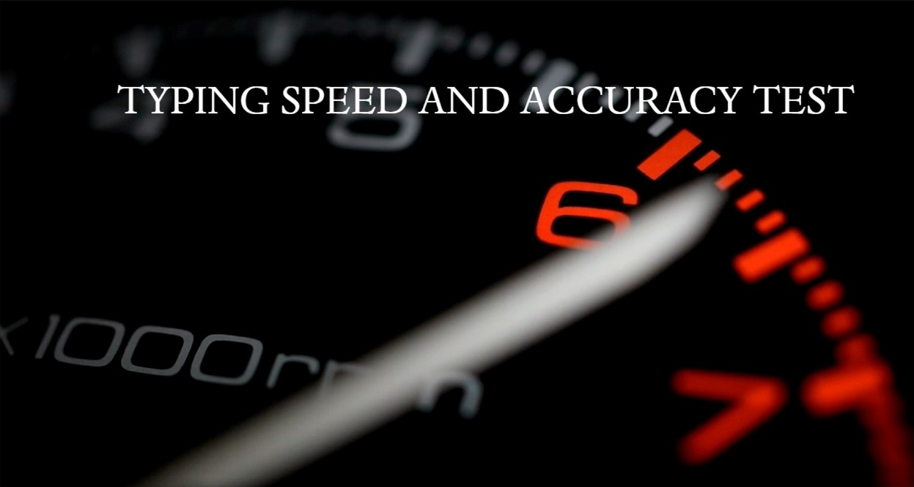
-N. BHUVAN SWAROOP (20-737-128)
-G. KARTHIKEYA REDDY (20-737-138)
-K. SAKETH (20-737-165)

Slide 2
ABSTRACT
This project aims to design and create media application that will be used to train the speed and accuracy of typing. As we are of IT branch most of the time, we practice a lot of coding on laptop or pc, even in the future after our company placement we almost work about 40+ hours in a company.
Since most of the programming languages are case sensitive even missing the capitals, semi colon, etc. gives an error. This becomes a problem if a code is huge finding the error becomes difficult. So having accuracy and staying focused while typing is important. Even if there was at least 5% increase in typing speed, for a 40+ hours of work the amount of time saved is a lot.
Main features this project includes are using a GUI displaying your accuracy, speed, storing data and giving your stats.

Slide 3
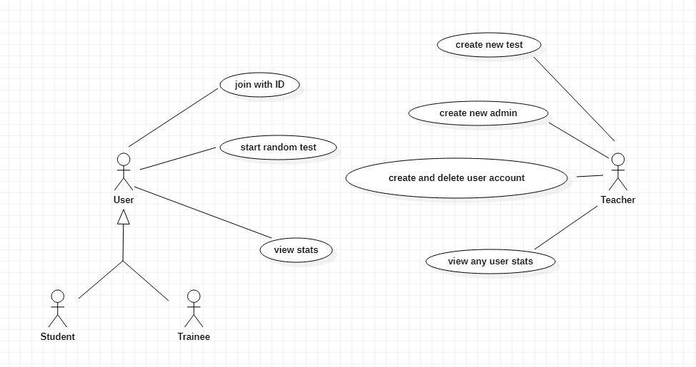
USE CASE DIAGRAM

Slide 4
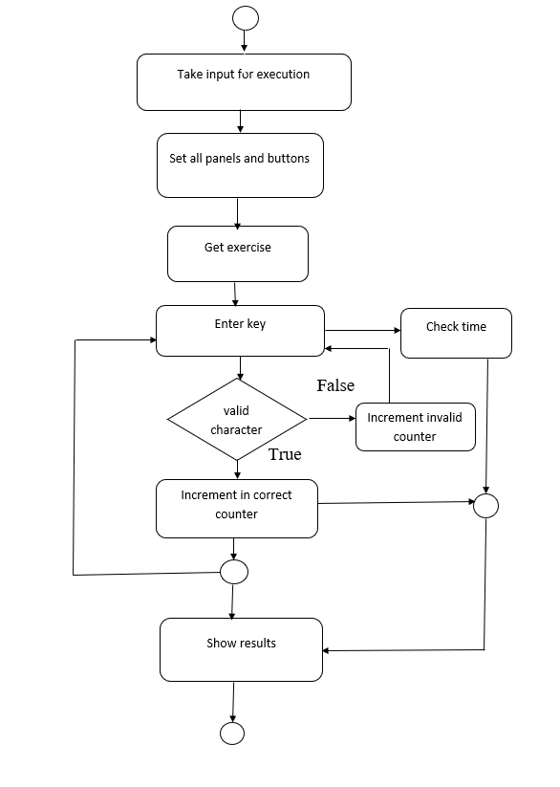
ACTIVITY DIAGRAM

Slide 5
TECHNOLOGY USED
Hardware Requirements:
512 MB RAM
2GB HDD
CORE i5
Software Requirements:
Windows XP/Windows 2000
PYTHON Interpreter
Packages used:
pygame
sys
os
time
random
essential_generators

Slide 6
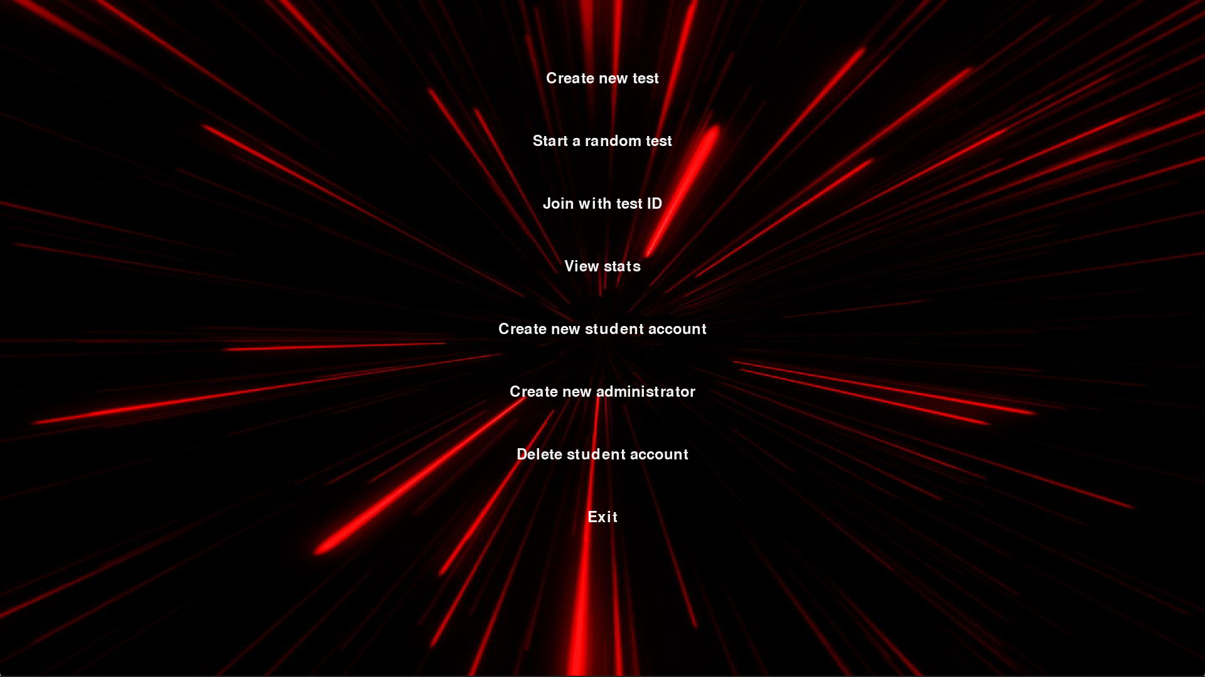
EXECUTION process MAIN MENU:

Slide 7
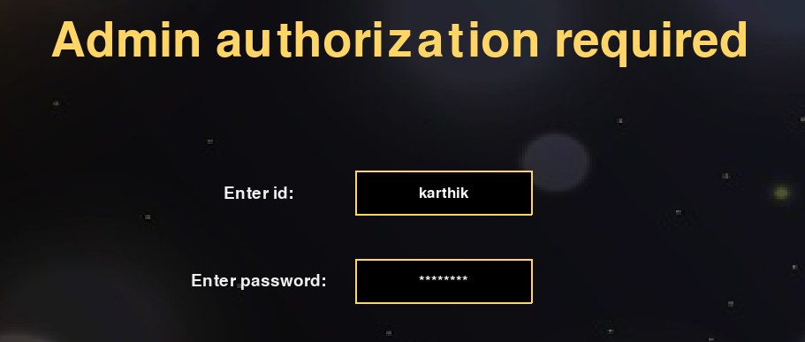
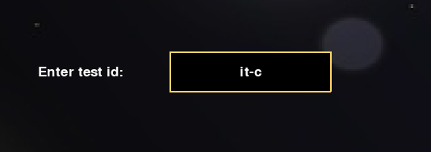
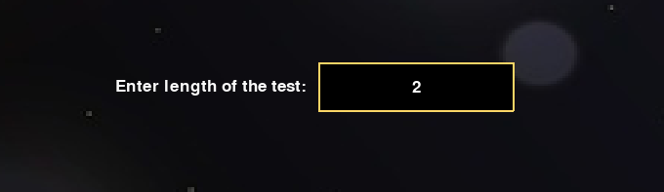
Creating test :

Slide 8
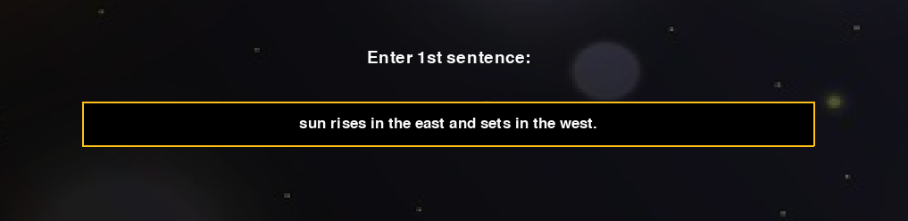
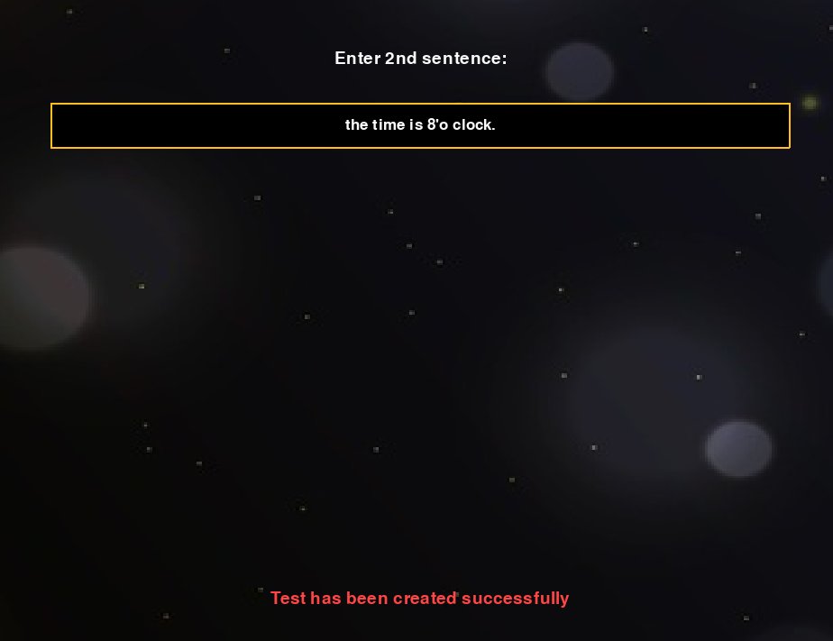
Cont.

Slide 9

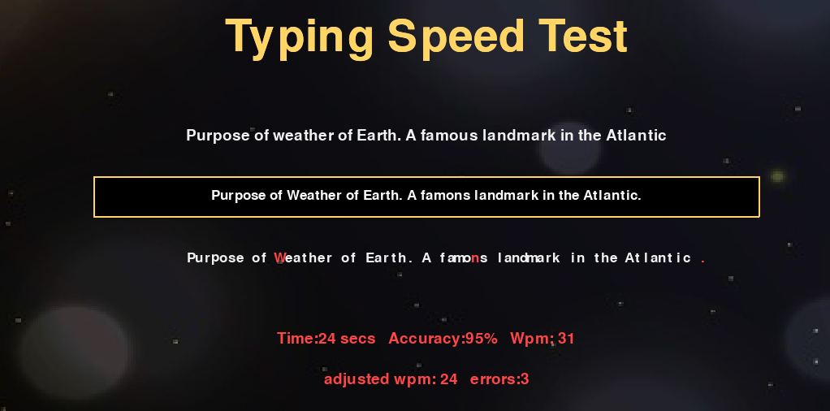
Starting random test:

Slide 10
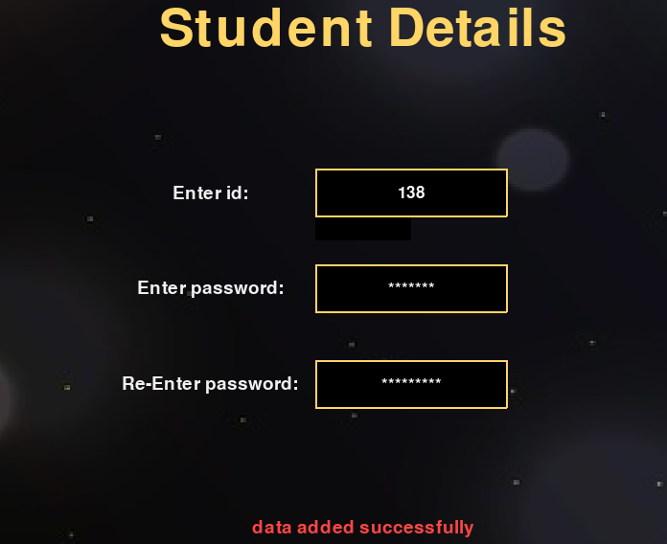
CREATING NEW STUDENT ACCOUNT:

Slide 11
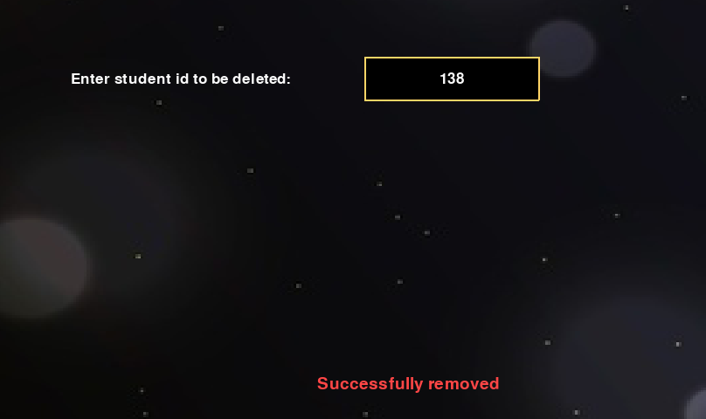
DELETING EXISTING STUDENT ACCOUNT:

Slide 12
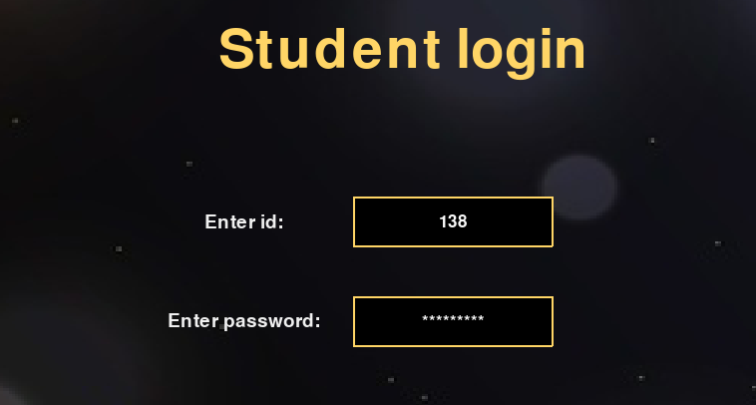
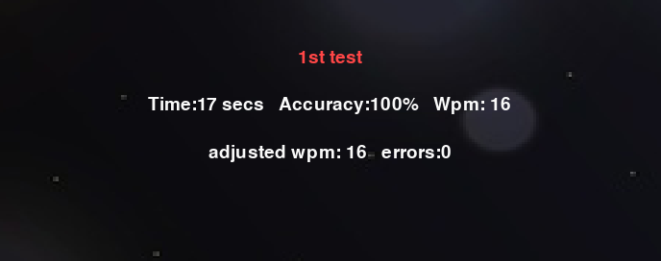
VIEWING STATS:

Slide 13
CONCLUSION AND FUTURE WORK
The “Typing speed and accuracy test” project is a GUI based application which has a lot of features such as a creating test, storing accounts data and viewing stats.
In future, we would like to make the improvements in graphics, more animations and add a graphical representation of data.

