Slide 1
Typing speed and accuracy test
N.Bhuvan Swaroop(128)
G.Karthikeya Reddy(138)
K.Saketh(165)

Slide 2
Actors wise Use Cases
User:
Join with ID
Start random test
View stats of the user
Teacher:
Create new test
Create new admin
Create and delete user account
View stats of all students

Slide 3
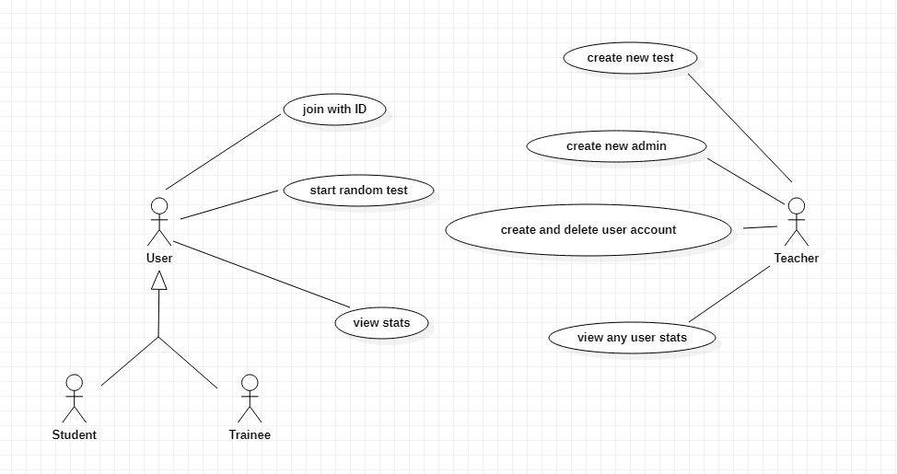
Use-Case Diagram

Slide 4
Use-Case Descriptions
Actors: User
Name: start random test
Description: allows the user to start a random test that is not created by admin
and not stored in his stats.
Main Flow:
User 1.Chooses random test option. 3.Enters the input accordingly. | System 2.Displays sentences randomly. 4.Displays the speed and accuracy.

Slide 5
Actors: Teacher
Name: create new test
Description: allows the teacher to create a new test, add sentences and difficulty to it.
Main Flow:
Teacher 1.Selects create new test. 3.Enters the correct details. 5.Gives few sentences as input and gives id for the exam. | System 2.Asks the teacher to login with admin id and password. 4.Logged in successfully, asks to enter the sentences to add for the test. 6.The data is stored with the given id.

Slide 6
Actors: User
Name: view stats
Description: displays stats showing your progression after logging with your ID.
Main Flow:
User 1.Selects view stats. 3.Enter the details correctly. | System 2.Prompts the user to enter his login id and password. 4.Displays the stats of the user.

Slide 7
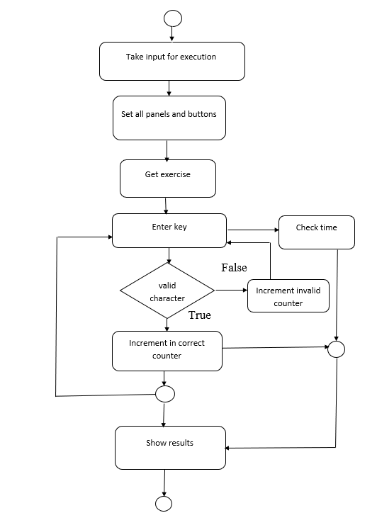
Activity Diagram

Slide 8
Thank you

