Slide 1
Typing speed and accuracy test
N.Bhuvan Swaroop(1602-20-737-128)
G.Karthikeya Reddy(1602-20-737-138)
K.Saketh(1602-20-737-165)

Slide 2

Abstract
This project aims to design and create media application that will be used to train the speed and accuracy of typing. As we are of IT branch most of the time, we practice a lot of coding on laptop or pc, even in the future after our company placement we almost work about 40+ hours in a company. Since most of the programming languages are case sensitive even missing the capitals, semi colon, etc. gives an error. This becomes a problem if a code is huge finding the error becomes difficult. So having accuracy and staying focused while typing is important. Even if there was at least 5% increase in typing speed, for a 40+ hours of work the amount of time saved is a lot. Main features this project includes are using a GUI displaying your accuracy, speed, storing data and giving a pictorial representation of your stats (speed graphs, accuracy tables etc.).

Slide 3

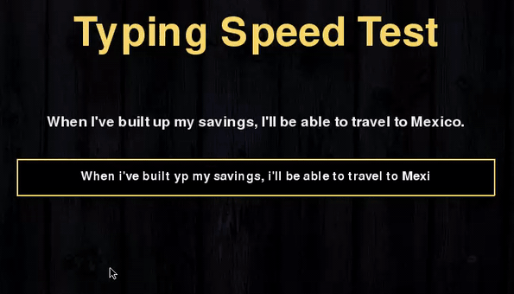
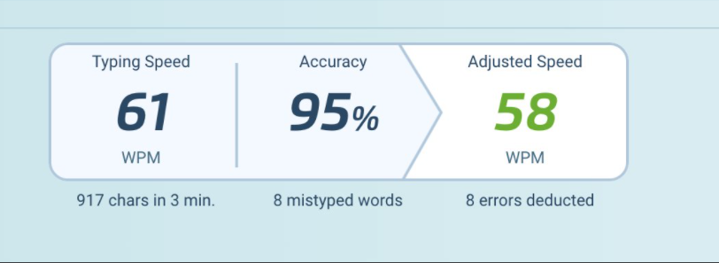
Application Features
Displaying accuracy
Displaying time taken
Displaying speed in terms of words per minute
Storing and accessing stats
Displaying the stored stats in graphs

Slide 4
Comparison with similar applications
Ratatype and typing master are the two most used applications that test typing speed.
They don’t store data of your previous records just they show the speed of the present test you have taken. We have added an extra feature to store data so that you can understand how well you have been advancing .
Those app features are restricted and have paid content. In our project there is no restriction for features every user can have the same experience.

Slide 5
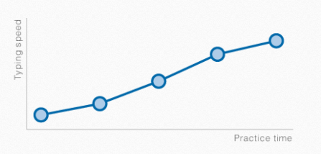
Future Scope
In the near future, we would like to add extra features such as creating a secure login system for each user, adding more graphics , adding difficulty levels and carry forward the project by adding much more concepts and make that as a good application.

