Slide 1


Department of Computer Science and Engineering (Data Science)
VI Semester MINI project :
Data Driven Modeling of Salary Dynamics across Job Roles in 2024
using predictive Machine Learning
Presented by : (Team-B6)
G.Karthikeya– 23641A67A7 K.Renuka- 23641A6772 M.Siri– 23641A67B6 S.Rajkumar– 23641A67C0
Guided by : B.J.Praveen Kumar DEPT OF CSE(DATA SCIENCE)

Slide 2
ABSTRACT:
This project focuses on predicting salary based on job-related factors using machine learning. The system analyzes a dataset containing information such as experience level, job title, company size, and location.
Data preprocessing techniques are applied to clean the dataset and prepare it for training. Different regression algorithms such as Linear Regression, KNN Regressor, and Huber Regressor are used and compared.
Hist Gradient Boosting Regressor is selected as the final model because it gives better accuracy. In this phase, we also started developing the front-end to allow users to enter details and get salary predictions easily.

Slide 3
INTRODUCTION:
Today many people search for jobs in different fields. Salary is an important factor for every job seeker. But salary depends on many things like experience, job role, company size, and location.
Many people do not know the correct salary for their role. With the help of machine learning, we can analyze job data and predict salary more accurately. This project aims to build a system that predicts salary based on job-related information.

Slide 4
Problem Statement:
In the current job market, many job websites show salary information, but it is often not accurate or updated. Job seekers do not clearly know the expected salary for a particular role. Salary also changes based on experience, company size, and location.
Existing systems.
mainly show average salary data and do not provide intelligent predictions. Therefore, there is a need for a system that can analyze job data and predict salary more accurately using machine learning techniques.

Slide 5
Existing System:
In this project, we used some basic machine learning algorithms to predict salary.
Linear Regression predicts salary based on the relationship between input data and output.
KNN Regressor predicts salary by comparing the input with similar data points in the dataset.
Huber Regressor is used to handle outliers and give more stable predictions.
These algorithms are trained on the dataset and their performance is compared to find the better model.

Slide 6
Proposed System:
In the proposed system, we use machine learning to predict salary more accurately. The dataset is first cleaned and prepared using preprocessing techniques.
Important features like experience level, job role, and company size are used for training the model. Different algorithms are trained and their performance is compared.
Hist Gradient Boosting Regressor is selected as the final model because it gives better accuracy. The system can predict salary based on the user input data.

Slide 7
Scikit-learn
Software Requirements:
Programming Language : Python
Development Environment:Jupyter Notebook / Google Colab / VS Code
Libraries Used:
NumPy (It is used for numerical computations)
Pandas (It is used for data manipulation and analysis)
Matplotlib (It is used for data visualization)
scikit-learn (It is used for implementing machine learning models)
Joblib (It is used for saving and loading models efficiently)
Machine Learning Algorithms
Linear Regression (It predicts values using a linear relationship)
KNN Regressor (It predicts based on similar nearby data points)
Huber Regressor (It handles outliers effectively during prediction)
Hist Gradient Boosting Regressor (It improves accuracy using multiple combined models)

Slide 8
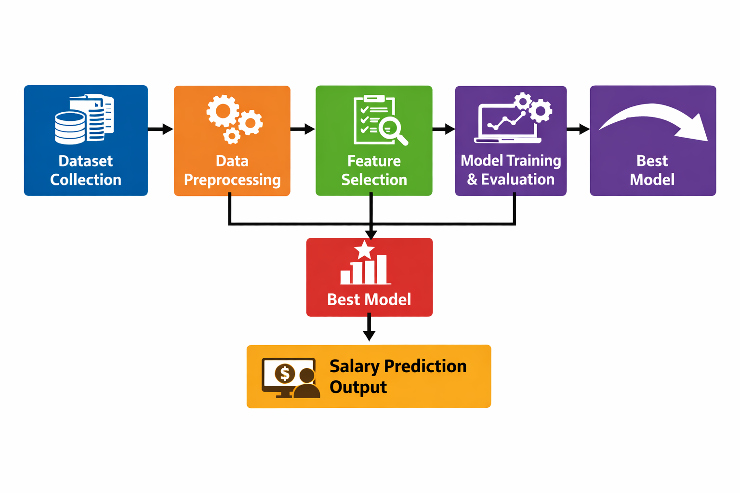
System Architecture (Salary Prediction System):

Slide 9
Conclusion:
In this project, we worked on analyzing the salary dataset and trained machine learning models to predict salaries. Different algorithms were tested to find the best model for accurate prediction. This system helps in understanding how factors like experience, job role, and company size affect salary.

Slide 10


