Slide 1
Melanam
Team Details:
Karthikeya H S
Meghana S Bhat
Krishna Prasad N R
Guide: Akshay K Kulkarni
www.ekathvainnovations.com

Slide 2
Problem Statement
When end users are not familiar with the video conferencing tools they are using, they will encounter various issues during live online conferences. Inadequate bandwidth and network connectivity issues can make for a poor online video conferencing experience.
As the technology is growing fast even we need to make use of new technologies. Due to covid situation is it not possible to attend classes/go to college or to meet relatives who are far, in this time video conferencing is the most suitable and helpful.

Slide 3
Overview of the project
A video conference is a live, visual connection between two or more people residing in separate locations for the purpose of communication.
Video conferencing plays a vital role in communication which can be point-to-point or multipoint real-time communication between two or more student located at different geographical locations.
In distance education, there is requirement of real- time interaction between faculty and student, getting feedback of student’s reactions to a lecture is very important.
Video conference will provide more interaction in the virtual classroom. In this pandemic situation the educators will provide the quality of education to the students and by sitting in home we can learn many things through video conference.

Slide 4
Technology used
In this project, we used HTML5,CSS3,Bootstrap4 and Angular (which uses typescript language) for front end i.e; for the user side interface which are sign-in page, sign-up, admin page and home page.
For the back end we used Firebase for the user’s information storage and Firebase authentication for the authentication of the user.
As our project is about video conferencing app, for the video and audio streaming we used a module called “peer js”.

Slide 5
Our Approach
Authentication
Sign In
Sign Up
2. Dashboard for admin
Meeting history
User management
3. User Page
Home page
Schedule meeting

Slide 6
Project flow and Our work
Video Conferencing has 3 essential components.
The hardware
The intervening network that carries the signals between sites
The conference environment or room
Basic equipment needed for video conference session include a camera, microphone, a video conferencing unit, display unit and audio system. Video conferencing technology works on internet protocol. Through these vast networks, video conferencing has the capabilities for connecting to worldwide audiences.

Slide 7
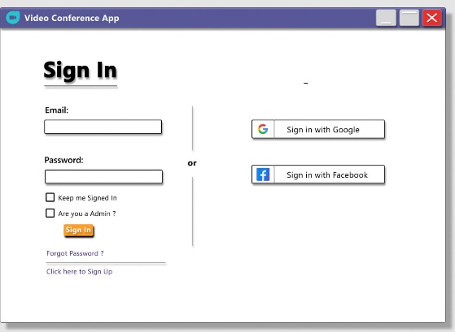
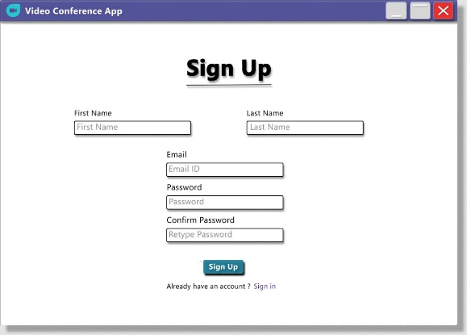
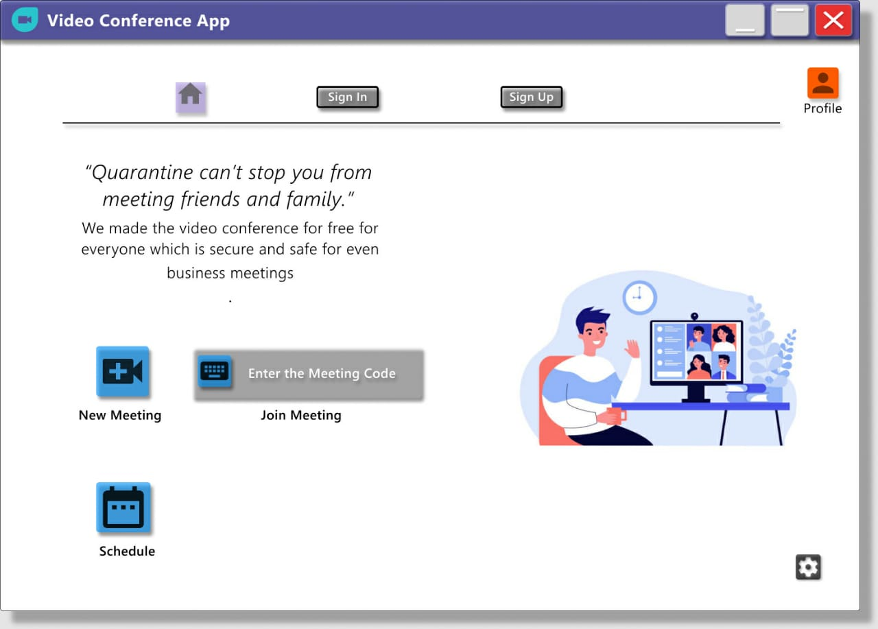
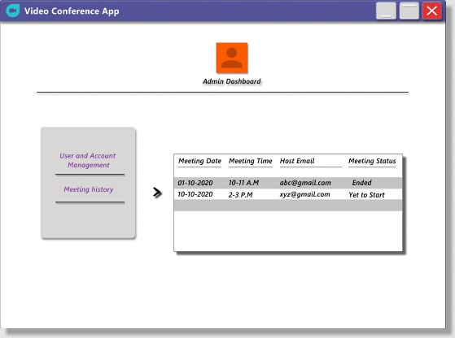
Wireframes designed

Slide 8
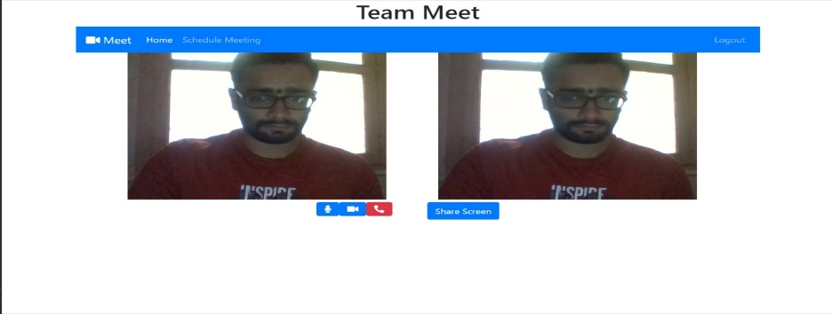
Project outcomes and outputs
By facilitating real-time, face-to-face communications with staff members, students, suppliers, employees and customers, video conference enables substantial savings of money and time that help to boost the profitability and success of an organization

Slide 9
Future work/scope
Enables people in the same room to communicate freely as well as establishing video contact with the other party.
Video conferencing provides students with the opportunity to learn by participating in two-way communication forums.
Through video conferencing students can visit other parts of the world to speak with their peers and educational facilities.
Video conferencing is a highly useful technology for real-time telemedicine and telenursing applications such as diagnosis.
Physicians in emergency or routine situations can discuss cases across large distances.

Slide 10
Conclusion
Video conferencing could lead the way for a dual approach, giving students more responsibility for their learning, working in groups, and doing educational tasks; all of which would benefit conventional teaching, but video conferencing provides an opportunity to implement them.
With the advancement and ease of availability of high speed and cheap internet connections, it is expected that video conferencing increasingly become popular thus, leading to more interest and use of distance learning.

Slide 11

Thank You!

