Slide 1
DATA ANALYTICS PROJECT
Startup Profit Analysis
What drives profit across 50 startups? EDA and multiple linear regression
Data source: DB (MySQL) → exported to CSV

Slide 2
Objective and dataset
Predict a startup's profit from how it spends its money
50
3
3
0
startups
spend variables
states
missing or duplicate rows
Data pipeline
MySQL DB
CSV export
Python
Power BI
project_profit_analysis
table: startup
→
startup_profit_analysis.csv
→
pandas, seaborn,
scikit-learn
→
Dashboard (.pbix) built
from the exported file
Columns: RD_Spend, Administration, Marketing_Spend, State (target: Profit)

Slide 3
Summary statistics
All values in US dollars, 50 startups
Variable | Mean | Std dev | Min | Median | Max
R&D Spend | 73,722 | 45,902 | 0 | 73,051 | 165,349
Administration | 121,345 | 28,018 | 51,283 | 122,700 | 182,646
Marketing Spend | 211,025 | 122,290 | 0 | 212,716 | 471,784
Profit | 112,013 | 40,306 | 14,681 | 107,978 | 192,262
1
Marketing is the biggest budget
Average marketing spend ($211K) is almost 3× R&D ($74K).
3
Some startups spend nothing
R&D and marketing both have minimums of $0.
2
Profit varies a lot
From $14.7K to $192.3K, with a spread (std dev) of about $40K.
4
Clean data
No missing values and no duplicates, so no cleaning was needed.

Slide 4
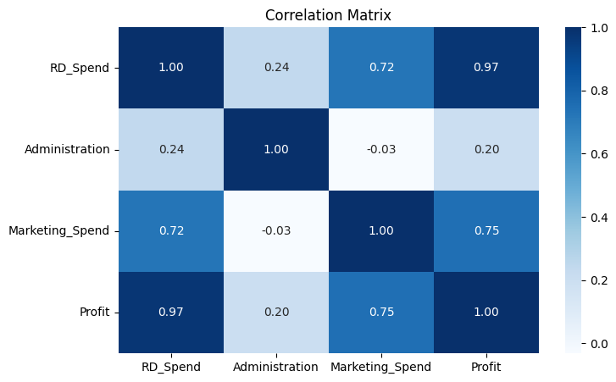
R&D spend moves almost in step with profit
Correlation between each variable
0.97
R&D Spend ↔ Profit
0.75
Marketing ↔ Profit
0.20
Administration ↔ Profit
R&D and marketing are also linked to each other (0.72), so part of marketing's link to profit is really R&D.

Slide 5
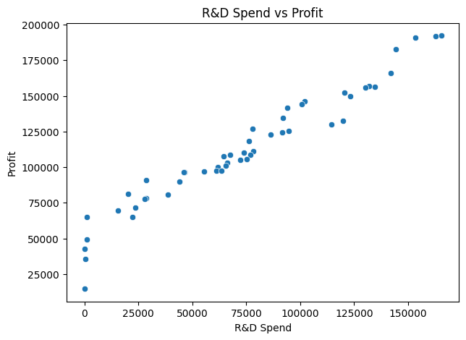
More R&D spend, more profit
Each dot is one startup
1
Nearly a straight line
Profit rises steadily as R&D spend rises, with little scatter.
2
Strongest single driver
R&D alone explains most of the difference in profit (r = 0.97).
3
Holds across the range
The pattern is the same for low-spend and high-spend startups.

Slide 6
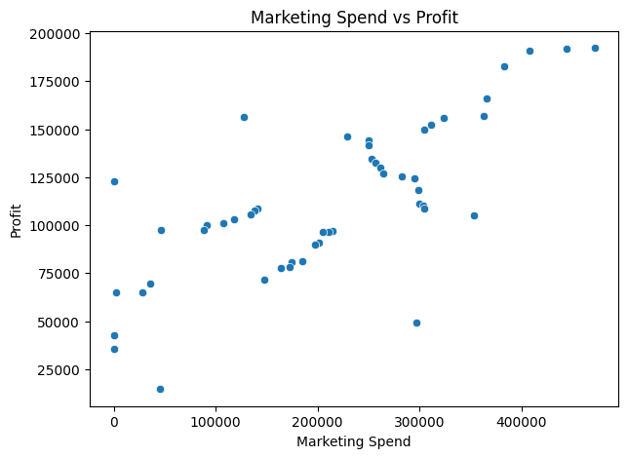
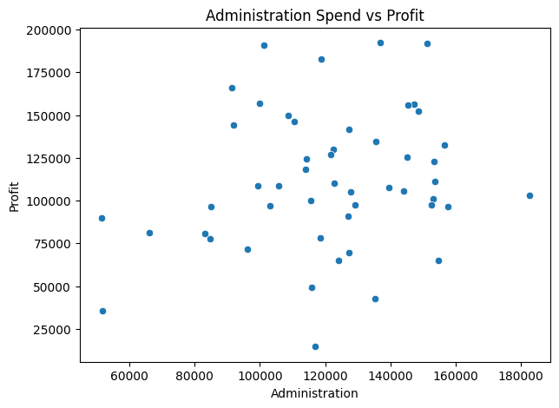
Marketing helps; administration barely matters
Spend vs profit for the other two budgets
Marketing: a clear upward trend but more scattered (r = 0.75).
Administration: no clear pattern, dots are spread out (r = 0.20).

Slide 7
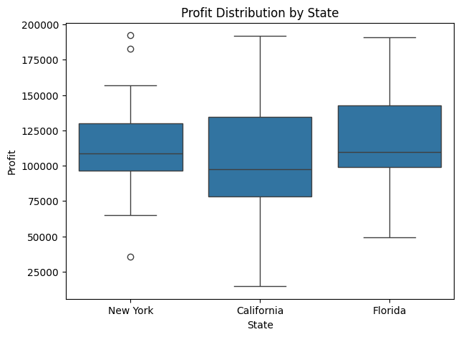
Profit by state
New York 17, California 17, Florida 16 startups
1
Similar typical profit
Median profit is roughly $98K–$110K in all three states.
2
California varies most
It has both the lowest profit (about $15K) and some of the highest.
3
New York has outliers
Two very high earners and one low one sit outside its normal range.
4
State is not a strong driver
The boxes overlap heavily, so location matters less than spending.

Slide 8
Regression model
Multiple linear regression with scikit-learn
Inputs (X)
Target (y)
1
2
RD_Spend, Administration, Marketing_Spend
Profit
Train / test split
Algorithm
3
4
80% train (40 rows), 20% test (10 rows), random_state = 42
LinearRegression, fitted on the training set
Equation: Profit = 54,071.88 + 0.8038 × R&D − 0.0679 × Administration + 0.0312 × Marketing
State was not used as an input.

Slide 9
What each extra dollar is worth
Change in profit per $1 of spend, other budgets held constant
1
R&D: +$0.80
Every extra $1 of R&D adds about 80 cents of profit.
2
Marketing: +$0.03
Small once R&D is accounted for; its effect overlaps with R&D.
3
Administration: −$0.07
Slightly negative: more overhead does not raise profit.

Slide 10
How accurate is the model?
Measured on the 10 test startups the model had not seen
0.90
$6,979
$8,996
≈ 8%
R² score
Mean absolute error
RMSE
RMSE vs avg profit
Explains 90% of the variation in profit
Average miss per prediction
Typical error, weighting big misses more
$8,996 against average profit of $112,013
A strong fit: the model predicts profit to within about $7K–$9K on average. The test set is small (10 rows), so these numbers could shift with a different split.

Slide 11
Predicting profit for new startups
Two sets of input values from the assignment
Input | R&D Spend | Administration | Marketing Spend | Predicted Profit
Startup 1 | 21,892.92 | 81,910.77 | 164,270.70 | 71,236.89
Startup 2 | 23,940.93 | 96,489.63 | 137,001.10 | 71,040.76
Why are they so close?
Startup 2 spends $2,048 more on R&D (+$1,646 profit) but $14,579 more on administration (−$990) and $27,270 less on marketing (−$852). The effects nearly cancel out, so both land near $71K, well below the $112K average because R&D is low.
$71,237
$71,041
Startup 1 predicted profit
Startup 2 predicted profit

Slide 12
Power BI dashboard
Startup_Profit_Analysis_Dashboard.pbix: one page, 11 visuals
1
Regression results
Four cards show R² 0.90, MAE 6,979, MSE 80.9M and RMSE 8,996.
Title banner
R²
MAE
2
Spend and profit totals
One card sums each budget and total profit for all 50 startups.
Spend & profit totals
RMSE
MSE
R&D vs Profit
3
Spend vs profit
Three scatter plots, one per budget, one dot per startup.
Admin vs Profit
4
Model check
Actual vs Predicted scatter, using a DAX column with the notebook's equation.
Actual vs Predicted
Marketing vs Profit
Avg Profit by State
5
State-wise profitability
Bar chart of average profit in each state.
Layout reproduced from the .pbix file

Slide 13
Dashboard: totals and state profitability
Values from the Power BI data model
$3.69M
$6.07M
Total R&D spend
Total administration
$10.55M
$5.60M
Total marketing spend
Total profit
Florida leads on average profit, about $15K ahead of California. In total, startups spent about 1.7 times as much on marketing as on administration, yet profit tracks R&D most closely.

Slide 14
Dashboard: actual vs predicted profit
How closely the regression equation matches all 50 startups
1
Tight fit overall
Green dots (startups) sit close to the grey diagonal of perfect predictions. Across all 50, R² is 0.95.
2
Higher than the test score
This view includes the 40 training startups, so it scores above the 0.90 test R².
3
Biggest miss: startup 50
California, $0 R&D. Actual profit $14,681 vs predicted $47,537 (over by $32,855).

Slide 15
Key insights and recommendations
1
Invest in R&D first
2
Treat marketing as a support
It is the strongest profit driver: about $0.80 back for every $1 spent.
Marketing tracks profit, but adds little once R&D is known.
3
Keep administration lean
4
Location is secondary
Higher overhead does not raise profit and slightly lowers it.
Profit ranges overlap across New York, California and Florida.

Slide 16
Limitations and next steps
1
Small dataset
Only 50 startups, and the model was tested on just 10.
4
Check significance
Use statsmodels OLS to get p-values for each coefficient.
2
State not modelled
Adding State as a dummy variable would test whether location matters.
5
Cross-validate
k-fold validation gives a more reliable accuracy estimate than one split.
3
Overlapping inputs
R&D and marketing are correlated (0.72), which blurs their separate effects.
6
Collect more data
More startups would make the estimates more reliable.

Slide 17
Conclusion
R&D spending is the main driver of startup profit.
A linear model built on R&D, administration and marketing spend explains 90% of the variation in profit on unseen data, with an average error of about $7K. Startups that want higher profit should put R&D first, use marketing to support it, and keep overhead in check.
0.97
0.90
$0.80
R&D ↔ profit correlation
R² on test data
profit per $1 of R&D
Thank you

