Slide 1
Customer Segmentation of U.S. Shoppers
Project CDACL-002 · Shopping Trends Analysis
Discount strategy · Card spending · Customer clusters & targeted campaigns
Team 5 | October 2026
Notes:
Hello everyone. We are Team 5 and this is our project CDACL-002, Customer Segmentation. We analysed 3,900 purchase records from U.S. shoppers to answer three questions: which product categories should get discounts, how card spending varies with age, season and location, and how customers can be grouped into segments for targeted marketing.

Slide 2
Executive summary
1
2
3
Discount strategy
Card spending
Customer segments
Discount Sports (lowest revenue, least loyal). Use bundle offers on Clothing (+6.5% basket). Don't discount Home Decor (basket shrinks 5%).
Spend per purchase is flat across age, season and city (p > 0.8). 36–45 yr olds, Spring and New York drive the most card volume.
4 value segments: Frequent Regulars and Big Spenders earn 67% of revenue, but Big Spenders rate only 2.3/5, so that revenue is at risk.
Notes:
Here are our three main findings. First, discounts should go to Sports, which has the lowest revenue and least loyal buyers, and to Clothing as bundle offers because discounted Clothing baskets are 6.5% larger. Home Decor should not be discounted because discounted orders are smaller. Second, card spend per purchase is the same for every age, season and city, so differences come from the number of card purchases: 36 to 45 year olds, Spring and New York lead. Third, clustering found four value segments and four offer-response segments. Two thirds of revenue comes from Frequent Regulars and Big Spenders, and the Big Spenders give low ratings, so that revenue is at risk.

Slide 3
Business problem and dataset
Objectives
Find where discounts pay off
Explain card spending by age, season and location
Group customers into 3+ segments, find the dominant factors
Design targeted marketing campaigns
3,900
purchase records
18
attributes
5
categories · 5 cities
$996K
total revenue
Source: MySQL · database “customer segmentation” · table shopping_trends_dataset · analysed in Python (Google Colab)
Notes:
The business wants to understand its customers better so it can spend its marketing budget wisely. The data comes from a MySQL database, customer segmentation, table shopping trends dataset. It has 3,900 purchases and 18 attributes, including age, gender, item, category, amount, city, season, rating, subscription, discount and promo use, previous purchases, payment method and purchase frequency. The data was clean: no missing values and no duplicates.

Slide 4
Approach: from database to campaigns
1
2
3
4
5
6
Extract
Clean
Explore
Test
Cluster
Act
MySQL → pandas via SQLAlchemy
Standardise columns, check nulls & duplicates
Category, city, age & season comparisons
ANOVA, Kruskal-Wallis, chi-square
Scaled K-Means, elbow + silhouette, K = 4
Random-Forest drivers → campaigns
Tools: Python · pandas · scikit-learn · SciPy · matplotlib/seaborn · Google Colab
Notes:
Our workflow had six steps. We connected to MySQL with SQLAlchemy and loaded the table into pandas. We standardised column names and checked data quality. Then we explored the data, compared categories, and ran ANOVA, Kruskal-Wallis and chi-square tests for card spending. For segmentation we scaled the features and used K-Means, choosing K with the elbow method and silhouette score, and used a Random Forest to find which features drive each cluster. Finally, we turned the cluster profiles into campaigns.

Slide 5
Task 1 · Where should discounts be applied?
Comparing five categories on revenue, ratings, loyalty and discount response
Notes:
Task 1: which product categories should get discounts, and why.

Slide 6
Discounts lift baskets only in Clothing
Discounted ÷ full-price order value
×1.065
Clothing
Basket grows
×0.993
Sports
Holds steady
×0.987
Accessories / Electronics
Holds steady
×0.954
Home Decor
Basket shrinks
Notes:
This chart compares the average order value with and without a discount for each category. Clothing is the only category where discounted orders are bigger: 271 dollars versus 254, about 6.5% more. In Accessories, Electronics and Sports, spend stays about the same. In Home Decor, discounted orders are 5% smaller, 253 versus 265 dollars, so a discount there simply loses money. All five categories have similar revenue, between 19 and 21 percent each.

Slide 7
Recommendation: discount Sports, bundle Clothing
Discount
Sports
Lowest revenue (19.0%) and fewest subscribers (46.8%), but the best rating (3.08). Price is the barrier.
Bundle
Clothing
Discounted baskets are 6.5% bigger. Use “10% off over $300” tiers, not blanket cuts.
Avoid
Home Decor
Discounts cut order value 5%. Lowest rating (2.98), so fix product quality, not price.
Notes:
To combine all the evidence we built a discount priority score. Each category is ranked on four signals: low revenue share, low rating, low subscriber share, and how well spend holds up under a discount. Sports scores highest at 0.60. It has the lowest revenue, 19%, the fewest subscribers, 46.8%, yet the best rating, 3.08. Customers like it but don't buy enough, so a discount can bring in new buyers. Clothing is second, but for a different reason: it already sells most, so use threshold or bundle deals to grow basket size. Home Decor should not be discounted. It has the most subscribers and the lowest rating, which points to a product quality issue, not price. One caveat: the differences between categories are small, so this is a relative priority.

Slide 8
Task 2 · Card spending by age, season and location
1,574 credit and debit card purchases worth $405,807 (40.7% of revenue)
Notes:
Task 2 looks at card spending, meaning credit and debit cards, and how it changes with age, season and location.

Slide 9
36–45 year olds spend the most by card
40.4%
of purchases paid by card
$88.5K
36–45: highest card spend
$250–270
avg card purchase, every age
Notes:
Card payments are 40.4% of all purchases. By age, 36 to 45 year olds spend the most on cards, 88.5 thousand dollars, and 18 to 25 year olds the least, 70.4 thousand, about 21% less. Credit cards beat debit cards in every age group. The important point is that the amount per purchase is the same for every age, around 250 to 270 dollars. So older groups spend more in total because they make more card purchases, not bigger ones. Nobody in the data is over 65.

Slide 10
Spring and New York lead card spending
Card spend: age group × season
Age \ Season | Spring | Summer | Fall | Winter
18–25 | $15.4K | $16.9K | $17.3K | $20.7K
26–35 | $23.4K | $17.8K | $18.8K | $21.9K
36–45 | $25.9K | $21.3K | $18.9K | $22.4K
46–55 | $19.5K | $24.2K | $22.7K | $18.4K
56–65 | $21.6K | $16.8K | $21.7K | $20.2K
Best: New York · Fall $28.3K Weakest: Miami · Fall $13.5K
Notes:
The heat map shows card spend for each age group and season. The darkest cells are the hotspots: 36 to 45 year olds in Spring spend 25.9 thousand dollars, the biggest single group, followed by 46 to 55 in Summer and 26 to 35 in Spring. Young shoppers, 18 to 25, peak in Winter, likely holiday shopping. Overall Spring brings 26.1% of card spend and Summer the least. By city, New York leads with 90.7 thousand dollars and the highest card use, 43%, while Miami is lowest at 71.5 thousand and 38%. The best city and season combination is New York in Fall, 28.3 thousand dollars.

Slide 11
Volume, not ticket size, drives the differences
Test | p-value | Significant?
Spend vs age group (ANOVA) | 0.97 | No
Spend vs season (ANOVA) | 0.84 | No
Spend vs city (ANOVA) | 0.89 | No
Card use vs age (chi-square) | 0.53 | No
Card campaign actions
Credit-card cashback for 36–45 in Spring
New York Fall card campaign (top cell)
Winter card offers for 18–25
Lift card use in Miami & Houston (38–39%)
Kruskal-Wallis (non-parametric) gives the same result: p = 0.97 / 0.83 / 0.89.
Notes:
We tested whether age, season or city change how much people spend per card purchase. ANOVA and Kruskal-Wallis p-values are all above 0.8, far from the 0.05 threshold, so none of them has a significant effect. The chi-square test also shows that the share of people paying by card does not depend on age. This means the differences we saw in totals come from how many card purchases are made. For marketing, that means card campaigns should aim to increase the number of card purchases in the hotspot groups and in the weak cities, rather than trying to raise the amount per purchase.

Slide 12
Task 3 · Customer clusters and campaigns
K-Means on two feature sets: offer response and customer value
Notes:
Task 3 is the customer segmentation: clustering, the dominant factors, and the marketing campaigns.

Slide 13
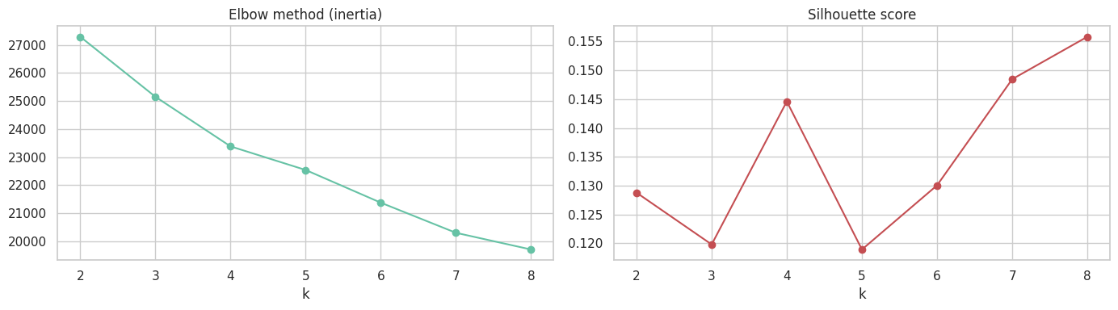
Choosing K: four clusters
K = 4
best silhouette among 3–5
0.145
silhouette score
943–1,052
customers per cluster
Notes:
We scaled eight features and ran K-Means for K from 2 to 8. The elbow curve on the left has no sharp bend, which is common with customer data, so we relied on the silhouette score on the right. Among the practical choices of 3, 4 and 5 clusters, K equals 4 clearly scores best at 0.145. Seven or eight clusters score a little higher but are too many to run separate campaigns for. The silhouette is low, which tells us customers differ gradually rather than falling into sharp groups, so we read the segments as tendencies.

Slide 14
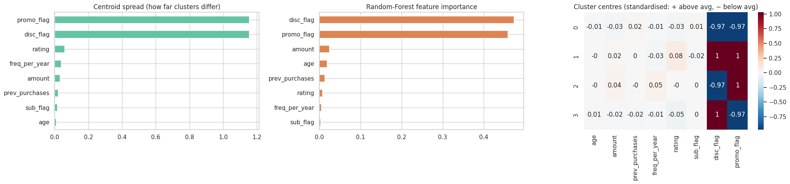
Clustering 1: segments by offer response
Segment | Discount | Promo | Customers | Revenue
Full-Price Loyalists | No | No | 1,052 | 27%
Deal Maximisers | Yes | Yes | 943 | 24%
Promo-Code Responders | No | Yes | 951 | 25%
Discount-Only Shoppers | Yes | No | 954 | 24%
Notes:
The first clustering used eight features. Both the centroid spread and the Random Forest importance show that discount use and promo-code use completely dominate, at about 94 percent of importance combined. Each cluster is either 0 or 100 percent on these two flags. Age, spend, rating and frequency are almost identical across clusters. So this clustering splits customers by how they respond to offers: Full-Price Loyalists who never use offers, Deal Maximisers who use both, Promo-Code Responders, and Discount-Only Shoppers. Each group is about a quarter of revenue.

Slide 15
Clustering 2: segments by customer value
Segment | Size | $/order | Buys/yr | Rating
Frequent Regulars | 1,305 | $259 | 52 | 3.0
Big Spenders at Risk | 838 | $395 | 19 | 2.3
Happy Occasionals | 939 | $233 | 19 | 4.6
Unhappy Bargain Buyers | 818 | $134 | 19 | 2.0
Dominant factors: purchase frequency, order value and rating. Age and previous purchases don't separate customers. Offer use is spread evenly across all value segments.
Notes:
The second clustering left out the offer flags and used only value features: age, order value, previous purchases, frequency and rating. This gives four clearly different groups, driven by frequency, order value and rating. Age and previous purchases don't separate customers. Frequent Regulars buy weekly and bring 34% of revenue. Big Spenders at Risk spend 395 dollars per order and bring 33% of revenue, but rate us only 2.3 out of 5. Happy Occasionals are the most satisfied at 4.6 but buy rarely. Unhappy Bargain Buyers spend the least and are least satisfied.

Slide 16
Targeted campaigns for each value segment
Frequent Regulars
34% revenue · weekly
Big Spenders at Risk
33% revenue · rating 2.3
Loyalty points + free express shipping
Bundles to grow basket size
No deep discounts
Post-purchase follow-up & quality guarantee
VIP service, early access to new lines
Win-back voucher after a low rating
Happy Occasionals
22% revenue · rating 4.6
Unhappy Bargain Buyers
11% revenue · $134/order
Reminder emails on a monthly cycle
“Give $10, get $10” referrals
Ask for reviews & testimonials
Discounts on entry-level items
Short survey + coupon reward
Keep marketing spend low
Notes:
Here is the campaign for each value segment. Frequent Regulars already buy weekly, so reward them with loyalty points and free express shipping, raise basket size with bundles, and avoid deep discounts. Big Spenders at Risk are the most urgent: one third of revenue and unhappy. Follow up after purchase, offer a quality guarantee and VIP service, and send a win-back voucher after a low rating. Happy Occasionals love us but buy rarely, so use reminders and a referral programme. Unhappy Bargain Buyers get low-cost entry-level offers and a short survey, with limited marketing spend.

Slide 17
Combined strategy: who to target × which offer
 | Full-price | Deal maximiser | Promo-code | Discount-only
Frequent Regulars | Loyalty points, no offers | Bundle tiers | Weekly personal codes | Member-only sales
Big Spenders at Risk | VIP service & guarantee | Premium bundles | VIP code after bad review | Early sale access
Happy Occasionals | Referral programme | Seasonal deals | Comeback codes | Price-drop alerts
Unhappy Bargain Buyers | Survey, fix issues | Entry-level bundles | Survey-reward codes | Clearance items
Rows: value segments (who). Columns: offer-response segments (which offer). Run discount offers in Fall, full-price launches in Spring.
Notes:
The cross-tab of the two clusterings shows offer behaviour is independent of customer value: every value segment contains all four offer types. So we combine them. The value segment decides who to prioritise and how; the offer segment decides which offer to send. For example, a Big Spender who only uses promo codes gets a VIP code after a bad review, while a Frequent Regular who pays full price gets loyalty points and no discount at all. This avoids giving away margin to customers who would buy anyway. We also time discount campaigns for Fall, when the deal-using segments shop most, and full-price launches for Spring.

Slide 18
Conclusions, limitations and next steps
Key takeaways
Limitations
Next steps
Discount Sports; bundle Clothing; fix Home Decor quality
Card volume peaks with 36–45, Spring, New York
Frequency, order value & rating drive customer value
33% of revenue is with unhappy big spenders
Small differences between groups
Low silhouette (0.15): segments overlap
Item–category labels are inconsistent
No dates, so no trend analysis
A/B-test each campaign
Track revenue per segment quarterly
Collect satisfaction reasons
Add transaction dates & re-cluster
Notes:
To conclude: discounts should go to Sports and to Clothing as bundles, and Home Decor needs product fixes rather than price cuts. Card spend is driven by the number of purchases, led by 36 to 45 year olds, Spring and New York. Customer value is driven by frequency, order value and rating, and one third of revenue sits with unhappy big spenders. Limitations: the differences between groups are small, the silhouette scores are low, the item and category labels in the data are not always consistent, and there is no date field, so we cannot measure trends over time. As next steps, we recommend A/B testing the campaigns, tracking revenue per segment each quarter, and adding real transaction dates.

Slide 19
Thank you
Questions & discussion
Team 5 · CDACL-002 Customer Segmentation
Notes:
Thank you for listening. We are happy to take any questions.

